Slide 1
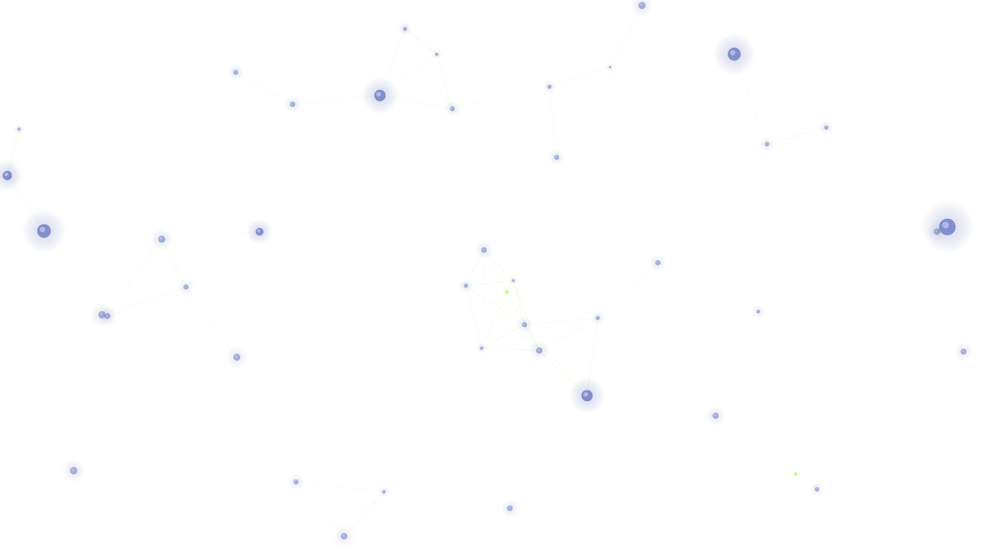


WORKSHOP · AUSTIN AI ALLIANCE · JUNE 2026
This is Your
LLM Wiki Brain
on Autopilot
J P. Whorley
Asst. Director Operations, Machine Learning Lab @ UT Austin
Notes:
Welcome everyone. This is a hands-on workshop — you'll leave with a working setup. The title is a riff on the 'This Is Your Brain on Drugs' PSA: your notes are the brain, Claude Code puts them on autopilot.

Slide 2
Today's Game Plan
PHASE 01 · 15 MIN
PHASE 02 · 20 MIN
PHASE 03 · 25 MIN
PHASE 04 · 15 MIN
Foundations
Setup + Live Demo
Hands-On
Advanced + Q&A
The LLM wiki-brain concept, Obsidian basics, and why this combination changes how you work.
Get Claude Code connected to a vault, then four live demos showing what it can actually do.
You build it. Two guided activities: your first vault query and your first agent command.
Advanced workflows, where to take this next, and open discussion.
Notes:
75 minutes total. We move quickly through concepts, then spend the majority in demos and hands-on. Don't worry if you don't finish — materials will be posted.

Slide 3
Your Notes Are Rotting
You write. You file. You forget.
Capture trap
You're rewarded for writing things down, not for acting on them. The inbox grows. Nothing gets processed.
The average knowledge worker captures thousands of notes over a career — and retrieves almost none of them. The problem isn't discipline. It's the missing layer between capture and use.
No connective tissue
Notes don't talk to each other. A 2021 idea and a 2024 project that should be linked — aren't.
Retrieval failure
You can't find what you know you wrote. Search fails you. Folders betray you. The insight is gone.
Notes:
Ask the room: how many of you have notes you haven't looked at in 6+ months? The problem isn't the tools — notes were never designed to be queried at scale.

Slide 4
LLMs Know Wikipedia. What If They Knew You?
THE LLM BRAIN
YOUR WIKI BRAIN
Trained on the world
Trained on you
Wikipedia, books, the entire web
Your daily notes, projects, ideas — in one vault
Knows everything about ML in general
Knows your specific context, language, patterns
Frozen at training cutoff — no updates
Updates every single time you write
Has no idea who you are or how you think
Claude Code can read and reason over ALL of it
Notes:
The core insight: LLMs are Wikipedia on the inside. What if that wikipedia was YOUR notes? Claude Code is the bridge.

Slide 5


The Stack: Obsidian + Claude Code
Obsidian
Claude Code
Together
LOCAL KNOWLEDGE VAULT
AI THINKING PARTNER
PERSONAL OPERATING SYSTEM
Plain markdown files — yours forever, no lock-in
Runs in your terminal, reads local files directly
Ask questions across years of writing
Interlinked notes via [[wiki-links]]
Traverses your entire vault in one context window
Surface patterns you never noticed
Graph view: visualize how ideas connect
Reads, writes, edits, and reorganizes markdown
Generate ideas grounded in your context
Plugins: Dataview, Templater, Git, Calendar
Executes custom commands and agents autonomously
Delegate tasks to autonomous agents

Slide 6
How It Works
STEP 02
STEP 01
STEP 03
Load
Write
Use
Open Claude Code in your terminal and point it at your vault. It reads every markdown file and builds context across your entire knowledge base.
Take notes naturally in Obsidian. Daily notes, project logs, ideas, links. Write for yourself — don't optimize for machines.
Ask questions, find patterns, generate ideas, delegate tasks. Years of writing become instantly queryable intelligence.
→
→

Slide 7
Setting Up Obsidian
Recommended Vault Structure
Essential Plugins
Lean Terminal
Simple .zsh within Obsidian
📁 Vault/
├── wiki/ # Agent writes everything here
Optional Community Plugins to check out
├── index.md # table of contents
Query your notes like a database with SQL-like syntax
Dataview
└── log.md # operations history
├── raw/ # drop new content here for the Agent
Version control — track how your thinking evolves over time
Git
└── *Claude.md # rules / schema
Calendar
Visualize daily notes as a heat-map over time
Notes:
Walk through your own vault structure here. PARA (Projects/Areas/Resources/Archive) is a great starting point. The key habit: daily notes as a consistent practice is the foundation everything else builds on.

Slide 8
Connecting Claude Code to Your Vault
1 — INSTALL
What Claude reads
$ npm install -g @anthropic-ai/claude-code
Every .md file — years of writing loaded into a single conversation context
2 — NAVIGATE TO YOUR VAULT
$ cd ~/Obsidian/MyVault
YAML frontmatter — dates, tags, and metadata become queryable attributes
$ claude
[[Wiki-links]] — Claude understands your note connections as a knowledge graph
3 — ENABLE OBSIDIAN URI (SETTINGS → GENERAL → ADVANCED)
☑ Enable Obsidian URI # obsidian.md/cli — one toggle, no install
Folder structure — context about how you organize different kinds of knowledge
Tip: The --dangerously-skip-permissions flag lets Claude work autonomously without prompting for each file operation.
4 — PRIME THE CONTEXT
› Build a model of my knowledge base.
› Write the schema for your second brain - don't let the "blank slate" intimidate you!
Notes:
Do this live. Show the install, navigate to your vault, prime Claude with the 'read all files' prompt. This is the magic moment where it all clicks for the audience.

Slide 9
Your wiki Command
MACOS — ADD TO ~/.ZSHRC
What wiki does
# paste this line into ~/.zshrc
alias wiki='cd "{path_to_your_vault}" && claude'
One word launches a full Claude Code session inside your vault — no path navigation, no setup
$ source ~/.zshrc
Replace {path_to_your_vault} with your actual vault path, e.g. ~/Obsidian/MyVault
WINDOWS — ADD TO $PROFILE (POWERSHELL)
# paste into $PROFILE (notepad $PROFILE)
Works from any directory — type wiki anywhere in your terminal
function wiki { Set-Location "{path_to_your_vault}"; claude }
Demo: Type wiki in terminal now — you're in your second brain in one keystroke.
PS> . $PROFILE
Notes:
This is your launch pad. Once wiki is set up, typing 'wiki' drops you directly into a Claude Code session inside your vault — no navigating, no thinking. Show it live here.

Slide 10
Basic Vault Queries
DEMO 01
EXAMPLE PROMPTS
WHAT TO WATCH FOR
Claude references actual file names and dates — it's reading your files, not hallucinating
› What do I know about machine learning?
› Summarize my notes from the past 3 months.
It synthesizes across files — patterns that span multiple notes and years
› What projects am I actively working on?
› Find all notes tagged #idea and summarize them.
Speed — a query that would take hours of manual search runs in seconds
Notes:
Switch to terminal. Run these prompts against your real vault. Let the audience see Claude referencing actual file names and dates. The speed is usually the first 'wow' moment.

Slide 11

Try It: Your First Vault Query
ACTIVITY · 7 MIN
1
Open terminal and navigate to your Obsidian vault folder
If you don't have a vault yet
2
Run claude to start a session
Download Obsidian free at obsidian.md
Create a vault and write 3–5 notes on topics you know well
3
Ask: "Summarize everything I know about [pick a topic you write about]"
Even 5 notes reveals something interesting when queried
4
Notice what it surfaces. What surprised you?
— or pair with a neighbor who has a vault
ADD VELOCITY TO YOUR VAULT
Summarize a YouTube video → paste the output into your vault as a new note
Clip any webpage directly into your vault — one click, ready to query
Web Clipper
Notes:
Give them 7 minutes. Walk the room. Help people stuck on install — pair them with someone who has a vault. The right box is for people starting from zero today.

Slide 12
Surfacing Hidden Patterns
DEMO 02
EXAMPLE PROMPTS
WHAT MAKES THIS POWERFUL
You wrote at different times, in different contexts — Claude connects them across years
› What themes recur most across my notes from 2023–2024?
Obsessions become visible — things you keep returning to without realizing it
› Trace how my thinking on [topic] evolved over time.
› Which ideas appear in multiple separate notes?
The pattern often reveals your next move better than any planning session
› What am I clearly obsessed with but haven't acted on?
Notes:
This is often the most surprising demo. Ask Claude what you've been 'obsessed with but haven't acted on' — the answer is usually uncomfortably accurate. Let that land with the audience.

Slide 13
Generating Ideas from Your Writing
DEMO 03
EXAMPLE PROMPTS
WHY THIS ISN'T GENERIC AI
Ideas are grounded in your actual writing — not hallucinated from general training data
› Based on my notes, generate 5 startup ideas for me.
Claude can cite which notes informed each idea — full traceability back to your thinking
› What research questions do my notes naturally raise?
› Draft a talk outline based on what I know about [topic].
The more you write, the more tailored and precise the output becomes
› What projects best leverage my documented skills?
Notes:
Generate startup ideas from your real vault. Point out that Claude cites which notes informed each idea — this is the 'not generic AI' moment. The ideas have your fingerprints on them.

Slide 14
Autonomous Agents & Custom Commands
DEMO 04
EXAMPLE AGENT COMMANDS
THE AUTOPILOT CONCEPT
Define a command once, run it forever — vault maintenance on autopilot
› Run my daily review: surface my top 3 open threads.
Claude can read, write, move, and tag files — full vault operations, not just queries
› Create a weekly digest from this week's daily notes.
› Auto-tag all untagged notes in /Inbox by topic.
Commands live in your vault as .md files — version-controlled and shareable
› Archive notes older than 90 days with no backlinks.
Notes:
Show the daily review command live. Then show the cron job concept — the system runs without you touching it. This is the autopilot payoff.

Slide 15
Build Your First Agent Command
ACTIVITY · 8 MIN
1
Think of a recurring task you do manually with your notes (weekly review, tagging, summarizing)
Starter template
# daily-review.md
2
Tell Claude: "Create a command that does [task] automatically and save it as commands/[name].md"
Read today's daily note and all
open tasks across the vault.
Output: top 3 priorities for
3
today based on context.
Run it. Inspect what Claude does. Refine the prompt until it's right.
Format as a brief bullet list.
4
Share what you built with the group
Notes:
8 minutes. Push them to actually run the command, not just design it. The template on the right is a real starting point they can copy verbatim and test immediately.

Slide 16
Advanced Workflows
Idea Evolution Tracing
Context-Aware Writing
Trace how an idea first appeared in your vault, evolved across notes over months, and what it eventually became.
Draft posts, emails, and proposals in your voice — trained on how you actually write, not a generic template.
› Write a post about [topic] in my voice, from my notes.
› Trace my thinking on [topic] from first mention to now.
Project Gap Analysis
Scheduled Digests
Claude reads your project notes and flags what's missing: undone tasks, unresolved decisions, stale threads.
Set a cron job to run your digest command daily. Claude summarizes automatically — no manual effort required.
› Audit my Projects/ folder. What's stalled or missing?
0 18 * * * cd ~/Vault && claude --print "run daily-digest"
Notes:
Mention these briefly and let people self-select. The scheduled digest is the most popular among daily users. Idea evolution tracing is the most intellectually exciting.

Slide 17
THE BIGGER PICTURE
Your writing is the fuel.
The more you write, the more powerful this becomes. Every note you take today is fuel for Claude tomorrow. The loop compounds: write → query → insight → write more.
Write consistently
Link freely
Trust the system
[[Wiki-links]] build the graph Claude navigates
Let Claude surface what you can't see yet
Quality matters less than frequency
Notes:
The key closing insight: this system compounds. It's not about the tool — it's about the habit. Your writing is the asset. Claude is the engine. The more you write, the smarter your system gets.

Slide 18
Resources & Next Steps
Get the tools
Further reading
Obsidian
How to Take Smart Notes — Sönke Ahrens
obsidian.md — free for personal use
The Zettelkasten method that inspired Obsidian
Claude Code
Building a Second Brain — Tiago Forte
claude.ai/code — requires Claude subscription
The PARA system used in this workshop
This workshop on GitHub
Claude Code Documentation
docs.anthropic.com/en/docs/claude-code
github.com/jpwhorley/llm-wiki-brain
Slides, example vault structure, starter commands
J P. Whorley
Asst. Director Operations, ML Lab @ UT Austin Institute for Foundations of Machine Learning (IFML) ifml.utexas.edu

Slide 19
THANK YOU
Questions?
J P. Whorley
Workshop materials
Asst. Director Operations Machine Learning Lab @ UT Austin
github.com/jpwhorley/llm-wiki-brain

