Slide 1
Graph Colouring with Cuckoo Algorithms
Jacob Howes

Slide 2
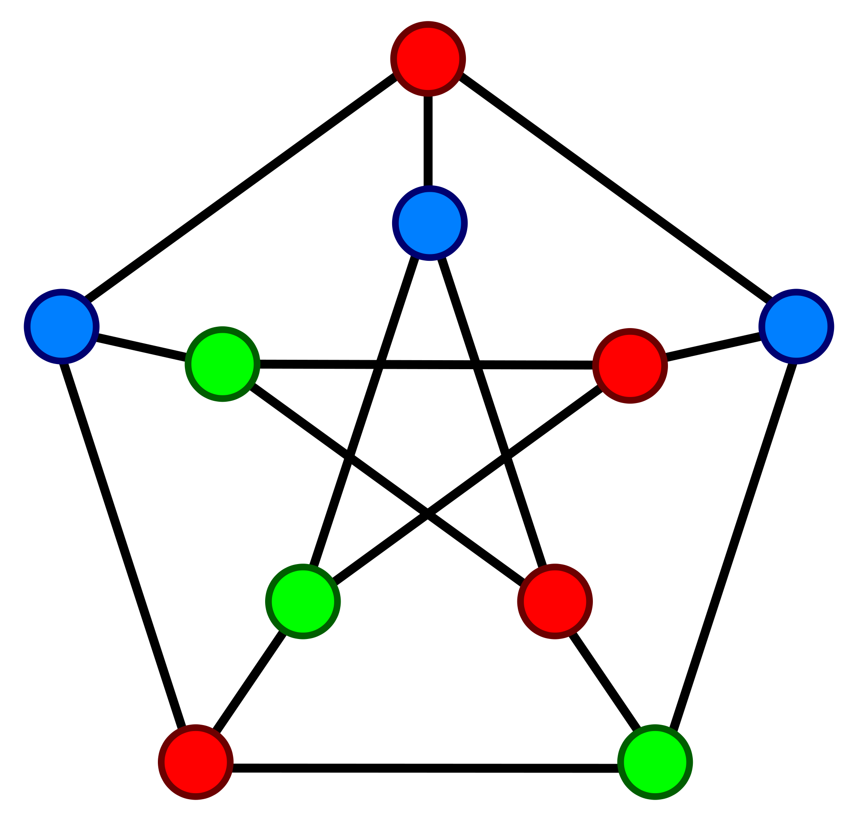
Aims of the Project
Investigation of population-based metaheuristic algorithms for graph colouring
Implementation of such algorithms from literature
Proposal of novel cuckoo-inspired algorithms for graph colouring

Slide 3
Achievements of the Project
Seven algorithms from literature implemented
Ant Colony Optimisation (ACO), Genetic Algorithm (GA), Simulated Annealing (SA), TABUCOL, Variable Space Search (VSS), Multi-Agent Evolutionary Algorithm (MEA), Particle Swarm Optimisation (PSO)
Three novel algorithms proposed
Cuckoo Search/ACO (CSACO), Cuckoo Optimisation Algorithm (COA), NEW
Investigation into the applicability of the above algorithms for the GCP

Slide 4
Continuous Cuckoo Optimisation

Slide 5

Egg Laying and Hatching
Each cuckoo lays between 5 and 20 eggs
An egg is a random point within a cuckoo’s Egg Laying Radius (ELR)
${ELR}_{i}=α\frac{number of eggs laid by i}{number of eggs laid by all cuckoos}({var}_{hi}−{var}_{lo})$
A fraction $p∈[0,1]$ of the worst eggs are killed before hatching
Once hatched, surviving eggs are added to the population of cuckoos
If new $N_{pop}>N_{max}$, the worst cuckoos are killed

Slide 6

Clustering and Migration
Cuckoos are clustered into $k$ “habitats”
The best cuckoo in the best habitat becomes the goal point towards which all other cuckoos migrate
Cuckoo $x$ migrates distance $λd(x,y)$ ($λ∼U(0,1)$) towards $y$ with deviation $φ∼U(−ω,ω)$

Slide 7
Continuous Cuckoo Search

Slide 8

Lévy Flights
A random walk with step-lengths drawn from a Lévy distribution
When generating a new solution $x^{(t+1)}$ for a nest $x^{(t)}$, a Lévy flight is performed:
$x_{i}^{(t+1)}=x_{i}^{(t)}+α\text{L}\text{é}\text{vy}\text{(}β)$

Slide 9

Continuous Cuckoo Search
Each nest represents a candidate solution
In each iteration a Lévy flight is performed on each nest
A fraction $p_{a}∈[0,1]$ of the worst nests are replaced with random solutions each iteration

Slide 10
Graph Colouring Discretisation Methods

Slide 11

3 Approaches
Legal
A solution is a legal colouring of G
Naïve fitness function $f\left(s\right)=number of colours$ produces poor results (search space is too flat)
I use $f\left(s\right)=−\sum_{i=1}^{k}{|V_{i}|^{2}}$ instead
K-fixed
Solutions are k-colourings of G (k is constant)
$f\left(s\right)=number of conflicts$
Penalty
Solutions are all possible colourings of G (not necessarily legal)
Fitness function must simultaneously reduce number of colours and conflicts
$f\left(s\right)=\sum_{i=1}^{k}{|V_{i}|(\left|E_{i}\right|−}|V_{i}|)$

Slide 12
Cuckoo Search for Graph Colouring

Slide 13

Aranha et al. (2017)
Only operator necessary to discretise is Lévy flights
Generate $M=α⌊\text{L}\text{é}\text{vy}\text{(}β)⌋+1$
Randomly recolour $M$ random vertices
Search space is penalty (any colouring is allowed)
Fitness function is number of conflicts

Slide 14
Aranha et al. Results
Graph | Number of Colours
dsjc250.5
r250.5
flat300_26
dsjc500.5
le450_5a
school1

Slide 15
Issues with Aranha et al.’s approach
This method of Lévy flights is arbitrary and too random
Unlikely to navigate the space effectively
Random re-initialisation is too aggressive for graph colouring
This is a k-GCP algorithm, not so applicable to GCP

Slide 16

ACO Lévy flights
A pheromone graph $τ$ is maintained
In a Lévy flight, $M=α⌊\text{L}\text{é}\text{vy}\text{(}β)⌋+1$ vertices are recoloured iteratively
From vertex $v$, a vertex $u$ is chosen with probability $P\left(u | v\right)=\frac{τ_{uv}^{α}η_{u}^{β}}{\sum_{u′∈V}{τ_{u′v}^{α}η_{u′}^{β}}}$
$η_{v}$ is the degree of saturation of $v$The number of distinct colours adjacent to $v$

Slide 17
ACO Lévy flights
A pheromone graph $τ$ is maintained
In a Lévy flight, $M=α⌊\text{L}\text{é}\text{vy}\text{(}β)⌋+1$ vertices are recoloured iteratively
From vertex $v$, a vertex $u$ is chosen with probability $P\left(u | v\right)=\frac{τ_{uv}^{α}η_{u}^{β}}{\sum_{u′∈V}{τ_{u′v}^{α}η_{u′}^{β}}}$
$η_{v}$ is the degree of saturation of $v$The number of distinct colours adjacent to $v$

Slide 18
ACO Lévy flights Results
Graph | Number of Colours
dsjc250.5
r250.5
flat300_26
dsjc500.5
le450_5a
school1

Slide 19

TABUCOL
A local search procedure applied to the best cuckoo each iteration
All recolourings of critical vertices considered
The best one is performed
When a move is performed it is made tabu for a number of iterations
A matrix $γ$ is maintained
$γ_{vc}=$ the number vertices adjacent to v coloured c

Slide 20
ACO Lévy flights + TABUCOL Results
Graph | Number of Colours
dsjc250.5 | 31
r250.5 | 72
flat300_26 | 35
dsjc500.5
le450_5a | 9
school1 | 14

Slide 21

Reference Sets
A technique inspired by Scatter Search
A less aggressive method for cuckoo re-initialisation
A reference set of $b+d$ cuckoos is maintained
When a cuckoo is killed it has two chances to join the reference set
If it is better than the worst of the first $b$ elements, or
If it is more diverse than the least diverse element
When a cuckoo is born, two random elements are selected and combined with Greedy Partition Crossover (GPX)

Slide 22
ACO Lévy flights + TABUCOL + Reference Sets Results
Graph | Number of Colours
dsjc250.5 | 33
r250.5 | 71
flat300_26 | 34
dsjc500.5
le450_5a | 7
school1 | 14

Slide 23
Rates of convergence (TODO)
Notes:
Put in graph showing rates of convergence of different methods (pick graph that demonstrates it best)

Slide 24
Cuckoo Optimisation for Graph Colouring

Slide 25
Mahmoudi et al. (2015) Egg Laying
Uses legal search space (no conflicts are allowed)

Slide 26

Mahmoudi et al. (2015) Migration
Migrating $x$ to $y$:
Generate a number $r∼U(0,1)$
For $rd_{H}(x,y)$ random vertices $v$ such that $x\left(v\right)≠y(x)$, set $x\left(v\right)≔y(v)$
$d_{H}(x,y)$ is the Hamming distance between $x$ and $y$

Slide 27

Egg Laying and Hatching
In the legal version, r random vertices are recoloured the smallest valid colour different to their current one
Where $r∈[1,ELR]$ is a random integer
Egg hatching is identical to the continuous version

Slide 28

Clustering
Typical clustering algorithms (e.g. k-means) are not applicable for metric spaces
k-means requires each cluster to have a centroid (which is not possible in a discrete metric space)
k-sets, proposed by Chang et al. (2015) clusters points in a metric space by minimising relative distance from each point to each cluster
Uses triangular distance
$Δ\left(x, S\right)=2\overline{d}\left(\left\{x\right\}, S\right)−\overline{d}(S,S)$
$\overline{d}\left(S_{1},S_{2}\right)=\frac{1}{\left|S_{1}\right||S_{2}|}\sum_{x∈S_{1}}{\sum_{y∈S_{2}}{d(x,y)}}$

Slide 29

Migrating
It’s computationally hard (PSPACE-complete for $k≥4$) to find a direct path from one colouring to another
Hence the legal implementation of cuckoo migration is less strict
When migrating x to y, we generate a colouring based off x distance $λd$ from y (but not necessarily distance $\left(1−λ\right)d$ from x)
Iteratively recolour vertices from x to their colour in y, cleaning up conflicts as they arise

Slide 30

Simulated Annealing Hybrid
Allows for greater population diversity
When an egg is compared with a cuckoo, if it is worse, it may still replace it with probability $e^{\frac{−d}{T}}$
$d=f\left(egg\right)−f(cuckoo)$

Slide 31
NEW

Slide 32

Greedy Partition Crossover (GPX)
A genetic crossover algorithm for graph colouring
In iteration $i$, the largest vertex set from parent $i mod p$ is taken to be the $i^{th}$ vertex set of the child
$p$ is the number of parents
The vertices in this set are then removed from both parents
Any vertices that remain uncoloured are coloured randomly

Slide 33

NEW Algorithm
A nest is a set of solutions
There are $C$ cuckoos (each with a single solution)
A nest is condensed into a single colouring via GPX
A cuckoo combines their egg with a random nest’s “representative” to replace their egg and the worst egg in that nest
TABUCOL is also applied to each cuckoo’s egg

