Slide 1
Graph Colouring with Cuckoo Algorithms

Slide 2
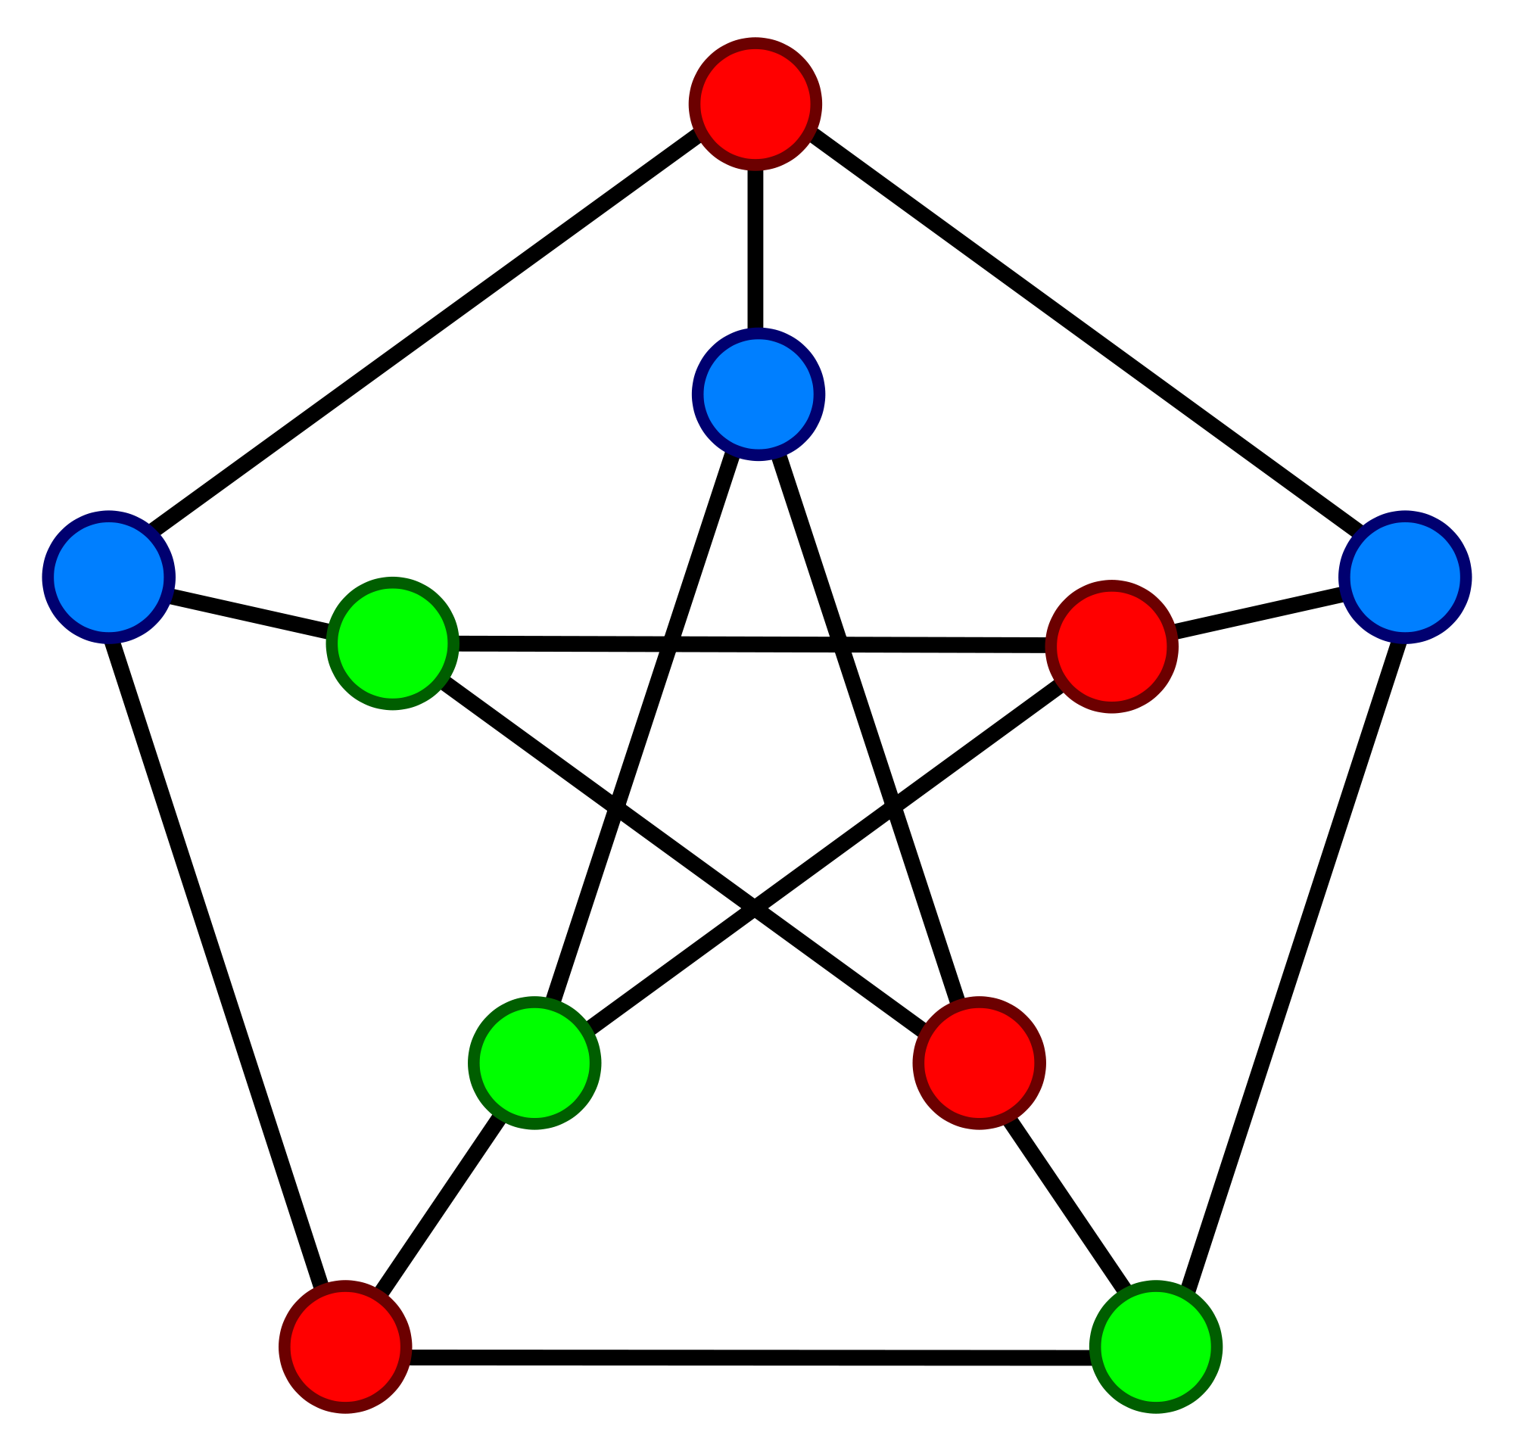

Graph Colouring
Given an undirected graph G = (V, E), a colouring C is a function $C :V→ℕ$
In a colouring c, we denote the colour of vertex v as $c_{v}$
A conflict in a colouring c is an edge $uv∈E$ s.t. $c_{u}=c_{v}$
A legal colouring is a colouring with no conflicts
The goal of the Graph Colouring Problem (GCP) is to find a legal colouring that minimises the number of colours used
The fewest number of colours possible to colour G with is called the chromatic number of G denoted $χ_{G}$

Slide 3
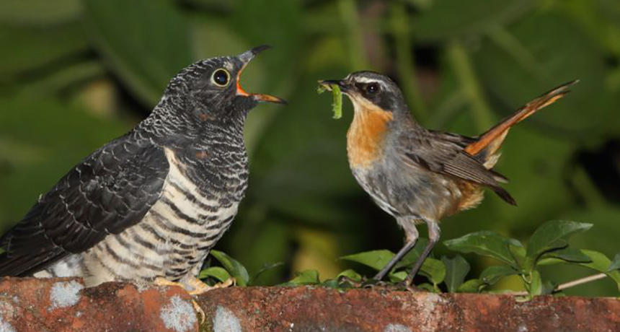
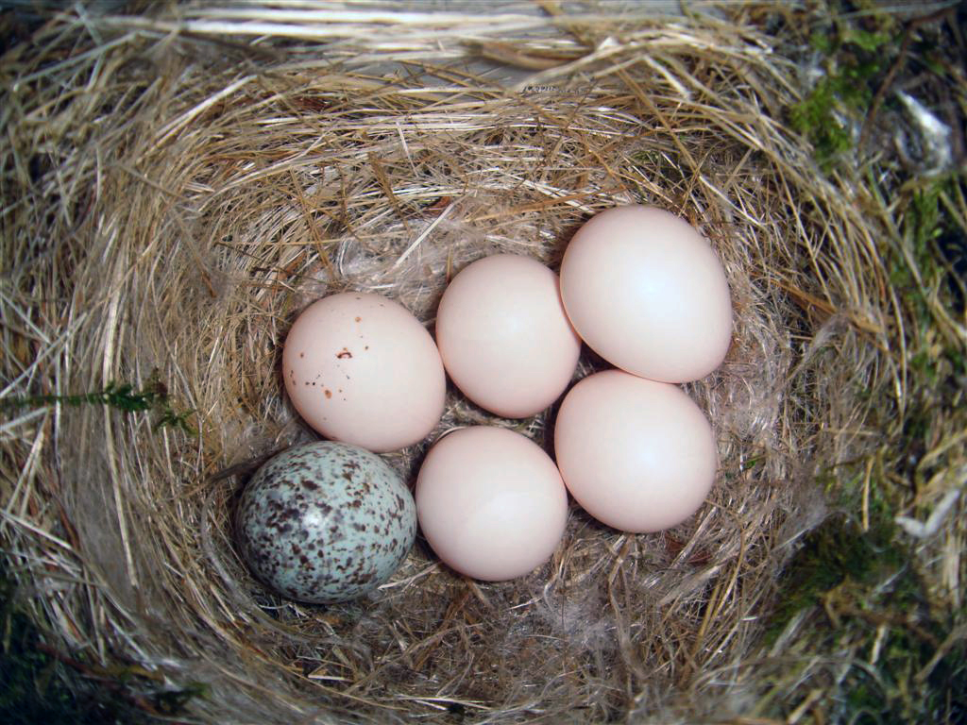
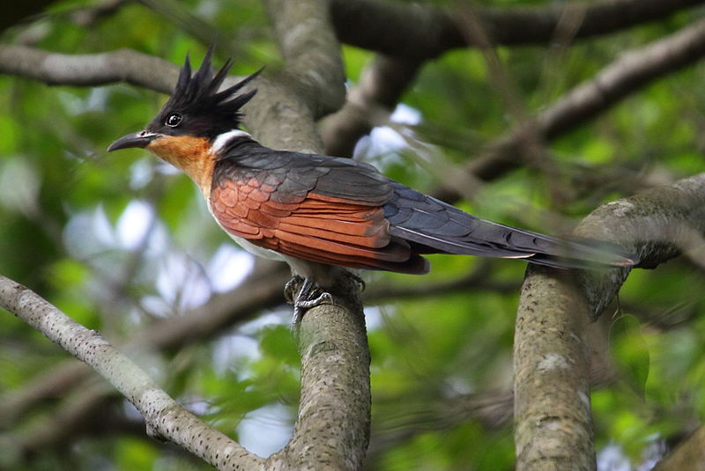
Cuckoo Behaviour and Brood Parisitism

Slide 4
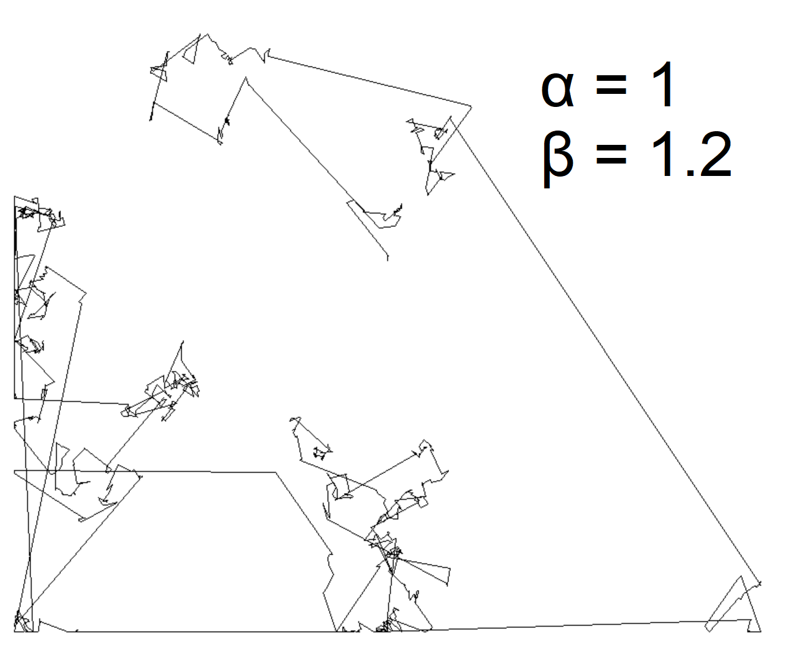
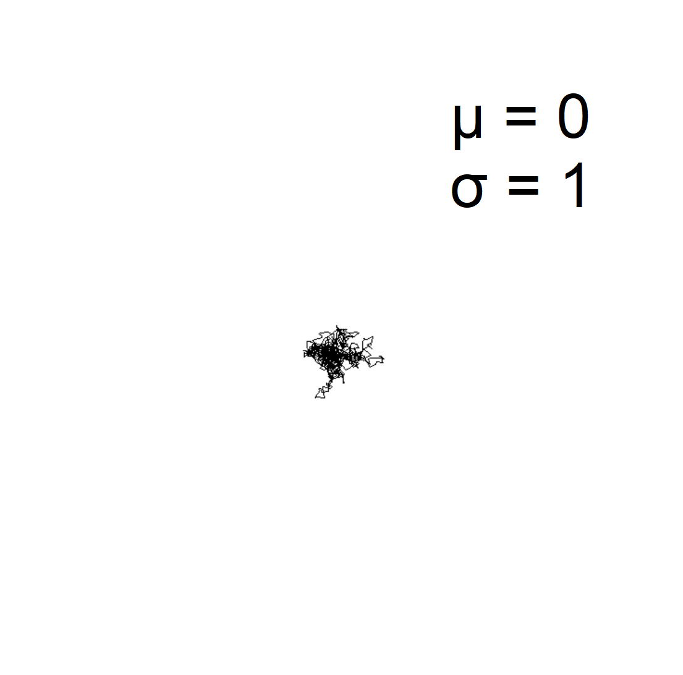

Continuous Cuckoo Search
Lévy flights
A random walk with step-lengths drawn from a long-tailed Lévy distribution
Solutions represented as nests
At each iteration, a Lévy flight is performed for each nest (to mimic a Cuckoo replacing an egg)
A fraction $p_{a}$ of the worst nests are replaced with random new solutions at the end of an iteration
Lévy Flight (left) vs. Normal Walk (right)
Notes:
There’re two algorithms, they’re both continuous optimisation algorithms
Mention that Levy flights are an efficient way of stochastically exploring a search space

Slide 5
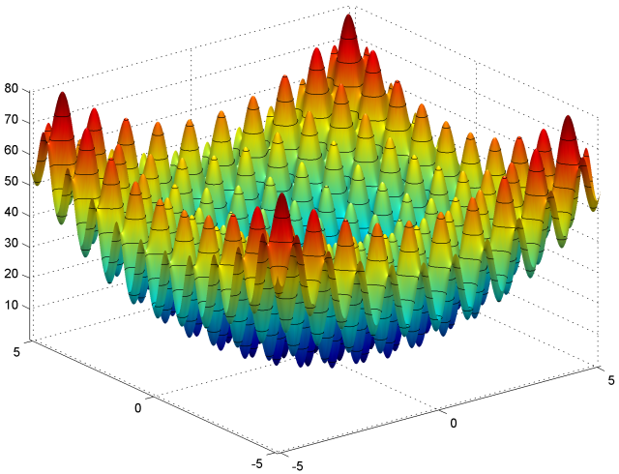
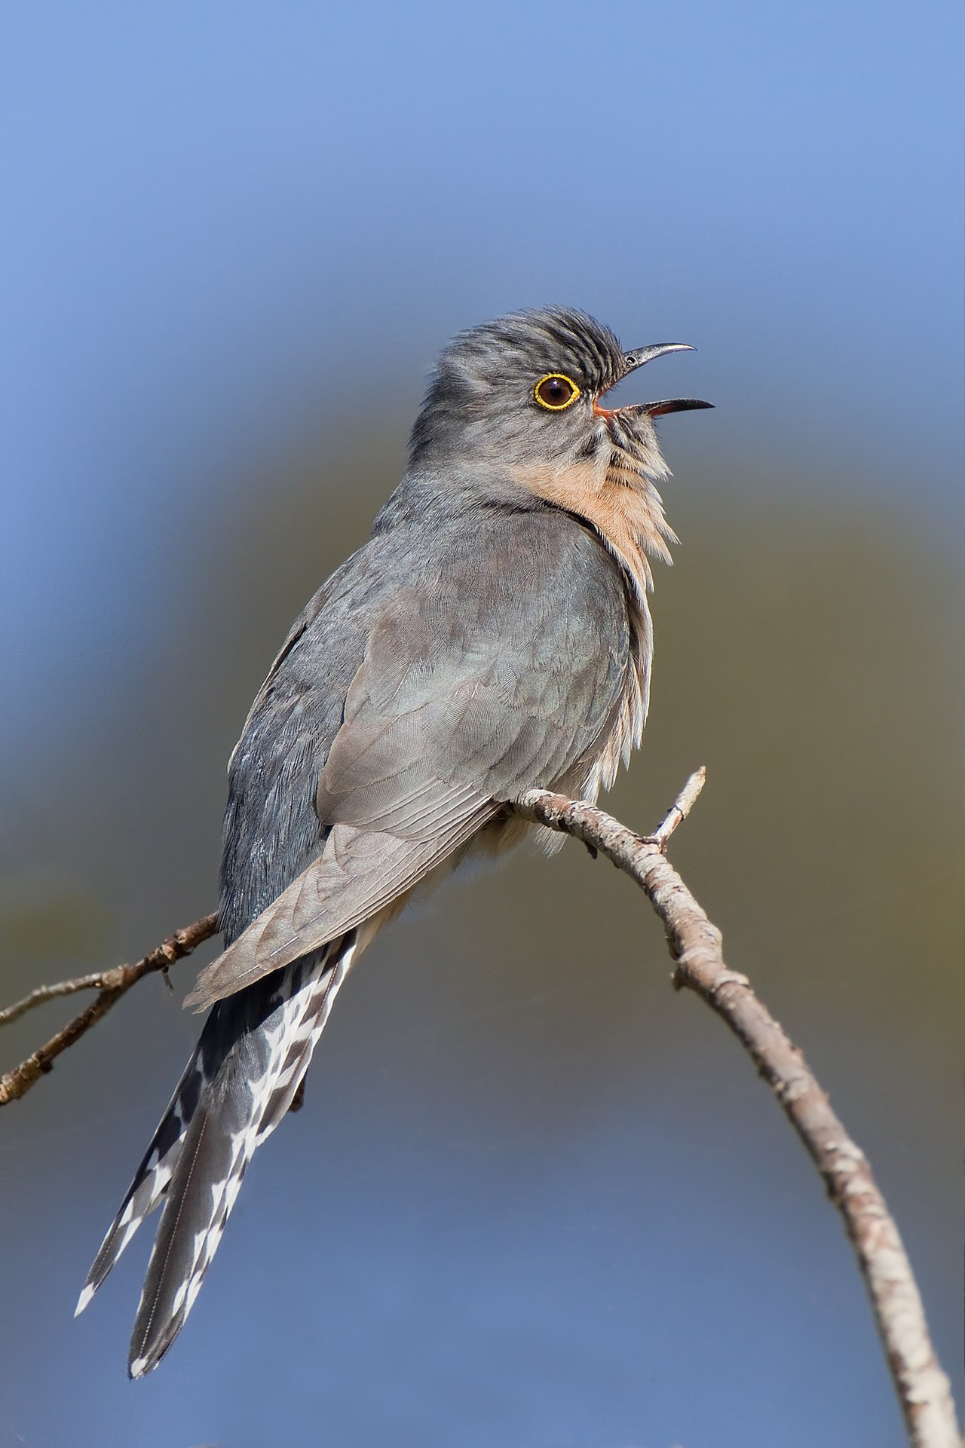
Continuous Cuckoo Optimisation
Egg Laying
Egg Hatching
Cuckoo Clustering
Cuckoo Migration
Notes:
Imitates the life span of the entire cuckoo

Slide 6
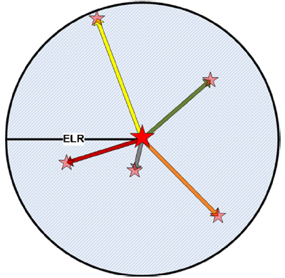

Egg Laying and Hatching
Each cuckoo lays a random number ($e \sim U(5,20)$) of eggs within its Egg Laying Radius (ELR)
${ELR}_{i}=α×\frac{Number of eggs laid by i}{Number of eggs laid by all cuckoos}×({var}_{hi}−{var}_{lo})$
A fraction $p∈[0, 1]$ of the worst eggs are killed
The surviving eggs “hatch” and are added to the main population
If the population exceeds $N_{max}$, the worst cuckoos are killed until it no longer does
Ramin Rajabioun. “Cuckoo optimization algorithm”. In: Applied soft computing11.8 (2011),pp. 5508–551
Notes:
P is a constant parameter of the algorithm

Slide 7
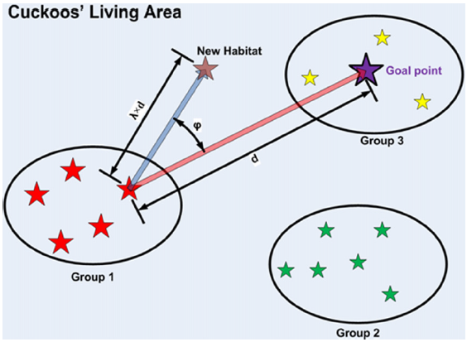
Cuckoo Clustering and Migration
To mimic Cuckoo migration, cuckoos are clustered into 3-5 “habitats”
For the continuous domain and a Euclidean distance function, k-means can be used
The best cuckoo in the best habitat is chosen to be the goal point
All cuckoos migrate towards the goal point with some random deviation
Ramin Rajabioun. “Cuckoo optimization algorithm”. In: Applied soft computing11.8 (2011),pp. 5508–551

Slide 8
Graph Colouring Discretisation Methods
Notes:
Now onto discretisation which is the theory of applying continuous algorithms to discrete problems, in this case graph colouring.

Slide 9
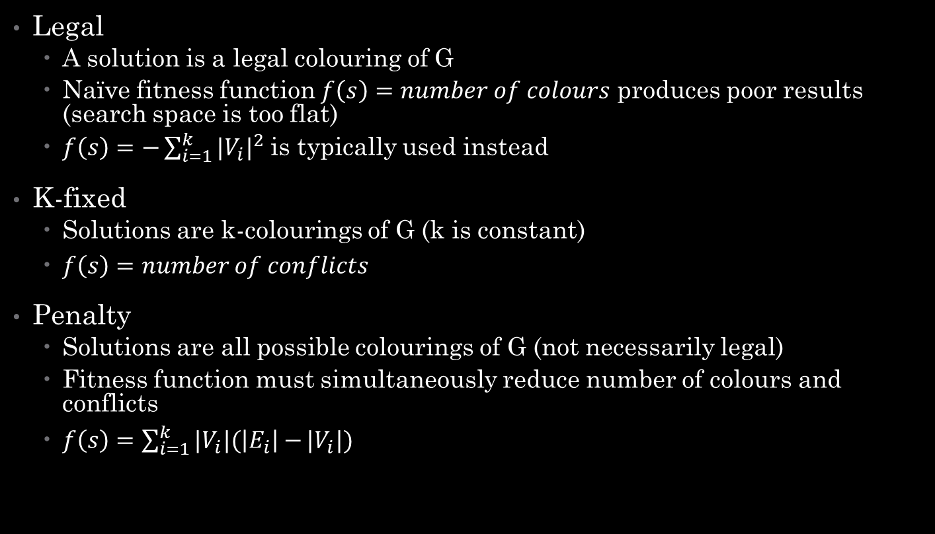
3 Approaches
Legal
A solution is a legal colouring of G
Naïve fitness function $f\left(s\right)=number of colours$ produces poor results (search space is too flat)
$f\left(s\right)=−\sum_{i=1}^{k}{|V_{i}|^{2}}$ is typically used instead
K-fixed
Solutions are k-colourings of G (k is constant)
$f\left(s\right)=number of conflicts$
Penalty
Solutions are all possible colourings of G (not necessarily legal)
Fitness function must simultaneously reduce number of colours and conflicts
$f\left(s\right)=\sum_{i=1}^{k}{|V_{i}|(\left|E_{i}\right|−}|V_{i}|)$
Notes:
State what V_i and E_i are.
State that Penalty reduces to Legal with no conflicts.
State that penalty often outperforms the other two and if time briefly mention why (finding paths in GCOL reconfiguration graph is PSPACE-complete).

Slide 10
Discretising Cuckoo Optimisation

Slide 11

Egg Laying and Hatching
In the legal version, r random vertices are recoloured the smallest valid colour different to their current one
Where $r∈[1,ELR]$ is a random integer
Egg hatching is identical to the continuous version
Notes:
Emphasise that this a legal approach
Egg hatching is identical as it isn’t a problem dependent operator

Slide 12
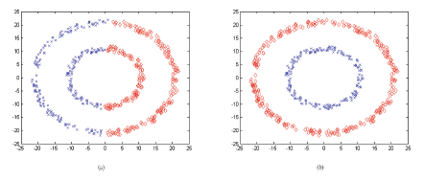

Clustering
Typical clustering algorithms (e.g. k-means) are not applicable for metric spaces
k-means requires each cluster to have a centroid (which is not possible in a discrete metric space)
k-sets, proposed by Chang et al. (2015) clusters points in a metric space by minimising relative distance from each point to each cluster
Uses triangular distance
$Δ\left(x, S\right)=2\overline{d}\left(\left\{x\right\}, S\right)−\overline{d}(S,S)$
$\overline{d}\left(S_{1},S_{2}\right)=\frac{1}{\left|S_{1}\right||S_{2}|}\sum_{x∈S_{1}}{\sum_{y∈S_{2}}{d(x,y)}}$
k-means (left) vs. k-sets (right)
Notes:
Briefly explain what a metric space is.
STATE THAT I USE HAMMING DISTANCE

Slide 13


Migrating
Given a cuckoo x and a goal point y, let $r=d(x,y)$
Generate a random number $λ \sim U(0, 1)$
We will generate a colouring distance $rλ$ from y
Let $I=\left\{v \right| x_{v}≠y_{v}\}$ be ordered arbitrarily
The set of vertices on which x and y disagree ($d\left(x,y\right)=|I|$)
For $i$ in $I_{1:rλ}$, recolour $i$ to $y_{i}$
$i$ contains no conflicts with any vertices in that came before $i$ in I or any vertices in $V \backslash I$
For $j$ in $I_{i+1:rλ}$, recolour j to the lowest valid colour different to $y_{j}$
It’s computationally hard (PSPACE-complete for $k≥4$) to find a direct path from one colouring to another
Hence the legal implementation of cuckoo migration is less strict
When migrating x to y, we generate a colouring based off x distance $λd$ from y (but not necessarily distance $\left(1−λ\right)d$ from x)
Iteratively recolour vertices from x to their colour in y, cleaning up conflicts as they arise
Notes:
Bring up the fact that finding a GCOL reconfiguration graph is PSPACE-complete.
Thus we can’t achieve idealized migration, the best we can hope for is generating a colouring distance lr from y (but not necessarily distance l(1-r) from x).

Slide 14
Discretising Cuckoo Search
Notes:
The only thing necessary to discretise is Levy flights

Slide 15
Simple Approach
Only thing necessary to discretise is the Lévy flight operator
Select M vertices (where M is drawn from a Lévy distribution) and recolour them randomly
In practice, produces poor results
Notes:
Briefly mention why this approach sucks (talk about finding a 50 colouring for a 500 vertex graph) and lead in to the motivation for CSACO

Slide 16

Ant Colony Optimisation Hybrid Approach
A weighted Pheromone Graph $τ$ is used to store the value of selecting one vertex from another
Lévy flights:
Generate a number M. Beginning from the vertex with highest degree, iteratively select M vertices with probability according to their weight
A vertex’s weight is the product of its heuristic value and the pheromone weight when moving from the current vertex
After performing a Lévy flight, $τ$ is updated so more weight is given to paths that created better solutions
Takes into account heuristic information while also learning from previous iterations and maintaining a degree of randomness
Notes:
EMPHASISE THAT IT’S YOUR ALGORITHM
Allows you to select a set of vertices in a specific order and recolour them in such a way that uses heuristic information while also learning from previous iterations
Very briefly go over weight based on pheromone and heuristic value and state that paths which produce better colourings are given more pheromone

Slide 17
Preliminary Results

Slide 18
PUT RESULTS HERE
Running Algorithms for 30 minutes (|V| = 250, |E| = 15681)
Algorithm | Number of Colours
CSACO | 32
COA | 37
ACO | 39
GA (with GPX) | 44
PSO
SA
TABUCOL
Notes:
Very briefly introduce results, state that CSACO does surprisingly well (but also stress that these are very early results)
Then ask for questions

