Slide 1
檔案資料 的 讀入 與 寫出
FILE *fp;
fp = fopen(“myfile.dat”,”r”);
fclose(fp);

Slide 2
File type -- FILE
FILE 是一 struct。”stdio.h” 定義它的結構。
typedef struct _iobuf
{
char* _ptr;
int _cnt;
char* _base;
int _flag;
int _file;
int _charbuf;
int _bufsiz;
char* _tmpfname;
} FILE;
FILENAME_MAX 260
FILEOPEN_MAX 20
BUFSIZE 512
stdin 0
stdout 1
stderr 2

Slide 3
Open and close a file fp =fopen(..,..); fclose(fp);
i/o mode
FILE *fp; \\ file pointer.
fp = fopen(string, mode);
string: 字串，檔名(可加上目錄路徑)
string = “R:\\mydata.txt”
mode: 字串，代表檔案的 i/o 模式，例 ”r” 、”w”。
r | Open text file for read
w | Creat text file for write
a | Append to a text file
rb | Open binary file for read
wb | Creat binary file for write
ab | Append to a binary file
rb+ | Open binary file for r/w
wb+ | Creat binary file for r/w
ab+ | Open binary file for r/w

Slide 4
Concept of file
device
a.exe
disk
CS
SS
fp
monitor
buffer
stdout
printer
DS
RAM
keyboard
stdin

Slide 5
Failure in fopen(..,..)
FILE *fp;
fp = fopen(“myfile”, “r”);
If (fp == NULL)
{ printf(“file open %s failed\a\n”, “myfile”);
開檔失敗時，fp 指向 NULL (stdio.h 所定義)
Char fname[40];
do
{ printf(“Type input file name : “);
scanf(“%s”,fname);
fp = fopen(fname, “r”);
} while (fp == NULL);

Slide 6
Write to a new file
FILE *fp;
fp = fopen(“mydata.txt”, “w”);
fprintf(fp, “cos(%lf) = %lf\n”,x, cos(x));
fclose(fp);
fprintf(fp, format_string, variable_list);
※fprintf(stdout, …); 等效於 printf(..);

Slide 7
Read from an existing file
FILE *fp;
fp = fopen(“c:\\ytlu\\my_old.dat”, “r”);
fscanf(fp, “%n %lf”, &n, &x);
fclose(fp);
fscanf(fp, format_string, pointer list);
※fscanf(stdin,….) 等效於 scanf(….);

Slide 8
End of file test – feof(file_pointer)
FILE *fp;
int id[100];
float score[100];
fp = fopen(“score.dat”, “r”);
n = 0;
while ( !feof(fp) )
{ fscanf(fp, “%n %lf”, &id[n], &score[n];
n++;
}
fclose(fp);
example
feof(fp) -- return ture (1) if encounter the end of file,
return false (0) else.

Slide 9
Strcpy(str1, str2): copy str2 → str1
#include <stdio.h>
#include <string.h>
int main()
{ char ss[40];
strcpy(ss, “.\\data\\number.dat”);
printf(“str = %s\n”,ss);
return(0);
}
example

Slide 10
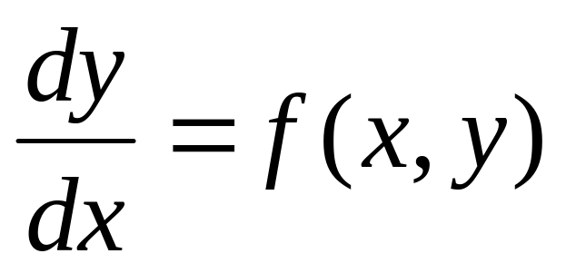
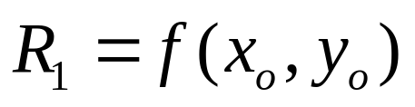
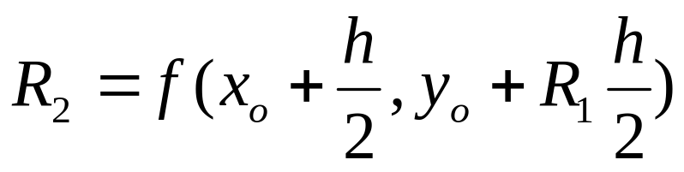
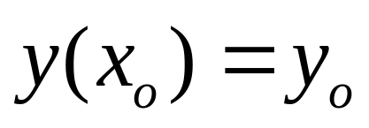
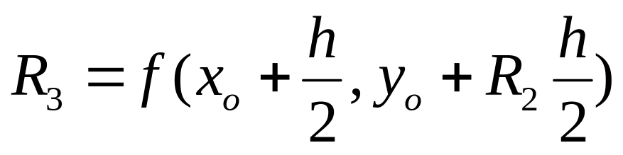
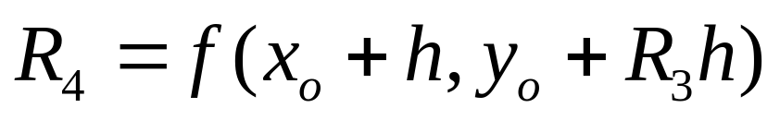
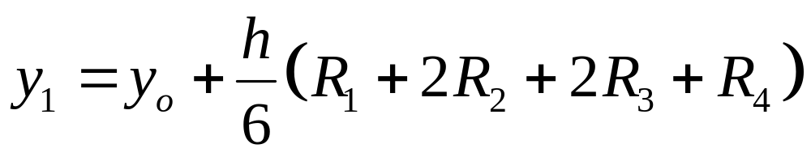
Runge Kuta 4th order

Slide 11
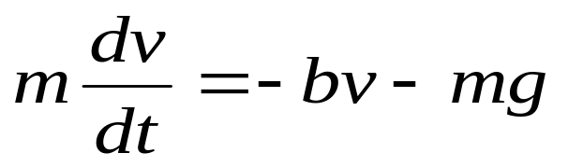
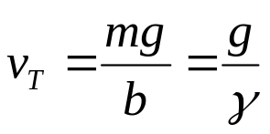
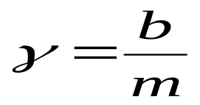
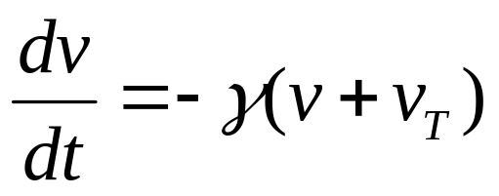
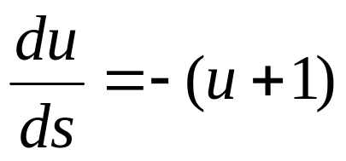
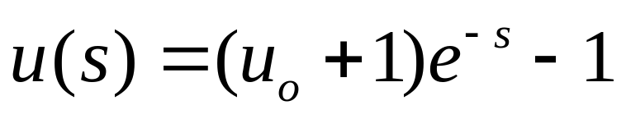
Frictional Fall doc file
Example program

Slide 12
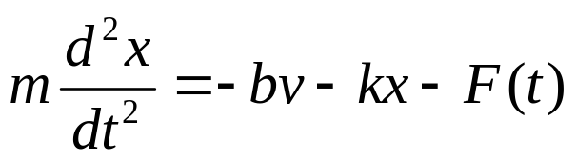

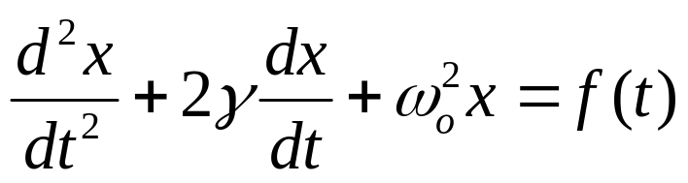
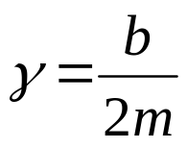
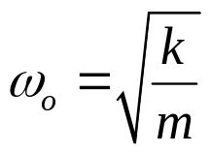
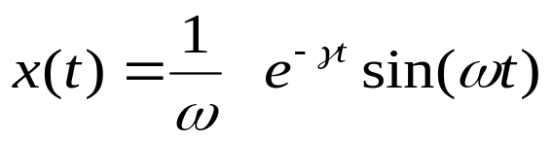
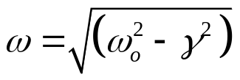
Driving Damping Oscillation doc
Exact solution for x(0)=0 v(0)=1

Slide 13
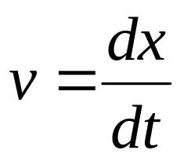
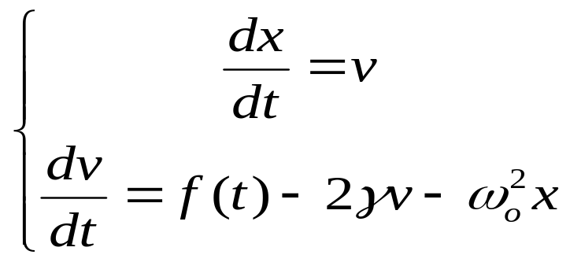
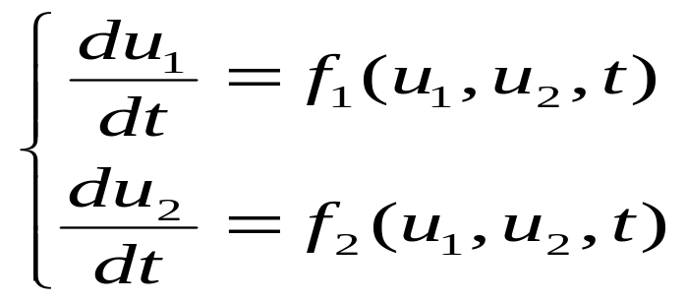
RK4 for 2nd Oder ODE
Generally, for 2nd order ODE

Slide 14
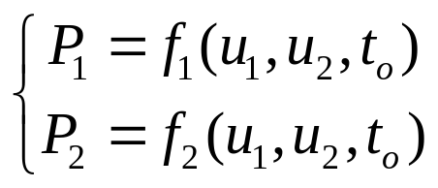
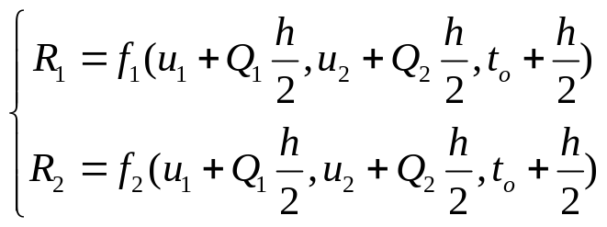
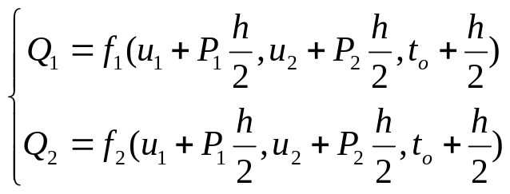
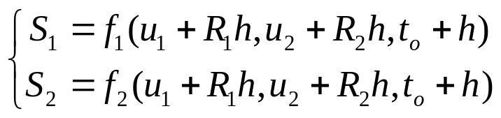
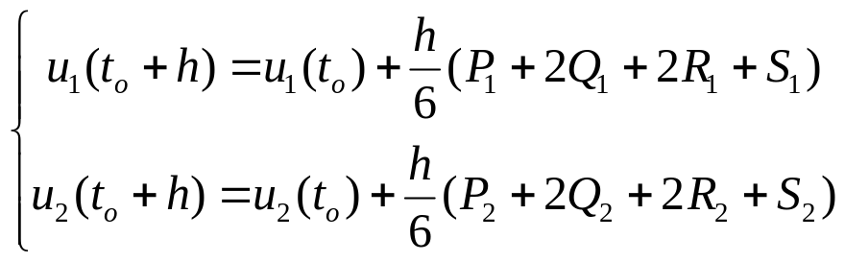
2nd Order ODE

Slide 15
Practice 4
Input data from file record.txt (純屬虛構)
----------------------------------------
1 C24926741 吳博鏞 90 68 61
2 C24926717 徐嘉伶 80 94 90
3 C24921165 張凱焜 91 67 70
4 C24926644 賴韋辰 66 52 72
5 C24921026 林晏徵 52 61 72
Compute the average 0.3*s1 + 0.3*s2 + 0.4*s3,
And output to another file as follows:
-------------------------
NO ID NO average
-------------------------
1 C24926741 71.80
2 C24926717 88.20
3 C24921165 75.40
4 C24926644 64.20
5 C24921026 62.70

Slide 16
typedef struct {int no; char id[12], name[10]; float t1,t2,t3,avg;} Student;
範例
開 inf 和 outf
Student fun1(FILE *fp){….;}
function type Student,
arguments (FILE *);
讀入一個學生的資料.
列印三標題行
feof(inf)?
yes
Close files
float fun2(Student ss){…;}
function type float;
argument (Student);
傳回學生平均成積
no
輸入學生資料
fun1
void fun3(FILE*fp, Student ss)
{…;}
function type void;
argument (FILE*, Student);
寫出學生序號, 學號, 平均成積
計算平均
fun2
輸出序號,
學號,平均
fun3

Slide 17
Project 4. 檔案的輸入和輸出
從 record.txt 當中讀取學生 序號, 學號, 姓名, 三次成績 t1, t2, t3.
計算平均 0.3*(t1+t2) + 0.4*t3
以平均排序.
排序後開新檔案輸出.
typedef struct { int no; // 學生序號
char idno[12]; // 學號
char name[10]; // 姓名
float t1, t2, t3 ; // 三次成績
float avg; // 平均
} STUDENT;

Slide 18
main()
{ STUDENT a[50]; // 儲存學生資料
int s[50]; // 排序用
int totaln; // total student number
// read student record
totaln = read_record(a);
// calculate the average
do_average(a, totaln);
// sorting according to average
do_sorting(a, totaln, s);
// print records
print_record(a, totaln, s);
system(“pause”);
return 0;
}
宣告:
int read_record(STUDENT *);
void do_average(STDUENT *, int);
void do_sorting(STUDENT*, int, int*);
void print_record(STUDENT*, int, int*);

Slide 19
do_sorting(STUDENT a, int n, int*s)
initial
s[i]=i, i=1, n
return;
no
ex_flag > 0?
do loop
yes
Set ex_flag = 0
no
i < n ?
for loop i=1
yes
a1 = a[s[i-1]].avg;
a2 = a[s[i]].avg;
no
a1 > a2 ?
exchange s[i] & s[i-1];
Set ex_flag = 1;
yes
Sorting

