Slide 1
Analysis of sustainability disclosure of food retailers in Europe
Johannes W.H. van der Waal

Slide 2
Objective
objectively chart the sustainability themes of food retailers
identify relevant topics that we must not miss
match our sustainability focus areas with those of retailers

Slide 3
Method
## [1] 9
Text analysis of nrow(docvars) sustainability reports.
Non-English reports were converted to English language with Deepl.com
Supervised and non-supervised thematic analysis
Description of the reports
## Warning: package 'ggthemes' was built under R version 4.0.5
## Warning: package 'ggrepel' was built under R version 4.0.5

Slide 4
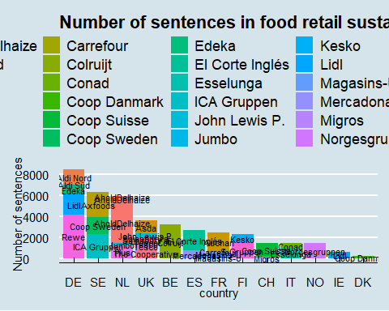

Slide 5
You can also embed plots, for example:

Slide 6
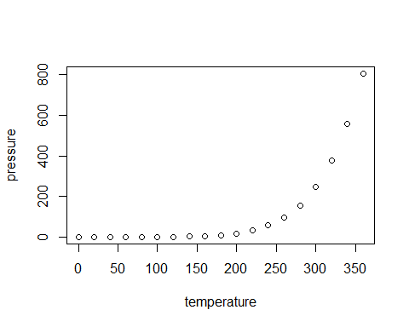

Slide 7
Note that the echo = FALSE parameter was added to the code chunk to prevent printing of the R code that generated the plot.

