Slide 1








RoadRadius Fusion
EHPS
$$Steering Angle$$
Tire Model
$$Tire Angle$$
EKF
$$Curvature$$
Conditional
Fusion
$$R_{final}$$
Fuzzy Logic
$$LPF Gain$$
LPF
$$YawRate_{filtered}$$
EBS
$$YawRate$$
CAM
$$Cam Curvature$$

Slide 2
SCC2 Emergency Stop Algorithm
SCC2
DSW
Off
Standby
Ready
Warning
LOC
LAC
Lockout1
Lockout2
Assist2
Assist1

Slide 3
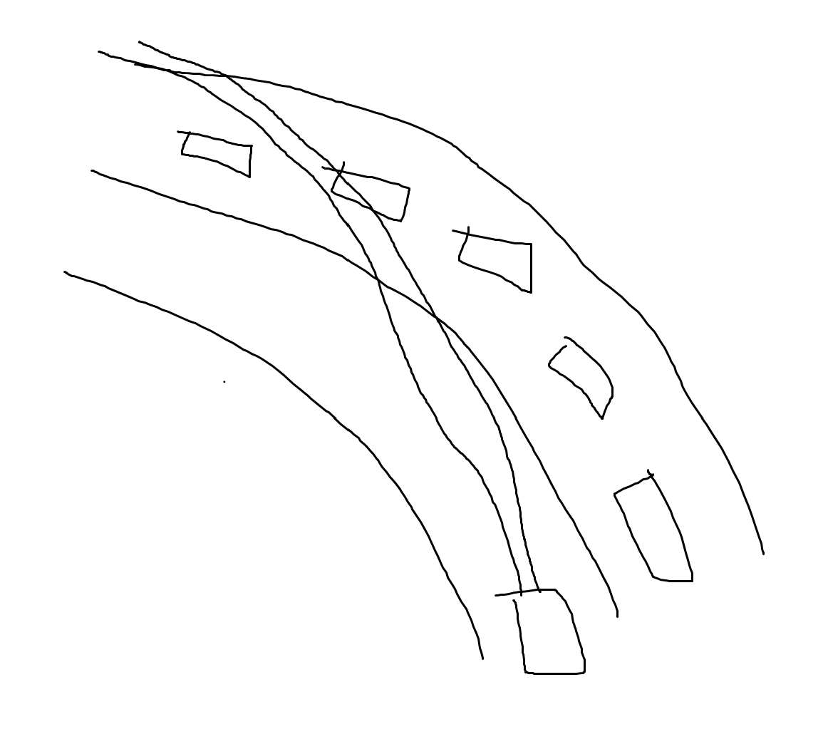
RoadRadius
TOS
Track5
Track4
Track3
Track2
Track1
EGO

Slide 4
https://www.youtube.com/watch?v=ysfj0QfXnWU
QZ FCEV Europe
https://ecv.hyundai.com/global/en/products/xcient-fuel-cell-truck-fcev
QZ FCEV NA
https://ecv.hyundai.com/global/en/products/xcient-fuel-cell-tractor-fcev
QZ 25PE ICE
https://www.hyundaimotorgroup.com/en/story/CONT0000000000191845

