Slide 2




Heteroscedastic UQNN
µ-head
µ
x₁
x₂
…
x_{n}
f₁
f₂
…
f_{m}
Feature
Extractor
$logσ_{au}^{2}$-head
$$logσ_{au}^{2}$$
$σ_{eu}$-head
$$σ_{eu}$$

Slide 3


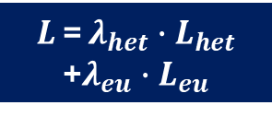


µ
x₁
x₂
…
x_{n}
$$L_{het}$$
$$logσ_{au}^{2}$$
H-UQNN
$L$ = ${λ_{het}∙L}_{het}$ +${λ_{eu}∙L}_{eu}$
$$σ_{eu}$$
$$L_{eu}$$

