Slide 1








TwoTriangle
$$1$$
$$5$$
$$C_{3,4}$$
$$3$$
$$4$$
$$C_{4,3}$$
$$2$$
$$6$$
Source: Georgiadis et al 2006. pg 9

Slide 2
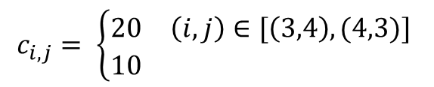
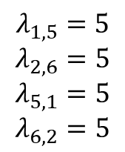
TwoTriangle1
$$c_{i,j}= \left\{\begin{matrix}20 & \left(i,j\right)∈[\left(3,4\right), (4,3)] \\ 10 & \end{matrix}\right.$$
$$λ_{1,5}=5$$
$$λ_{2,6}=5$$
$$λ_{5,1}=5$$
$$λ_{6,2}=5$$
$$1$$
$$5$$
$$C_{3,4}$$
$$3$$
$$4$$
$$C_{4,3}$$
$$2$$
$$6$$
Source: Georgiadis et al 2006. pg 9

Slide 3
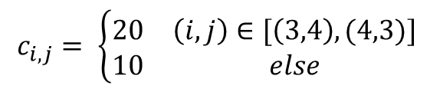
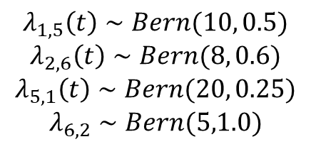
TwoTriangle1b
$$c_{i,j}= \left\{\begin{matrix}20 & \left(i,j\right)∈[\left(3,4\right), (4,3)] \\ 10 & else\end{matrix}\right.$$
$$1$$
$$5$$
$$λ_{1,5}\left(t\right)∼Bern(10, 0.5)$$
$$λ_{2,6}\left(t\right)∼Bern(8, 0.6)$$
$$λ_{5,1}\left(t\right)∼Bern(20, 0.25)$$
$$λ_{6,2}∼Bern(5,1.0)$$
$$C_{3,4}$$
$$3$$
$$4$$
$$C_{4,3}$$
$$2$$
$$6$$
Source: Georgiadis et al 2006. pg 9

Slide 4
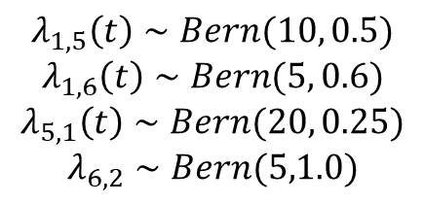
TwoTriangle2
$$c_{i,j}= \left\{\begin{matrix}20 & \left(i,j\right)∈[\left(3,4\right), (4,3)] \\ 10 & else\end{matrix}\right.$$
$$1$$
$$5$$
$$λ_{1,5}\left(t\right)∼Bern(10, 0.5)$$
$$λ_{1,6}\left(t\right)∼Bern(5, 0.6)$$
$$λ_{5,1}\left(t\right)∼Bern(20, 0.25)$$
$$λ_{6,2}∼Bern(5,1.0)$$
$$C_{3,4}$$
$$3$$
$$4$$
$$C_{4,3}$$
$$2$$
$$6$$
Source: Georgiadis et al 2006. pg 9

Slide 5



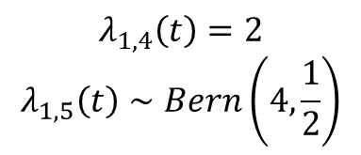








Env1b
$$(3)$$
$$(2)$$
$$2$$
$$4$$
$$λ_{1,4}\left(t\right)=2$$
$$λ_{1,5}\left(t\right)∼Bern\left(4,\frac{1}{2}\right)$$
$$1$$
$$(3)$$
$$(3)$$
$$(3)$$
$$3$$
$$5$$
$$(2)$$

Slide 6




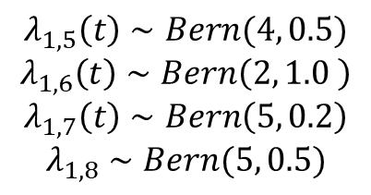















Env2a
$$5$$
$$(3)$$
$$2$$
$$(3)$$
$$(2)$$
$$6$$
$$λ_{1,5}\left(t\right)∼Bern(4, 0.5)$$
$$λ_{1,6}\left(t\right)∼Bern\left(2, 1.0 \right)$$
$$λ_{1,7}\left(t\right)∼Bern\left(5, 0.2\right)$$
$$λ_{1,8}∼Bern(5, 0.5)$$
$$(3)$$
$$(2)$$
$$(2)$$
$$1$$
$$(3)$$
$$3$$
$$(2)$$
$$(5)$$
$$(2)$$
$$7$$
$$(2)$$
$$4$$
$$(3)$$
$$8$$

Slide 7
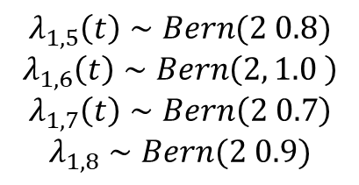




Env2d
$$5$$
$$(3)$$
$$2$$
$$(3)$$
$$(2)$$
$$(3)$$
$$6$$
$$λ_{1,5}\left(t\right)∼Bern(2 0.8)$$
$$λ_{1,6}\left(t\right)∼Bern\left(2, 1.0 \right)$$
$$λ_{1,7}\left(t\right)∼Bern\left(2 0.7\right)$$
$$λ_{1,8}∼Bern(2 0.9)$$
$$(3)$$
$$(2)$$
$$(2)$$
$$1$$
$$(5)$$
$$3$$
$$(2)$$
$$(5)$$
$$(2)$$
$$7$$
$$(2)$$
$$4$$
$$(3)$$
$$8$$

Slide 8


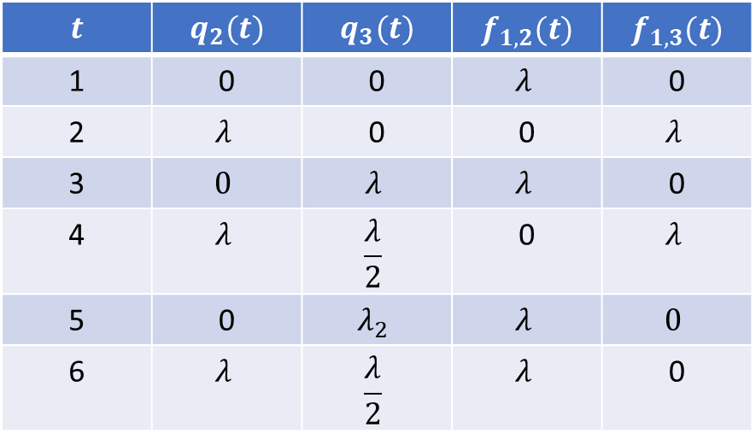

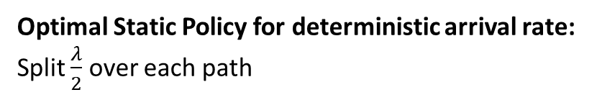

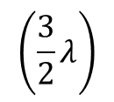
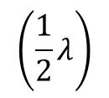
Diamond
Optimal Static Policy for deterministic arrival rate:
Split $\frac{λ}{2}$ over each path
$$\left(\frac{3}{2}λ\right)$$
$$(2λ)$$
$$2$$
$$λ_{1,4}\left(t\right)=λ$$
$$1$$
$$4$$
Backpressure Sequence
$$t$$ | $$q_{2}(t)$$ | $$q_{3}(t)$$ | $$f_{1,2}(t)$$ | $$f_{1,3}(t)$$
1 | 0 | 0 | $$λ$$ | 0
2 | $$λ$$ | 0 | 0 | $$λ$$
3 | $$0$$ | $$λ$$ | $$λ$$ | 0
4 | $$λ$$ | $$\frac{λ}{2}$$ | 0 | $$λ$$
5 | 0 | $$λ_{2}$$ | $$λ$$ | $$0$$
6 | $$λ$$ | $$\frac{λ}{2}$$ | $$λ$$ | 0
$$(2λ)$$
$$3$$
$$\left(\frac{1}{2}λ\right)$$

Slide 9
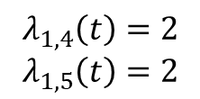
Env1c
$$(3)$$
$$(2)$$
$$2$$
$$4$$
$$λ_{1,4}\left(t\right)=2$$
$$λ_{1,5}\left(t\right)=2$$
$$1$$
$$(3)$$
$$(3)$$
$$(3)$$
$$3$$
$$5$$
$$(2)$$

Slide 10
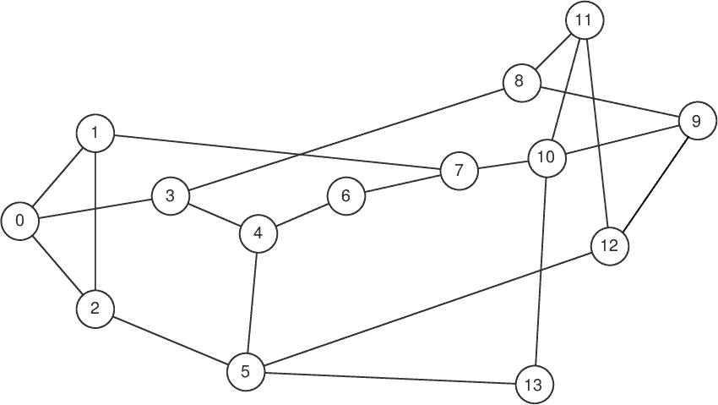
NSFNET
Source: https://knowledgedefinednetworking.org/

Slide 11






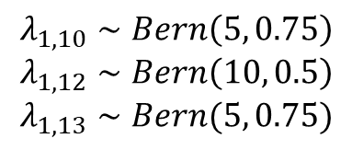








NSFNET2
$$12$$
$$λ_{1,10}∼Bern\left(5, 0.75\right)$$
$$λ_{1,12}∼Bern\left(10, 0.5\right)$$
$$λ_{1,13}∼Bern(5, 0.75)$$
$$9$$
$$2$$
$$10$$
$$8$$
$$11$$
$$4$$
$$7$$
$$1$$
$$5$$
$$13$$
$$3$$
$$6$$
$$14$$
Source: https://knowledgedefinednetworking.org/

Slide 12











Env1c
$$1$$
$$2$$
$$3$$
$$λ_{1,4}\left(t\right)=2$$
$$λ_{1,5}\left(t\right)=2$$
$$(3)$$
$$4$$
$$5$$
$$6$$
$$(2)$$
$$5$$
$$6$$
$$6$$

Slide 13
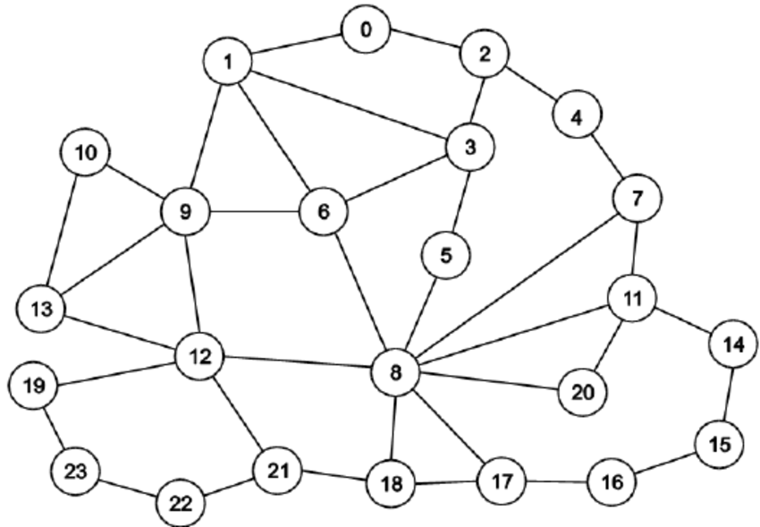
GEANT2
Source: https://knowledgedefinednetworking.org/

