Slide 1








TwoTriangle
$$1$$
$$5$$
$$C_{3,4}$$
$$3$$
$$4$$
$$C_{4,3}$$
$$2$$
$$6$$
Source: Georgiadis et al 2006. pg 9

Slide 2
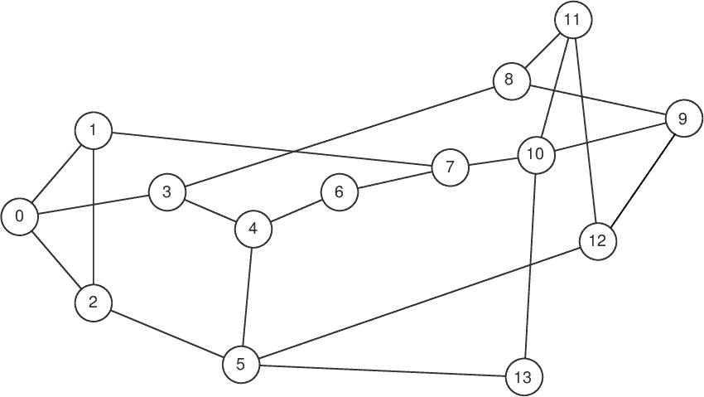
NSFNET
Source: https://knowledgedefinednetworking.org/

Slide 3
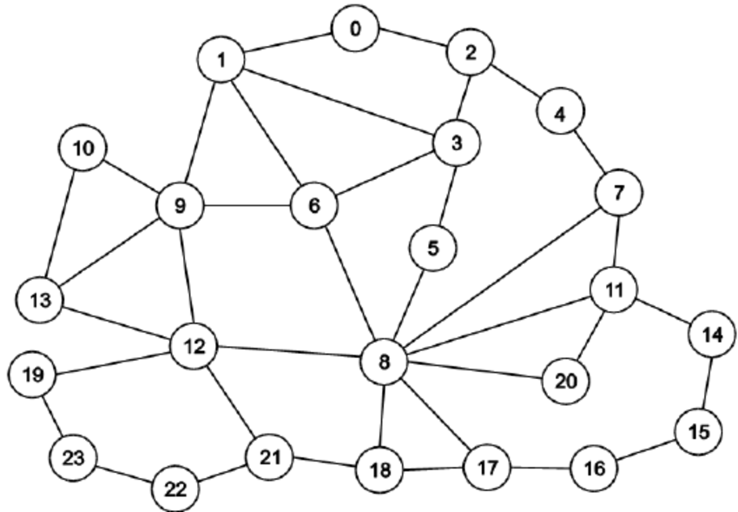
GEANT2
Source: https://knowledgedefinednetworking.org/

