Slide 2
Base Settings
Loss Function:

Slide 3
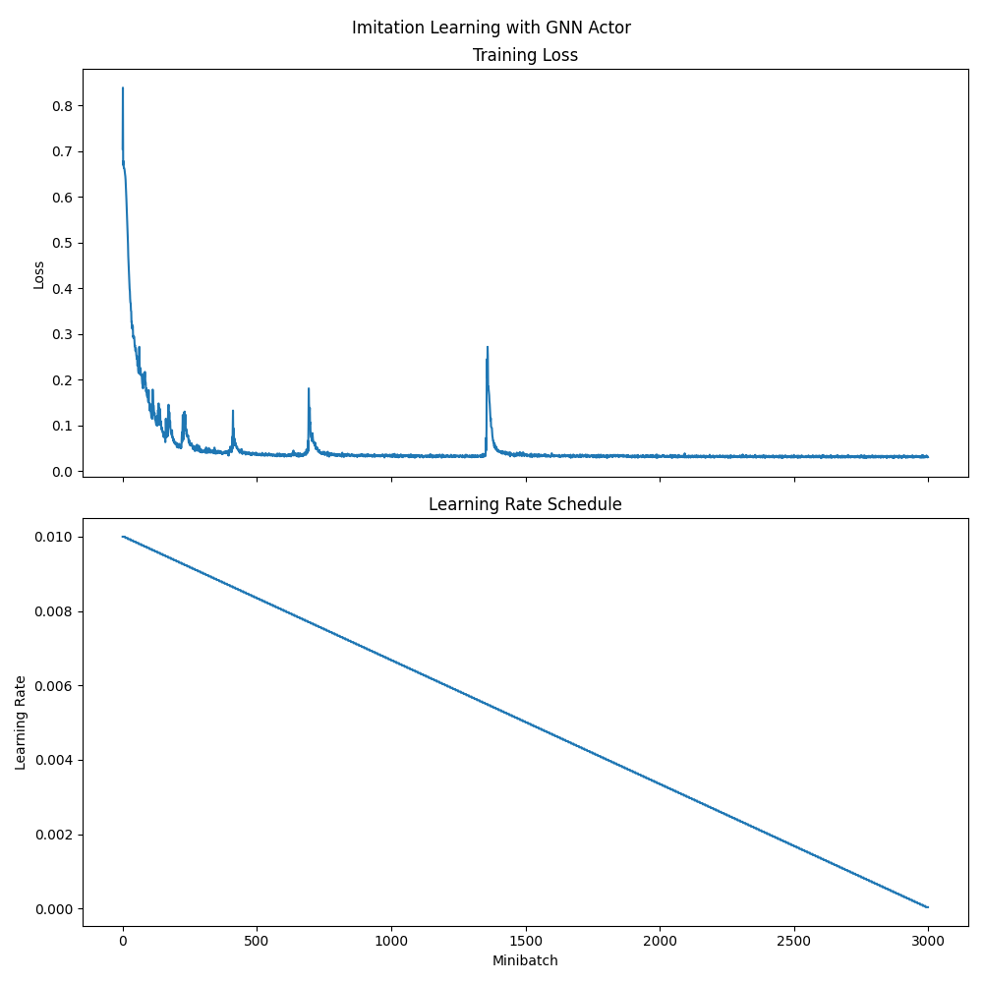
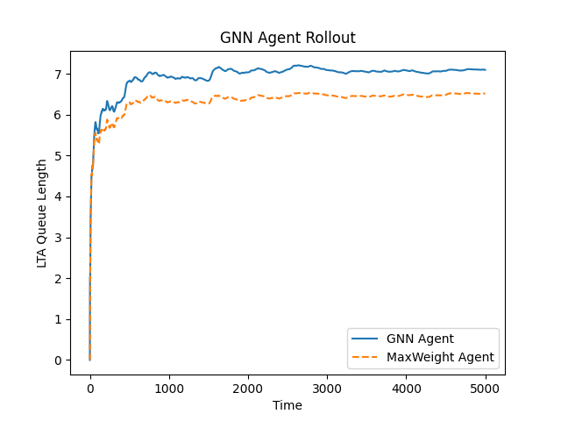
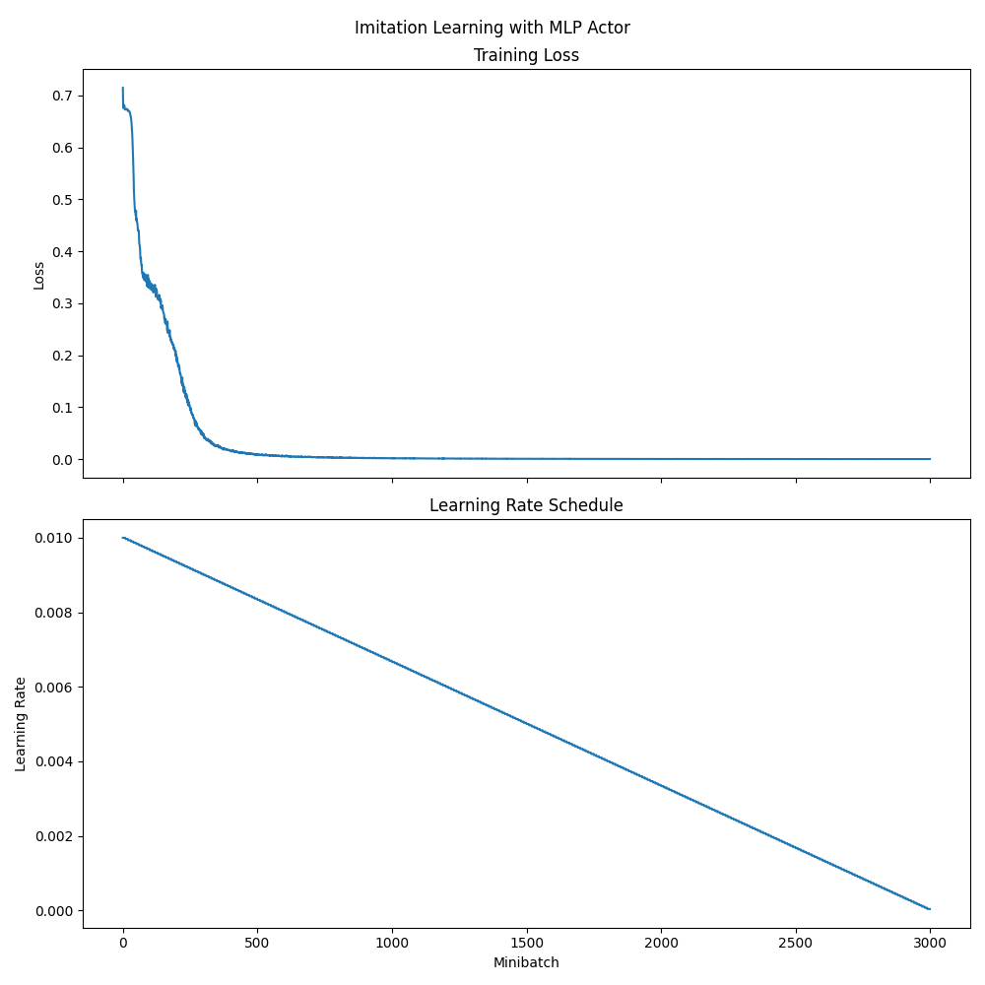
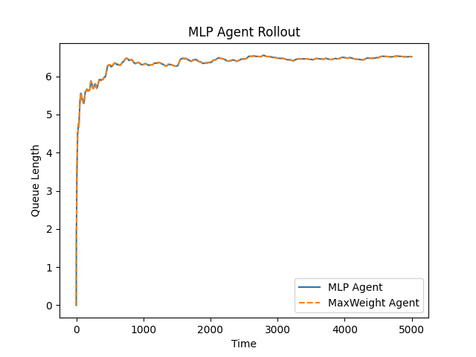
6 Node line graph
policy_module = Policy_Module2(node_features, 64, num_layers = 3, dropout=0.1)
mlp_agent = create_mlp_actor_critic(
input_shape=mlp_env.observation_spec["observation"].shape,
output_shape = mlp_env.action_spec.shape,
in_keys=["observation"],
action_spec=env.action_spec,
actor_depth=3,
actor_cells=64,
)

Slide 4
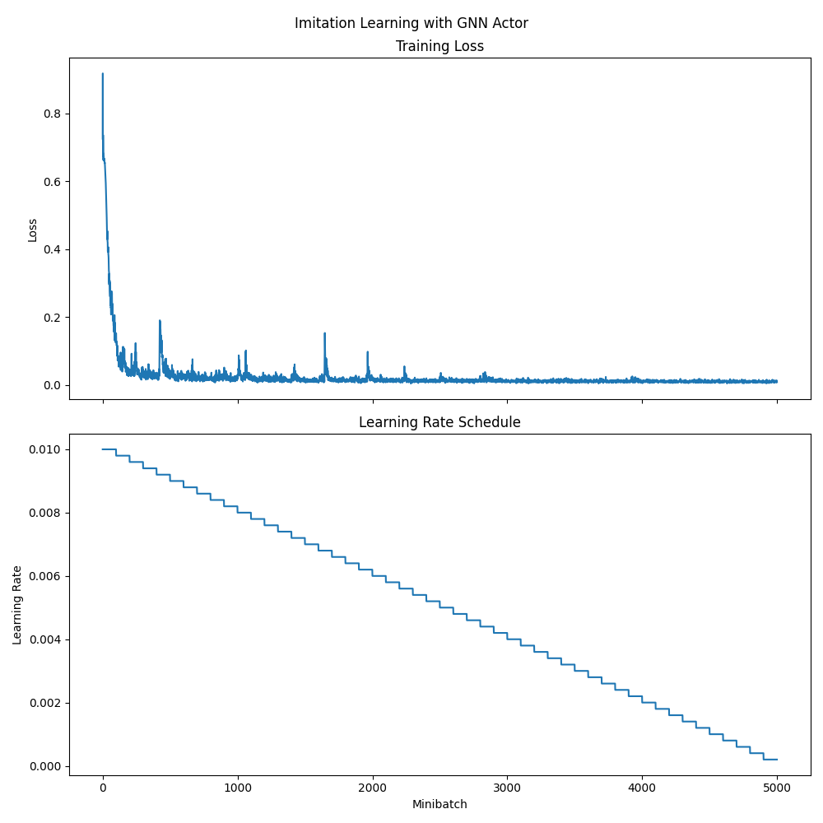
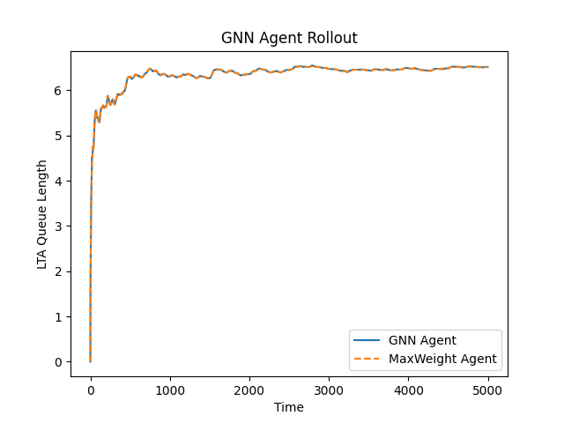
6 Node line graph
policy_module = Policy_Module2(node_features, 64, num_layers = 4, dropout=0.1)
mlp_agent = create_mlp_actor_critic(
input_shape=mlp_env.observation_spec["observation"].shape,
output_shape = mlp_env.action_spec.shape,
in_keys=["observation"],
action_spec=env.action_spec,
actor_depth=3,
actor_cells=64,
)

Slide 5
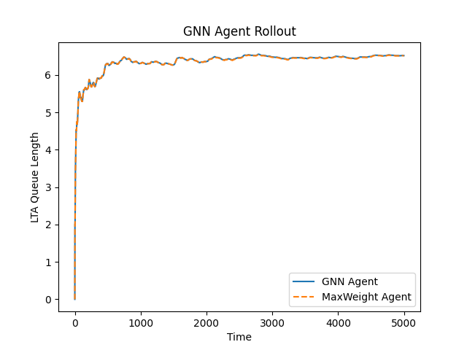
6 Node line graph
policy_module = Policy_Module2(node_features, 32, num_layers = 4, dropout=0.1)
mlp_agent = create_mlp_actor_critic(
input_shape=mlp_env.observation_spec["observation"].shape,
output_shape = mlp_env.action_spec.shape,
in_keys=["observation"],
action_spec=env.action_spec,
actor_depth=3,
actor_cells=64,
)
Notes:
Significance: We can reduce the GNN hidden sizes to half

Slide 6
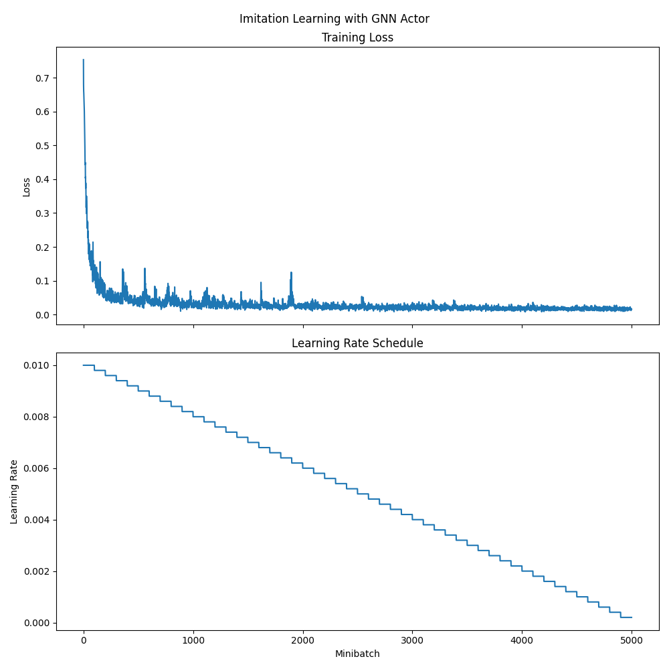
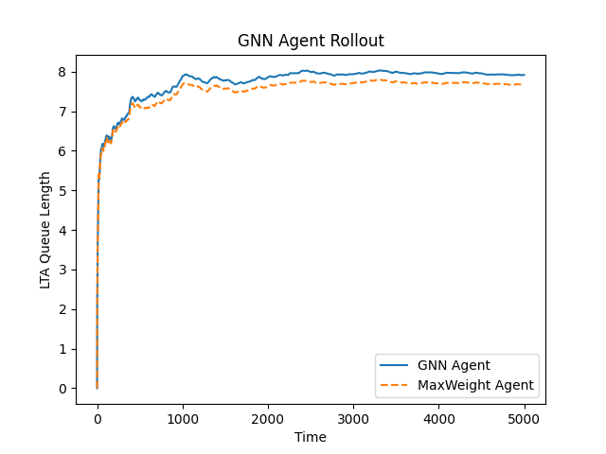
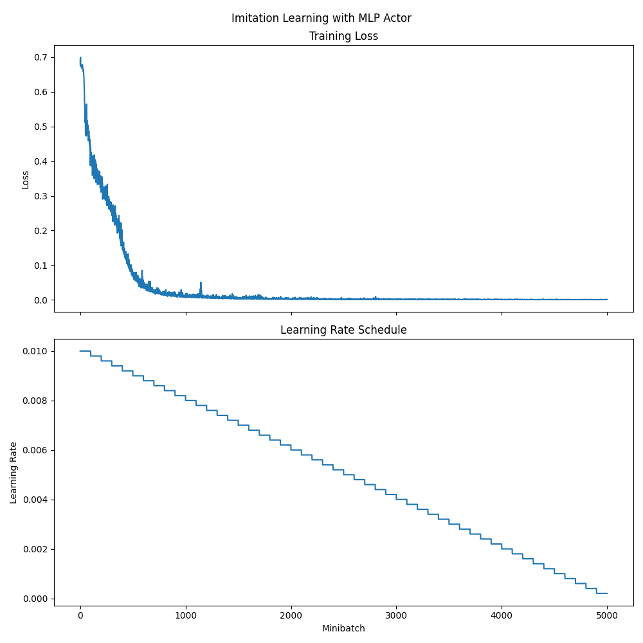
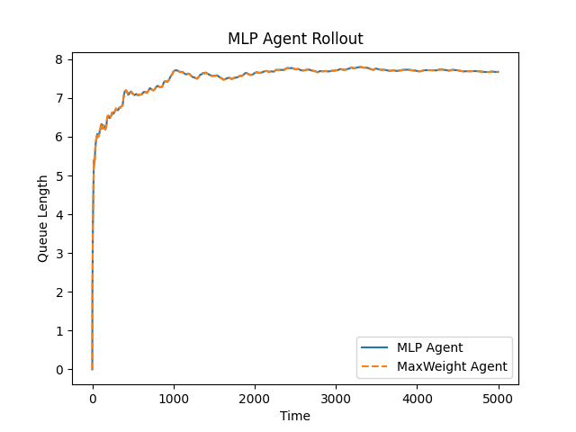
7 Node line graph
policy_module = Policy_Module2(node_features, 32, num_layers = 4, dropout=0.1)
mlp_agent = create_mlp_actor_critic(
input_shape=mlp_env.observation_spec["observation"].shape,
output_shape = mlp_env.action_spec.shape,
in_keys=["observation"],
action_spec=env.action_spec,
actor_depth=3,
actor_cells=64,
)
Notes:
Significance: We can reduce the GNN hidden sizes to half

Slide 7
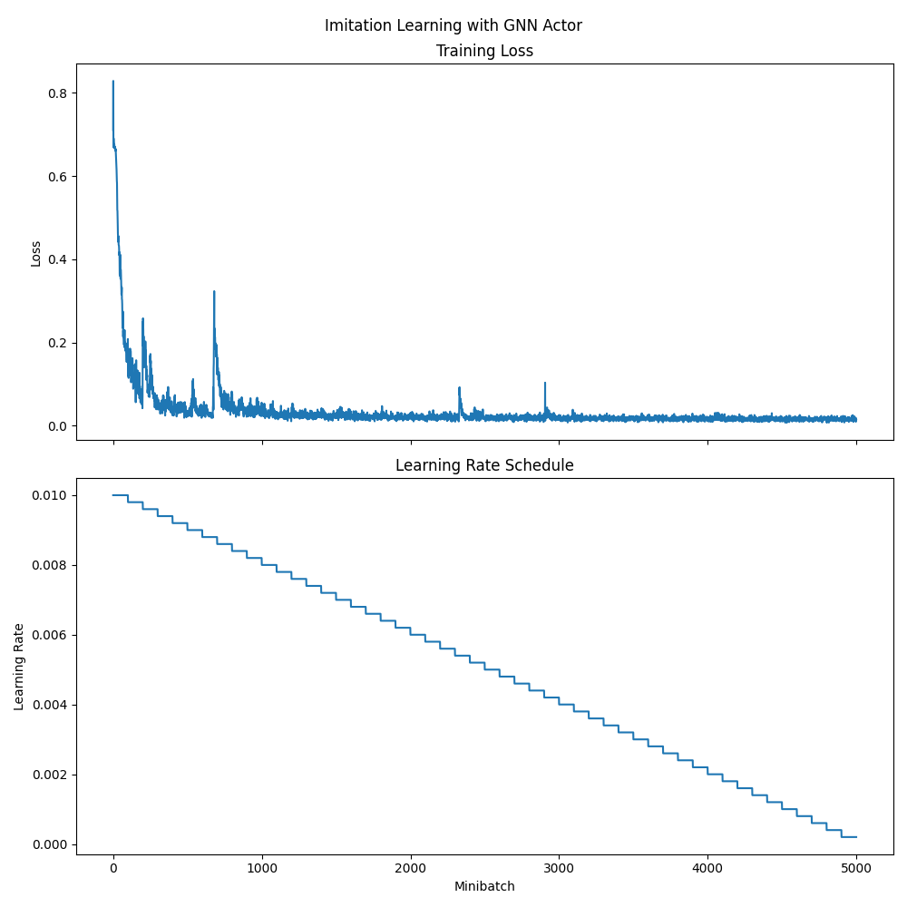

7 Node line graph
policy_module = Policy_Module2(node_features, 64, num_layers = 4, dropout=0.1)
mlp_agent = create_mlp_actor_critic(
input_shape=mlp_env.observation_spec["observation"].shape,
output_shape = mlp_env.action_spec.shape,
in_keys=["observation"],
action_spec=env.action_spec,
actor_depth=3,
actor_cells=64,
)
Notes:
Significance: Hidden width does not help

Slide 8
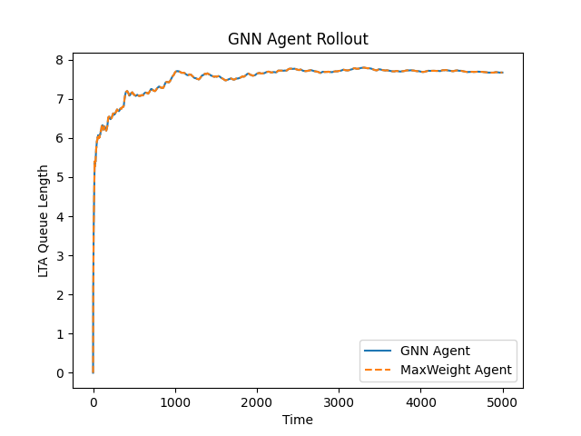
7 Node line graph
policy_module = Policy_Module2(node_features, 64, num_layers = 5, dropout=0.1)
mlp_agent = create_mlp_actor_critic(
input_shape=mlp_env.observation_spec["observation"].shape,
output_shape = mlp_env.action_spec.shape,
in_keys=["observation"],
action_spec=env.action_spec,
actor_depth=3,
actor_cells=64,
)
Notes:
Significance: GNN length triumphs once again

Slide 9
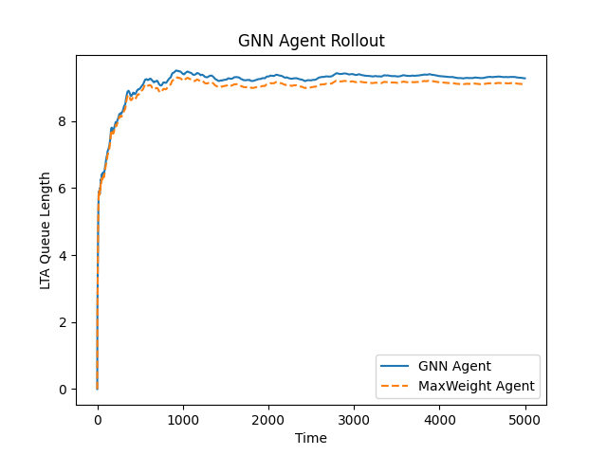
8 Node line graph
policy_module = Policy_Module2(node_features, 64, num_layers = 5, dropout=0.1)
mlp_agent = create_mlp_actor_critic(
input_shape=mlp_env.observation_spec["observation"].shape,
output_shape = mlp_env.action_spec.shape,
in_keys=["observation"],
action_spec=env.action_spec,
actor_depth=3,
actor_cells=64,
)
Notes:
Significance: GNN length triumphs once again

