Slide 1

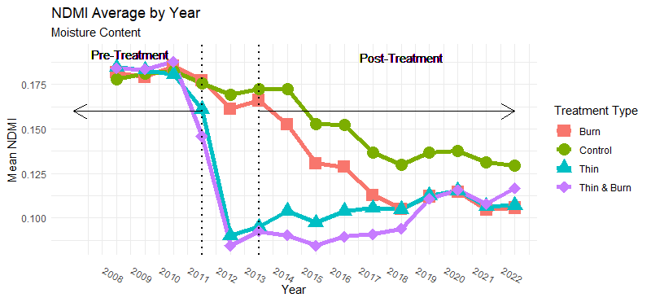
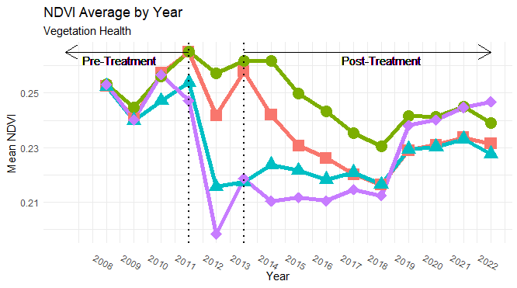
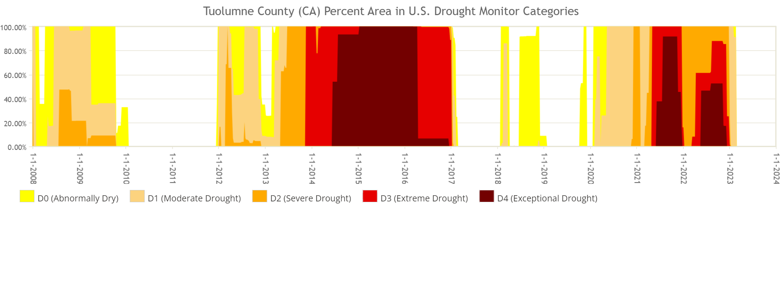
Thinning Increases Forest Resiliency to Extreme Drought in Stanislaus National Forest
Adaptive Management Effects on Drought Resilience in the Sierra Nevada, California, USA
Johnny Wilkens and Helen Poulos
AMMO BAR
Delete this and replace it with your…
Extra Graphs
Extra Correlation tables
Extra Figures
Extra nuance that you’re worried about leaving out.
Keep it messy! This section is just for you.
BACKGROUND:
Forests around the world are facing severe mortality threats from climate change and historical fire exclusion
Prescribed fire, forest thinning and their combination are tools that forest managers are employing across the West to increase forest resilience to drought and wildfire
LANDSAT satellite imagery offers a way to measure temporal changes in forest water balance in response to forest restoration activities from space
METHODS
Calculated the Normalized Difference Vegetation Index and Normalized Difference Moisture Indices in Google Earth Engine from LANDSAT imagery from 2008-2022 for treated versus untreated mixed conifer forests in the Stanislaus NF in the Sierra Nevada, CA.
Used zonal statistics within each treated polygon in the study over the time-series to quantify mean NDVI and NDMI in treated versus untreated areas.
Tested for differences among treatments over time using Mann Kendall Test trend analysis
Results
NDMI and NDVI may be more sensitive to vegetation cover than moisture content or health
RESULTS
Notes:
Notes:
In Powerpoint, click View > Guides
Keep text within gutter guides.
Author list: Don’t split names onto two lines (e.g., “Jimmy [break] Smith”). If that happens, use a new line, unless you need the space. Bold the first names of anybody who’s presenting in person.
Intro/methods/result: Do not drop below font size 28, but if you have extra space, jack up the font size until the space is full.
Do not use color in the sidebars except in graphs/figures. It’ll pull attention from the center and slow interpretation for passersby.

