Slide 1
MMAE 555 Final Presentation
Jonah Wilkes

Slide 2
The Problems
GNSS data set with two closely spaced antennas
Antenna 1: reference receiver
Antenna 2: user receiver
Data:
RINEX
RinexObsSample-1.txt
RinexObsSample-2.txt
Broadcast Navigation Files:
SEPT1250.25N (GPS, L1/L2)
SEPT1250.25L (Galileo, E1/E5)
Goal: Implement five positioning methods of increasing complexity
Problems 1–3: differential baseline estimation of Antenna 2 relative to Antenna 1
Problems 4–5: absolute stand-alone position of Antenna 2

Slide 3
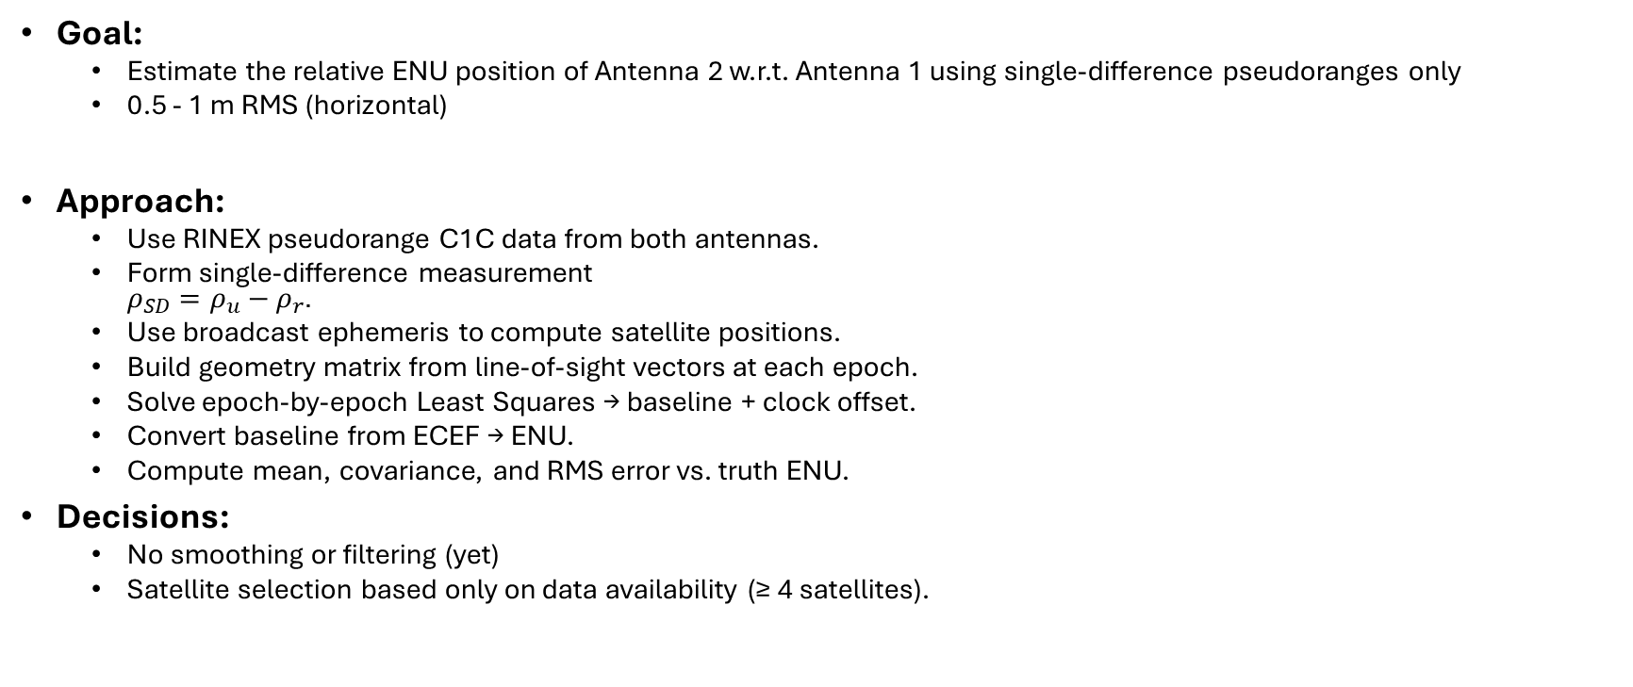
Problem 1: Overview
Goal:
Estimate the relative ENU position of Antenna 2 w.r.t. Antenna 1 using single-difference pseudoranges only
0.5 - 1 m RMS (horizontal)
Approach:
Use RINEX pseudorange C1C data from both antennas.
Form single-difference measurement $ρ_{SD}=ρ_{u}−ρ_{r}$.
Use broadcast ephemeris to compute satellite positions.
Build geometry matrix from line-of-sight vectors at each epoch.
Solve epoch-by-epoch Least Squares → baseline + clock offset.
Convert baseline from ECEF → ENU.
Compute mean, covariance, and RMS error vs. truth ENU.
Decisions:
No smoothing or filtering (yet)
Satellite selection based only on data availability (≥ 4 satellites).

Slide 4
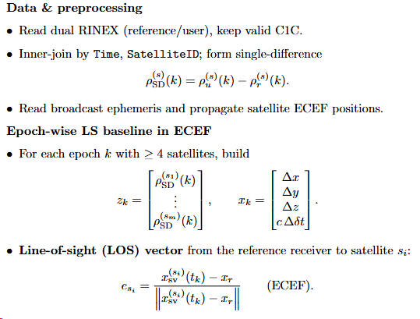
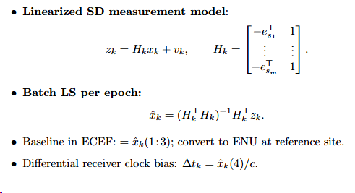
Problem 1: Method

Slide 5
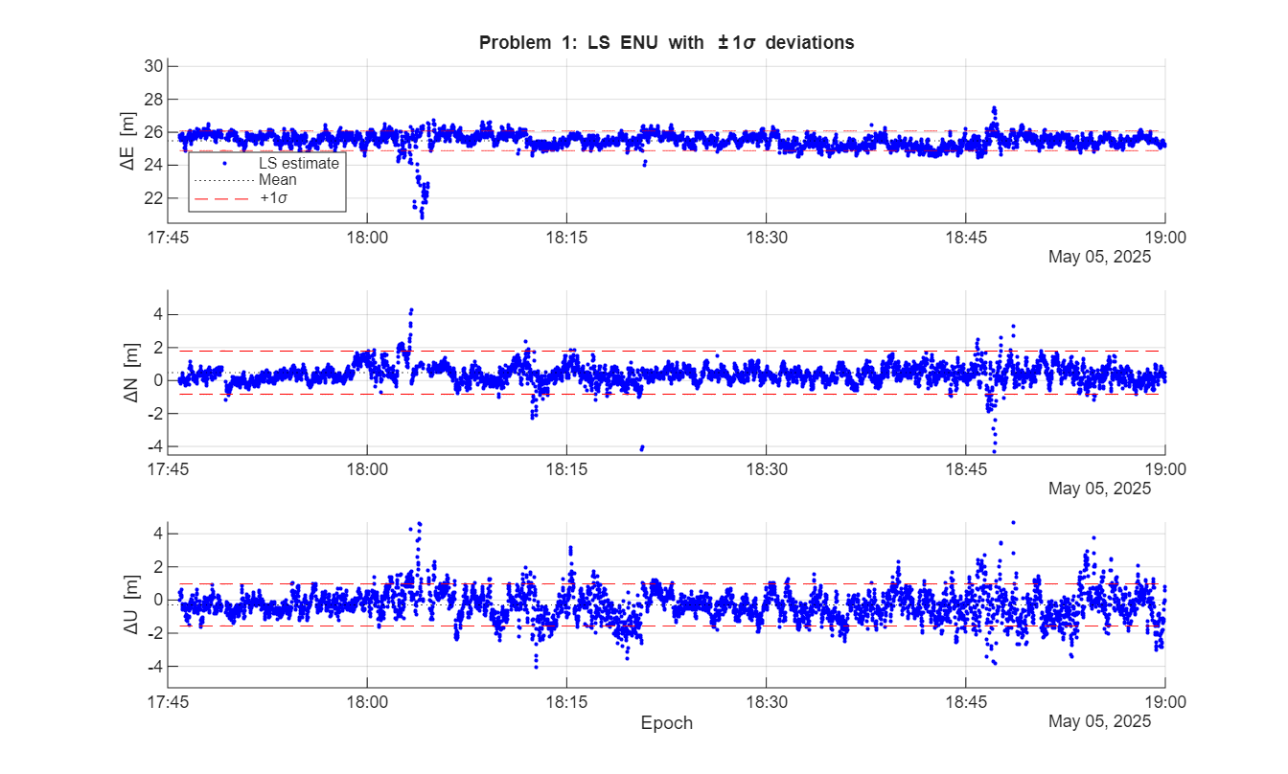
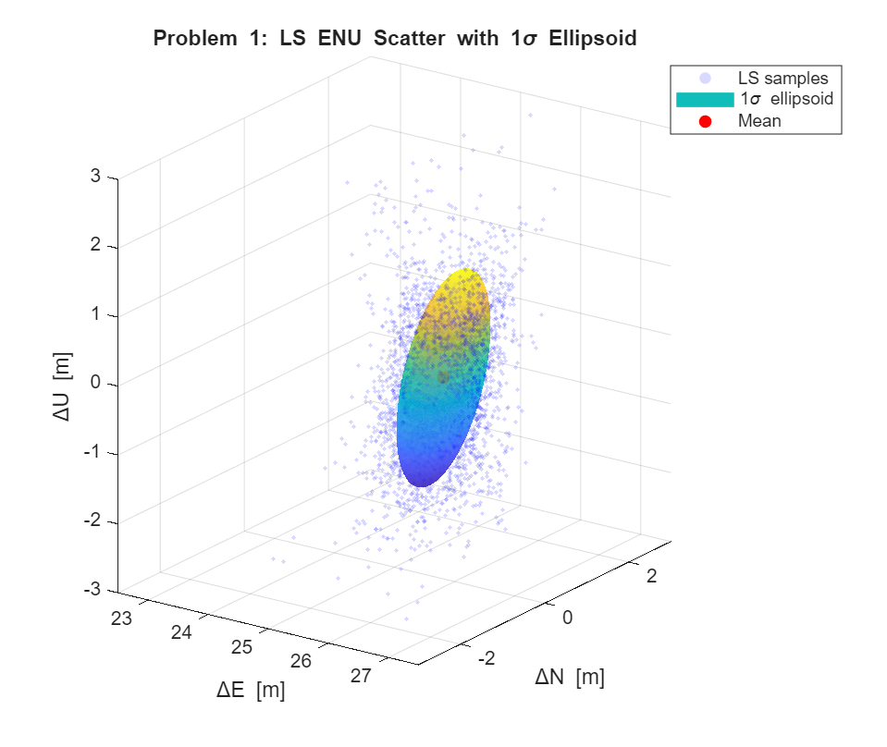
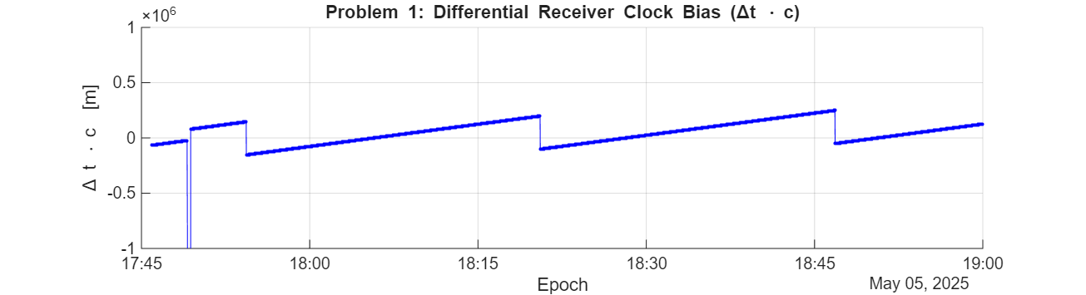
Problem 1: Results, estimated error
Final Estimated Position:
ENU [25.183, -0.024, -0.808] m
1σ: [0.588, 1.311, 1.263] m
Note – 1σ values here are based on the distribution of the LS values, not KF covariances
Notes:
The covariance / 1 sigma is estimated from the cloud of position states, not the covariance (P), so it’s based off the mean

Slide 6
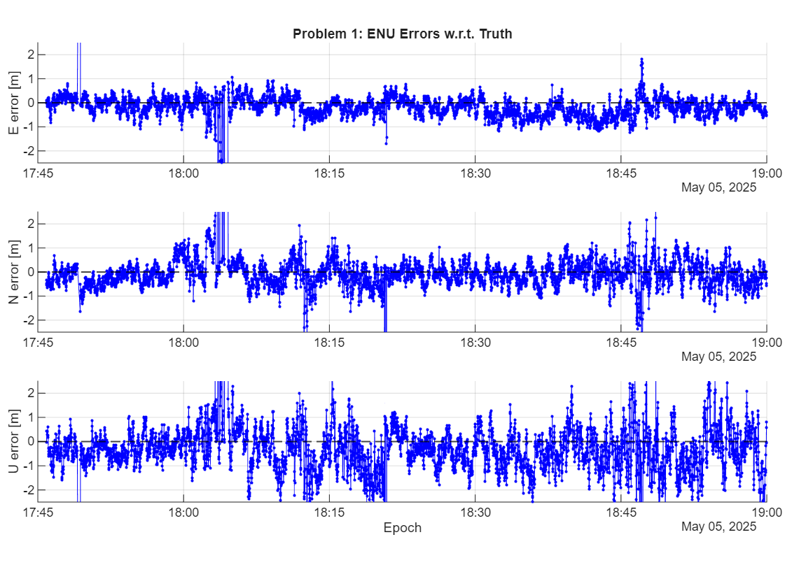
Problem 1: Results, actual error
Final Estimated Position:
ENU [25.183, -0.024, -0.808] m
Actual: [25.679 0.455 -0.002] m
RMS Error from actual position at final
epoch:
Horizontal = 0.689 m, Vertical = 0.810 m

Slide 7
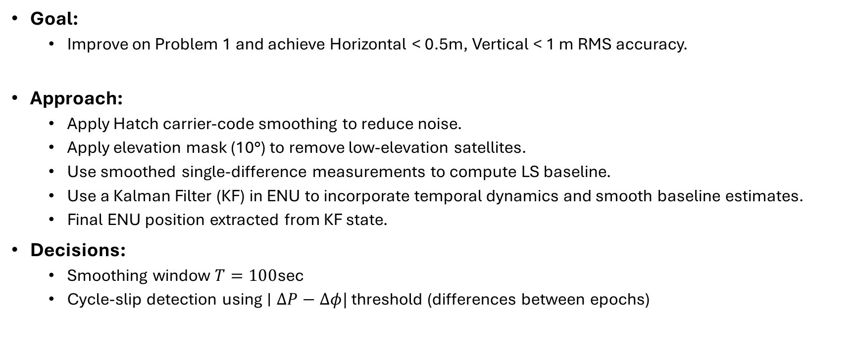
Problem 2: Overview
Goal:
Improve on Problem 1 and achieve Horizontal < 0.5m, Vertical < 1 m RMS accuracy.
Approach:
Apply Hatch carrier-code smoothing to reduce noise.
Apply elevation mask (10°) to remove low-elevation satellites.
Use smoothed single-difference measurements to compute LS baseline.
Use a Kalman Filter (KF) in ENU to incorporate temporal dynamics and smooth baseline estimates.
Final ENU position extracted from KF state.
Decisions:
Smoothing window $T=100$sec
Cycle-slip detection using $∣ΔP−Δφ|$ threshold (differences between epochs)

Slide 8
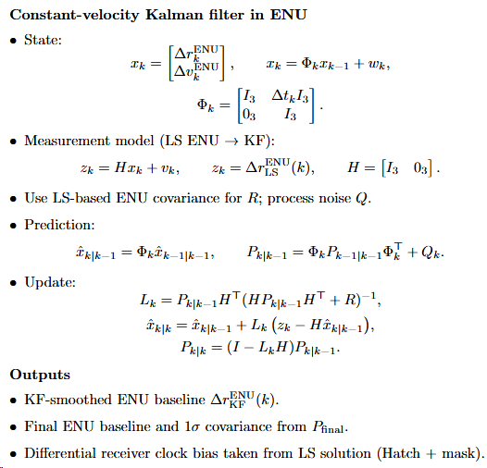
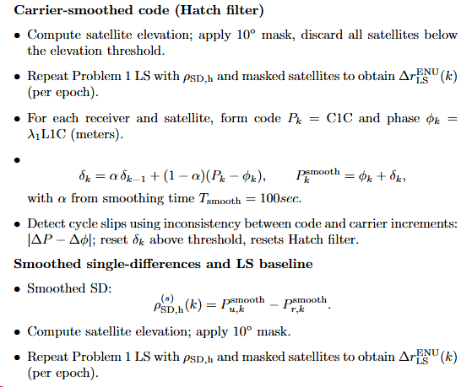
Problem 2: Method

Slide 9
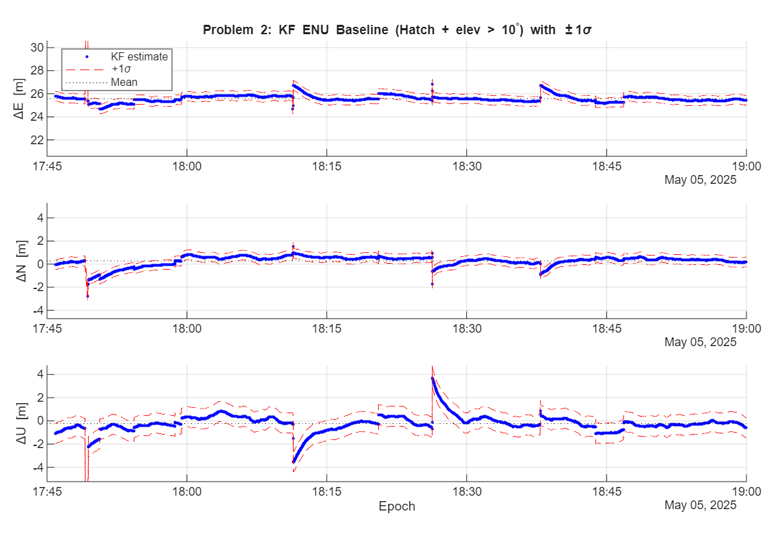
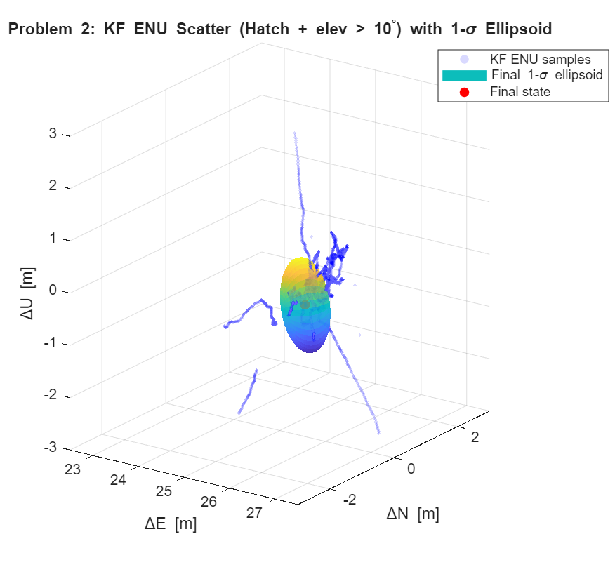
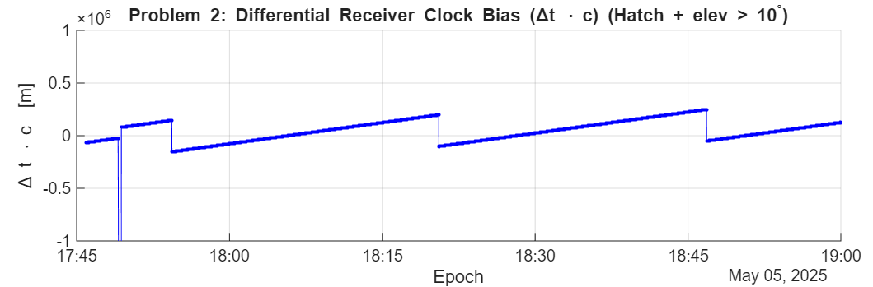
Problem 2: Results, estimated error
Final Estimated Position:
ENU [25.428, 0.187, -0.556] m
1σ: [0.415, 0.417, 0.871] m

Slide 10
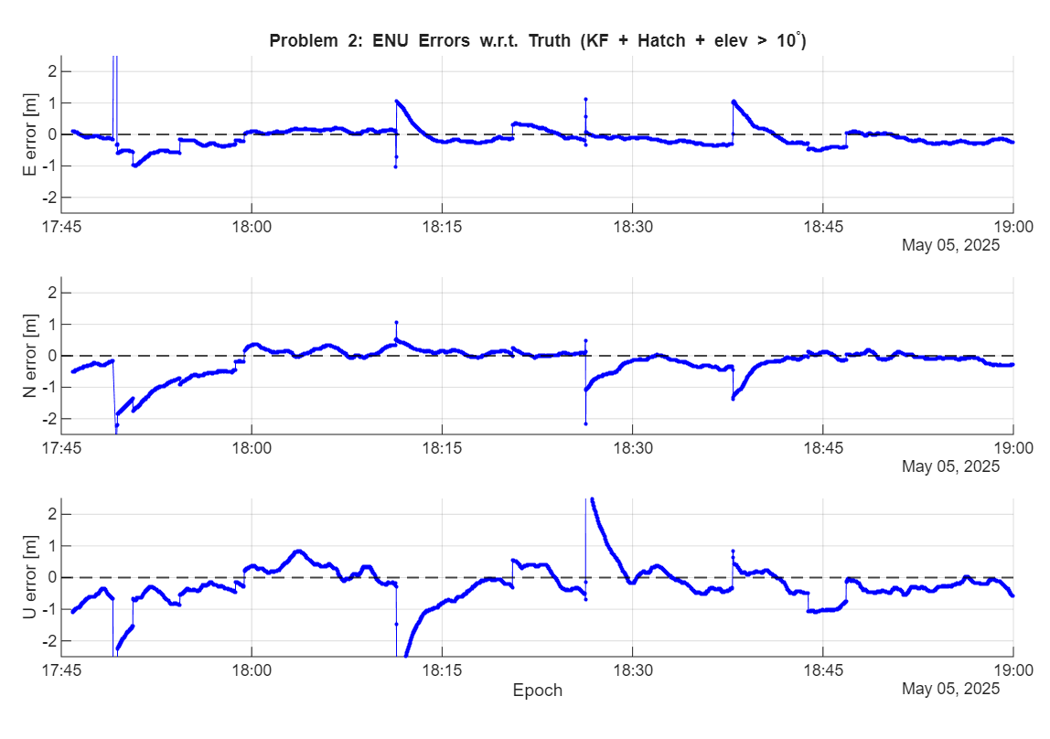
Problem 2: Results, actual error
Final Estimated Position:
ENU [25.428, 0.187, -0.556] m
Actual: [25.679 0.455 -0.002] m
RMS Error from actual position at final
epoch:
Horizontal = 0.367 m, Vertical = 0.564 m

Slide 11
Problem 3: Overview
Goal:
Achieve high-accuracy differential positioning, using all tools: double-differencing, code + carrier, dynamic filtering, and ambiguity fixing.
Horizontal < 0.1 m, Vertical <0.2 m RMS
Approach:
Build double-difference (DD) code and DD phase observations.
Use a CV Kalman Filter in ECEF to jointly estimate baseline, velocity, and DD ambiguities.
Use LAMBDA integer ambiguity resolution for final fixed baseline.
Convert final ECEF baseline → ENU; compute 1σ precision and RMS errors.

Slide 12
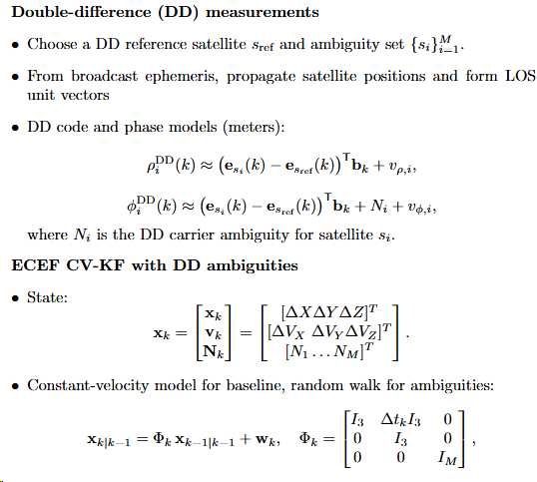
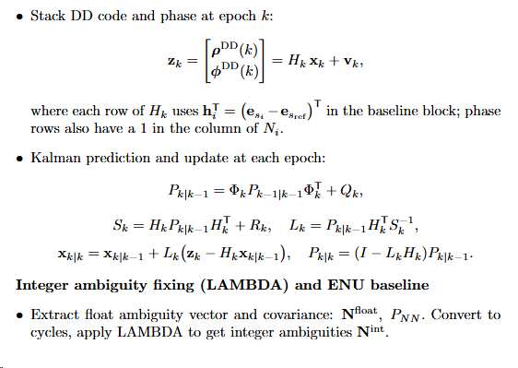
Problem 3: Method

Slide 13
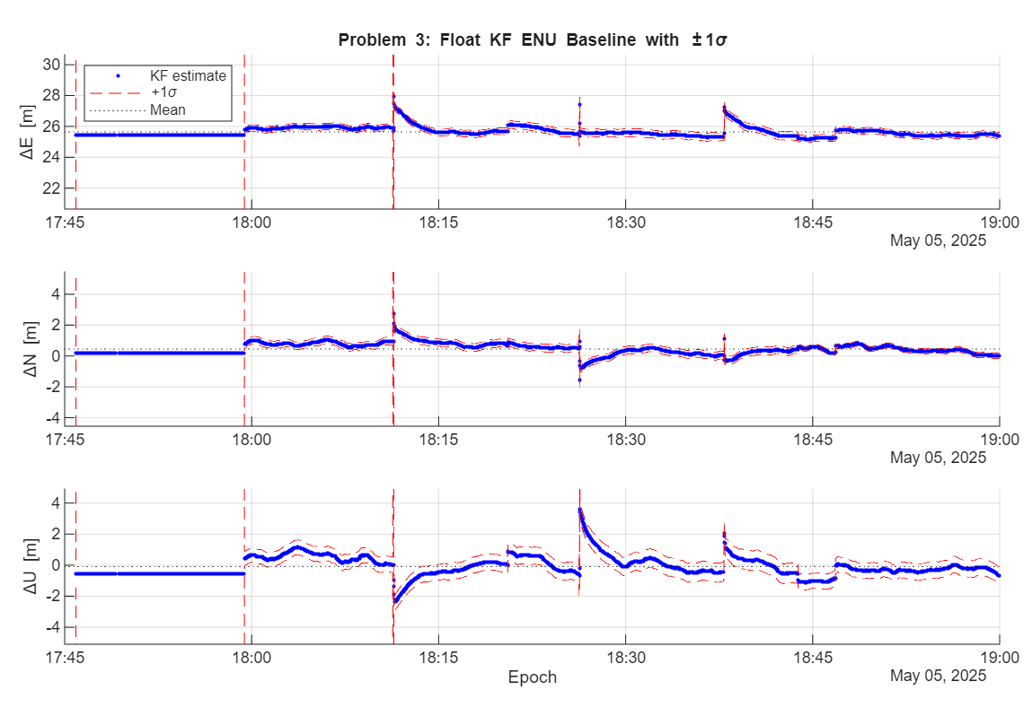
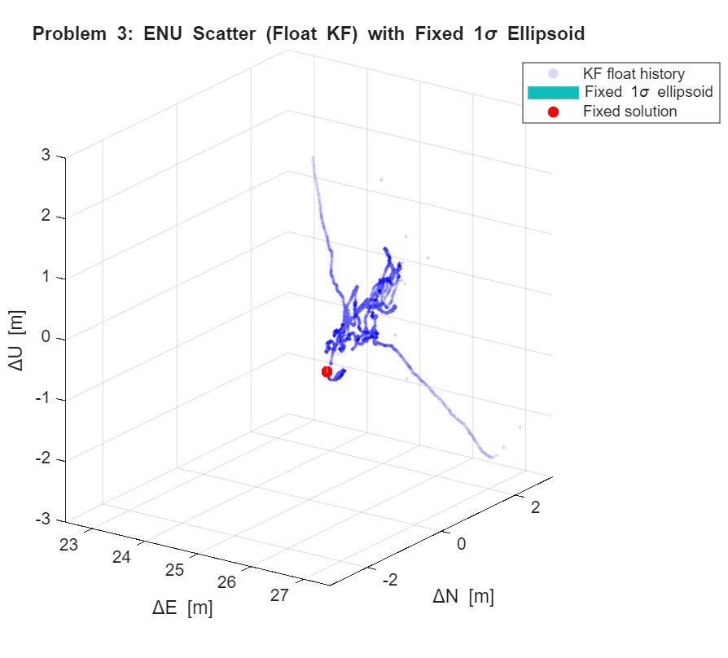
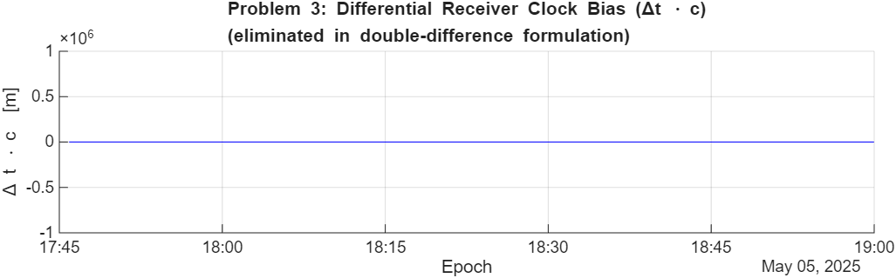
Problem 3: Results, estimated error
Final Estimated Position:
ENU [25.284, 0.075, -0.855] m
1σ: [0.027, 0.021, 0.069] m

Slide 14
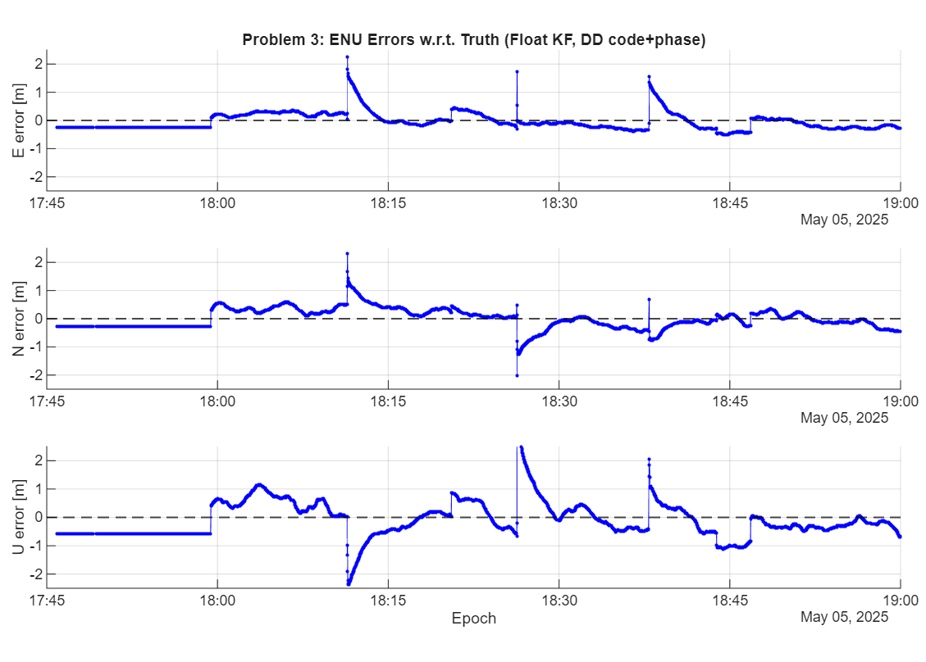
Problem 3: Results, actual error
Final Estimated Position:
ENU [25.284, 0.075, -0.855] m
Actual: [25.679 0.455 -0.002] m
RMS Error from actual position at final
epoch:
Horizontal = 0.470 m, Vertical = 0.648 m

Slide 15
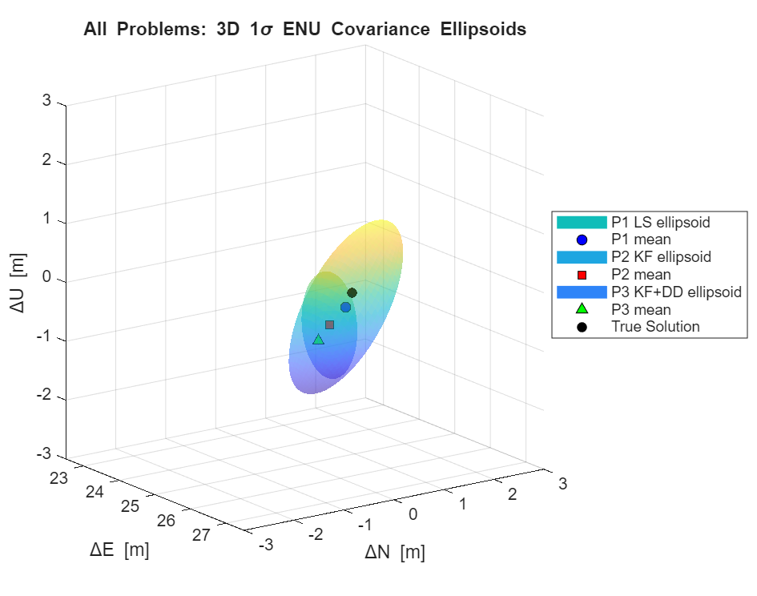
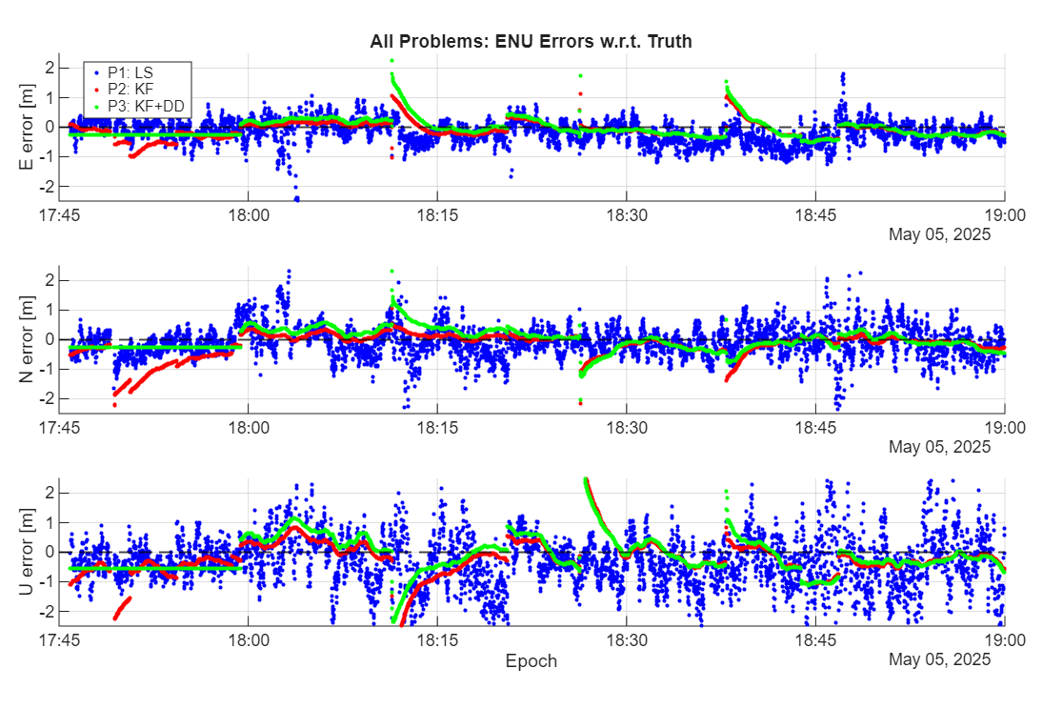
Problems 1-3
RMS Errors:
P1) Horizontal = 0.689 m, Vertical = 0.810 m
P2) Horizontal = 0.367 m, Vertical = 0.564 m
P3) Horizontal = 0.470 m, Vertical = 0.648 m
Notes:
Problem 3, despite using LAMBDA and improving perceived confidence (1 sigma), had worse errors. Overall, each iteration got further from the truth

Slide 16
Problem 4: Stand-alone Single Point Positioning
Goal: Absolute Position of Antenna 2
Compute latitude, longitude, height using GPS only
No reference antenna
Use broadcast ephemeris
Meet approx. ≤ 5 m horizontal, ≤ 10 m vertical accuracy
Approach
GPS pseudorange = geometric range + receiver clock error − satellite clock error + noise.
Satellite clock correction and transmit-time update from the broadcast ephemeris.
Linearize the model around a current estimate → build geometry matrix H from line-of-sight vectors.
Use iterative least squares to solve for position + clock bias each epoch.
Repeat for all epochs → average final ECEF position to get the final LLH solution.
Decisions/notes:
I treat the system as dynamic by assuming noise correlation between epochs (seconds)
Therefore, I negate this correlation by evaluating single point epochs every minute, instead of second
The final position is a Mean of the estimated positions, not a Kalman filter converged value

Slide 17
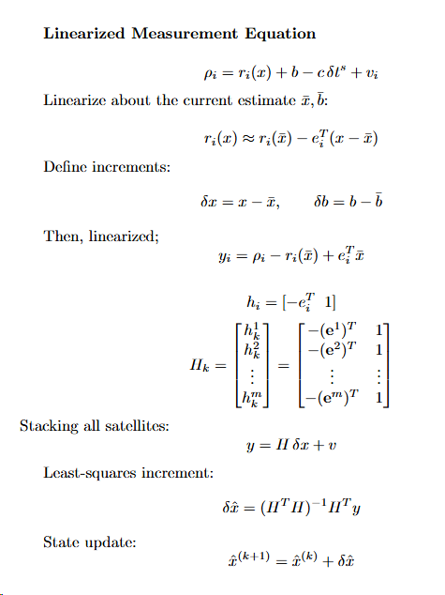
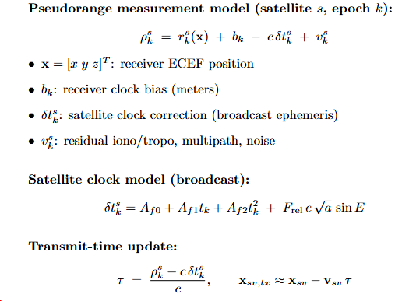
Problem 4: Method
Notes:
For satellite clock model and transmit time update, they were in lecture 13 and 14 (mainly 14)

Slide 18
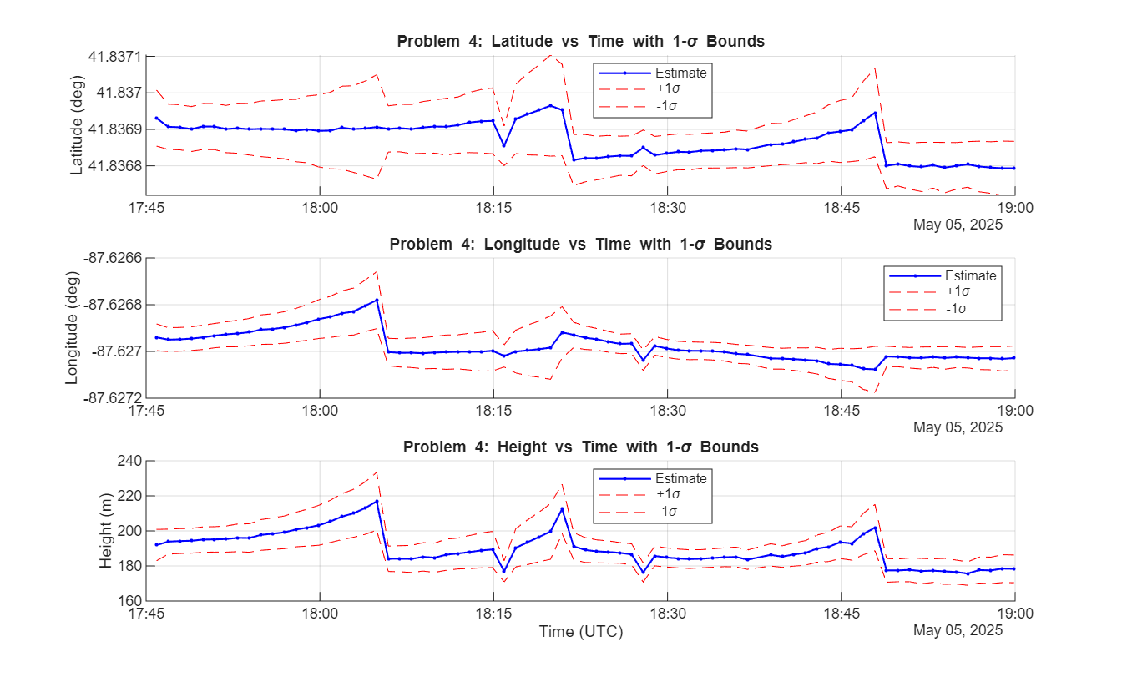
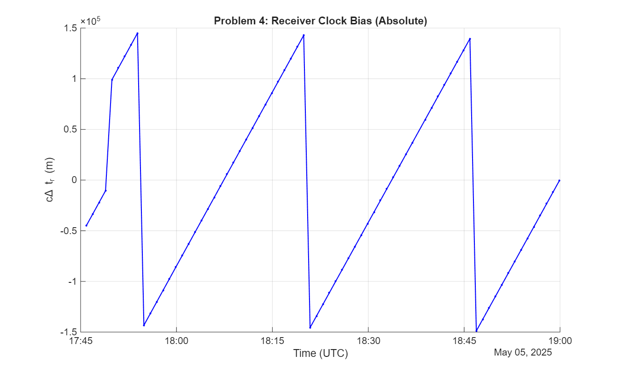
Problem 4: Results, estimated precision
Final Position Estimate (LS Mean): Estimated Precision (1σ) LLH (1σ) ECEF
lat = 41.836872682 deg σ_lat = 5.535273e-06 deg σ_x = 0.640 m lon = -87.626977509 deg σ_lon = 7.461291e-06 deg σ_y = 0.596 m h = 189.817 m σ_h = 1.120 m σ_z = 1.119 m
t

Slide 19
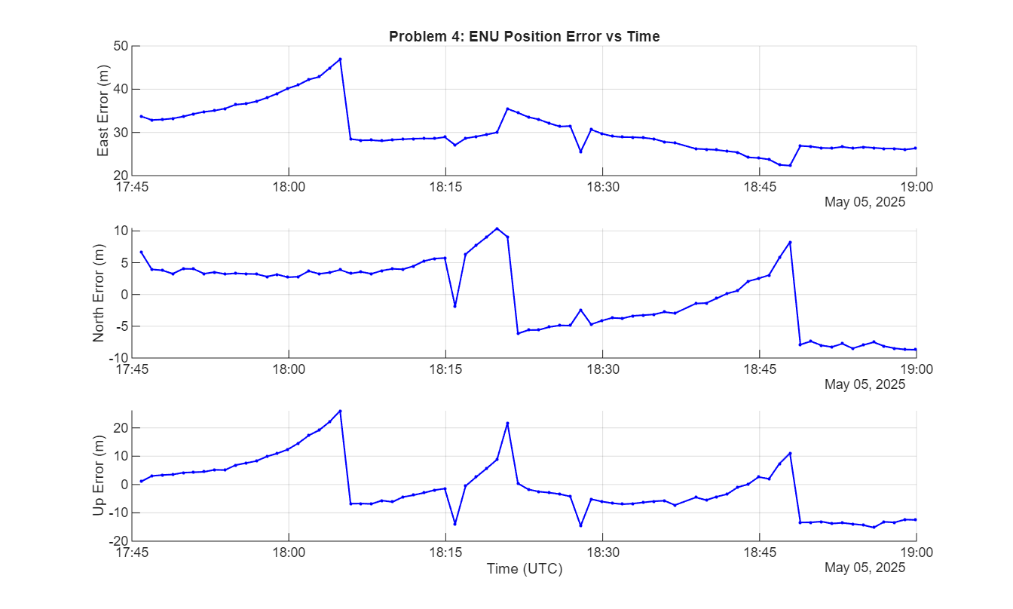
Problem 4: Results, actual error
Mean Position Estimate:
lat = 41.836872682 deg lon = -87.626977509 deg h = 189.817 m
Mean Position RMS (ENU)
ΔE = 30.543 m
ΔN = 0.136 m
ΔU = -1.024 m
H=30.543, V=1.024

Slide 20
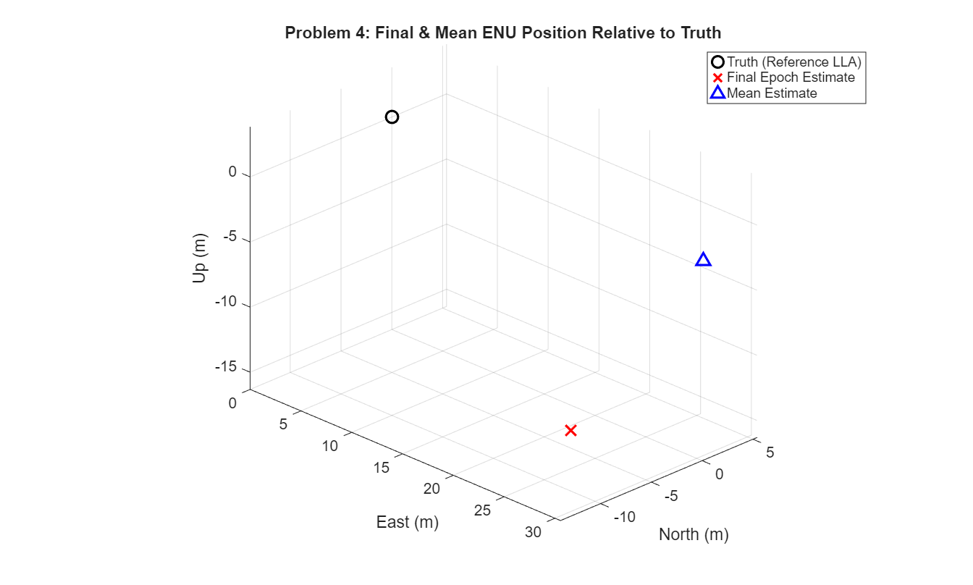
Problem 4: Results (Final Epoch Estimate)
Final Position Estimate (Final Pos): Estimated Precision (1σ) LLH (1σ) ECEF
lat = 41.836793193 deg σ_lat = 7.391743e-05 deg σ_x = 4.306 m lon = -87.627028509deg σ_lon = 5.189732e-05 deg σ_y = 6.543 m h = 178.341 m σ_h = 7.907 m σ_z = 9.336 m
Final Position RMS (ENU)
ΔE = 26.306 m
ΔN = -8.693 m
ΔU = -12.500 m
H=27.705 m, V=12.500 m

Slide 21
Problem 5: Overview
Goal: Improve on Problem 4
Initial Attempt:
Apply a Kalman filter to converge results
In practice, produced worse ENU errors
Then:
Used both code and carrier (L1C and C1C)
Applied a hatch filter (like problems 2 and 3)
Applied signal based weighting using C1C_SSI, building a SNR-weighted Least Squares solution
Results were still sub-optimal

Slide 22
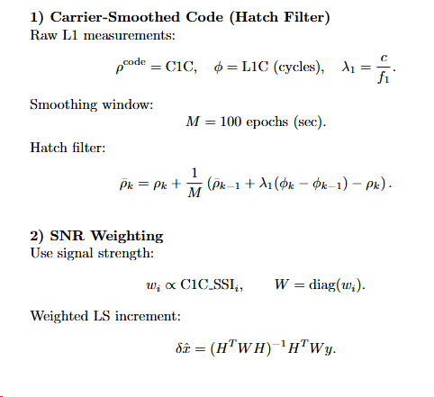
Problem 5: Method

Slide 23
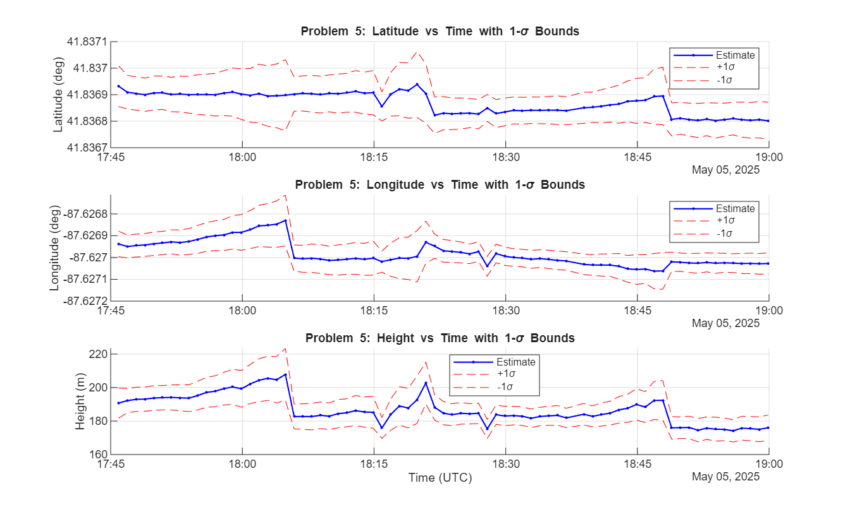

Problem 5: Results, estimated precision
Final Position Estimate: Estimated Precision (1σ) LLH (1σ) ECEF
lat = 41.836868921 deg σ_lat = 4.710204e-06 deg σ_x = 0.566 m lon = -87.626983093 deg σ_lon = 6.590610e-06 deg σ_y = 0.526 m h = 186.951 m σ_h = 0.992 m σ_z = 0.980 m

Slide 24
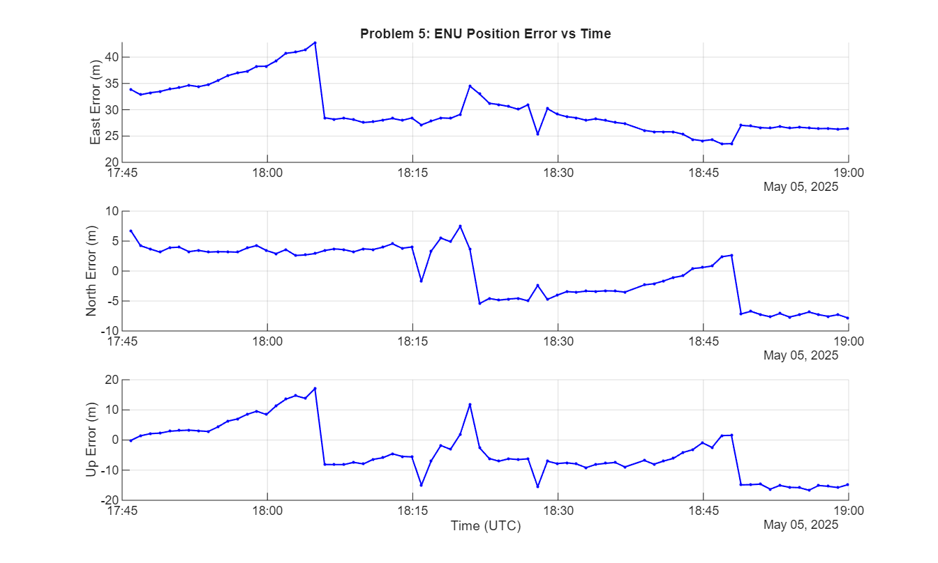
Problem 5: Results, actual error
Final Position Estimate:
lat = 41.836868921 deg lon = -87.626983093 deg h = 186.951 m
Mean Position RMS (ENU)
ΔE = 30.079 m
ΔN = -0.282 m
ΔU = -3.890 m
H=30.080 m, V=3.890 m

Slide 25
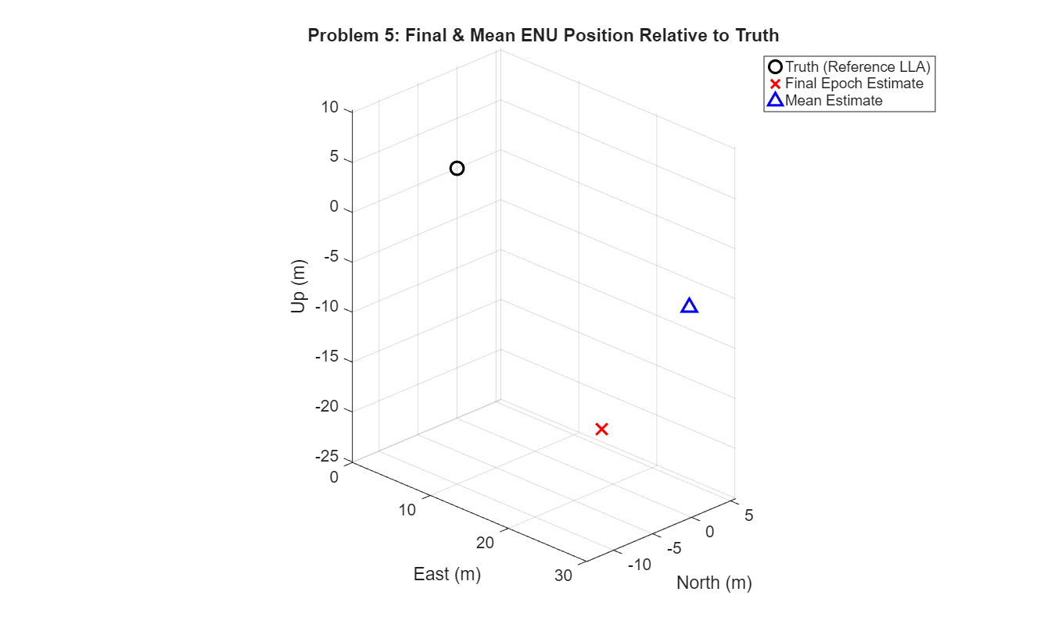
Problem 5: Results (Final Epoch Estimate)
Final Position Estimate (Final Pos): Estimated Precision (1σ) LLH (1σ) ECEF
lat = 41.836801158 deg σ_lat = 7.051474e-05 deg σ_x = 4.022 m lon = -87.627027221 deg σ_lon = 4.848219e-05 deg σ_y = 6.466 m h = 176.013 m σ_h = 7.580 m σ_z = 8.777 m
Final Epoch RMS (ENU)
ΔE = 26.413 m
ΔN = -7.808 m
ΔU = -14.838 m
H=27.543 m, V=14.828 m

Slide 26
Error Summary
Problems 1-3 RMS Errors (final position):
P1) Horizontal = 0.689 m, Vertical = 0.810 m
P2) Horizontal = 0.367 m, Vertical = 0.564 m
P3) Horizontal = 0.470 m, Vertical = 0.648 m
Problems 4-5
RMS Errors (mean position / Final Position)
P4) Horizontal = 30.543 m, Vertical = 1.024m | Horizontal = 27.705 m, Vertical = 12.500 m
P5) Horizontal = 30.080 m, Vertical = 3.890 m | Horizontal =27.543 m, Vertical = 14.828 m
Future work:
Improve error in problems 1-3
Analyze why there is drift at the end
Implement better cycle slip detection
Improve error in problems 4-5
Cycle slips
Improve height error
Kalman Filter

