Slide 1
Ames Housing Data:
Predicting Property Sale Price
Joshua Willey

Slide 2
Problem Statement
As an employee for Zillow, I am tasked with creating a model that will accurately predict sale prices for new properties. I will use the given training data to create the most accurate possible model. The model will then be tested against a test set.

Slide 3
Exploratory Data Analysis
Our training set has information listed for 2,051 previous properties.
Along with the sale price, there are 80 features which will be used to create our model.
Of those 80 features:
38 are quantitative
42 are qualitative
The quantitative and qualitative features were separated for preprocessing

Slide 4
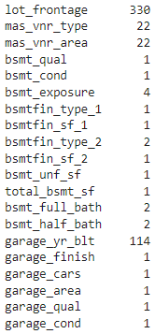
Exploratory Data Analysis
20 total columns have missing data
Several columns, especially lot_frontage and garage_yr_blt, have a significant number of values missing

Slide 5

Dealing with missing values
Missing lot frontage values were replaced with the mean value for the column. This prevents us from having to drop rows, and produces less variance than replacing with 0.
Garage year built showed a high correlation with the year the house was built, so the column was dropped rather than having values imputed.
The other missing numeric values were largely due to measuring features that the house did not have, so they were set to 0

Slide 6
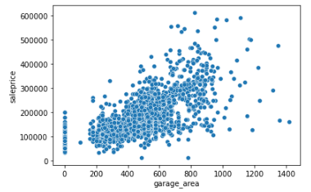
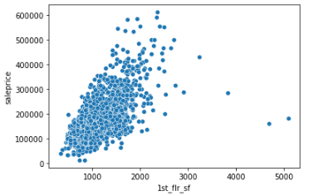
Visual inspection of numerical features
Several features show a high correlation with sale price at first glance, notably those that are area measurements

Slide 7
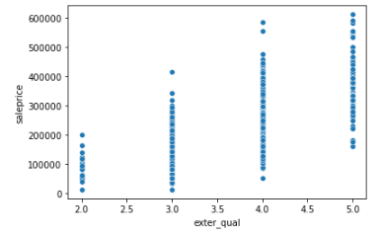
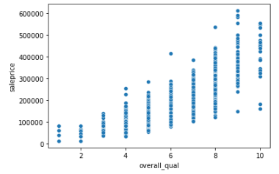
Encoding and visualization of ordinal features
19 of the categorical features are ordinal values based on quality, most on a scale of poor to excellent . These were encoded to a 0-5 value, 0 being non-existent and 5 being excellent.

Slide 8
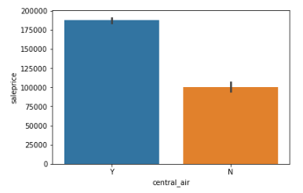
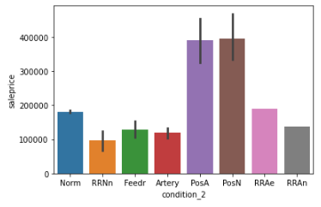
Encoding and visualization of categorical values
The remaining categorical values were converted to dummy columns so that they can be used in the building of our model. Several of these showed significant correlation to sale price

Slide 9
Model creation process
After completing the preprocessing of data, several linear regression models were created with different regularization methods, as well as one using K nearest neighors
Linear Regression
Ridge
Lasso
ElasticNet
KNN

Slide 10
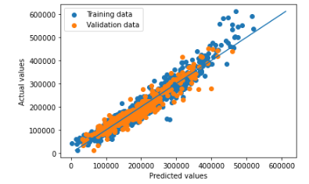

Initial modeling
In the first phase of model creation, the linear regression models did similarly well. The basic Linear Regression model had an R2 score of .90
LR Model

Slide 11
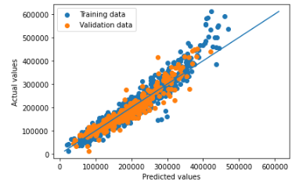

Standard Scaler
After scaling, the Ridge, Lasso, and ElasticNet models showed some marginal improvement
Scaled ElasticNet model
Scaled ElasticNet Scores

Slide 12
RFE and Polynomial Features
Recursive Feature Elimination was performed to remove insignificant data. However, all of the models scored slightly worse after features were removed.
PolynomialFeatures were added, increasing the total features to 26,334.
Introduced bias
R2 on the train set increased to .99
R2 on the test set dropped to .73
Ideally, RFE could have been used to remove some of these features, but would require more time or computing power

Slide 13
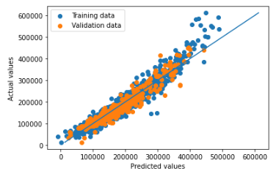

Lasso fine tuning
LassoCV was used to create the best model. The scaled data set was used, but the RFE and polynomial sets were disregarded
LassoCV decided an alpha value of 729.45
R2 on train set is .92
R2 on test set is .91
LassoCV test scores

Slide 14
Conclusions
The LassoCV model is the best of the models we created to predict sale price
In future models, pipelines would allow for faster creation of models
Gridsearch may be able to fine tune the model even further to improve results

