Slide 1
Subreddit Classification:
r/WorldNews vs. r/UpliftingNews
Joshua Willey

Slide 2
Problem Statement
r/WorldNews is a subreddit dedicated to major news stories from around the globe, while r/UpliftingNews aims to share positive stories to counter the cynicism present in a lot of news media.
The purpose of this analysis is to build a model that can accurately determine whether a new post belongs to r/WorldNews or r/UpliftingNews.

Slide 3
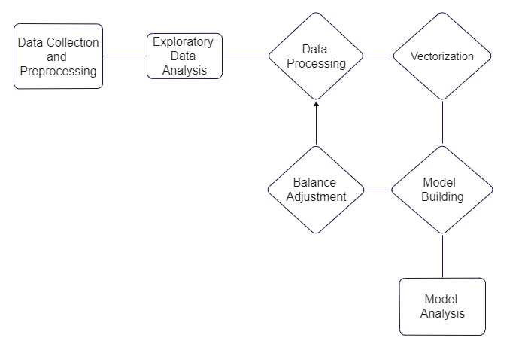
Workflow

Slide 4
Data Collection
Posts collected from r/WorldNews and r/UpliftingNews
March 1, 2022 to April 24, 2022
Total Posts: 55716
UpliftingNews: 3,998
WorldNews: 51,718

Slide 5
Preprocessing
Combined scraped data from both subreddits
Removed special characters
Limit text to ASCII
CountVectorization
Tokenize
Remove punctuation
Lowercase

Slide 6
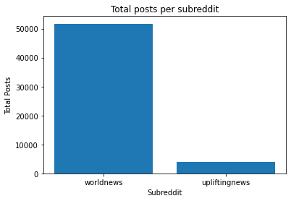
Post Distribution
WorldNews: 92.8%
UpliftingNews: 7.2%

Slide 7
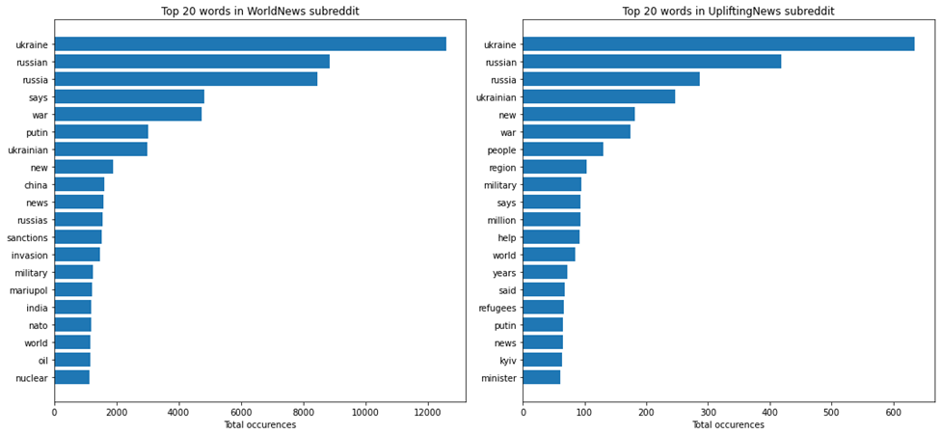
Top words for each subreddit

Slide 8
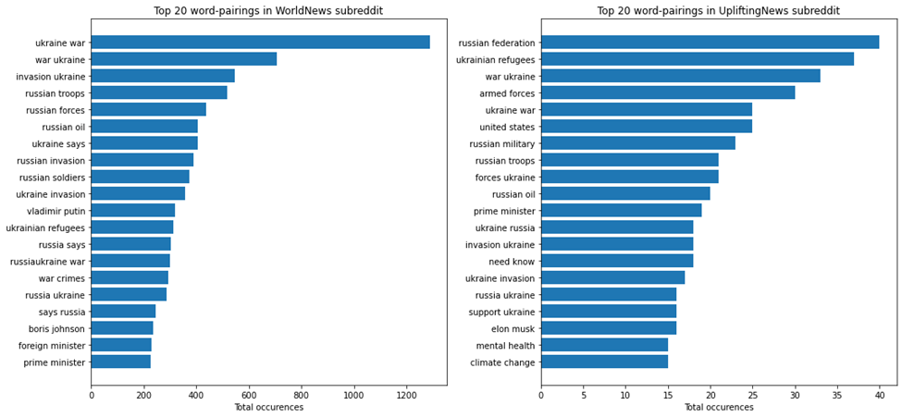
Top word pairings for each subreddit

Slide 9
Models
Logistic Regression
Naive Bayes
Random Forest Classifier

Slide 10
Processing Data
Vectorizer
TfidfVectorizer
CountVectorizer
Balance Adjustment
Random Oversampling
SMOTE
ADASYN
Balanced class weight

Slide 11
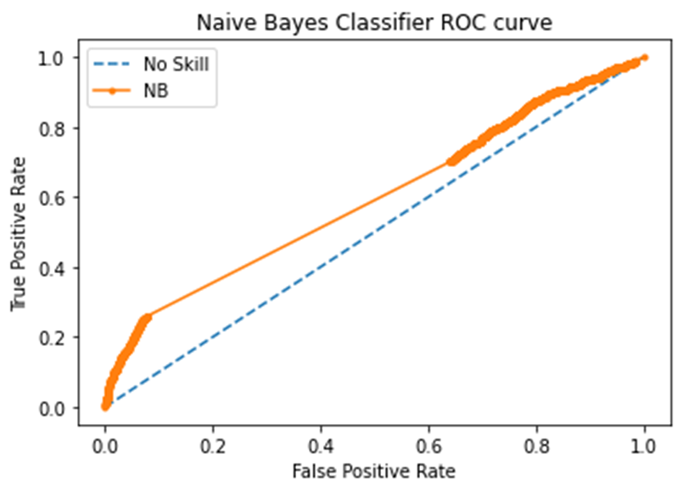
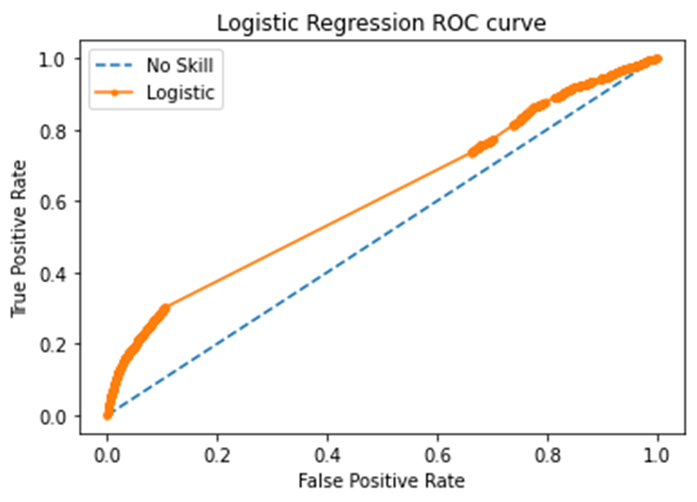
Logistic Regression Analysis

Slide 12
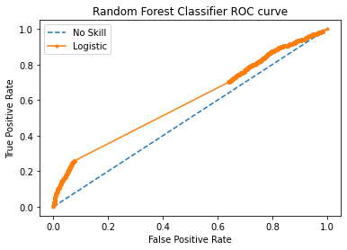
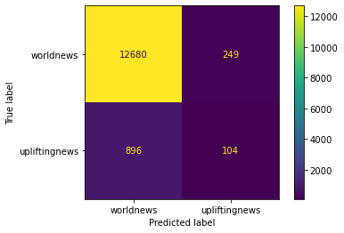
Random Forest

Slide 13
Classification Metrics
 | Logistic Regression | Random Forest
Accuracy Score | 0.928 | 0.918
Balanced Accuracy Score | 0.503 | 0.542
Recall Score | 0.007 | 0.104
Precision Score | 0.636 | 0.295
F1 Score | 0.014 | 0.154

Slide 14
Conclusion
The models were not able to significantly exceed the baseline
Both subreddits are related to current events, so there is a lot of overlap
Balance correction increased sensitivity to the minority class, but at the expense of precision
For future models:
Examine similar sample sizes, possibly from different time periods
Add additional stopwords to eliminate some overlap
Add computing power to examine more hyperparameters

