Slide 1
Veterans Affairs
Expenditures Analysis
Joshua Willey

Slide 2

Background
The U.S. Department of Veterans Affairs is an agency of the federal government that provides services to military veterans, including:
Pensions and Disability
Medical Care
Education and Training
Home Loans
Insurance

Slide 3
Background
In 2021, VA expenditures totalled $224 Billion
Compensation and Pension: $111 Billion
VA Health Care: $88 Billion
Over 6 million unique patients
Education: $11.5 Billion
About 1 million beneficiaries

Slide 4
Problem Statement
Analyze at the state and county level where VA resources are being used the most, and determine what types of local variables most impact VA spending

Slide 5
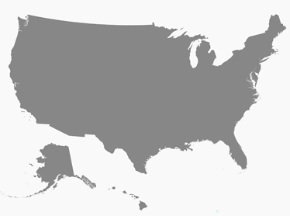
Factors Analyzed
Analyzed Data at the County Level
State
Health
Economy
Education
Population

Slide 6
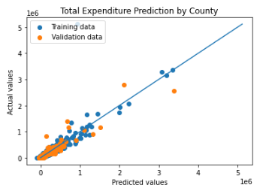
Regression Model
Lasso Regression
R2 Score: 0.87
RMSE: 67,800
MAE: 25,329

Slide 7
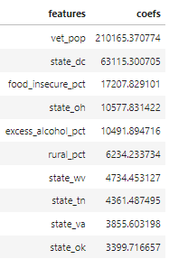
Findings
Highest Environmental Coefficients
Food Insecurity
Excessive alcohol use
Rural Areas
Highest State Coefficients
DC
Ohio
West Virginia
Tennessee

Slide 8
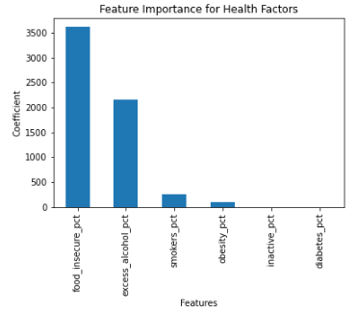
Predicting Medical Expenditures
Based on rates of:
Food Insecurity
Excess Alcohol Consumption
Smoking
Obesity
Inactivity
Diabetes

Slide 9

Education/Training Expenditures
Highest Coefficient:
% of Pop. living in a rural area
States with highest coefficients:
California
Virginia
Hawaii
Texas
Colorado

Slide 10
Conclusions
The most significant feature for every model was number of veterans in the county, so future models may need have a better control for population.
For further study, there are many more variables that can be examined, for example, only a small subset health variables were used in the model.

Slide 11
Sources
https://www.va.gov/vetdata/expenditures.asp
https://www.ers.usda.gov/data-products/county-level-data-sets/
https://www.countyhealthrankings.org/explore-health-rankings/rankings-data-documentation

