Slide 1


Slide 2

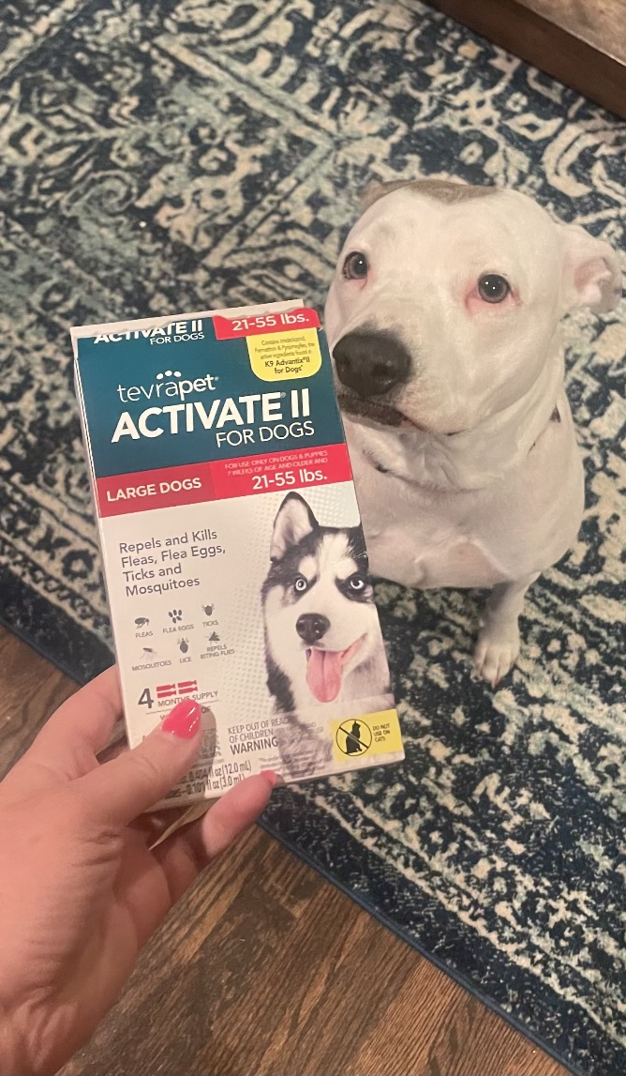




Slide 3
SADIE is:
A low-, mid- and high-level API library for immunoinformatics.
Testable, reusable and portable Python library.
One step installation.
Provide a customized and verified germline reference library
Creates germline references on the fly
Maintains data formats consistent with AIRR
Completely open source (MIT License)

Slide 4
