Slide 1


Slide 2
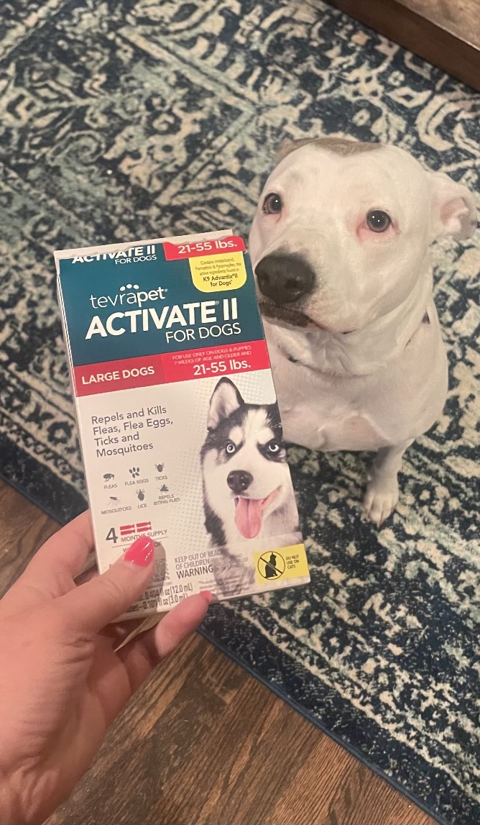

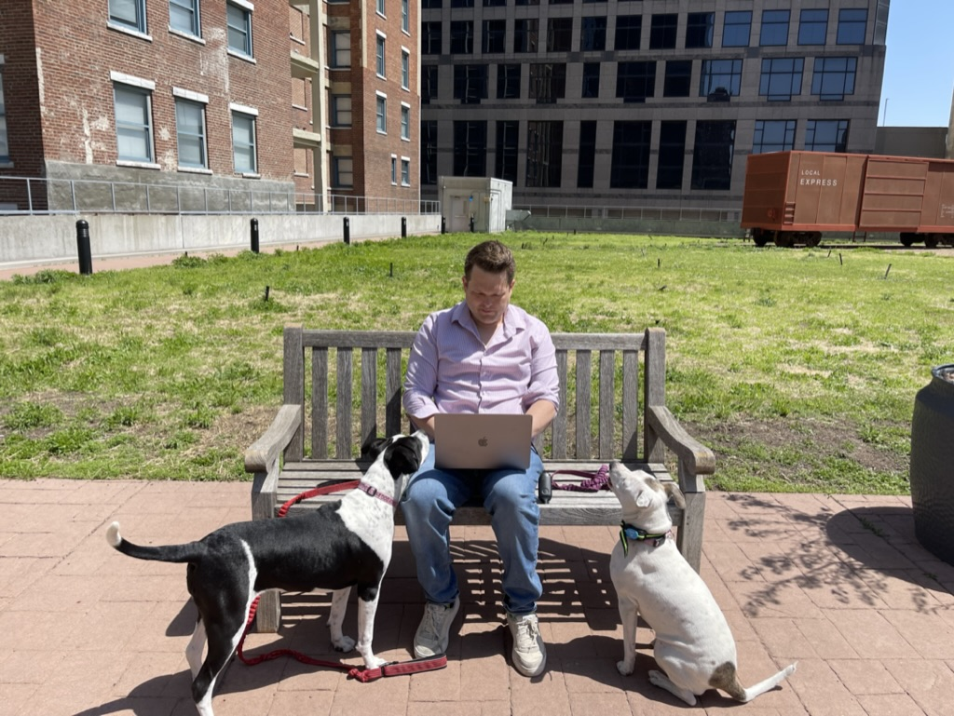



Slide 3
Motivation:
G001, the first HIV vaccine trial to meet it’s primary endpoint needed a standardized sequencing analysis pipeline.
Lots of people touching data and needing to verify the analysis.
These included a vast range of computational expertise.
We needed a portable, semantic, versioned and tested pipeline.
Look for SADIE in two G001 manuscripts that are (almost) submitted.

Slide 4
SADIE is:
A low-, mid- and high-level API library for immunoinformatics.
Testable, reusable and portable Python library.
One step installation.
Provide a customized and verified germline reference library
Creates germline references on the fly
Maintains data formats consistent with AIRR
Static type hints!
Maintainable and readable code open for contribution ( no technical debt)
Completely open source (MIT License)

Slide 5
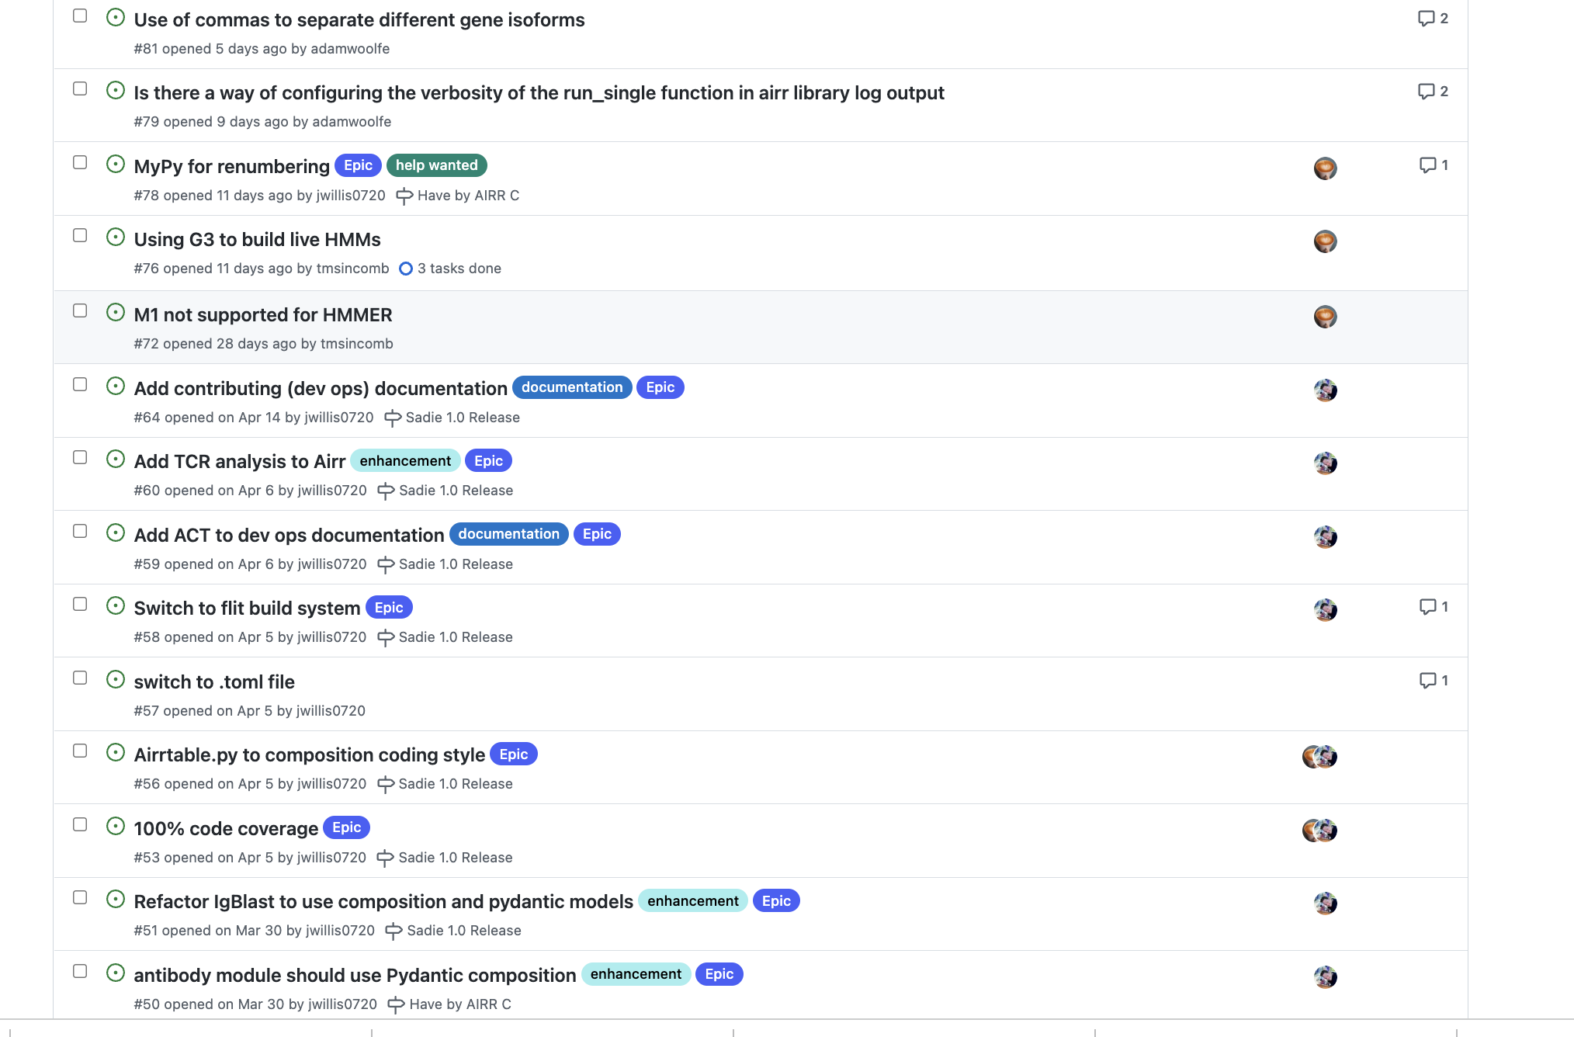
We are in an active development phase

Slide 6



We are in an active development phase
Acknowledgements:
Before we release stable 1.0:
TCR sequences in our curated web API
100% coverage
Windows and ARM build
100% documentation
https://g3.jordanrwillis.com/docs
https://sadie.jordanrwillis.com
Troy Sincomb
Ana Lujan
Chris Cottrell
https://colab.research.google.com/github/jwillis0720/sadie/blob/airr_c/notebooks/airr_c/SADIE_DEMO.ipynb

