Slide 1





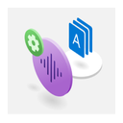




















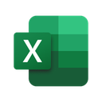
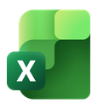






























































































































































Power Platform connectors available in GCC
Total connectors: 210
Microsoft Learn connector reference | Duplicate product logos shown once
STANDARD
PREMIUM
Total Standard: 113
Icons shown: 102 standard / 85 premium
Total Premium: 97

Slide 2

Power Platform connectors available in GCC High
Total connectors: 128
Microsoft Learn connector reference | Duplicate product logos shown once
STANDARD
PREMIUM
Total Standard: 62
Icons shown: 59 standard / 54 premium
Total Premium: 66

Slide 3

Power Platform connectors available in DoD
Total connectors: 126
Microsoft Learn connector reference | Duplicate product logos shown once
STANDARD
PREMIUM
Total Standard: 55
Icons shown: 53 standard / 58 premium
Total Premium: 71

