Slide 1
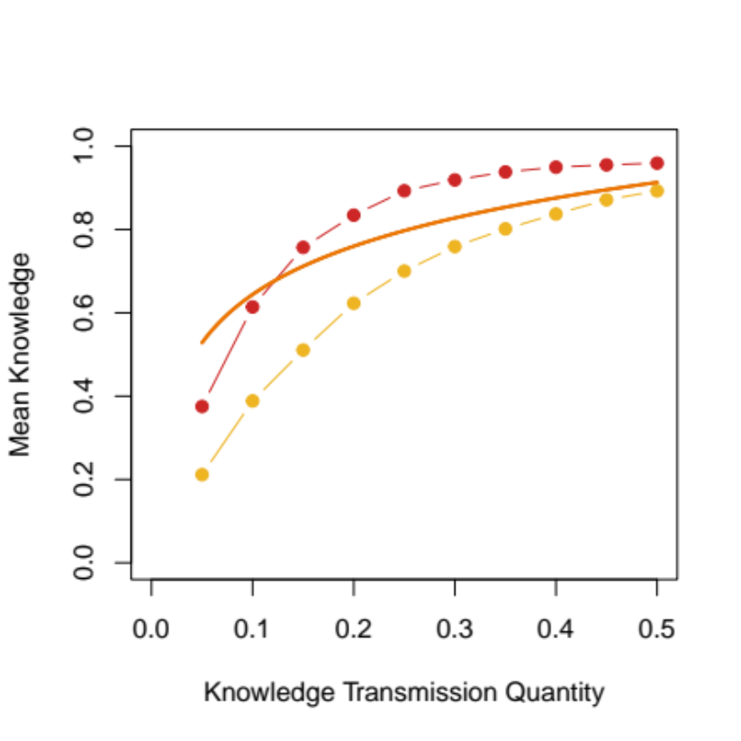
Small demographic group
Small demographic group 50% reduced interaction probability

