Slide 1
Organic Garden Automation
Joshua Williams

Slide 2
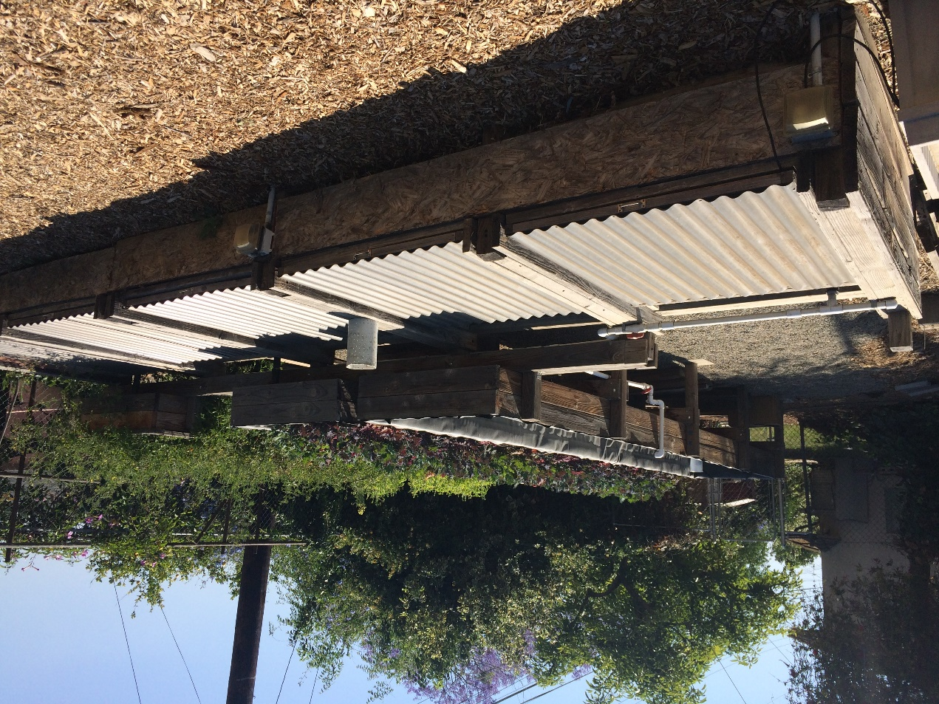
Current Solution
Filling all gravel beds 15 minutes on, 45 minutes off
Manual tank filling
No oxygen level measurements

Slide 3
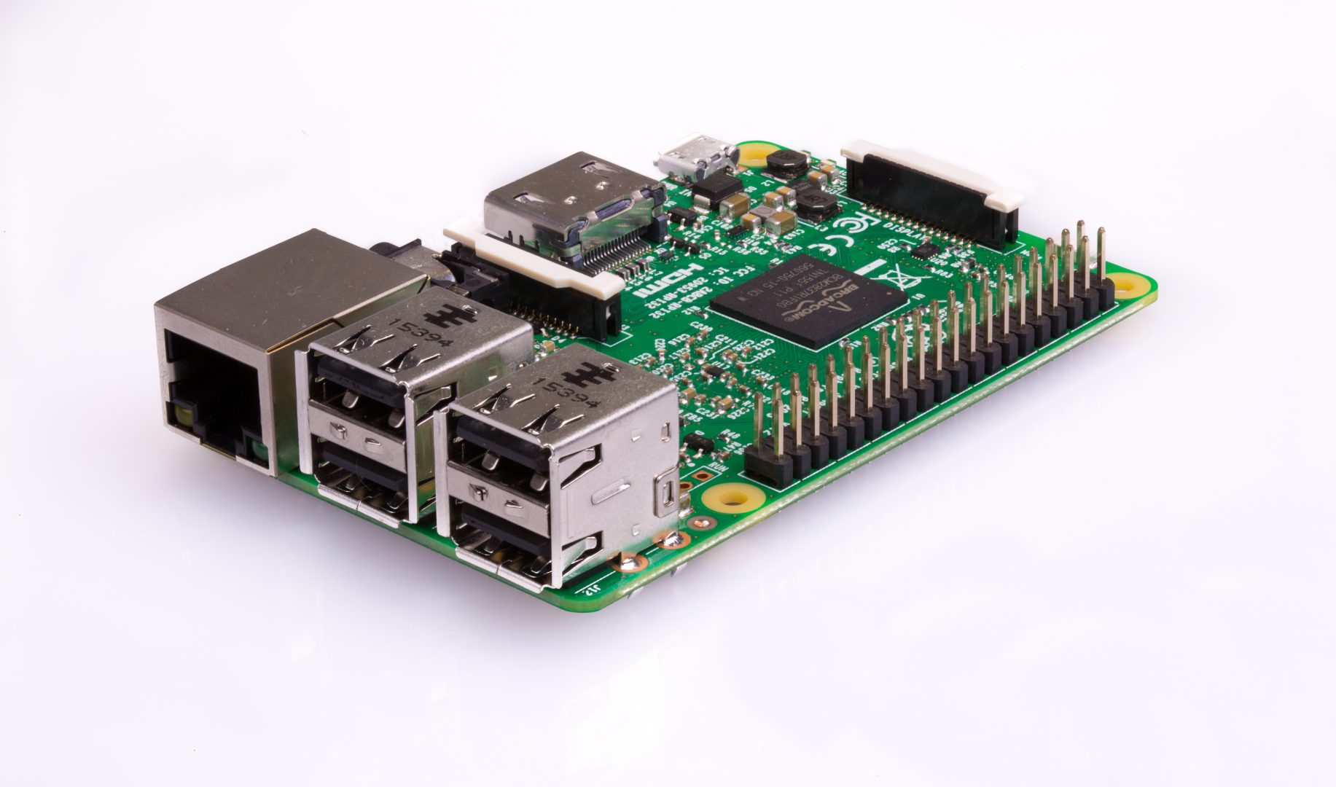
Raspberry Pi
Cheap computer
26 input and output ports
WiFi enabled (Tweets)
Programmable with Python

Slide 4
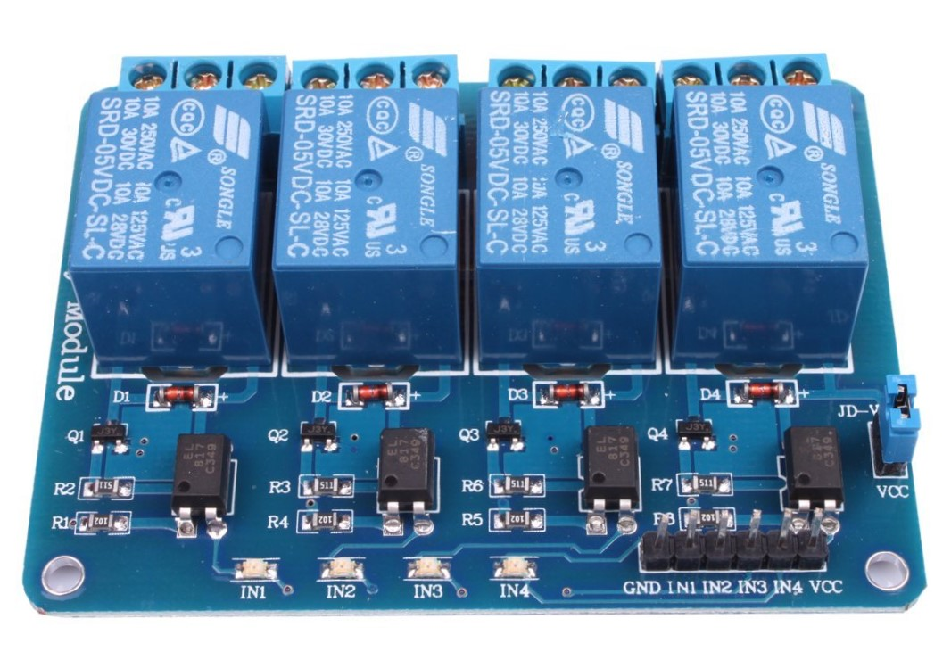
Gravel Beds
Raspberry Pi software
Turn on 1 valve every 15 minutes
Other valves off 45 minutes
7am – 7pm
Raspberry Pi
Relay
Valve

Slide 5
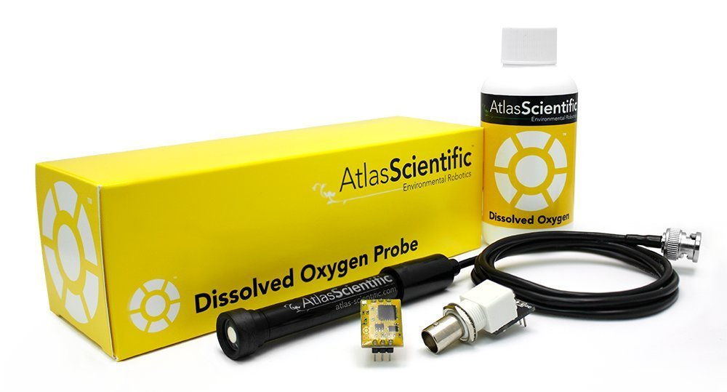

Dissolved Oxygen Sensor
Measures oxygen level
Turns on valve when low
Sprinkler system to break water surface

Slide 6
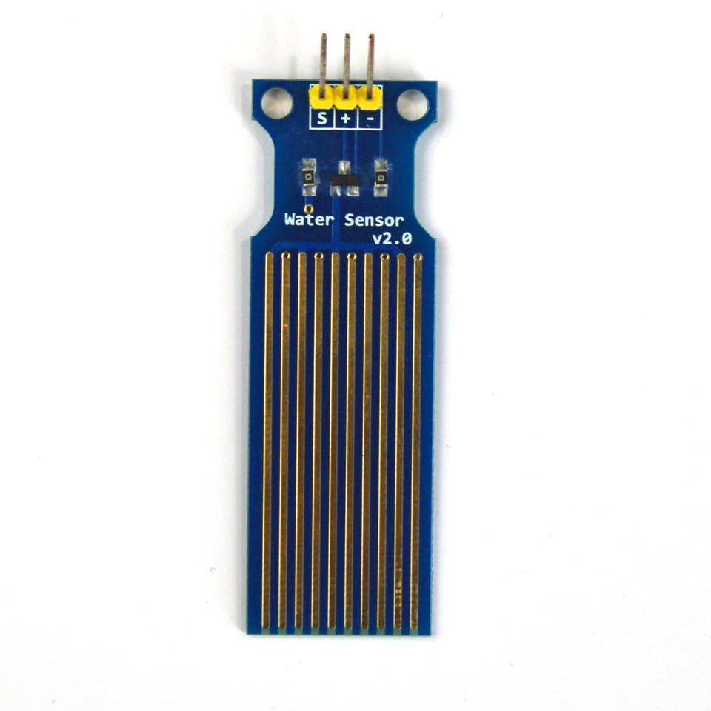
Water Level Sensor
Measures water level
Turns on valve when low
Turns off valve when at correct level

