Slide 1
Lab 5 EEC180 Winter 2025
Kemper Hall 2110
Daniel Chevy ……………………………………… W 1:10PM – 5PM

Slide 2
Lab 4 Checkoffs
I will checkoff any demonstrations for Lab 4 today
It should already be done!
Submit Lab Report 4 before 11:59PM today
Prelab for Lab 5 is also due today
Next Week
Continue Lab 5

Slide 3
Lab Report Format
Title Page
Name of Lab, Date, Your Name + Partner Name, Lab Checkoffs
Objectives
What is the goal of the experiment?
Prelab - Theoretical Background
You can attach your prelab here as well as any other theoretical background observations
Experimental Procedure (for each part)
Describe the procedure in words such that another person could recreate your work
Do not forget FIGURES, TABLES, and EQUATIONS that are relevant to the work
Analysis and Answers to Questions (for each part)
Experimental Results of the procedure you described above
Any answers to questions from the lab handout
Conclusion
State what you learned from completing the lab
State what you think you learned that will be useful in your future endeavors

Slide 4
Lab Report Grading
I will grade Lab Report 4
Lab Report 5 and 6 will be graded by the Reader
Requirements for the lab report will be posted later
The two TAs will start to hold a Saturday lab period [1pm - 3pm] for a chance to ask questions and get checkoffs
Feb 15 - Alireza
Feb 22 - Alireza
Mar 1 - Daniel
Mar 8 - Alireza
Mar 14, 15 - Alireza + Daniel

Slide 5
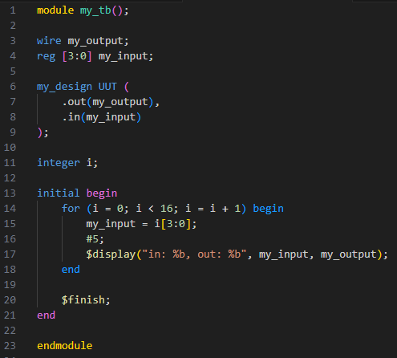
Testbench
In the testbench, we typically have a for loop to test all possible input combinations
For future testbenches, make sure your looping variable is an integer so that there are no infinite loops
Integer has a width of 32 bits
Simply perform “run -all”

Slide 6
Lab 5

Slide 7
Part I - RAM
Make sure you follow the code syntax and general instructions very closely
Quartus is picky about when it uses the M9K block memories
To get checkoff, make sure:
The design works to the specification
M9K blocks are being used (show the Chip Planner or Resource Usage)
You can initialize the memories via initial block or Memory Init File (MIF)

Slide 8
Part II - Square Root
The block diagrams are provided to you in the lab instructions
Design your own controller that can handle this task
Use your prelab state diagram before starting the code!

Slide 9
Questions?
Demonstrations for Lab 4 checkoffs due today
Lab 5 Prelab due today
Submit Lab Report 4 due 11:59PM today
Demonstrations for Lab 5 checkoffs ready after 2 lab sessions
Lab 6 Prelab ready after 2 lab sessions
Submit Lab Report 5 due 11:59PM in 2 lab sessions

