Slide 1
finetrack_prep.py
jesse wimert
November 2023

Slide 2
finetrack_prep
Routine for extracting TEPs and calibration data from ATL03
Produce expected waveform tables using TEPs from ATL03
Write data to h5 file
Execution:
python finetrack_prep.py -g1 ATL03_20220726163210_05311604_006_02.h5
Output:
atl03_calibrations_and_wf_tables.h5

Slide 3
finetrack_prep - setup
Read ATL03 file
write ATL03 filename to output file
Read orientation
set ground track strong/weak beam flags
Set constants for generating expected waveform table
Define gaussian distributions

Slide 4
finetrack_prep – dead_time
Dead_time is given for each channel
16 channels for strong beam
4 channels for weak beam
Array of 20 channels given for each beam, array repeated for each beam in a beam pair
Compute average dead_time for each beam by averaging dead_time over active channels for each ground track
Convert from seconds to nanoseconds

Slide 5
finetrack_prep – dead_time
Read array of dead_times for each beam:
hf['ancillary_data/calibrations/dead_time/' + beam + '/dead_time'][:]
For strong beams, average over 16 channels:
dead_time[beam] = (np.sum(deadtime_read[beam][0:16])/16.0)* 1.0e9
For weak beams, average over 4 channels:
dead_time[beam] = (np.sum(deadtime_read[beam][16:20])/4.0)* 1.0e9

Slide 6
finetrack_prep - CAL19 tables
CAL19 tables provided for each beam, but are identical
simply read first one
hf['ancillary_data/calibrations/first_photon_bias/gt1l/dead_time'][:]
hf['ancillary_data/calibrations/first_photon_bias/gt1l/strength'][:][:]
hf['ancillary_data/calibrations/first_photon_bias/gt1l/width'][:][:]
hf['ancillary_data/calibrations/first_photon_bias/gt1l/ffb_corr'][:][:][:]
Size of arrays:
(6,) (6, 160) (6, 498) (6, 160, 498)

Slide 7
finetrack_prep – Read TEP data
Read tep_range_prim to get bounds of primary pulse [2]
hf.get(‘ancillary_data/tep/tep_range_prim')[:]
Read tep_valid_spot to determine which TEP to use for each beam [6]
hf.get('ancillary_data/tep/tep_valid_spot')[:]

Slide 8
finetrack_prep – Read TEP data
Read tep_hist and tep_time for pce1_spot1
hf.get(‘atlas_impulse_response/pce1_spot1/tep_histogram/tep_hist')[:]
hf.get(‘atlas_impulse_response/pce1_spot1/tep_histogram/tep_hist_time')[:]
Read tep_hist and tep_time for pce2_spot3
hf.get(‘atlas_impulse_response/pce2_spot3/tep_histogram/tep_hist')[:]
hf.get(‘atlas_impulse_response/pce2_spot3/tep_histogram/tep_hist_time')[:]

Slide 9
finetrack_prep – Adjust TEP so it may be convolved with gaussian distribution
Do for both TEP1 and TEP2:
Isolate primary pulse using tep_range_prim
Center the mean and normalize
Convert from time to meters
Squish TEP and normalize
Reverse order and flip signs to change from range space to height space
Compute centroid and shift
Interpolate resulting TEP to gaussian distribution bins (binz)

Slide 10
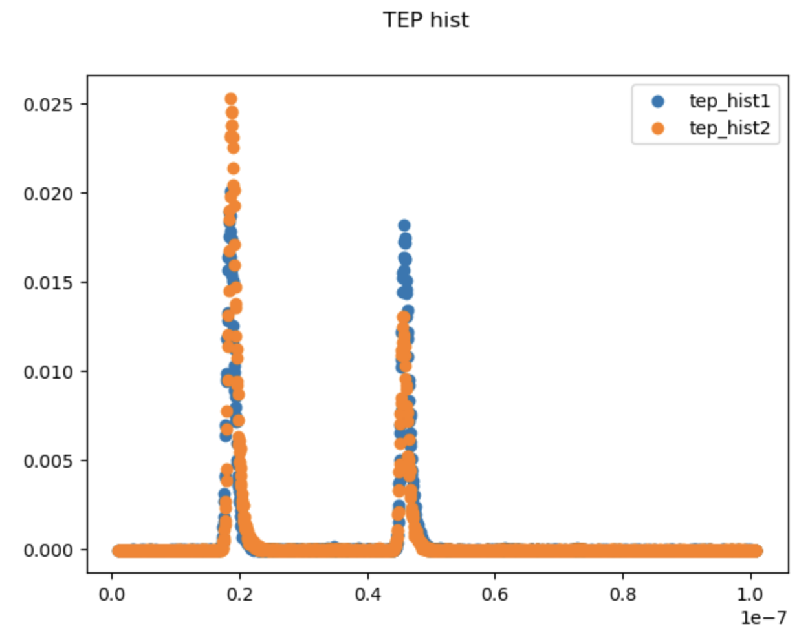
Read TEP pulses

Slide 11
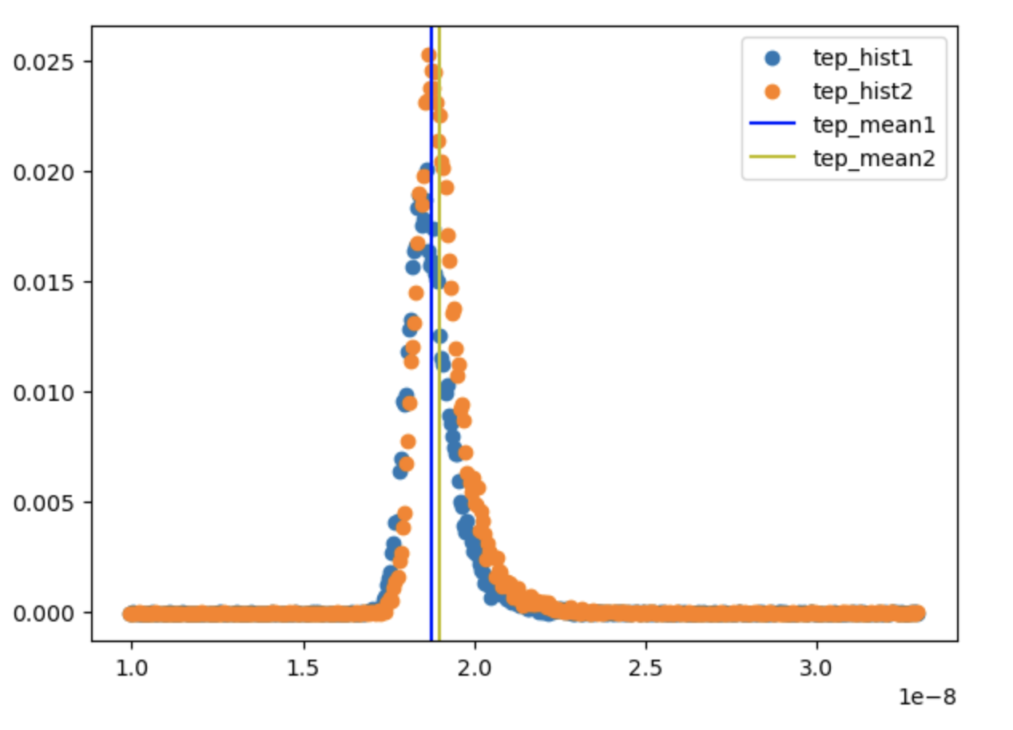
Isolated TEP primary pulses

Slide 12
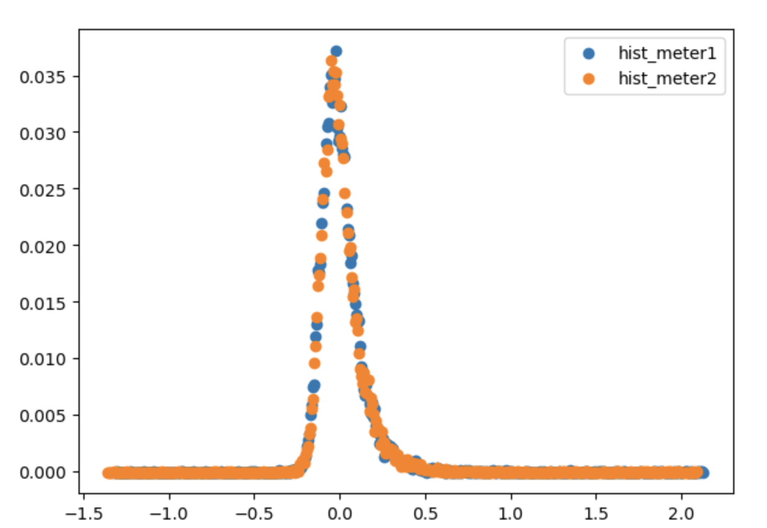
Centered TEP converted to meters

Slide 13
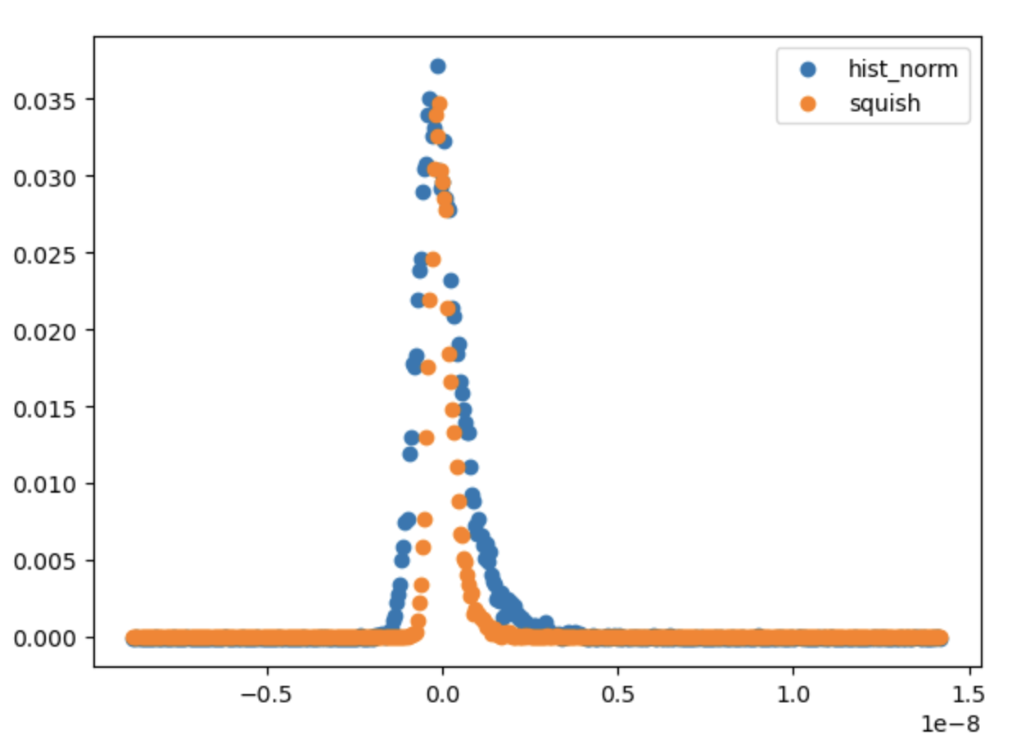
TEP pulse before and after Squish

Slide 14
finetrack_prep – Create Expected Waveform Table
Expected waveform distribution computed by calculating gaussian distribution and convolving with TEP
Compute expected waveform distributions for a range of mu and sigma, save to wf_table1 and wf_table2
For each bin in waveform table
compute gaussian distribution for given mu and sigma
convolve gaussian with TEP
normalize
store in waveform table

Slide 15
finetrack_prep – Write to h5 file
Write data to atl03_calibrations_and_wf_tables.h5

Slide 16
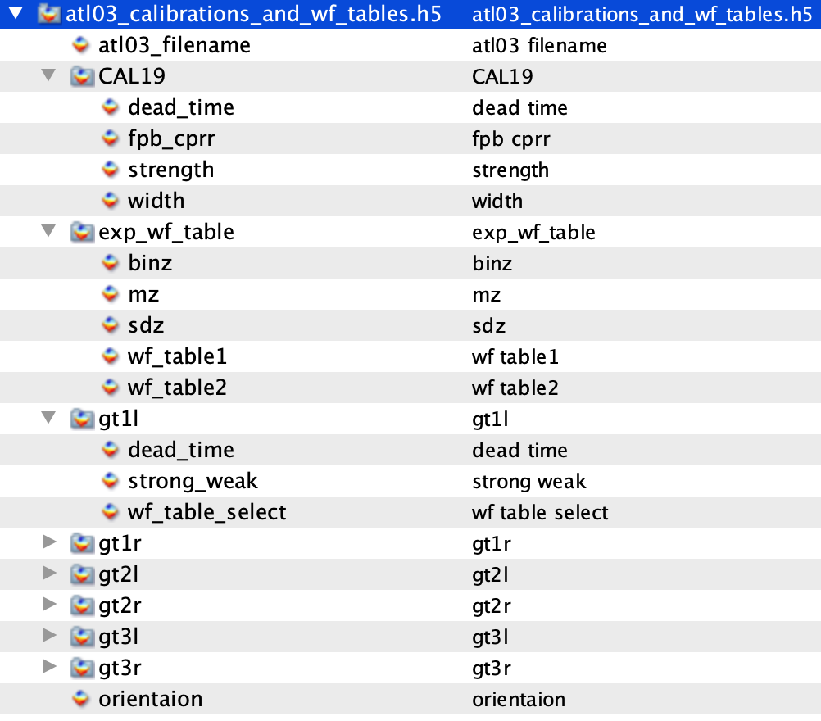
finetrack_prep – h5 file

