Slide 1
MSDA 607 Final Project Data mashups in R
Adejare Windokun

Slide 2
acknowledgment
Project Design / Ideas
Adam Patrick, Prashanth Padebettu
Class Professor
Andrew Catlin

Slide 3
motivation for performing this analysis.
Have only worked on single data sources at one time
Wanted to see how easy / difficult it would be
Data mashups (obtaining data from different sources and combine them) is becoming huge in the analytic world

Slide 4
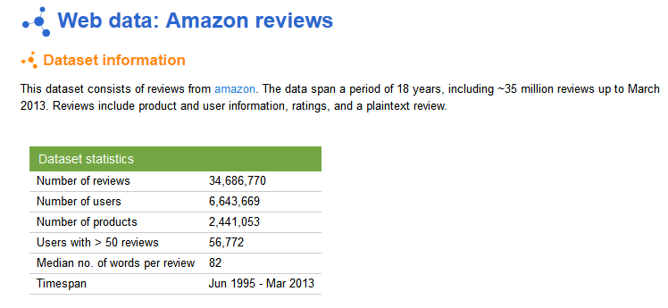
1st Source - snap.stanford.edu

Slide 5
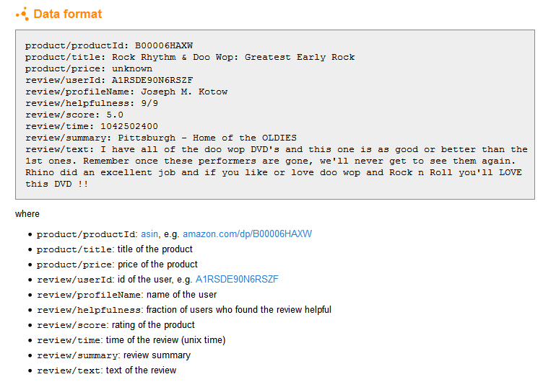
Gourmet_Foods.txt.gz Gourmet Food reviews (154,635 reviews) 30M

Slide 6
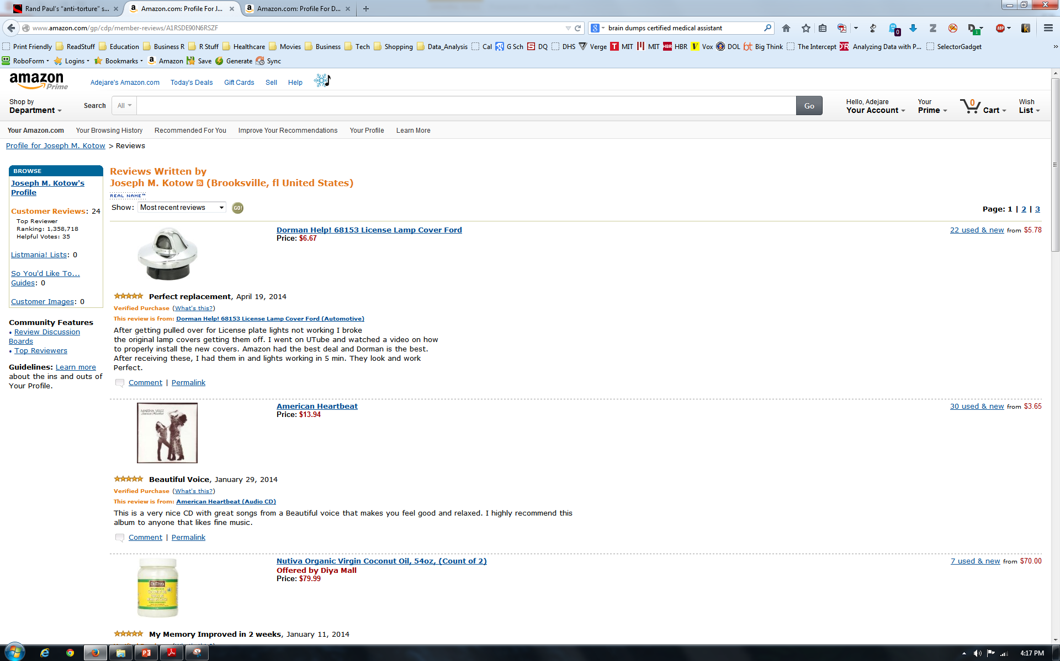
2nd Source - Amazon Reviews review/userId: id of the user, e.g. A1RSDE90N6RSZF

Slide 7
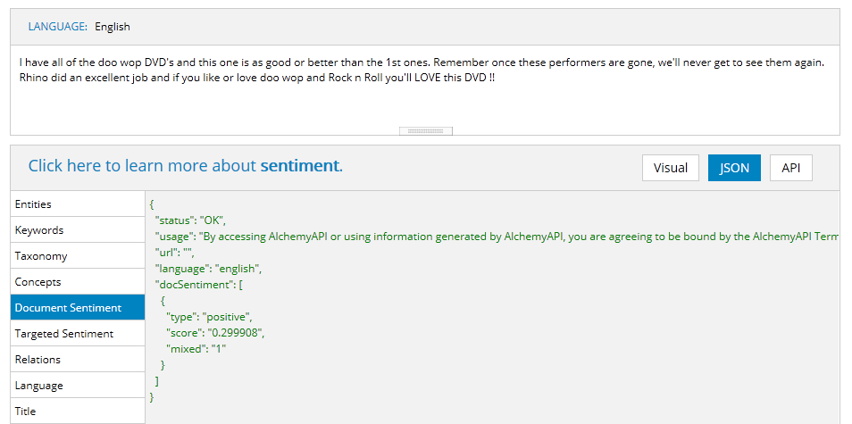
3rd Source - http://www.alchemyapi.com Sentiment Analysis on Text and Summary Fields

Slide 8
Data Transformation
Data Source | Format | Tools | Transformation
Stanford Amazon Data | ? | Base R, Stringr | 10 rows of data make up one line of data, each row has a label, have to change char to numerical, Unix time
Amazon Web Reviews | HTML post and get | Rvest, stringr, XML | CSS, grep to obtain required data, transformation to proper format
Alchemy API | HTML Get JSON reply | Rjson, RCurl | HTML Get to submit request, rjson to process reply

Slide 9
Graphics / Statistical Analysis
Results –Stored as RData files
35,000 records for Amazon Reviews
~2000 results from Alchemy API (limited by Alchemy to 1000 queries per day, need two per record
~2000 real time Amazon Web Scrapping Reviews – limited by server time out

Slide 10
Graphics / Statistical Analysis
Package sqldf used for aggregation of data
Ggplot2 for graphics
Simple linear regression using base R package

Slide 11
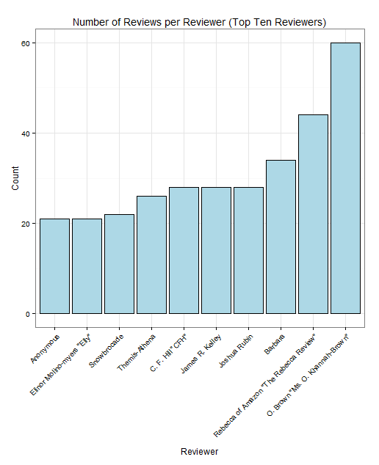
Bar plot of top 10 Reviewers

Slide 12
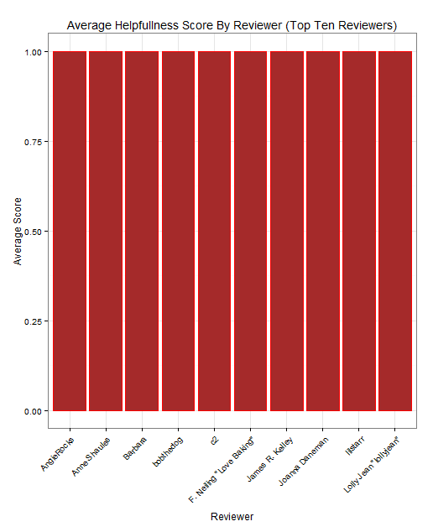
Helpfulness Score by Revierer

Slide 13
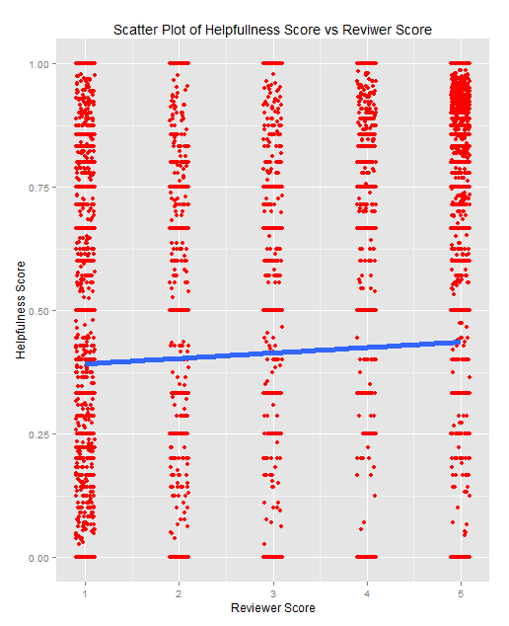
Scatter Plot of Helpfulness score vs Reviewer Score

Slide 14
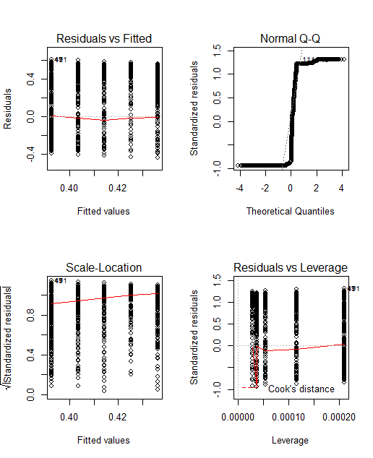
Statistical Analysis Helpfulness vs Score
Call: lm(formula = helpfulness ~ score, data = gourmetFoods) Residuals: Min 1Q Median 3Q Max -0.4364 -0.4364 -0.3923 0.5636 0.6077 Coefficients: Estimate Std. Error t value Pr(>|t|) (Intercept) 0.381320 0.008559 44.553 < 2e-16 *** score 0.011018 0.001928 5.715 1.11e-08 *** --- Signif. codes: 0 ‘***’ 0.001 ‘**’ 0.01 ‘*’ 0.05 ‘.’ 0.1 ‘ ’ 1 Residual standard error: 0.4641 on 35204 degrees of freedom Multiple R-squared: 0.0009269, Adjusted R-squared: 0.0008986 F-statistic: 32.66 on 1 and 35204 DF, p-value: 1.105e-08

Slide 15
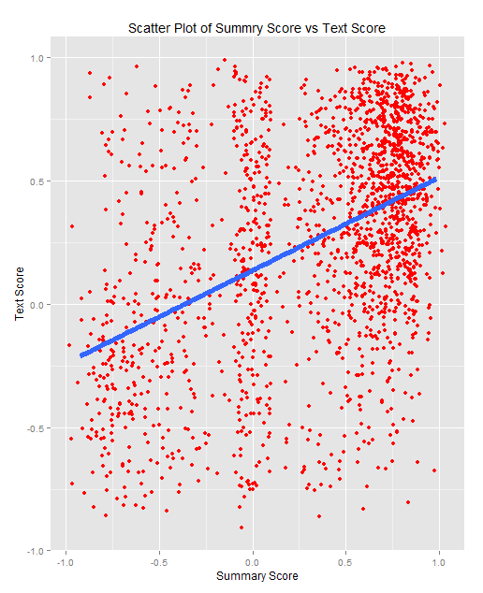
Scatter Plot of Text score vs Summary Score

Slide 16
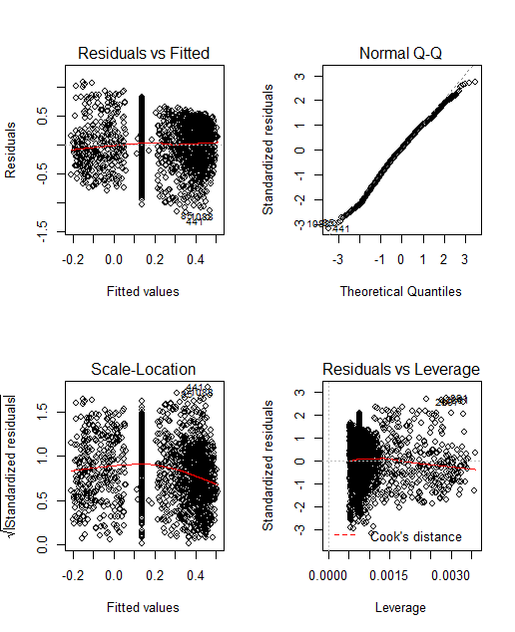
Statistical Analysis Text Score vs Summary Score
Call: lm(formula = apitextScore ~ apisummaryScore, data = gourmetFoodsAPI) Residuals: Min 1Q Median 3Q Max -1.2651 -0.2522 0.0223 0.2890 1.0881 Coefficients: Estimate Std. Error t value Pr(>|t|) (Intercept) 0.13784 0.01092 12.62 <2e-16 *** apisummaryScore 0.37732 0.01746 21.61 <2e-16 *** --- Signif. codes: 0 ‘***’ 0.001 ‘**’ 0.01 ‘*’ 0.05 ‘.’ 0.1 ‘ ’ 1 Residual standard error: 0.3984 on 1884 degrees of freedom Multiple R-squared: 0.1987, Adjusted R-squared: 0.1983 F-statistic: 467.1 on 1 and 1884 DF, p-value: < 2.2e-16

Slide 17
Use Case
Why Data Analysis?
Understanding the data (descriptive analysis)
Predicting the future (predictive analysis)

Slide 18
Use Case – Helpfulness vs Review Score
Multiple R-squared: 0.0009269, Adjusted R-squared: 0.0008986

Slide 19
Use Case – Helpfulness vs Review Score
What dose this mean? Both negative and positive reviews are regarded as important by customers Sellers need to focus on negative reviews Majority of reviews would be positive Therefore focus on what you can change

Slide 20

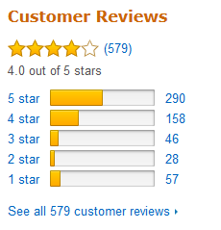
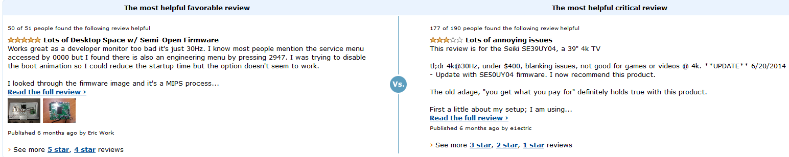
Use Case – Example - Seiki SE39UY04 39-Inch 4K Ultra HD 120Hz LED TV http://www.amazon.com/Seiki-SE39UY04-39-Inch-Ultra-120Hz/dp/B00DOPGO2G/ref=sr_1_32?s=tv&ie=UTF8&qid=1418686622&sr=1-32&keywords=4k+TV

Slide 21
Challenges
75 % of time spent on data transformation (obtaining, transforming and cleaning the data)
Cannot understand why Stanford does not supply the data in csv form
Amazon website very difficult to parse – cannot directly identify required fields using CSS only, have to parse each row
Alchemy API does not provide an API for R, therefore need to use HTML, much more challenging
Storing data as Rdata files makes it much easier to distribute (small file size, 1/6 CSV)
Running/Loading data files from GitHub is problematic

Slide 22
Takeaways
Obtaining the data (acquiring, transformation and cleaning) is the most difficult part of data analytics
Web scrapping should be the last resort – APIs first
Tons and tons of tools available for data mash ups, which allow much more detailed information to be obtained
R has the tm package for text mining and the sentiment package for sentiment analysis which provides similar functionality to that of Alchemy API

Slide 23
Future Strategies?
Text mining reviews – what makes reviews helpful?
Characteristics of good reviewers
Education?
Number of reviews?
Helpfulness score over time?
Limited to specific categories of items?
Does helpfulness of reviews influence buying (positive or negative?)

Slide 24
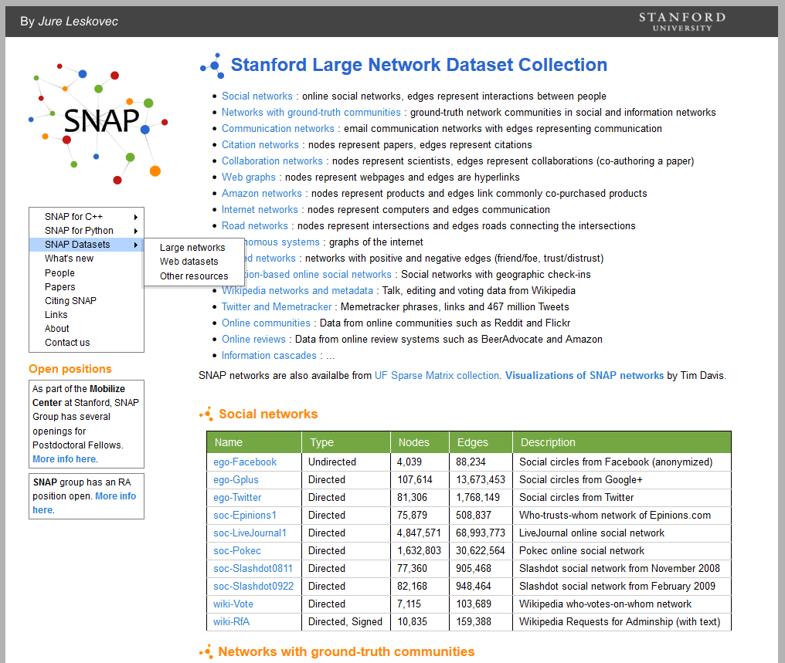

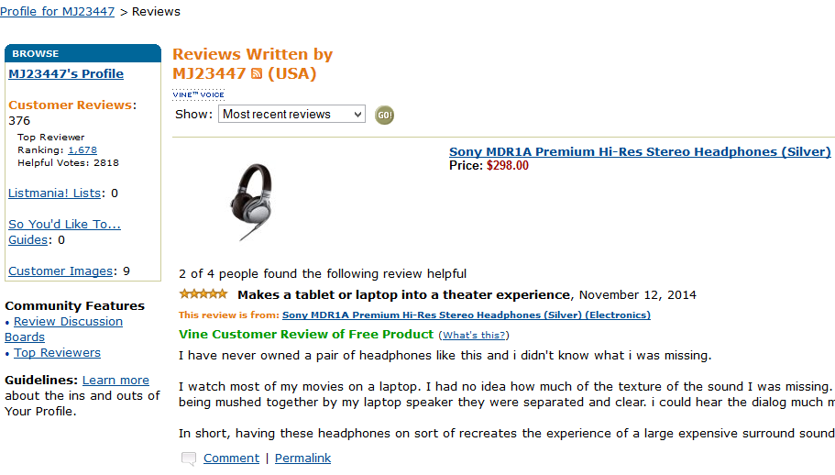
Questions?

