Slide 1
Project
Worksheet
Demo
Presentation
Reflection

Slide 2
Project Objective
You will be creating your own system that prototypes a solution to a real world problem/situation.
The problem/situation requirements:
Human interaction is necessary
System provides a service or support to a situation that improves the quality of life for a person in some way
Multiple inputs and outputs
  1 motor (servo, stepper or DC), your sensor, 1 LED and another input (pot, switch, photoresistor or water sensor) are the minimum
Use AI to help develop the code

Slide 3
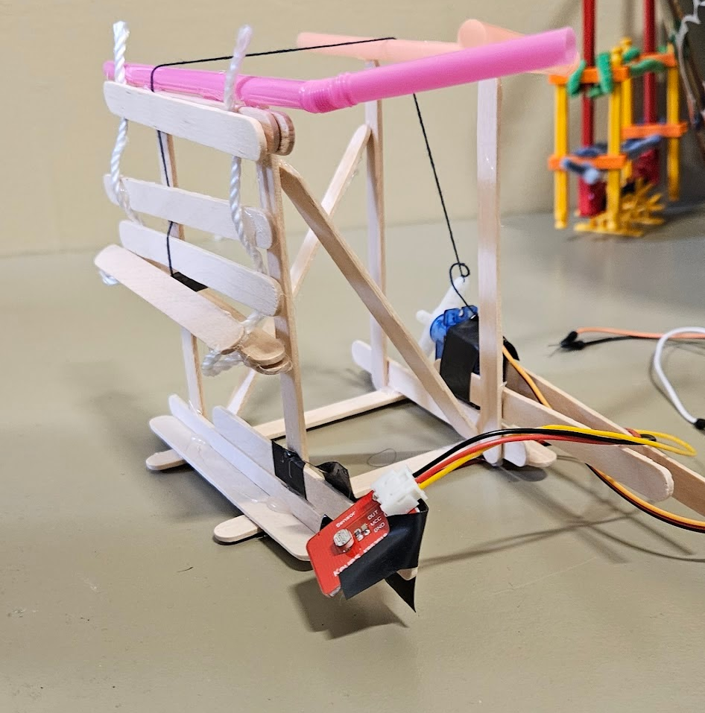
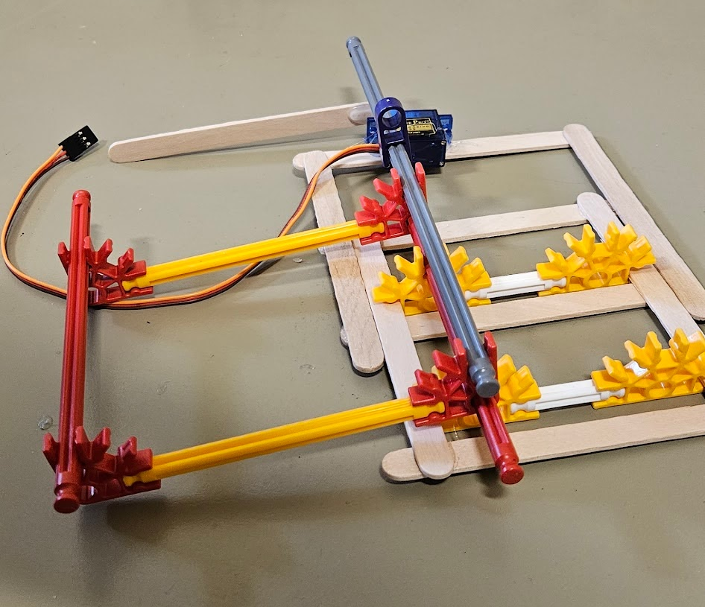
Examples
Automated blinds
Automated Dam
Inspired by Venice’s MOSE Electromechanical Dam

Slide 4
Worksheet
Complete today
This is your plan
5% of module grade

Slide 5
Work Days
Attendance Expected

Slide 6
Demo - October 5
Explain in 1-2 sentences what your prototype is doing
Explain what each component in the system does
Show what it does
10% of module grade

Slide 7
Demo Grading
Criteria | Points Available
Functionality
Custom Sensor | 5
Other Sensor/Input | 5
Motor | 5
LED | 5
Construction of Prototype | 5
Overall System | 20
TOTAL | 45

Slide 8
Presentation - October 7
Rubric will be completed by everyone and scores averaged
4 minutes to present, 1 minute for questions, 1 minute for class to complete feedback
10% of module grade

Slide 9
Presentation Grading
Criteria | Points Available
Content
Introduction and project overview | 5
Implementation Overview | 5
Use of AI | 5
Results | 5
Conclusion | 5
Presentation
Slide visuals and content presentation | 5
Teamwork | 5
Presentation Communication | 5
TOTAL | 40

Slide 10
Reflection
Due 10/11
Just like your other reflections but for the project part of the module
5% of module grade

Slide 11
Portfolio Grading - 5% of module grade
Criteria | Points Available
Portfolio Page
Content: Appropriate content including sections such as Interests, Projects, Links, Resume, and Experiences. | 15
Clarity: Easy to read layout (lettering, spacing, contrast), grammar, spelling, clean formatting. Appearance is accessible to diverse audiences. | 5
Creativity: Use of color, use of diagrams and visuals, eye-catching, professional. | 5
FYRE Repo
Repo README.md: Clear description of the content in the repo and appropriate links. A picture of your project would be a nice feature. | 15
Reflections: Folder contains all 3 reflections from the “Sensing the World” Module | 15
Programming Activities: Folder contains the code from the programming activities done during class. README.md in the folder describing what each file name corresponds to is present. | 20
Project: All code, development files and presentation slides should be present. README.md in the folder describing what each file name corresponds to is present. | 25
TOTAL | 100

Slide 12
Extra Lab Time
Friday - 9/25: 2-4pm
Tuesday - 9/29: 10-11am
Thursday - 10/1: 10-11am
Monday - 10/5: Noon - 1pm

