Slide 1
ChIP-Seq Pipeline Progress Report
Jeff Wintersinger
MDSC 507
2012.11.18

Slide 2
Outline
Kepler
Galaxy
General pipeline improvements
Kepler quibbles
Galaxy quibbles
Kepler vs. Galaxy: which is least painful?

Slide 3
Kepler pipeline

Slide 4
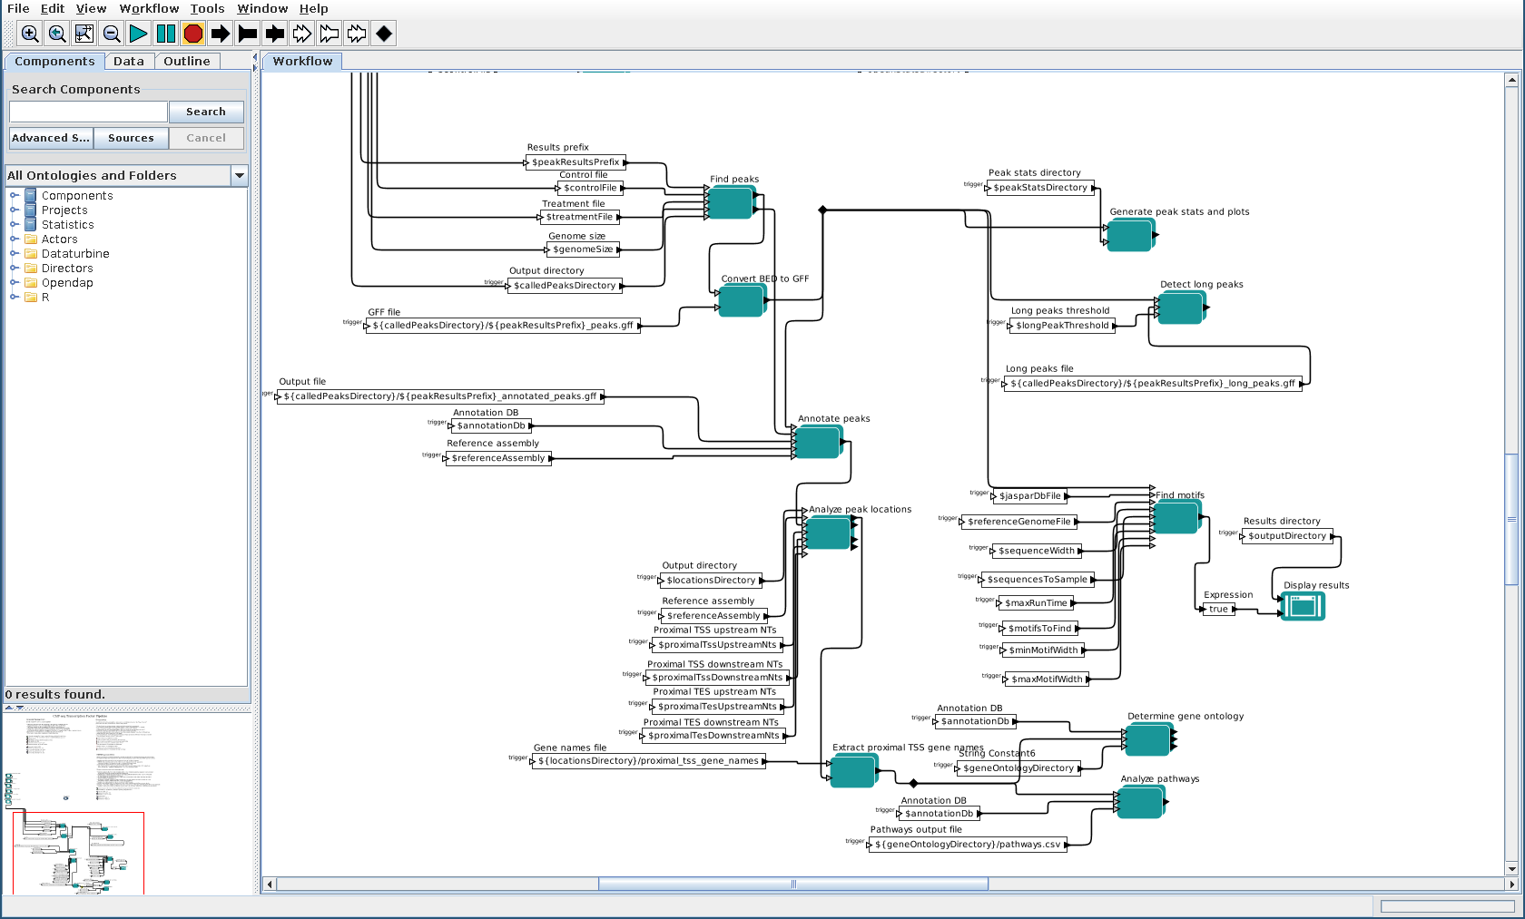
Kepler pipeline

Slide 5
Known problems
Results window displays too soon
Should wait for all terminal actors to complete, but instead only waits for one
Has not been updated for enhancements made during Galaxy port
Still works fine with older version, though
Output names duplicated in both constituent scripts and composite actors
Two possible fixes:
Make script take all output filenames as arguments, rather than just output directory
Have scripts write their output filenames to STDOUT

Slide 6
Areas for improvement
Take advantage of parallel execution capabilities
Add per-actor documentation
Make actors available for independent use
Add to standard Kepler library

Slide 7
Development experience
In a word: painful
Kepler (seems to) solve interesting problems
But these problems aren’t my problems
What I want: graphically glue together disparate tools
Yes, Kepler does this
But graphical nature is grossly inefficient
Debugging is arduous
Ruined: Version control, standard text editors, greppability

Slide 8
Summary
Kepler pipeline works
But both development and use are painful
Primary goals of pipeline are realized
Analyses are reproducible
Visual representation of components and their interconnections made accessible to non-technical users
But costs to realize these benefits are too great
I’d rather use a simple shell script

Slide 9
Galaxy pipeline

Slide 10
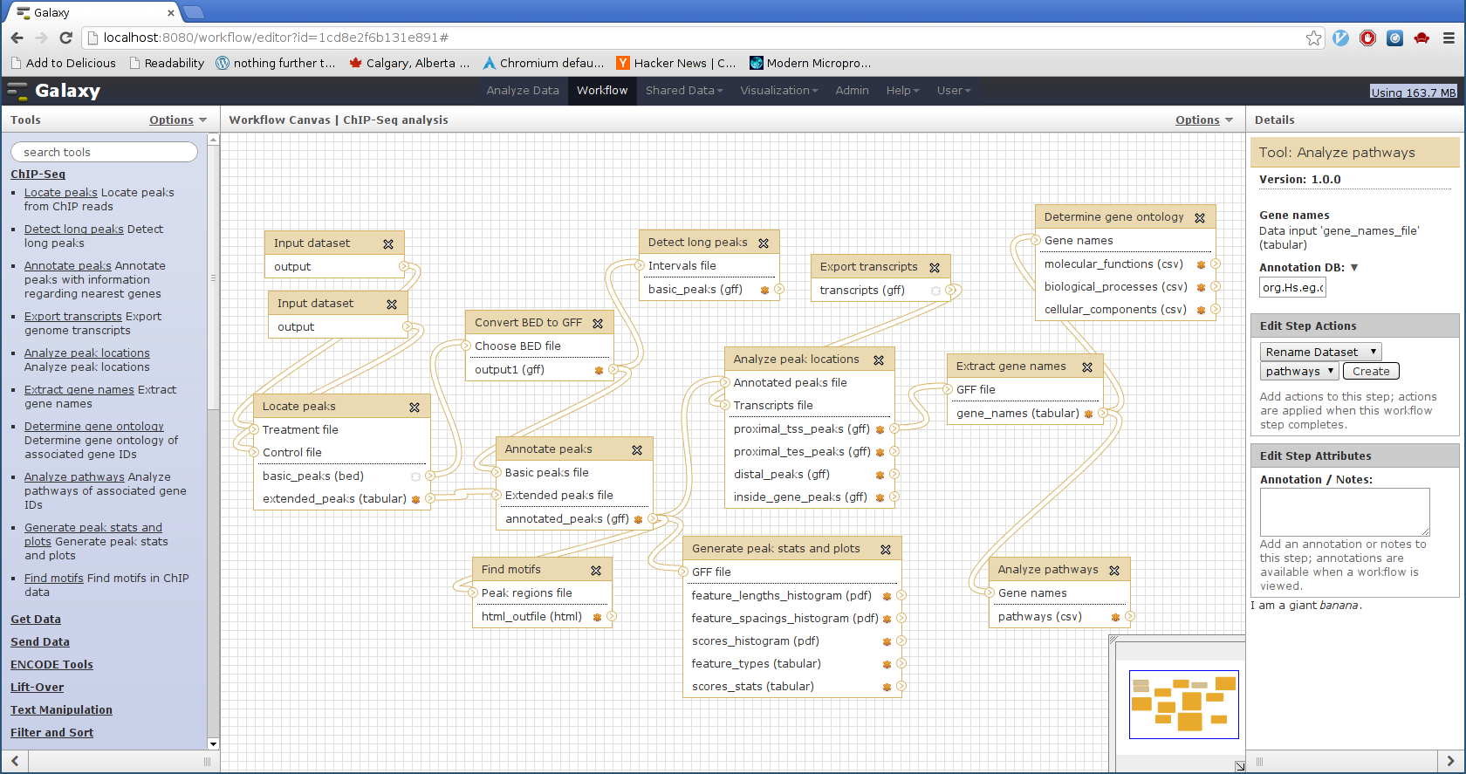
Galaxy pipeline

Slide 11
Known problems
Format requirements of some pipeline components not made explicit in tool inputs
Gene names: newline-separated list of Ensembl gene IDs
Extended peaks: tab-separated list of supplementary information for each called peak provided by MACS
Annotated peaks: GFF file containing specific data regarding gene names and positions

Slide 12
Areas for improvement
Document tools (equivalent of Kepler’s “actors”)
reStructuredText makes this easy
Make parameter specification for tools more robust
E.g., allow for peak calling without control data
Permit definition of common parameters across workflow
E.g., currently must repeatedly specify annotation database and reference genome
Establish better means of handling reference data needed for MEME (and, in future, other tools)
E.g., reference genome, JASPAR DB

Slide 13
Development experience
Altogether quite pleasant
Galaxy installation is trivial, given modicum of development experience
Add tools by writing XML rather than pointing-and-clicking
Leverage standard development tools: VCS, text editor, grep, etc.
Standard “plumbing” tasks do not require any programming
E.g., convert BED to GFF, extract column from text file
Easier to test components in isolation

Slide 14
Galaxy is awesome
Automatic parallelization!
When multiple tools queued, Galaxy figures out dependencies between them based on inputs/outputs
Whatever can be executed concurrently, is, without user intervention
Still haven’t figured out how to do this in Kepler, despite multiple perusals of manual
Automatic conversion between formats
E.g., if tool can only consume GFF, you can still select BED file as input, with Galaxy automatically doing conversion

Slide 15
Summary
Galaxy pipeline works
Development and use much more enjoyable than with Kepler
Primary goals of pipeline again realized
Analyses are reproducible
Visual representation of components and their interconnections made accessible to non-technical users
Distinction from Kepler: I could see myself using Galaxy on a day-to-day basis, despite knowing how to use underlying tools “manually”
More convenient than invoking tools individually
Access to built-in suite of tools convenient
Tools more useful than those in Kepler
Great many more tools in community Tool Shed
Galaxy much more widely used

Slide 16
General pipeline Information

Slide 17
Run time
Snyder E2F1 ENCODE data:
18.5M E2F1 reads
28.7M control reads
Run times:
MACS: 8 minutes
9600 peaks found
Export transcripts: 25 s
Annotate peaks: 3 minutes
Pathway analysis: 23 s
Gene ontology: 3 minutes
MEME: 31 minutes
Other tools: negligible (< 10 s each)

Slide 18
Potential improvements
Integrate gene expression data
Allow visualization of results in genome browsers
Galaxy makes this easy
Generate better visualizations of peak locations
Support for this taken from Kepler 1.0 workflows, but because axes automatically scaled, a few outlying data make the axes so large as to render histogram essentially useless

Slide 19
ChIPpeakAnno sucks
Even moderate-sized analyses impossible—ChIPpeakAnno requires too much memory
Annotating peaks found in Snyder’s Pol2 data from ENCODE consumed all 8 GiB of my RAM
Enabling swap allowed analysis to continue running, but far too slow—still running after 3 hours, constantly hitting swap
Bioconductor packages in general seem shaky
rtracklayer choked when importing GFF file with “##gff-version 2” line
Solution: filter out this line using Galaxy before import

Slide 20
Kepler Quibbles

Slide 21
Kepler issues
Can’t temporarily disable (“comment out”) actors
Interface far too graphical, mouse-driven
This is perhaps desired for use of system
But this is stupid for development—Kepler not tailored to developers
Good luck aligning elements so they don’t look like they were produced by a 3-year-old
Contributes to general unprofessional “look”
It’s Java!
Java GUI apps almost universally poor—never fit in with platform conventions
Desktop application
Much more sensible to deploy workflow system on Web

Slide 22
Kepler’s embedded interpreters
Kepler advantage: unlike Galaxy, has embedded R and Python interpreters
In theory: makes embedding code much easier
In practice: pain in the ass
Problems:
Debugging much more difficult than with traditional script
All code written in small textbox in Kepler GUI—no keyboard shortcuts, syntax highlighting, or other niceties of proper editor
Code stored in XML, which is then stored in zipped KAR file
Becomes almost impossible to track changes over time
Though exchanging data with Kepler becomes easier than with external script, one’s code becomes tied to Kepler
Reusing code in other systems impossible without modification
As a result, I eschewed embedded interpreters, and relied only on execution of external scripts

Slide 23
Kepler external execution
Most fundamental task in system—executing external programs—is painful
Kepler process:
Add parameters for each user-modifiable value
Create and open composite actor
Add ports for each input/output produced
Add external execution actor
Add logging actors for STDOUT and STDERR
Connect trigger of preceding actor
Galaxy process:
Write tool-specific XML file
Graphical layout, parameter validation all handled by Galaxy
Plain text, so use text editor, store in VCS—hooray!
Add registration line to tool_conf.xml

Slide 24
Kepler usability problems
Can’t rename existing workflows
Mouse scroll wheel doesn’t pan, but zooms
Accessing documentation while Kepler is running locks up application
Should I save subworkflows manually? Terribly confusing
“Undo” sometimes undoes multiple steps at once
Editing workflow (even documentation) while workflow running causes execution to error out

Slide 25
Galaxy Quibbles

Slide 26
Galaxy’s workflow support is primitive
Only Kepler advantage over Galaxy: better workflow support
Kepler: design workflow from scratch
Galaxy: extract workflow from existing history
Galaxy workflow problems:
No way to add tools to existing workflow
Must extract anew from history
Can’t define common parameters for use by multiple workflow tools
Thus must repeat parameters such as reference genome, annotation DB, etc.

Slide 27
Galaxy can be silly
Some parts of Galaxy are poorly documented
No worse than Kepler, though
Use the source, Luke
I find Galaxy’s source much more comprehensible than Kepler’s—if necessary, can read it to grok what I need
Frustrating: tools with lots of output files (e.g., MEME)
Canonical solution: write HTML file that links to each of the files
I like this—elegant enough
Problem: all of a tool’s output files must be in the same directory
Easy enough with MEME, but could be more irksome for tools with more complex directory structures

Slide 28
Galaxy aggravations
Loading files into data library failed in stable (“galaxy-dist”) branch
Known problem—had to upgrade to dev branch (“galaxy-central”)
Forcing Galaxy to use Python 2 on a system where /usr/bin/python is Python 3 more involved than necessary
Solution: create directory, symlink /usr/bin/python2 to python, set PATH so this directory comes first
Executing R scripts often results in SQLite query error
Source: standard R library-loading messages output non-ASCII characters, which SQLite won’t accept in queries
Fix: direct STDERR to /dev/null when executing R script

Slide 29
Galaxy aggravations (cont.)
Hitting CTRL+C won’t cause Galaxy to exit
Solution: run Galaxy server with --reload parameter
Running workflow often causes SQLite error
Cause: multiple processes concurrently trying to access DB
Running each tool separately works fine
Fix: migrate from SQLite to PostgreSQL
When running CPU-intensive process, paster.py also takes 100% CPU
This effectively doubles amount of CPU power needed

Slide 30
Kepler vs. Galaxy: which is least painful?

Slide 31
Galaxy vs. Kepler
Kepler’s annoyances stem from fundamental design decisions
Desktop rather than web application
Ignore basic software engineering ideals
Binary-blob KARs make meaningful version control impossible
Encourage writing embedded code tightly coupled to Kepler specifics
Not well-tailored to rapid tool development
Gluing together multiple programs far more painful than in Galaxy
What the hell is the difference between the PN and SDF directors, let alone the other three? Why should I care?
Even after reading the documentation, neither will let me easily execute my tools in parallel
Solve pie-in-the-sky problems entirely disconnected from bioinformatics domain
Does little to solve problems faced in pipeline development

Slide 32
Galaxy vs. Kepler (cont.)
Galaxy’s annoyances stem from small engineering errors rather than large design ones
Given maturity of project, more problems than expected—such is the nature of bioinformatics
But Galaxy’s fundamental philosophy is sound
Make it as easy as possible to string together multiple tools
Don’t ignore this task in favour of trying to solve pie-in-the-sky problems entirely disconnected from your users’ domain
Obey basic software-engineering norms
Text everywhere!
Don’t piss off your developers
Make it web-based
Permits analysis from anywhere
I used this to develop on my powerful home machine, no matter where I was working from
Allow data to be uploaded by user, transferred from remote system, loaded from local file, sucked in via UCSC browser

Slide 33
Conclusion
I don’t like Kepler
Even after using it for two months, developing in it was far slower than tying together tools with shell scripts
I like Galaxy
Still slower development than ad hoc shell scripts
But not much slower
Biggest difference: Galaxy doesn’t make me hate my life for every single minute I use it
I could see myself using Galaxy in lab setting
Realizes reproducability and visualizability that is goal of workflow systems, with relatively little pain
Given 5,000 hours to create a workflow system, I would write something very much like Galaxy

