Slide 1
Comparing JSON data store performance on complex documents
Jeff Wintersinger
CSC 2508 project proposal
2014.10.31

Slide 2
What am I doing?
Performance comparison of JSON stores for complex documents
Compare:
  Argo on top of PostgreSQL and MySQL
  PostgreSQL JSON data store
  MongoDB

Slide 3
Why is this important?
JSON used as exchange format
  Sometimes simple, flat documents (e.g., logging events)
  Sometimes complex, nested documents
Existing comparisons focused on flat schema
  This was primary shortcoming of Argo paper—of 12 queries part of NoBench, only one used a join
  Extensive comparison from U of T of key-value stores, but little for JSON
I will examine more complex documents corresponding to partially denormalized relations

Slide 5
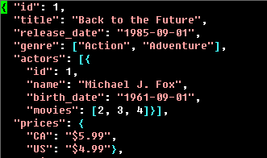
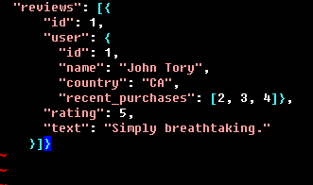
The relation as JSON

Slide 6
Example queries
Simple queries:
  What movies were released in the last year?
Aggregation queries:
  How many movies are listed in both the action and adventure genres?
  How many movies have at least half of their reviewers from Canada?
Join queries:
  What movies have at least two actors who were also in movies released more than twenty years ago?

Slide 7
How will I evaluate my results?
Can I reproduce Argo authors’ results relative to MongoDB?
  Hopefully yes
How do these systems compare?
  Mongo results will depend on how well-written map-reduce code for doing joins is
  Expectation: Argo’s performance benefits likely degrade on complex joins
Extensions:
  How does Oracle compare?
  How does SSD vs. hard disk change results?

Slide 8
Challenges
Randomly generating large data set (1 M, 4 M, 64 M records)
Automating test suite, ensuring repeatability
How will I gain access to sufficiently powerful hardware?

