Slide 1
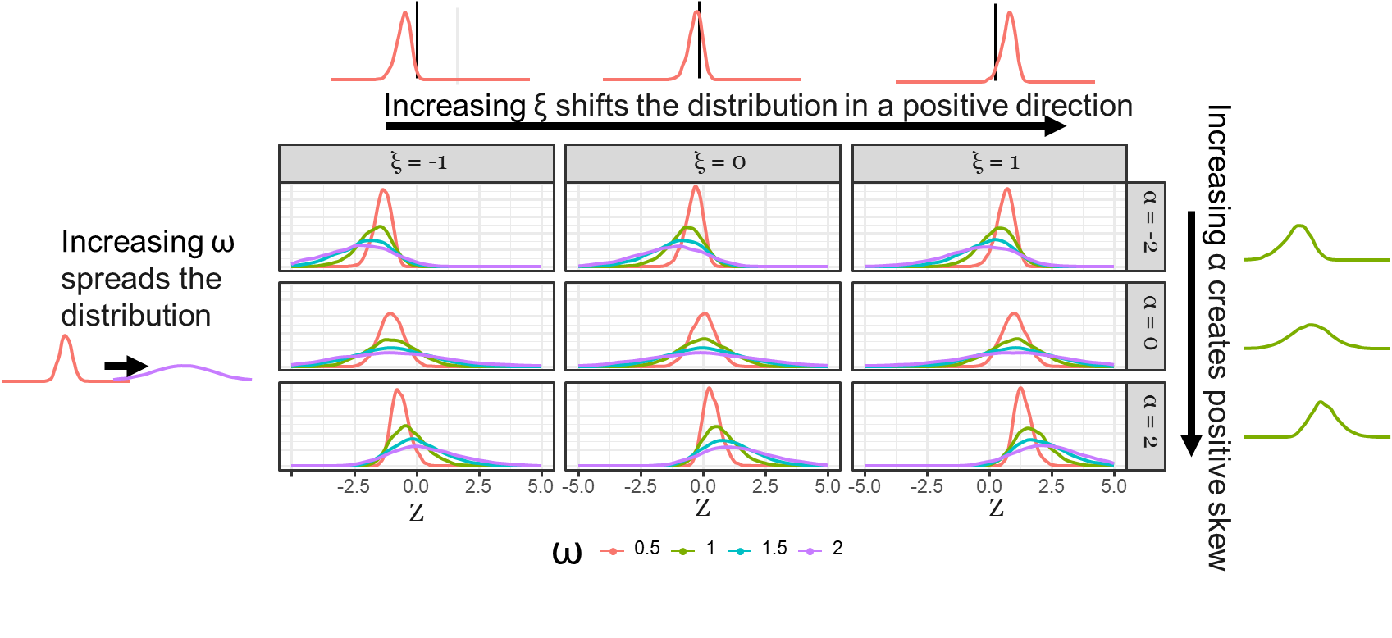
Skew-Normal Densities by a (skewness), ξ (location), ω (scale)
ξ = -1
ξ = 0
ξ = 1
1.2
0.8
a = -2
0.4
0.0
1.2
0.8
Density
a = 0
0.4
0.0
1.2
0.8
a = 2
0.4
0.0
-5.0
-2.5
0.0
2.5
5.0
-5.0
-2.5
0.0
2.5
5.0
-5.0
-2.5
0.0
2.5
5.0
Skew-Normal Value
ω (Scale)
0.5
1
1.5
2

