Slide 1



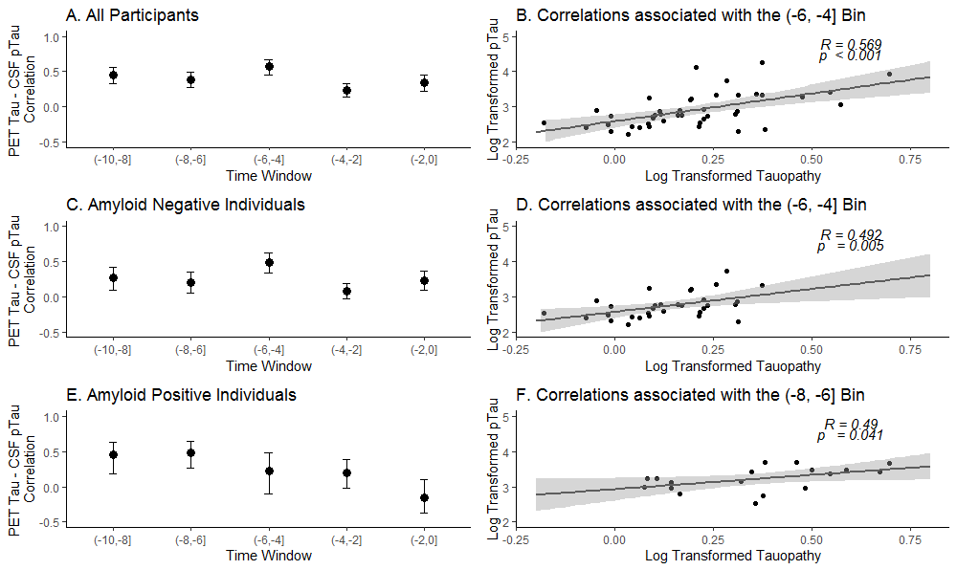
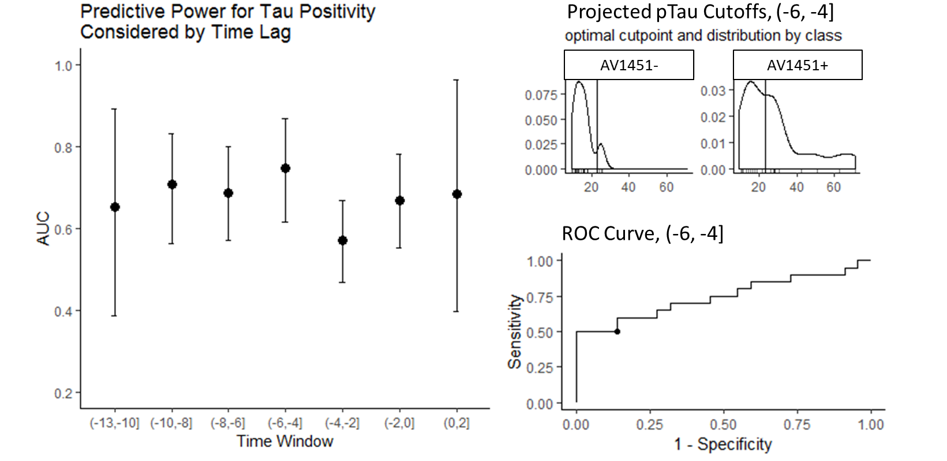
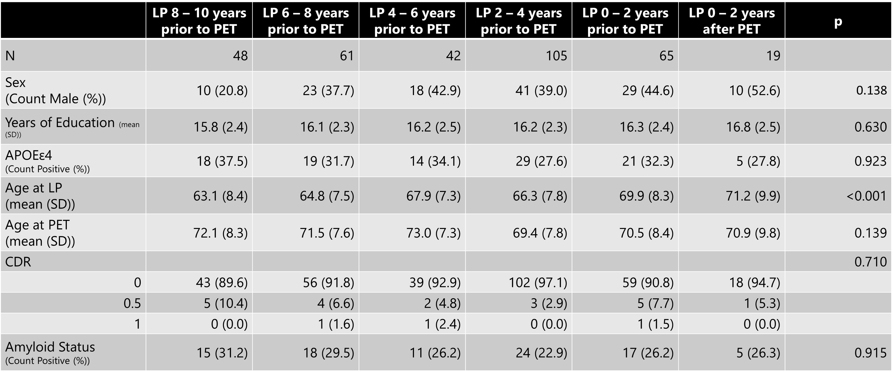
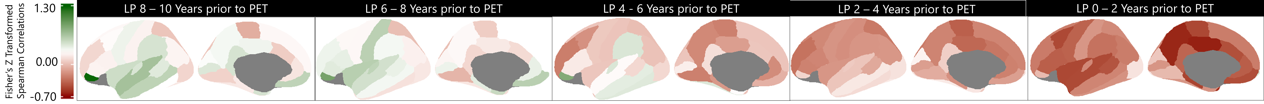
Temporal evaluation for maximum CSF pTau181 – [18F]Flortaucipir Concordance
Julie K. Wisch PhD¹, Brian A. Gordon, PhD^{2,3}, Suzanne E. Schindler, MD³, Shaney Flores, BS ², Aylin Dincer, BA ²,
Anne M. Fagan, PhD³, Tammie L. Benzinger MD, PhD^{2,3}, John C. Morris MD^{1,2,3}, Beau M. Ances MD, PhD^{1,3}
Department of Neurology, Washington University in St. Louis ¹
Department of Radiology, Washington University in St. Louis² Knight Alzheimer Disease Research Center, Washington University School of Medicine³
Background
Tau proteins phosphorylated at theoronine 181 (pTau181) develop into the paired helical filaments that are characteristic of Alzheimer Disease (AD) ¹
PET Tau [18F]Flortaucipir binds to mature tangles of both paired helical filaments and neurofibrillary tangles ²
AD was defined by the National Institute on Aging - Alzheimer’s Association (NIA-AA) as an appropriate diagnosis only if an individual has biomarker evidence of both amyloid and tau (by either tau PET or CSF pTau181) ³
Several studies have assessed the concordance between PET Tau [18F]Flortaucipir and CSF pTau181, finding moderately strong concordance (r ≈ 0.5) ⁴⁻⁶, but only one study reports the temporal separation between these two measures. This study limits the separation between PET and CSF collection to 0 – 4 years. ⁵
Figure 1. Overall, the greatest concordance between CSF pTau181 and PET Tau occurs when the CSF data is obtained 4 – 6 years prior to the PET scan. This is also true for amyloid negative participants. For amyloid positive participants, the greatest correlation between CSF pTau181 and PET Tau occurs when the LP is performed 6 – 8 years prior to the PET scan. This correlation is significantly better than when the LP is obtained 0 – 4 years prior to the PET scan.
Results
For both the combined cohort and the amyloid negative only cohort, the greatest concordance between CSF pTau181 and PET Tau occurs when the LP was performed 4 to 6 years prior to the PET scan
For the amyloid positive cohort, the greatest concordance between CSF pTau181 and PET Tau occurs when the LP was performed 6 to 8 years prior to the PET scan
The optimal CSF cutpoint for classifying tau positivity is 21.68 pg/mL, and is best when the LP is performed 4 to 6 years prior to the PET scan
Conclusions
CSF changes precede PET detected changes by 4 – 8 years
It may be inappropriate to interchangeably use CSF and PET for AT(N) classification
Project Aims
Identify the time window for which CSF pTau181 and tauopathy as measured by [18F]Flortaucipir have the greatest concordance
Determine the optimal CSF pTau181 cutpoint for classifying tau positivity
References
¹ Schonknecht et al, 2003. Levels of total tau and tau protein phosphorylated at threonine 181 in patients with incipient and manifest Alzheimer’s disease. https://doi.org/10.1016/S0304-3940(02)01481-7
² Lois et al, 2019. PET imaging of tau protein targets: a methodology perspective. https://doi.org/10.1007/s11682-018-9847-7
³Jack et al, 2018. NIA-AA Research Framework: Toward a biological definition of Alzheimer’s disease. https://doi.org/10.1016/J.JALZ.2018.02.018
⁴Gordon et al, 2016. The relationship between cerebrospinal fluid markers of Alzheimer pathology and positron emission tomography tau imaging. https://doi.org/10.1093/brain/aww139
⁵La Joie et al, 2018. Associations between [18F]AV1451 tau PET and CSF measures of tau pathology in a clinical sample. https://doi.org/10.1212/WNL.0000000000004860
⁶Zhao et al, 2019. Quantitative 18F-AV1451 brain tau PET imaging in cognitively normal older adults, mild cognitive impairment, and Alzheimer’s disease patients. https://doi.org/10.3389/fneur.2019.00486
⁷Schindler et al, 2018. Cerebrospinal fluid biomarkers measured by Elecsys assays compared to amyloid imaging. https://doi.org/10.1016/j.jalz.2018.01.013
Methods
200 participants enrolled at the Knight Alzheimer’s Disease Research Center at WUSTL completed the following:
Amyloid PET Imaging (PiB, used to classify as amyloid +/-)
Tau PET Imaging (AV1451)
Lumbar puncture (LP) for CSF pTau181 acquisition
Participants also underwent clinical screening for cognitive status (as measured by Clinical Dementia Rating (CDR))
CSF samples were binned into 2 year time windows relative to PET scan
We calculated Spearman correlations between CSF pTau181 and PET Tau for each time bin, then performed Fisher’s R to Z to compare correlations We performed receiver operating characteristic (ROC) analysis to identify the optimal CSF pTau181 cutpoint to classify individuals as tau positive or tau negative with greatest concordance to their PET Tau tauopathy measure
\
Figure 2. CSF pTau181 has the greatest ability to differentiate between tau positive and tau negative individuals (as classified by PET Tau tauopathy) when the lumbar puncture is performed 4 to 6 years prior to the PET scan. This predictive ability (AUC = 0.748) falls short of the classification levels associated with CSF AB42 and PET Amyloid (AUC = 0.85) ⁷
Acknowledgements
The authors thank the participants, investigators, and staff of the Knight Alzheimer’s Disease Research Center (ADRC) Clinical Core for participant assessments, ADRC Genetics Core for APOE ε genotyping, and the ADRC Imaging Core for amyloid and structural imaging. Imaging facilities were supported by the Washington University Institute of Clinical and Translational Sciences grant UL1TR000448 from the National Center for Advancing Translational Sciences (NCATS) of the National Institutes of Health (NIH). Imaging analyses used the services of the Neuroimaging Informatics and Analysis Center, supported by NIH grants 5P30NS048056, R01NR012907, R01NR012657, R01NR014449, P01AG00391, P01AG026276, and P01AG005681. This work was also supported by the generous support of the Barnes-Jewish Hospital; the Hope Center for Neurological Disorders; the Paula and Rodger O. Riney Fund; the Daniel J Brennan MD Fund; and Fred Simmons and Olga Mohan Fund. . Support for Florbetapir F18 (18F-AV-45) and Flortaucipir F18 (18F-AV-1451) was provided by Avid Radiopharmaceuticals, a wholly owned subsidiary of Eli Lilly.
Table 1. Participant demographics, separated by time bin
Figure 3. Regional correlations between CSF pTau181 and PET Tau for Amyloid Positive participants, separated by time bin

