Slide 1
Worst-case Optimal Join Algorithms Techniques, Results, and Open Problems
Hung Q. Ngo
RelationalAI Inc.
Based on Joint Works with Mahmoud Abo Khamis, Ely Porat, Chris Ré, Atri Rudra, Dan Suciu

Slide 2
Birdeye’s View
Paper with the same title on ArXiV contains more details

Slide 3
Three Fundamental Problems in RDBMS
Query plans
Based on variable elimination and (equivalently) tree decompositions
Very general query types (Boolean, aggregations, max, min, etc.)
Refs:
[FDB: Olteanu, Závodný TODS’13]
[FAQ: Abo Khamis, Ngo, Rudra PODS’16 / SIGMOD Records 16]
[TD: Gottlob, Greco, Leone, Scarcello PODS’16]
Output size bound
Fascinating connection to information theory & group theory
Worst-case optimal join algorithms
To evaluate intermediate queries
Key insight: “one can turn a proof into an algorithm”

Slide 4
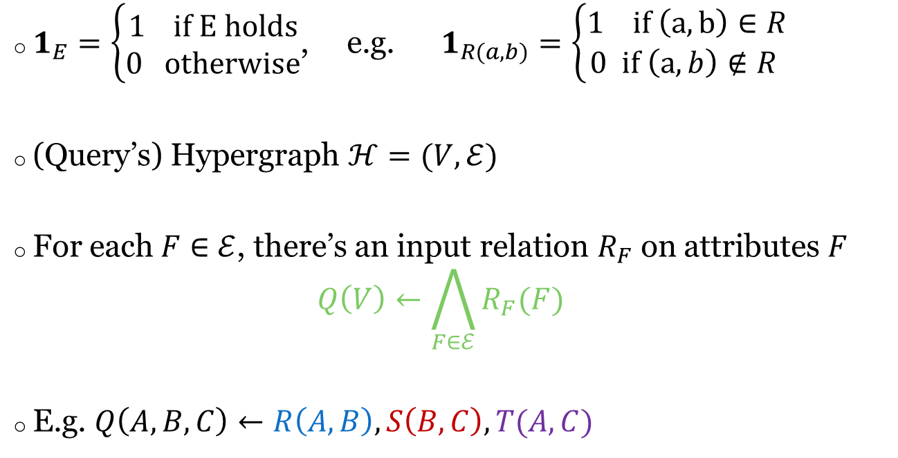
Notations
$1_{E}=\left\{\begin{aligned}1 if E holds \\ 0 otherwise\end{aligned}\right.$, e.g. $1_{R(a,b)}=\left\{\begin{aligned}1 if \left(a,b\right)∈R \\ 0 if \left(a,b\right)∉R \end{aligned}\right.$
(Query’s) Hypergraph $ℋ=(V,ℰ)$
For each $F∈$ $ℰ$, there’s an input relation $R_{F}$ on attributes $F$ $Q\left(V\right)←\bigwedge_{F∈ℰ}{R_{F}(F)}$
E.g. $Q\left(A,B,C\right)←R\left(A,B\right), S\left(B,C\right), T(A,C)$
R
T
A
S
B
C

Slide 5
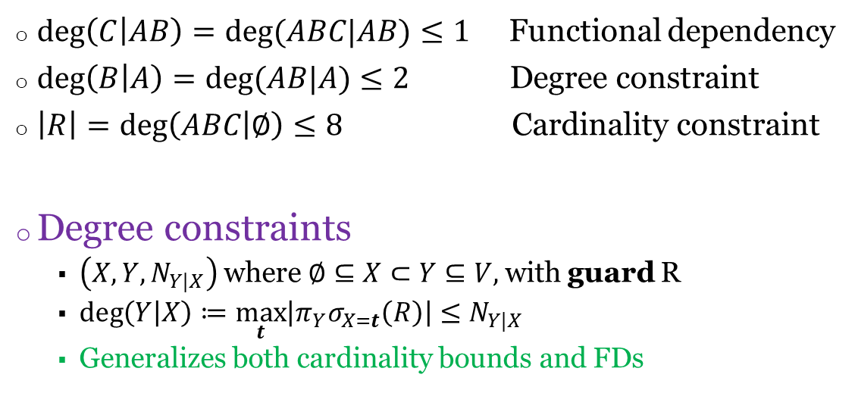
Degree Constraints
R(A,B,C)
A | B | C
1 | 1 | 5
1 | 1 | 5
1 | 2 | 3
2 | 1 | 3
2 | 1 | 3
2 | 1 | 3
3 | 1 | 8
3 | 2 | 9
$\deg\left(C | AB\right)=deg⁡(ABC|AB)≤1$ Functional dependency
$\deg\left(B | A\right)=deg⁡(AB|A)≤2$ Degree constraint
$\left|R\right|=\deg\left(ABC | ∅\right)≤8$ Cardinality constraint
Degree constraints
$\left(X,Y,N_{Y|X}\right)$ where $∅⊆X⊂Y⊆V,$with guard R
$\deg\left(Y | X\right)≔\max_{t}\left|π_{Y}σ_{X=t}\left(R\right)\right|≤N_{Y|X}$
Generalizes both cardinality bounds and FDs

Slide 6
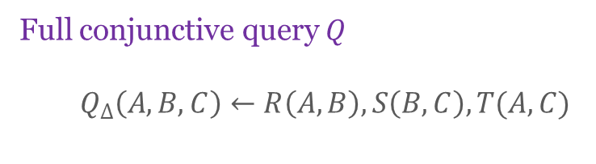
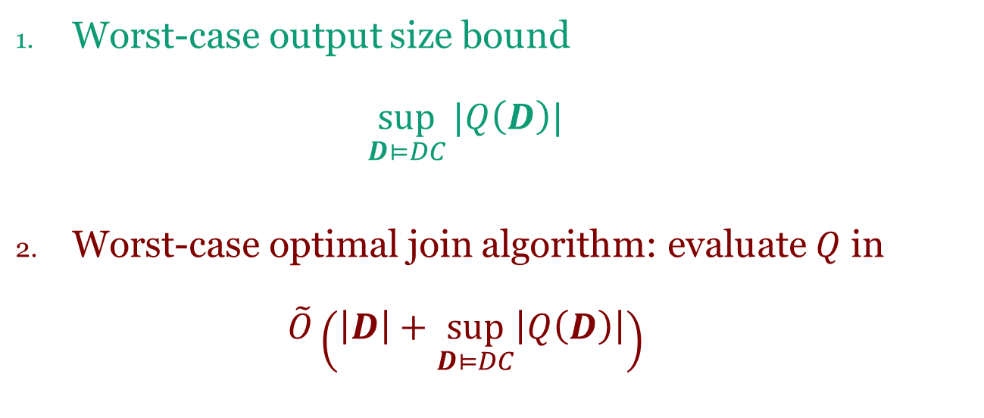
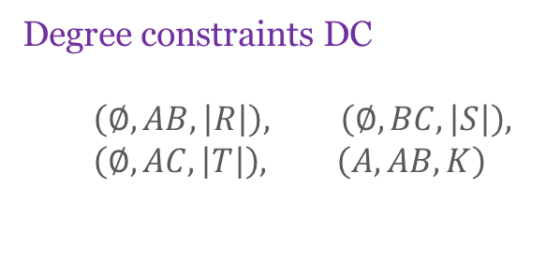
Twin Problems
Full conjunctive query $Q$
$$Q_{Δ}\left(A,B,C\right)←R\left(A,B\right), S\left(B,C\right), T(A,C)$$
Degree constraints DC
$$\left(∅, AB,\left|R\right|\right), \left(∅, BC,\left|S\right|\right), \\ \left(∅, AC,\left|T\right|\right), \left(A, AB,K\right)$$
Worst-case output size bound $\sup_{D⊨DC}{|Q\left(D\right)|}$
Worst-case optimal join algorithm: evaluate $Q$ in $\tilde{O}\left(\left|D\right|+\sup_{D⊨DC}\left|Q\left(D\right)\right|\right)$

Slide 7

$$\sup_{D⊨DC}{|Q\left(D\right)|}$$
Geometry
[Loomis-Whitney 1949, isoperimetric inequalities]
[Bollobas-Thomason 1995] the Holder argument!
Extremal combinatorics, graph theory
[Alon 81]
[Chung, Graham, Frankl, Shearer, 86] the entropy argument!
[Friedgut-Kahn 98]
Constraint satisfaction
[Grohe & Marx SODA’06]
Databases
[Atserias, Grohe, Marx FOCS’08]
[Gottlob, Lee, Valiant, Valiant JACM’2012]
[Ngo, Porat, Re, Rudra PODS’12]
[Abo Khamis, Ngo, Suciu PODS’16, PODS’17]

Slide 8
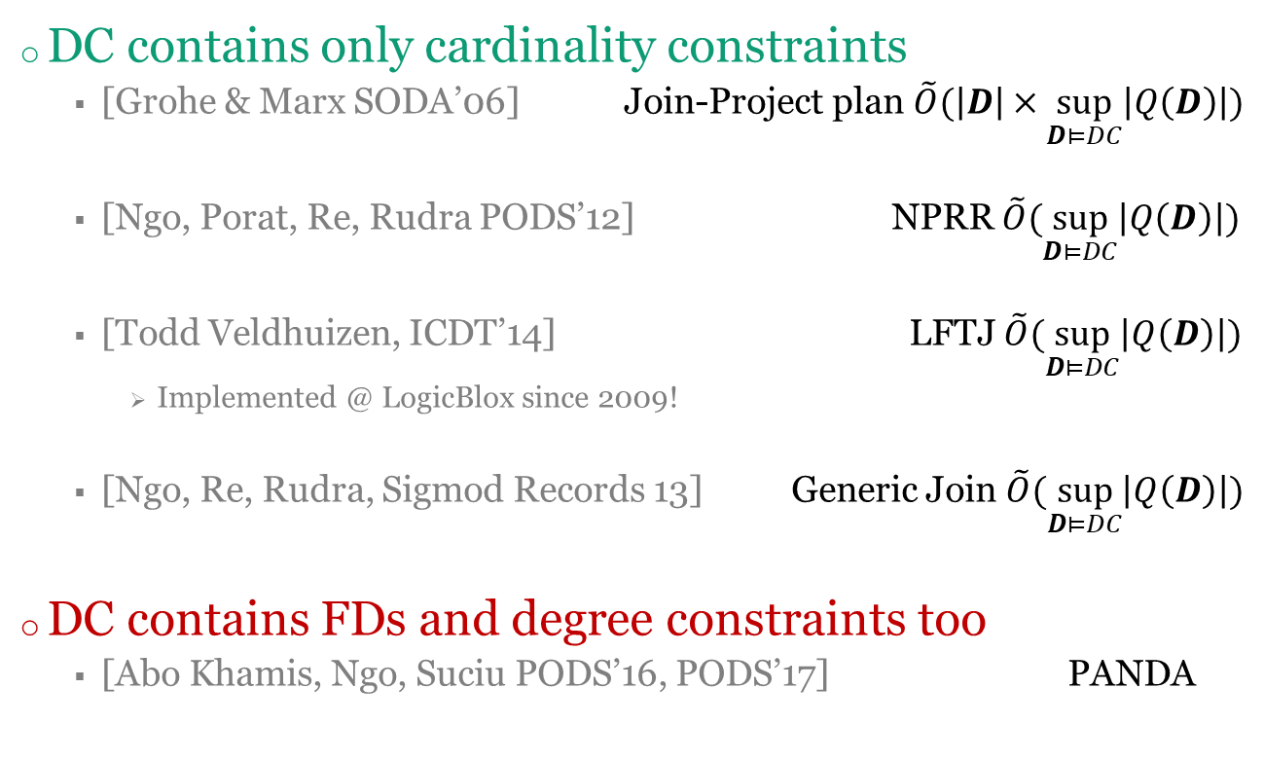
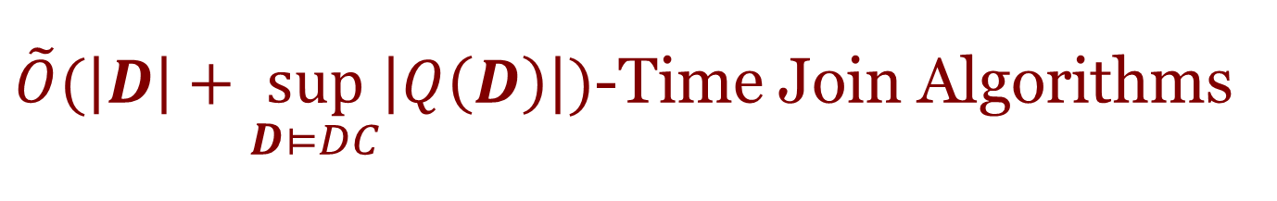
$\tilde{O}(\left|D\right|+\sup_{D⊨DC}\left|Q\left(D\right)\right|)$-Time Join Algorithms
DC contains only cardinality constraints
[Grohe & Marx SODA’06] Join-Project plan $\tilde{O}(\left|D\right|×\sup_{D⊨DC}\left|Q\left(D\right)\right|)$
[Ngo, Porat, Re, Rudra PODS’12] NPRR $\tilde{O}(\sup_{D⊨DC}\left|Q\left(D\right)\right|)$
[Todd Veldhuizen, ICDT’14] LFTJ $\tilde{O}(\sup_{D⊨DC}\left|Q\left(D\right)\right|)$
Implemented @ LogicBlox since 2009!
[Ngo, Re, Rudra, Sigmod Records 13] Generic Join $\tilde{O}(\sup_{D⊨DC}\left|Q\left(D\right)\right|)$
DC contains FDs and degree constraints too
[Abo Khamis, Ngo, Suciu PODS’16, PODS’17] PANDA

Slide 9
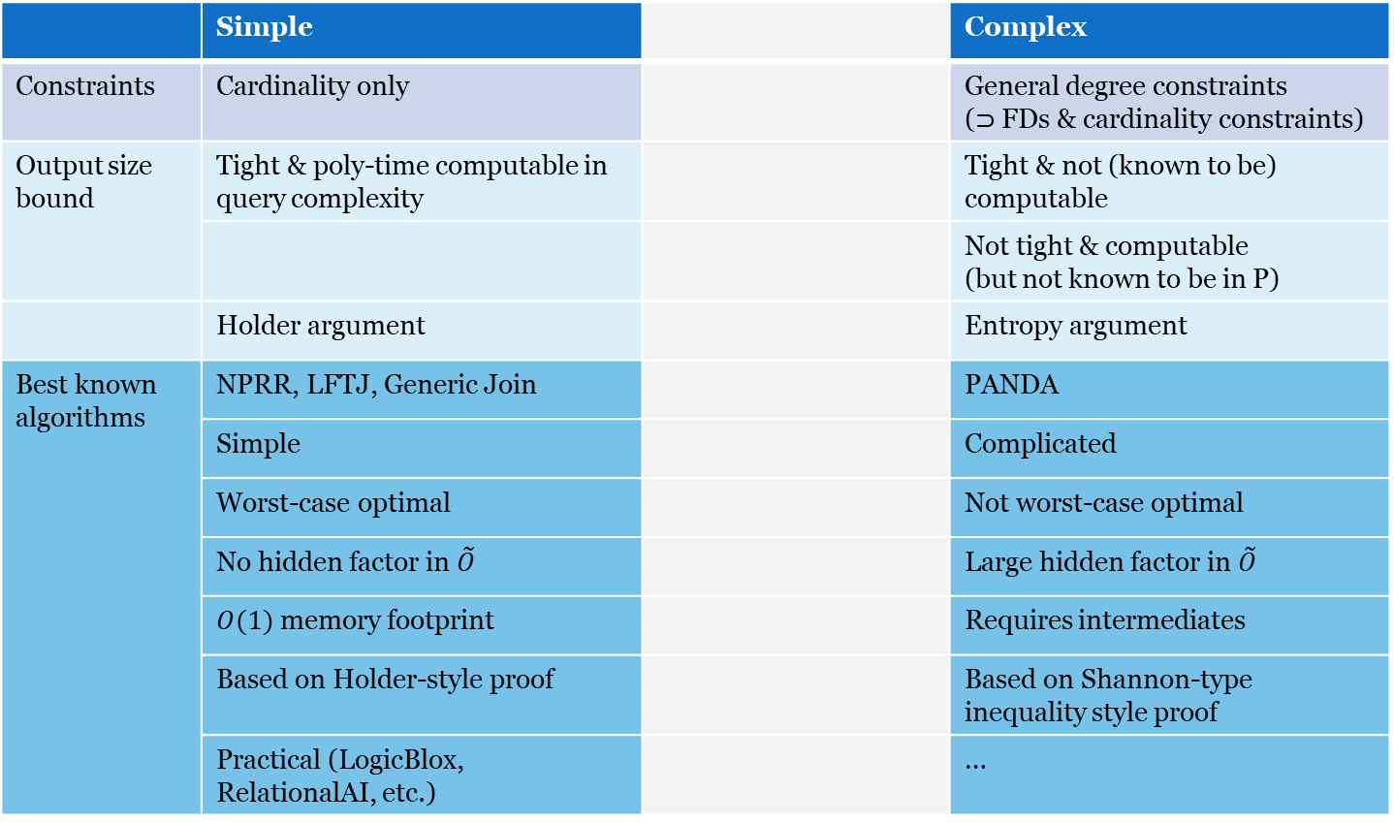
Spectrum of Problems and Solutions
 | Simple |  | Complex
Constraints | Cardinality only |  | General degree constraints ($⊃$ FDs & cardinality constraints)
Output size bound | Tight & poly-time computable in query complexity |  | Tight & not (known to be) computable
 |  |  | Not tight & computable (but not known to be in P)
 | Holder argument |  | Entropy argument
Best known algorithms | NPRR, LFTJ, Generic Join |  | PANDA
 | Simple |  | Complicated
 | Worst-case optimal |  | Not worst-case optimal
 | No hidden factor in $\tilde{O}$ |  | Large hidden factor in $\tilde{O}$
 | $O(1)$ memory footprint |  | Requires intermediates
 | Based on Holder-style proof |  | Based on Shannon-type inequality style proof
 | Practical (LogicBlox, RelationalAI, etc.) |  | …
This Talk

Slide 10
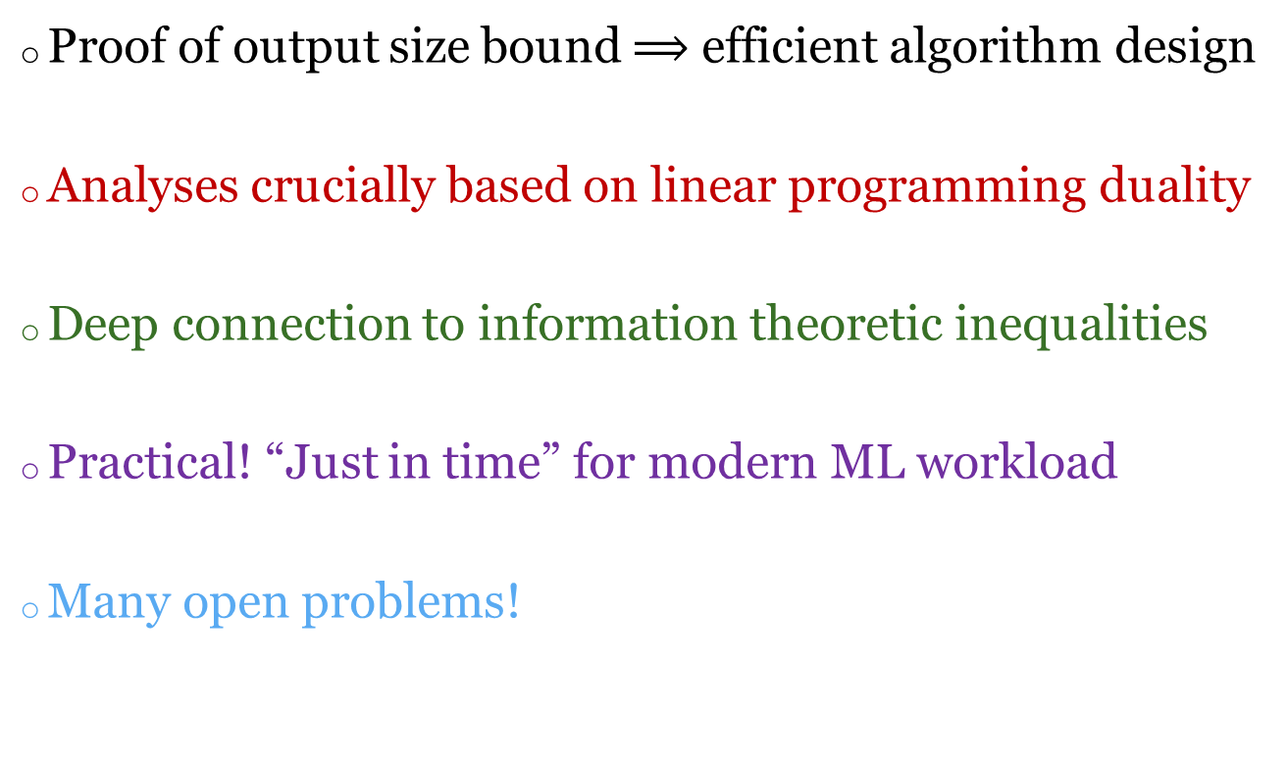
Takeaways
Proof of output size bound $⟹$ efficient algorithm design
Analyses crucially based on linear programming duality
Deep connection to information theoretic inequalities
Practical! “Just in time” for modern ML workload
Many open problems!

Slide 11
Triangle Query Dissected
Beating a dead horse

Slide 12

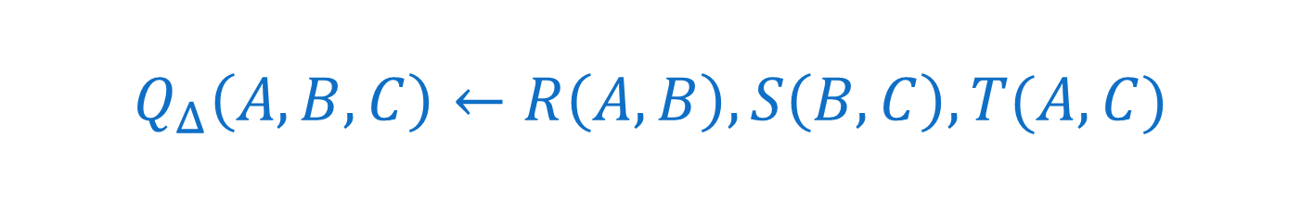
$$Q_{Δ}\left(A,B,C\right)←R\left(A,B\right), S\left(B,C\right), T(A,C)$$
$DC=\{\left(∅, AB,N_{R}\right), \left(∅, BC,N_{S}\right), \left(∅, AC,N_{T}\right)$
$\sup_{D⊨DC}{|Q\left(D\right)|}$= $\max{|R\left(A,B\right)⋈S\left(B,C\right)⋈T(A,C)|}$ subject to $\left|R\right|≤N_{R}$ $\left|S\right|≤N_{S}$ $\left|T\right|≤N_{T}$

Slide 13
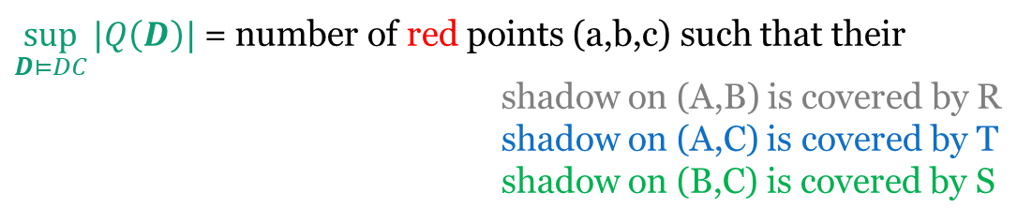
The Geometric View
A
R(A,B)
T(A,C)
B
S(B,C)
C
$\sup_{D⊨DC}{|Q\left(D\right)|}$ = number of red points (a,b,c) such that their shadow on (A,B) is covered by R
shadow on (A,C) is covered by T
shadow on (B,C) is covered by S

Slide 14
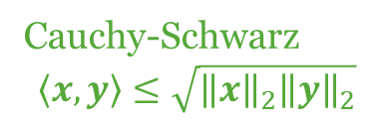
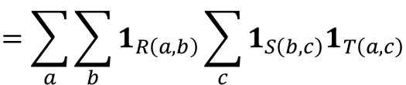
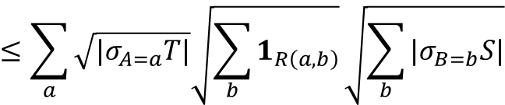
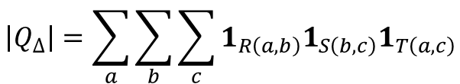
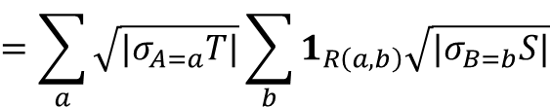

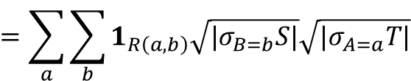
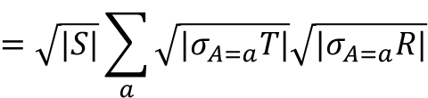
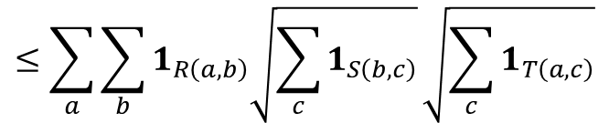
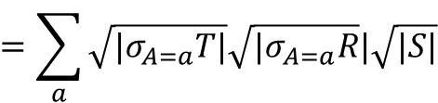
The Holder Argument
$$\left|Q_{Δ}\right|=\sum_{a}{\sum_{b}{\sum_{c}{1_{R\left(a,b\right)}1_{S\left(b,c\right)}1_{T\left(a,c\right)}}}}$$
$$=\sum_{a}{\sum_{b}{1_{R\left(a,b\right)}\sum_{c}{1_{S\left(b,c\right)}1_{T\left(a,c\right)}}}}$$
$$≤\sum_{a}{\sum_{b}{1_{R\left(a,b\right)}\sqrt{\sum_{c}{1_{S\left(b,c\right)}}}\sqrt{\sum_{c}{1_{T\left(a,c\right)}}}}}$$
Cauchy-Schwarz
$$\left\langle x,y\right\rangle ≤\sqrt{{\left\|x\right\|}_{2}{\left\|y\right\|}_{2}}$$
$$=\sum_{a}{\sum_{b}{1_{R\left(a,b\right)}\sqrt{{|σ}_{B=b}S|}\sqrt{{|σ}_{A=a}T|}}}$$
$$=\sum_{a}{\sqrt{|σ_{A=a}T|}\sum_{b}{1_{R\left(a,b\right)}\sqrt{|σ_{B=b}S|}}}$$
$$≤\sum_{a}{\sqrt{|σ_{A=a}T|}\sqrt{\sum_{b}{1_{R\left(a,b\right)}}}\sqrt{\sum_{b}{|σ_{B=b}S|}}}$$
Cauchy-Schwarz
$$=\sum_{a}{\sqrt{|σ_{A=a}T|}\sqrt{{|σ}_{A=a}R}|\sqrt{|S|}}$$
$$=\sqrt{|S|}\sum_{a}{\sqrt{{|σ}_{A=a}T|}\sqrt{{|σ}_{A=a}R|}}$$
$$≤\sqrt{\left|R\right|⋅\left|S\right|⋅|T|}$$
E.g. number of triangles in a graph is $O(m^{1.5})$ [Alon, 1981]

Slide 15
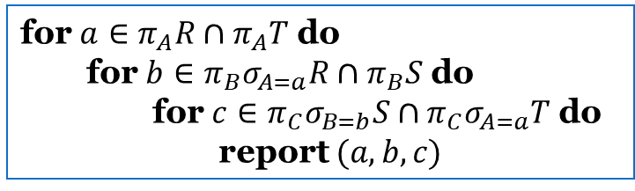
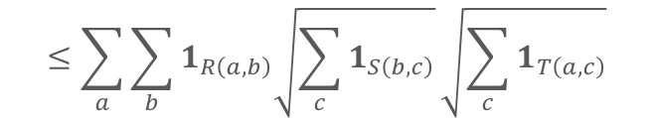



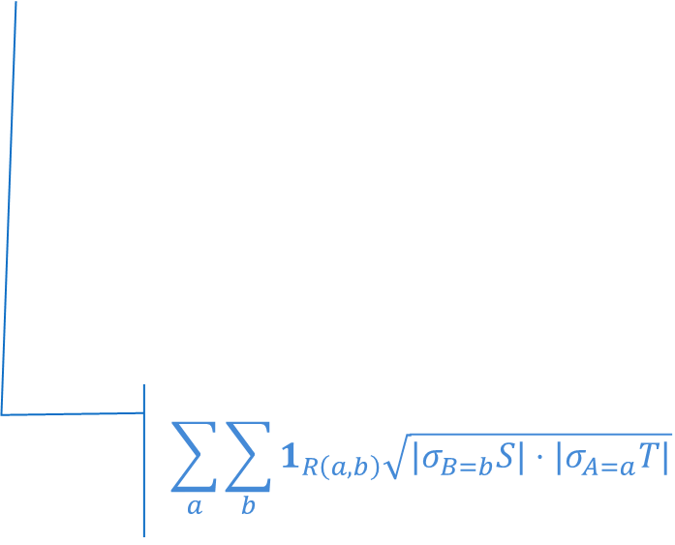
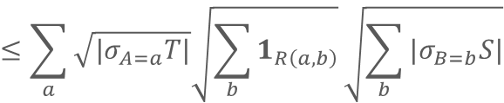
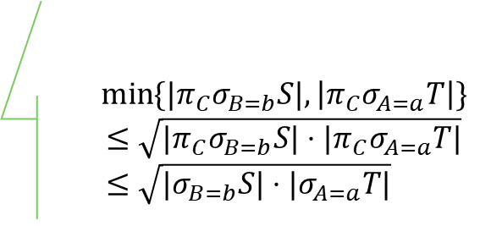


Algorithm from Holder argument
$$Q_{Δ}\left(A,B,C\right)←R\left(A,B\right), S\left(B,C\right), T(A,C)$$
for $a∈π_{A}R∩π_{A}T$ do
for $b∈π_{B}σ_{A=a}R∩π_{B}S$ do
for $c∈π_{C}σ_{B=b}S∩π_{C}σ_{A=a}T$ do report $(a,b,c)$
$$\left|Q_{Δ}\right|=\sum_{a}{\sum_{b}{\sum_{c}{1_{R\left(a,b\right)}1_{S\left(b,c\right)}1_{T\left(a,c\right)}}}}$$
$$≤\sum_{a}{\sum_{b}{1_{R\left(a,b\right)}\sqrt{\sum_{c}{1_{S\left(b,c\right)}}}\sqrt{\sum_{c}{1_{T\left(a,c\right)}}}}}$$
$$\min{\{{|π}_{C}σ_{B=b}S|,\left|π_{C}σ_{A=a}T\right|\}}$$
$$≤\sqrt{{|π}_{C}σ_{B=b}S|⋅|π_{C}σ_{A=a}T|} \\ ≤\sqrt{|σ_{B=b}S|⋅|σ_{A=a}T|}$$
$$=\sum_{a}{\sum_{b}{1_{R\left(a,b\right)}\sqrt{{|σ}_{B=b}S|}\sqrt{|σ_{A=a}T|}}}$$
Total runtime:
$$≤\sum_{a}{\sqrt{{|σ}_{A=a}T|}\sqrt{\sum_{b}{1_{R\left(a,b\right)}}}\sqrt{\sum_{b}{{|σ}_{B=b}S|}}}$$
$$\sum_{a}{\sum_{b}{1_{R\left(a,b\right)}\sqrt{|σ_{B=b}S|⋅|σ_{A=a}T|} }}$$
$$=\sum_{a}{\sqrt{{|σ}_{A=a}T|}\sqrt{{|σ}_{A=a}R|}\sqrt{|S|}}$$
$$≤\sqrt{\left|R\right|⋅\left|S\right|⋅|T|}$$

Slide 16






The Entropy View (Shearer)
R
S
T
Q
A | B
1 | 1
1 | 2
2 | 2
2 | 5
2 | 6
B | C
1 | 1
1 | 2
2 | 1
2 | 2
3 | 1
3 | 3
A | C
1 | 1
1 | 2
2 | 1
2 | 2
A | B | C
1 | 1 | 1
1 | 1 | 2
1 | 2 | 1
1 | 2 | 2
2 | 2 | 1
2 | 2 | 2
1/3
1/3
1/3
¼
0
1/6
1/6
1/3
1/3
0
0
1/3
1/3
1/6
1/6
1/6
1/6
1/6
1/6
1/6
1/6
4
5
6
$$H\left[A,C\right]≤\log_{2}{|T|}$$
$$H\left[A,B\right]≤\log_{2}{|R|}$$
$$H\left[B,C\right]≤\log_{2}{|S|}$$
$$H\left[A,B,C\right]=\log_{2}{|Q_{Δ}|}$$
$$H\left[B|A\right]≤\log_{2}{3}$$
$$H\left[A|B\right]≤\log_{2}{2}$$

Slide 17
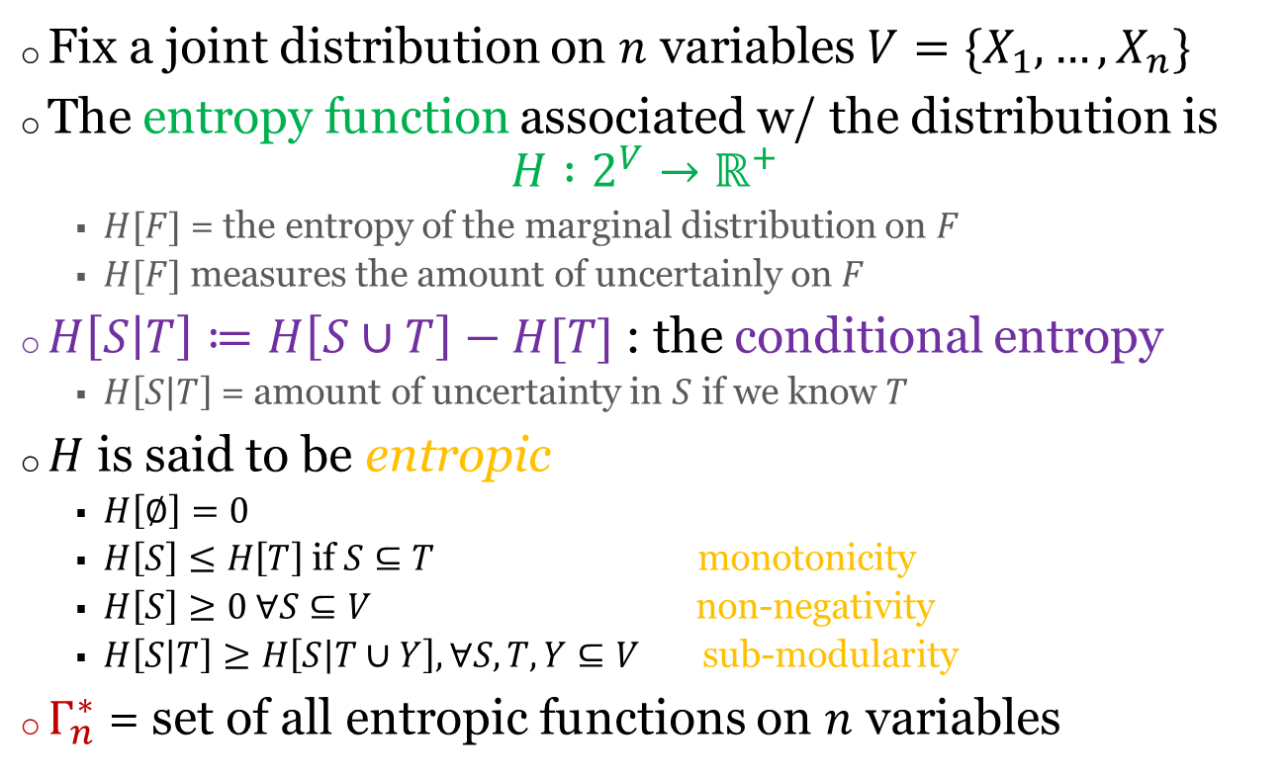
Information Theory Detour
Fix a joint distribution on $n$ variables$V=\{X_{1},…, X_{n}\}$
The entropy function associated w/ the distribution is $H :2^{V}→ℝ^{+}$
$H[F]$ = the entropy of the marginal distribution on $F$
$H[F]$ measures the amount of uncertainly on $F$
$H\left[S | T\right]≔H\left[S∪T\right]−H[T]$ : the conditional entropy
$H\left[S | T\right]$ = amount of uncertainty in $S$ if we know $T$
$H$ is said to be entropic
$H\left[∅\right]=0$
$H\left[S\right]≤H\left[T\right]$ if $S⊆T$ monotonicity
$H\left[S\right]≥0 ∀S⊆V$ non-negativity
$H\left[S | T\right]≥H\left[S | T∪Y\right], ∀S, T, Y⊆V$ sub-modularity
$Γ_{n}^{∗}$ = set of all entropic functions on $n$ variables
Shannon-type
inequalities

Slide 18

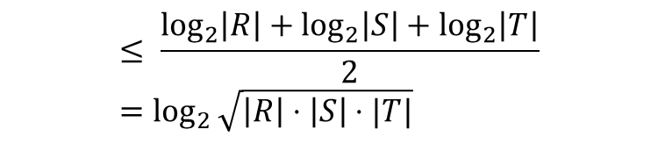

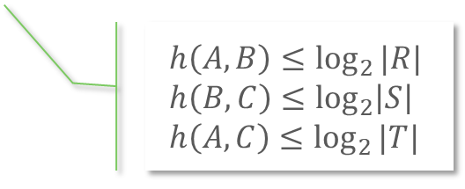

The Entropy Argument
There is a joint distribution on (A,B,C)
for which h is the entropy function of
$$\log\left|Q_{Δ}\right|=H\left[A,B,C\right]≤\max{h(A,B,C)}$$
s.t. $h$ is entropic
& $h$ satisfies degree constraints
$$h\left(A,B\right)≤\log_{2}{|R|} \\ h\left(B,C\right)≤\log_{2}\left|S\right| \\ h\left(A,C\right)≤\log_{2}{|T|}$$
$$h\left(A,B\right)+h\left(B,C\right)+h\left(A,C\right)$$
$$=h\left(A\right)+h\left(B | A\right)+h\left(B,C\right)+h\left(A,C\right)$$
Defn. of conditional entropy
$$=\left[h\left(A\right)+h\left(B,C\right)\right] +[h(B|A) +h\left(A,C\right)]$$
$$≥\left[h\left(A|B,C\right)+h\left(B,C\right)\right]+[h(B|A,C) +h\left(A,C\right)]$$
Submodularity, twice
$$=h\left(A,B,C\right) + h(A,B,C)$$
$$\log\left|Q_{Δ}\right|≤\max_{h∈Γ_{3}^{∗}∩DC}{h\left(A,B,C\right)}≤\max_{h∈Γ_{3}^{∗}∩DC}{\frac{h\left(A,B\right)+h\left(B,C\right)+h(A,C)}{2}}$$
$$≤ \frac{\log_{2}\left|R\right|+\log_{2}\left|S\right|+\log_{2}\left|T\right|}{2}=\log_{2}{\sqrt{\left|R\right|⋅\left|S\right|⋅|T|}}$$

Slide 19



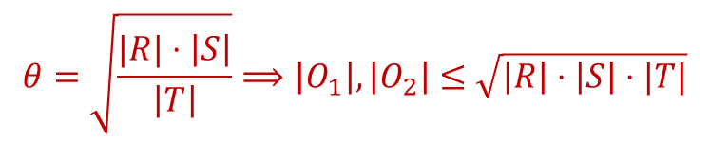













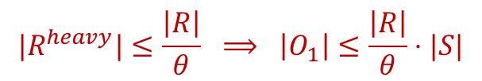



Algorithm from Entropy Argument
$$Q_{Δ}\left(A,B,C\right)←R\left(A,B\right), S\left(B,C\right), T(A,C)$$
$$R^{heavy}=\{\left(a,b\right)∈R :\left|σ_{A=a}R\right|>θ\}$$
$$R$$
$$S$$
$$T$$
$$R^{light}=\{\left(a,b\right)∈R :\left|σ_{A=a}R\right|≤θ\}$$
$$h\left(A,B\right)+h\left(B,C\right)+h\left(A,C\right)$$
$$R^{h}$$
$$R^{l}$$
$$=h\left(A\right)+h\left(B | A\right)+h\left(B,C\right)+h\left(A,C\right)$$
$$R(A,B)=R^{heavy}(A,B)∪R^{light}(A,B)$$
$$=\left[h\left(A\right)+h\left(B,C\right)\right] +[h(B|A) +h\left(A,C\right)]$$
$$R^{h}$$
$$S$$
$$R^{l}$$
$$T$$
$$O_{1}(A,B,C)=R^{heavy}(A,B)⋈S(B,C)$$
$$≥\left[h\left(A|B,C\right)+h\left(B,C\right)\right]+[h(B|A,C) +h\left(A,C\right)]$$
$$O_{2}(A,B,C)=R^{light}(A,B)⋈T(A,C)$$
$$=h\left(A,B,C\right) + h(A,B,C)$$
$${{Q_{Δ}=O}_{1}∪O}_{2}$$
$${|R}^{heavy}|≤\frac{\left|R\right|}{θ} ⟹ \left|O_{1}\right|≤\frac{\left|R\right|}{θ}⋅|S|$$
$$θ=\sqrt{\frac{|R|⋅\left|S\right|}{\left|T\right|}}⟹\left|O_{1}\right|, \left|O_{2}\right|≤\sqrt{\left|R\right|⋅\left|S\right|⋅|T|}$$
$$\left|O_{2}\right|≤\left|T\right|⋅θ$$

Slide 20


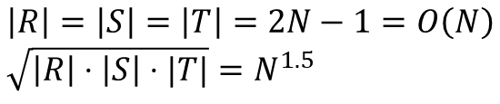

Any Pairwise Join Plan is Sub-Optimal
$$N$$
$$\left|R\right|=\left|S\right|=\left|T\right|=2N−1=O\left(N\right) \\ \sqrt{\left|R\right|⋅\left|S\right|⋅|T|}=N^{1.5}$$
R
T
$$N$$
$$N$$
S
⨝
⨝
⨝
Ω(N²)
T
Ω(N²)
R
Ω(N²)
S
⨝
⨝
⨝
R
S
T
S
R
T

Slide 21
Holder-based Bound
Holder wasn’t the first to prove the inequality

Slide 22



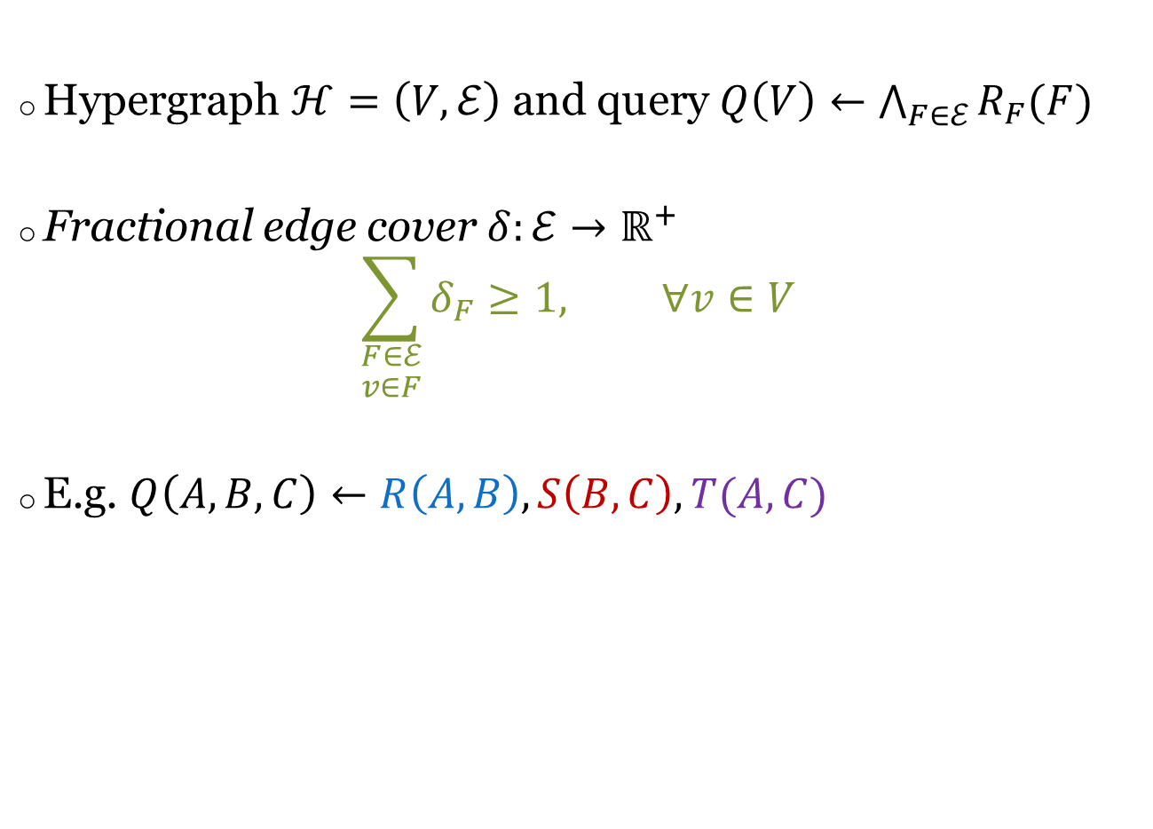



Fractional Edge Cover
Hypergraph $ℋ=\left(V,ℰ\right)$ and query $Q\left(V\right)←\bigwedge_{F∈ℰ}{R_{F}(F)}$
Fractional edge cover $δ:ℰ→ℝ^{+}$ $\sum_{\begin{aligned}F∈ℰ \\ v∈F\end{aligned}}{δ_{F}≥1, } ∀v∈V$
E.g. $Q\left(A,B,C\right)←R\left(A,B\right), S\left(B,C\right), T(A,C)$
R
T
R
T
A
A
$$δ_{R}=1/2$$
$$δ_{T}=1/2$$
$$δ_{R}=1$$
$$δ_{T}=1$$
S
S
B
C
B
C
$$δ_{S}=1/2$$
$$δ_{S}=0$$

Slide 23
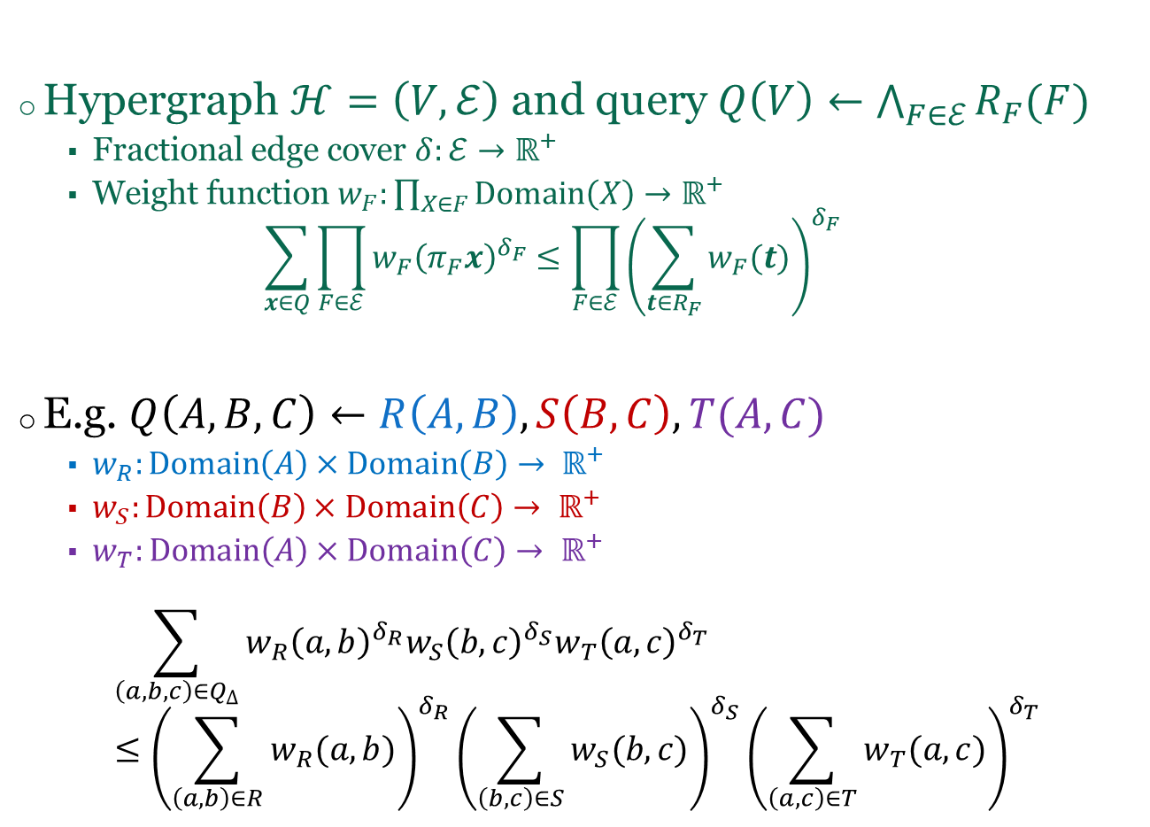
Friedgut Inequality (2004)
Hypergraph $ℋ=\left(V,ℰ\right)$ and query $Q\left(V\right)←\bigwedge_{F∈ℰ}{R_{F}(F)}$
Fractional edge cover $δ:ℰ→ℝ^{+}$
Weight function $w_{F}:\prod_{X∈F}{Domain\left(X\right)→ℝ^{+}}$ $\sum_{x∈Q}{\prod_{F∈ℰ}{{w_{F}\left(π_{F}x\right)}^{δ_{F}}}≤\prod_{F∈ℰ}{{\left(\sum_{t∈R_{F}}{w_{F}(t)}\right)}^{δ_{F}}}}$
E.g. $Q\left(A,B,C\right)←R\left(A,B\right), S\left(B,C\right), T(A,C)$
$w_{R}:Domain\left(A\right)×Domain\left(B\right)→ ℝ^{+}$
$w_{S}:Domain\left(B\right)×Domain\left(C\right)→ ℝ^{+}$
$w_{T}:Domain\left(A\right)×Domain\left(C\right)→ ℝ^{+}$
$$\sum_{\left(a,b,c\right)∈Q_{Δ}}{w_{R}{\left(a,b\right)}^{δ_{R}}w_{S}{\left(b,c\right)}^{δ_{S}}w_{T}{\left(a,c\right)}^{δ_{T}} }≤{\left(\sum_{\left(a,b\right)∈R}{w_{R}(a,b)}\right)}^{δ_{R}}{\left(\sum_{\left(b,c\right)∈S}{w_{S}(b,c)}\right)}^{δ_{S}}{\left(\sum_{\left(a,c\right)∈T}{w_{T}(a,c)}\right)}^{δ_{T}}$$
R
T
A
S
B
C

Slide 24
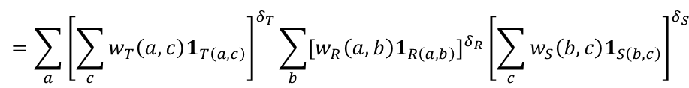
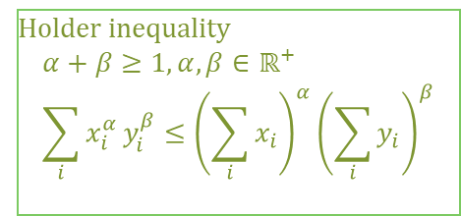
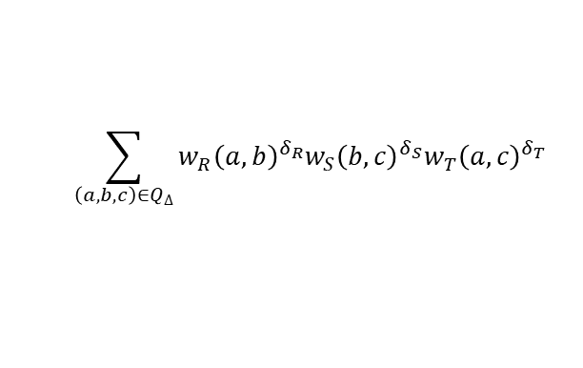
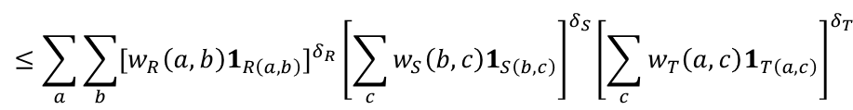


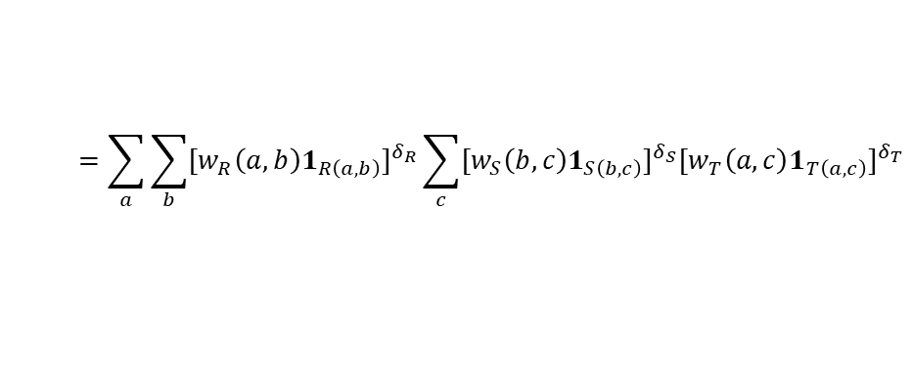
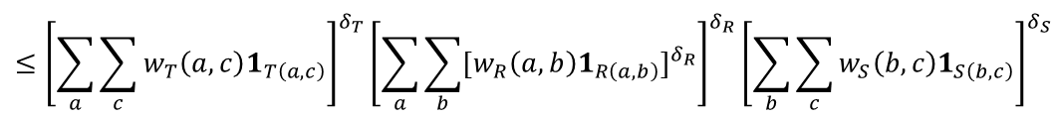
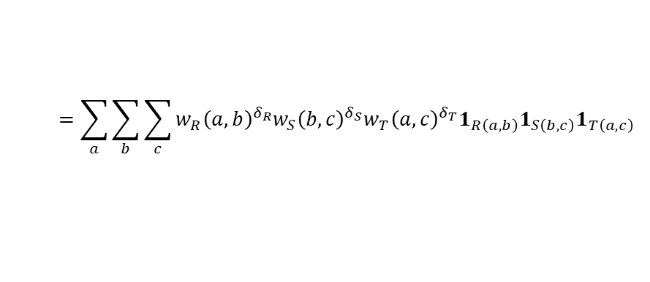
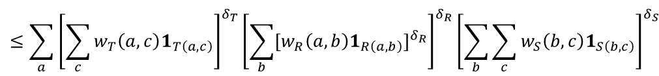
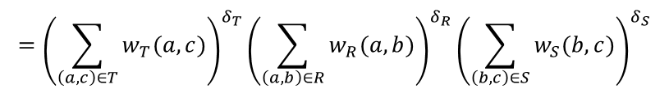
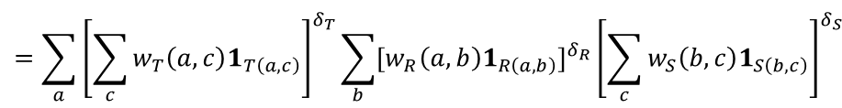
Proof for $n=3$, then let $3→∞$
$$\sum_{\left(a,b,c\right)∈Q_{Δ}}{w_{R}{\left(a,b\right)}^{δ_{R}}w_{S}{\left(b,c\right)}^{δ_{S}}w_{T}{\left(a,c\right)}^{δ_{T}} }$$
$$=\sum_{a}{\sum_{b}{\sum_{c}{w_{R}{\left(a,b\right)}^{δ_{R}}w_{S}{\left(b,c\right)}^{δ_{S}}w_{T}{\left(a,c\right)}^{δ_{T}}1_{R\left(a,b\right)}1_{S\left(b,c\right)}1_{T\left(a,c\right)}}} }$$
$$=\sum_{a}{\sum_{b}{{{[w}_{R}\left(a,b\right)1_{R\left(a,b\right)}]}^{δ_{R}}\sum_{c}{{{[w}_{S}\left(b,c\right)1_{S\left(b,c\right)}]}^{δ_{S}}{{[w}_{T}\left(a,c\right)1_{T\left(a,c\right)}]}^{δ_{T}}}} }$$
Holder inequality $$α+β≥1, α, β∈ℝ^{+} \\ \sum_{i}{x_{i}^{α}}y_{i}^{β}≤{\left(\sum_{i}{x_{i}}\right)}^{α}{\left(\sum_{i}{y_{i}}\right)}^{β}$$
$$≤\sum_{a}{\sum_{b}{{{[w}_{R}\left(a,b\right)1_{R\left(a,b\right)}]}^{δ_{R}}{\left[\sum_{c}{w_{S}\left(b,c\right)1_{S\left(b,c\right)}}\right]}^{δ_{S}}{\left[\sum_{c}{w_{T}\left(a,c\right)1_{T\left(a,c\right)}}\right]}^{δ_{T}}} }$$
$$=\sum_{a}{{\left[\sum_{c}{w_{T}\left(a,c\right)1_{T\left(a,c\right)}}\right]}^{δ_{T}}\sum_{b}{{{[w}_{R}\left(a,b\right)1_{R\left(a,b\right)}]}^{δ_{R}}{\left[\sum_{c}{w_{S}\left(b,c\right)1_{S\left(b,c\right)}}\right]}^{δ_{S}}} }$$
$$=\sum_{a}{{\left[\sum_{c}{w_{T}\left(a,c\right)1_{T\left(a,c\right)}}\right]}^{δ_{T}}\sum_{b}{{{[w}_{R}\left(a,b\right)1_{R\left(a,b\right)}]}^{δ_{R}}{\left[\sum_{c}{w_{S}\left(b,c\right)1_{S\left(b,c\right)}}\right]}^{δ_{S}}} }$$
$$δ_{S}+δ_{T}≥1$$
$$≤\sum_{a}{{\left[\sum_{c}{w_{T}\left(a,c\right)1_{T\left(a,c\right)}}\right]}^{δ_{T}}{\left[\sum_{b}{{{[w}_{R}\left(a,b\right)1_{R\left(a,b\right)}]}^{δ_{R}}}\right]}^{δ_{R}}{\left[\sum_{b}{\sum_{c}{w_{S}\left(b,c\right)1_{S\left(b,c\right)}}}\right]}^{δ_{S}} }$$
$$≤{\left[\sum_{a}{\sum_{c}{w_{T}\left(a,c\right)1_{T\left(a,c\right)}}}\right]}^{δ_{T}}{\left[\sum_{a}{\sum_{b}{{{[w}_{R}\left(a,b\right)1_{R\left(a,b\right)}]}^{δ_{R}}}}\right]}^{δ_{R}}{\left[\sum_{b}{\sum_{c}{w_{S}\left(b,c\right)1_{S\left(b,c\right)}}}\right]}^{δ_{S}}$$
$$={\left(\sum_{\left(a,c\right)∈T}{w_{T}(a,c)}\right)}^{δ_{T}}{\left(\sum_{\left(a,b\right)∈R}{w_{R}(a,b)}\right)}^{δ_{R}}{\left(\sum_{\left(b,c\right)∈S}{w_{S}(b,c)}\right)}^{δ_{S}}$$

Slide 25
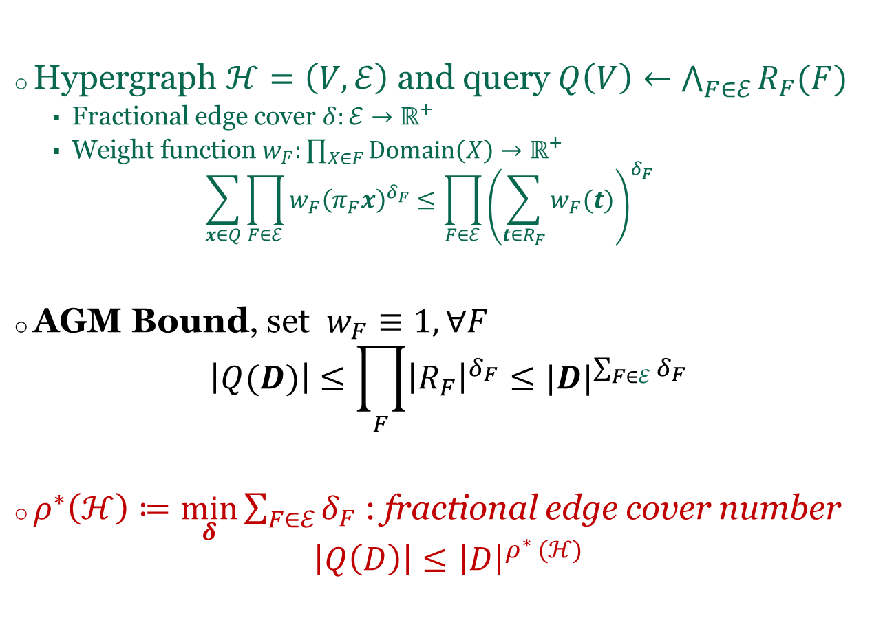

Friedgut Inequality $⇒$ AGM-Bound
Hypergraph $ℋ=\left(V,ℰ\right)$ and query $Q\left(V\right)←\bigwedge_{F∈ℰ}{R_{F}(F)}$
Fractional edge cover $δ:ℰ→ℝ^{+}$
Weight function $w_{F}:\prod_{X∈F}{Domain\left(X\right)→ℝ^{+}}$ $\sum_{x∈Q}{\prod_{F∈ℰ}{{w_{F}\left(π_{F}x\right)}^{δ_{F}}}≤\prod_{F∈ℰ}{{\left(\sum_{t∈R_{F}}{w_{F}(t)}\right)}^{δ_{F}}}}$
AGM Bound, set $w_{F}≡1, ∀F$ $\left|Q(D)\right|≤\prod_{F}{{\left|R_{F}\right|}^{δ_{F}}}≤{|D|}^{\sum_{F∈ℰ}{δ_{F}}}$
$ρ^{∗}\left(ℋ\right)≔\min_{δ}{\sum_{F∈ℰ}{δ_{F}}}$ : fractional edge cover number $\left|Q\left(D\right)\right|≤{\left|D\right|}^{ρ^{∗} (ℋ)}$

Slide 26
Entropy-based Bound
The argument from Chung, Graham, Frankl, and Shearer

Slide 27
Information Theory Reminder
Fix a joint distribution on $n$ variables$V=\{X_{1},…, X_{n}\}$
The entropy function associated w/ the distribution is $H :2^{V}→ℝ^{+}$
$H[F]$ = the entropy of the marginal distribution on $F$
$H[F]$ measures the amount of uncertainly on $F$
$H\left[S | T\right]≔H\left[S∪T\right]−H[T]$ : the conditional entropy
$H\left[S | T\right]$ = amount of uncertainty in $S$ if we know $T$
$H$ is said to be entropic
$H\left[∅\right]=0$
$H\left[S\right]≤H\left[T\right]$ if $S⊆T$ monotonicity
$H\left[S\right]≥0 ∀S⊆V$ non-negativity
$H\left[S | T\right]≥H\left[S | T∪Y\right], ∀S, T, Y⊆V$ sub-modularity
$Γ_{n}^{∗}$ = set of all entropic functions on $n$ variables
Shannon-type
inequalities

Slide 28
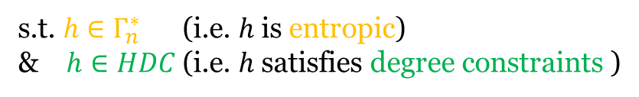

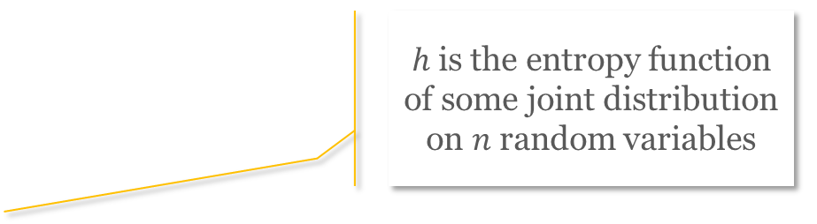
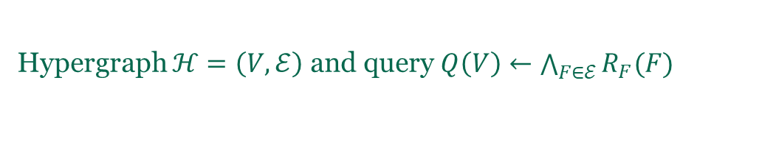
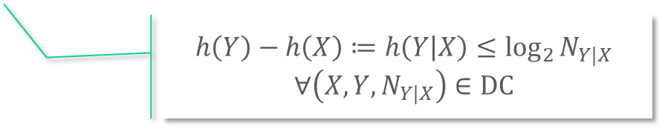
The Entropy Argument
$h$ is the entropy function of some joint distribution on $n$ random variables
Hypergraph $ℋ=\left(V,ℰ\right)$ and query $Q\left(V\right)←\bigwedge_{F∈ℰ}{R_{F}(F)}$
$$\log_{2}\left|Q(D)\right|=H\left[V\right]≤\max{h(V)}$$
s.t. $h∈Γ_{n}^{∗}$ (i.e. $h$ is entropic)
& $h∈HDC$ (i.e. $h$satisfies degree constraints )
$$h\left(Y\right)−h\left(X\right)≔h\left(Y | X\right)≤\log_{2}{N_{Y|X}}$$
$∀\left(X, Y, N_{Y|X}\right)∈DC$
The entropic bound $$\sup_{D⊨DC}{\log_{2}{|Q\left(D\right)|}}=\sup\left\{h\left(V\right) \right| h∈Γ_{n}^{∗}∩HDC\}$$
[ANS’16]
Is a cone
Not topologically closed
Not polyhedral
Membership not known to be decidable

Slide 29
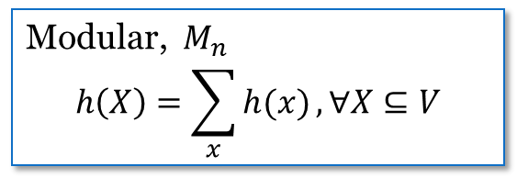






Relaxations $M_{n}⊂Γ_{n}^{∗}⊂{\overline{Γ}}_{n}^{∗}⊂Γ_{n}⊂{SA}_{n}$
Non-negative set functions $h :2^{V}→ℝ^{+}$
${SA}_{n}$
Monotonicity $h\left(S\right)≤h\left(T\right), S⊆T$
Subadditivity $h\left(S∪T\right)≤h\left(S)+h(T\right), ∀S,T⊆[V]$
Polymatroids,$Γ_{n}$
Submodularity $h\left(S∪T\right)+h\left(S∩T\right)≤h\left(S\right)+h\left(T\right)$
Topological closure,${\overline{Γ}}_{n}^{∗}$
Entropic, $Γ_{n}^{∗}$
Modular, $M_{n}$ $$h\left(X\right)=\sum_{x}{h(x)}, ∀X⊆V$$

Slide 30





Hierarchy $M_{n}⊂Γ_{n}^{∗}⊂{\overline{Γ}}_{n}^{∗}⊂Γ_{n}⊂{SA}_{n}$
$$\max\left\{h\left(V\right) \right| h∈M_{n}∩HDC\}≤$$
Modular bound
Efficiently computable
$$\sup_{D⊨DC}{\log_{2}{|Q\left(D\right)|}}=\sup\left\{h\left(V\right) \right| h∈Γ_{n}^{∗}∩HDC\}$$
Entropic bound
Not known to be computable
$$=\max\left\{h\left(V\right) \right| h∈{\overline{Γ}}_{n}^{∗}∩HDC\}$$
Polymatroid bound
Computable
Not (known to be) efficiently computable
Not tight
Becomes fractional edge cover # under cardinality constraints
$$≤\max\left\{h\left(V\right) \right| h∈Γ_{n}∩HDC\}$$
$$≤\max\left\{h\left(V\right) \right| h∈{SA}_{n}∩HDC\}$$
Becomes integral edge cover # under cardinality constraints

Slide 31


Natural Follow-Up Questions
Entropic bound
Not known to be computable
Polymatroid bound
Computable, not tight
$$\sup_{D⊨DC}{\log_{2}{|Q\left(D\right)|}}=\max\left\{h\left(V\right) \right| h∈{\overline{Γ}}_{n}^{∗}∩HDC\}$$
$$≤\max\left\{h\left(V\right) \right| h∈Γ_{n}∩HDC\}$$
When do these two bounds collide?
When they do, is there a matching algorithm?

Slide 32

Degree-Constraint Dependency Graph
$G_{DC}=\left(V,E_{DC}\right)$
$V$ = set of all variables -- same as $V$ in $ℋ=\left(V,ℰ\right)$
$E_{DC}=\{X×\left(Y−X\right) :\left(X,Y,N\right)∈DC\}$
Ex 1: $Q\left(A,B,C\right)←R\left(A,B\right), S\left(B,C\right), T(A,C)$
$\left(∅, AB, \left|R\right|\right), \left(∅, BC,\left|S\right|\right), \left(∅, AC, \left|T\right|\right)$
$G_{DC}=(\left\{A,B,C,\right\}, ∅)$
Ex 2: $Q\left(A,B,C\right)←R\left(A,B\right), S\left(B,C\right), T(A,C)$
$\left(∅, AB, \left|R\right|\right),\left(A AB, 1\right), \left(∅, BC,\left|S\right|\right),\left(C, BC,N_{2}\right),\left(∅, AC, \left|T\right|\right)$
Ex 3: $Q\left(A,B,C\right)←R\left(A,B\right), S\left(B,C\right), T(A,C)$
$\left(∅, AB, \left|R\right|\right),\left(A AB, 1\right), \left(∅, BC,\left|S\right|\right),\left(B, BC,N_{2}\right),$
$\left(∅, AC, \left|T\right|\right), (C, AC,N_{3})$
A
B
C
A
B
C
A
B
C

Slide 33


Acyclic Degree Constraints & Properties
DC is acyclic iff $G_{DC}$ is a directed acyclic graph (DAG)
DC is acyclic if it contains only cardinality constraints
DC is acyclic if it has cardinality constraints and key-foreign key FDs
Recall: the modular bound is efficiently computable! $M_{n}=\left\{h:2^{V}→ℝ^{+} \right| h\left(X\right)=\sum_{x}{h(x)}, ∀X⊆V\}$
Theorem: given $Q$ and acyclic DC, then $\max_{h∈M_{n}∩HDC}{h\left(V\right)=}\sup_{D⊨DC}{\log_{2}{|Q\left(D\right)|}}=\max_{h∈{\overline{Γ}}_{n}^{∗}∩HDC}{h\left(V\right)}$ =$\max_{h∈Γ_{n}∩HDC}{h\left(V\right)}$

Slide 34





$\max_{h∈M_{n}∩HDC}{h\left(V\right)}$ and Linear Programming Duality
$$\max{\sum_{v∈V}{h(v)}}$$
$$\sum_{v∈Y−X}{h\left(v\right)≤\log{N_{Y|X}}, \left(X,Y,N_{Y|X}\right)∈DC}$$
$h\left(v\right)≥0, v∈V$
$$\min{\sum_{\left(X,Y,N_{Y|X}\right)∈DC}{δ_{Y|X}\log{N_{Y|X}}}}$$
$$\sum_{\begin{aligned}\left(X,Y,N_{Y|X}\right)∈DC \\ v∈Y−X\end{aligned}}{δ_{Y|X}≥1, v∈V}$$
$δ_{Y|X}≥0, \left(X,Y,N_{Y|X}\right)∈DC$
Fractional vertex packing
Fractional edge covering
Exactly the AGM bound if all constraints are of the form $(∅, Y, N_{Y})$
$h^{∗}$ : primal optimal, and $δ^{∗}$ : dual optimal, then $$\sup_{D⊨DC}\left|Q\left(D\right)\right|=2^{h^{∗}(V)}=\prod_{\left(X,Y,N_{Y|X}\right)∈DC}{N_{Y|X}^{δ_{Y|X}^{∗}}}$$

Slide 35
Natural Follow-Up Questions
Entropic bound
Not known to be computable
Polymatroid bound
Computable, not tight
$$\sup_{D⊨DC}{\log_{2}{|Q\left(D\right)|}}=\max\left\{h\left(V\right) \right| h∈{\overline{Γ}}_{n}^{∗}∩HDC\}$$
$$≤\max\left\{h\left(V\right) \right| h∈Γ_{n}∩HDC\}$$
When do these two bounds collide?
Acyclic DC is sufficient
When they do, is there a matching algorithm?
Yes, a Holder-based algorithm

Slide 36

But what if DC is not acyclic?
Run the entropy-based algorithm (PANDA)
Theorem: when $DC$ is not acyclic, we can construct $DC’$ from $DC$ such that
$DC’$ is acyclic
$D⊨DC⟹D⊨DC′$
Run Holder-based algorithm on $DC′$

Slide 37
Holder-based Algorithm
Backtracking search, along the line of LFTJ & Generic Join

Slide 38


Backtracking Search for Acylic DC
BTS
$ℋ=\left(V,ℰ\right)$Relations $R_{F}$ for $F∈$ $ℰ$
Acyclic DC set, each $\left(X,Y,N_{Y|X}\right)$ has a guard $R$
Input:
Pick $A∈V$ s.t. ${indegree}_{G_{DC}}\left(A\right)=0$
$I=\bigcap_{\begin{aligned}\left(∅,Y,N_{Y|∅}\right)∈DC \\ A∈Y, R guards it\end{aligned}}{π_{A}R}$
for each $a∈I$ do
$ℋ^{a}=\left(V^{a},ℰ^{a}\right);$ relations $R_{F}^{a}$ for $F∈$ $ℰ^{a}$, constraints ${DC}^{a}$
$Q^{a}=BTS(ℋ^{a}$, $R_{F}^{a},DC^{a})$
$Q←Q∪Q^{a}$
Return $Q$

Slide 39









The Sub-Problems
… // variable A selected
for each $a∈I$ do
$ℋ^{a}=\left(V^{a},ℰ^{a}\right);$ relations $R_{F}^{a}$ for $F∈$ $ℰ^{a}$, constraints ${DC}^{a}$
$Q^{a}=BTS(ℋ^{a}$, $R_{F}^{a},DC^{a})$
$Q←Q∪Q^{a}$
…
$$R(A,B,C)$$
$$V^{a}=V−\{A\}$$
$$ℰ^{a}=\{F∖\left\{A\right\} :F∈ℰ\}$$
A | B | C
a | 1 | 1
a | 1 | 2
a | 2 | 3
a’ | 1 | 1
a’ | 1 | 2
a’ | 1 | 3
a’’ | 1 | 1
a’’ | 2 | 2
$$R_{}^{a}$$
$$R_{F}^{a}=\left\{\begin{aligned}R_{F}, A∉F \\ {π_{F−\{A\}}σ}_{A=a}R_{F}, A∈F\end{aligned}\right.$$
$${DC}^{a}=\left\{ \left(X∖\left\{A\right\}, Y∖\left\{A\right\}, N_{Y∖\{A\}|∖\{A\}}\right) \right| \left(X,Y,N_{Y|X}\right)∈DC\}$$
$R^{a}$ guards this
$$⟸$$
$R$ guards this
$$⟸$$

Slide 40






Analysis
$$Time\left(Q\right)≤\sum_{a∈I}{Time(Q^{a})}$$
$$≤\sum_{a∈I}{\prod_{\begin{aligned}\left(∅, Y, N_{Y|∅}\right)∈DC \\ A∈Y \\ R is the guard\end{aligned}}{{|σ_{A=a}R|}^{δ_{Y|∅}}}\prod_{\begin{aligned}\left(X, Y, N_{Y|X}\right)∈DC \\ A∉Y\end{aligned}}{N_{Y|X}^{δ_{Y|X}}}}$$
Induction hypothesis
$$≤\prod_{\begin{aligned}\left(∅, Y, N_{Y|∅}\right)∈DC \\ A∈Y \\ R is the guard\end{aligned}}{{\left(\sum_{a∈I}{|σ_{A=a}R|}\right)}^{δ_{Y|∅}}}\prod_{\begin{aligned}\left(X, Y, N_{Y|X}\right)∈DC \\ A∉Y\end{aligned}}{N_{Y|X}^{δ_{Y|X}}}$$
Friedgut inequality
$$≤\prod_{\begin{aligned}\left(∅, Y, N_{Y|∅}\right)∈DC \\ A∈Y \\ R is the guard\end{aligned}}{{\left(N_{Y|∅}\right)}^{δ_{Y|∅}}}\prod_{\begin{aligned}\left(X, Y, N_{Y|X}\right)∈DC \\ A∉Y\end{aligned}}{N_{Y|X}^{δ_{Y|X}}}$$
$R$ guards $(∅, Y, N_{Y|∅})$
$$≤\prod_{\left(X, Y, N_{Y|X}\right)∈DC}{N_{Y|X}^{δ_{Y|X}}}$$

Slide 41
Entropy-based Algorithm
Where Shannon-type inequalities are interpreted as relational operators

Slide 42



So we have to settle for less
Entropic bound
Not known to be computable
Polymatroid bound
Computable, not tight
$$\sup_{D⊨DC}{\log_{2}{|Q\left(D\right)|}}=\max\left\{h\left(V\right) \right| h∈{\overline{Γ}}_{n}^{∗}∩HDC\}$$
$$≤\max\left\{h\left(V\right) \right| h∈Γ_{n}∩HDC\}$$
PANDA runs in time $\tilde{O}\left(\left|D\right|+2^{polymatroid bound}\right)$
$\tilde{O}$ hides humongous factors in query size and polylog in data size
Works for (a type of) disjunctive datalog rule $⊃$ conjunctive queries
Three main steps
$\max\left\{h\left(V\right) \right| h∈Γ_{n}∩HDC\}$ and its dual gives Shannon-flow inequality
Show that there’s a “proof sequence” for the SFI
Convert each step in the proof sequence into a relational operator

Slide 43


Example
$Q←R\left(A,B\right),S\left(B,C\right),T\left(C,D\right),W\left(A,C,D\right),V\left(A,B,D\right)$
$2^{polymatroid bound}=\sqrt{N_{1}N_{2}N_{3}N_{4}N_{5}}$
(under mild assumptions above relative magnitutes of $N_{i}$)
E.g. $N_{1}=N_{2}=N_{3}=N, N_{4}=N_{5}=1$ then we want $O\left(N^{1.5}\right)$-time
Constraint | Guard
$$(∅, AB, N_{1})$$ | $$R$$
$$(∅, BC, N_{2})$$ | $$S$$
$(∅, CD, N_{3})$ | $$T$$
$$(AC,ACD,N_{4})$$ | $$W$$
$$(BD,ABD,N_{5})$$ | $$V$$

Slide 44


Corresponding Shannon-flow inequality
The following inequality holds for all polymatroids
Implies $\left|Q\right|≤\sqrt{N_{1}N_{2}N_{3}N_{4}N_{5}}$
$$h\left(ABCD\right)≤\frac{1}{2}\left(h\left(AB\right)+h(BC)+h\left(CD\right)+h\left(ACD | AC\right)+h(ABD|BD)\right)$$

Slide 45

Proof sequence
$$h\left(AB\right)+h\left(BC\right)+h\left(CD\right)+h\left(ACD | AC\right)+h\left(ABD | BD\right) \\ =h\left(AB\right)+h\left(B\right)+h\left(BC | B\right)+h\left(CD\right)+h\left(ACD | AC\right)+hABD\left|BD\right) \\ ≥h\left(AB\right)+h\left(B\right)+h\left(BC | B\right)+h\left(BCD | B\right)+h\left(ACD | AC\right)+h\left(ABD | BD\right) \\ =h\left(AB\right)+h\left(BC | B\right)+h\left(BCD\right)+h\left(ACD | AC\right)+h\left(ABD | BD\right) \\ ≥h\left(AB\right)+h\left(BC | B\right)+h\left(BCD\right)+h\left(ACD | AC\right)+h\left(ABCD | BCD\right) \\ =h\left(AB\right)+h\left(BC | B\right)+h\left(ACD | AC\right)+h\left(ABCD\right) \\ ≥h\left(AB\right)+h\left(ABC | AB\right)+h\left(ACD | AC\right)+h\left(ABCD\right) \\ =h\left(ABC\right)+h\left(ACD | AC\right)+h\left(ABCD\right) \\ ≥h\left(ABC\right)+h\left(ABCD | ABC\right)+h\left(ABCD\right)$$ $=h(ABCD)$ $+h\left(ABCD\right)$

Slide 46

PANDA
Proof step | Operation | Action
$h\left(BC\right)→h\left(B\right)+h(BC|B)$ | Partition | $S→S^{heavy}∪S^{light}$ threshold $θ$
$h\left(CD\right)→h(BCD|D)$ | NOOP | $T$ “affiliated” with $h(BCD\left|B\right|)$
$h\left(B\right)+h\left(BCD | B\right)→h(BCD)$ | Join | $I_{1}\left(B,C,D\right)←S^{heavy}\left(B,C\right)⋈T\left(C,D\right)$
$h\left(ABD | BD\right)→h(ABCD|BCD)$ | NOOP | $V$ “affiliated” with $h(ABCD|BCD)$
$$h\left(ABCD | BCD\right)+h\left(BCD\right)→h(ABCD)$$ | Join | $O_{1}←V\left(A,B,D\right)⋈I_{1}\left(B,C,D\right)$
$h\left(BC | B\right)→h(ABC|AB)$ | NOOP | $S^{light}$ “affiliated” with $h(ABC|AB)$
$h\left(AB\right)+h\left(ABC | AB\right)→h(ABC)$ | Join | $I_{2}\left(A,B,C\right)←R\left(A,B\right)⋈S^{light}(B,C)$
$h\left(ACD | AC\right)→h(ABCD|ACD)$ | NOOP | $W$ “affiliated with $h(ABCD|ACD)$
$$h\left(ABC\right)+h\left(ABCD | ABC\right)→h(ABCD)$$ | Join | $O_{2}\left(A,B,C,D\right)←I_{2}\left(A,B,C\right)⋈W(A,C,D)$

Slide 47
Open Problems
Some are much harder than others

Slide 48

1. Is the entropic bound computable?
2. What is the computational (query) complexity of computing the polymatroid bound?
3. For which class of $DC$ is the best acyclic modification tight w.r.t. $DC$?
4. For which class of $DC$ is the polymatroid bound tight?

Slide 49
5. Improve the (humongous) hidden factors in PANDA
6. Theory and algorithm for average case output size bound
7. Theory and practical algorithms for instance-optimal query evaluation
8. Theory and practical algorithms for optimizers of multi-way join operators

