Slide 1
Deploying HDInsight Spark Cluster on Azure
Step by Step

Slide 2
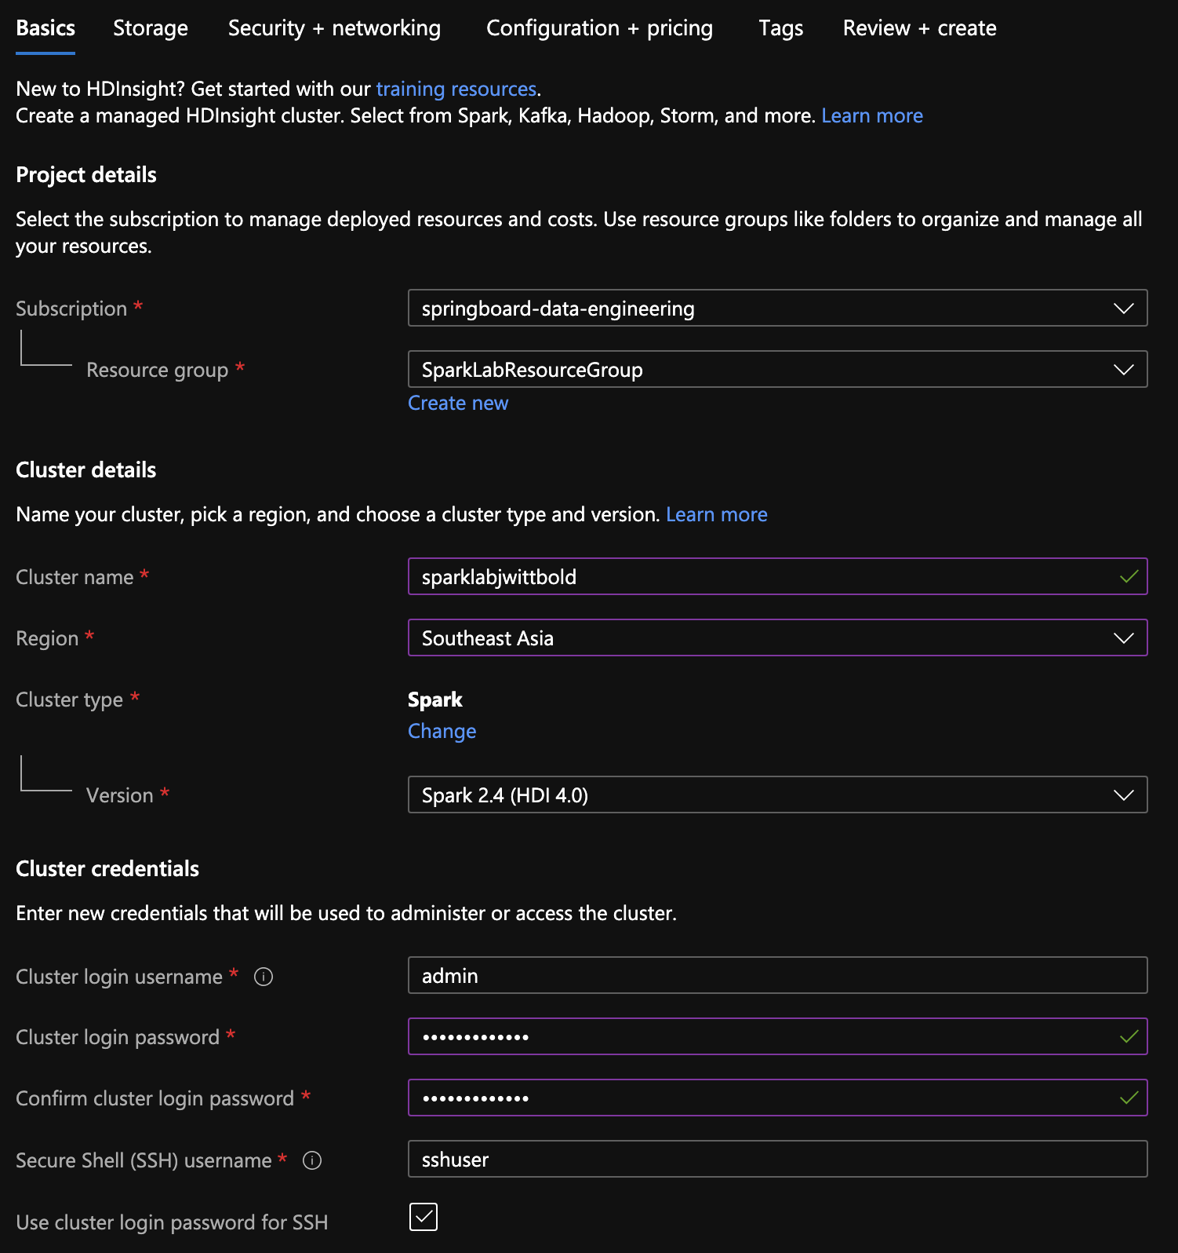
- Select Subscription
- Select Resource Group
- Provide Cluster name
- Choose Region
- Specify Cluster Type / Version
- Set password to login as admin over
SSH

Slide 3
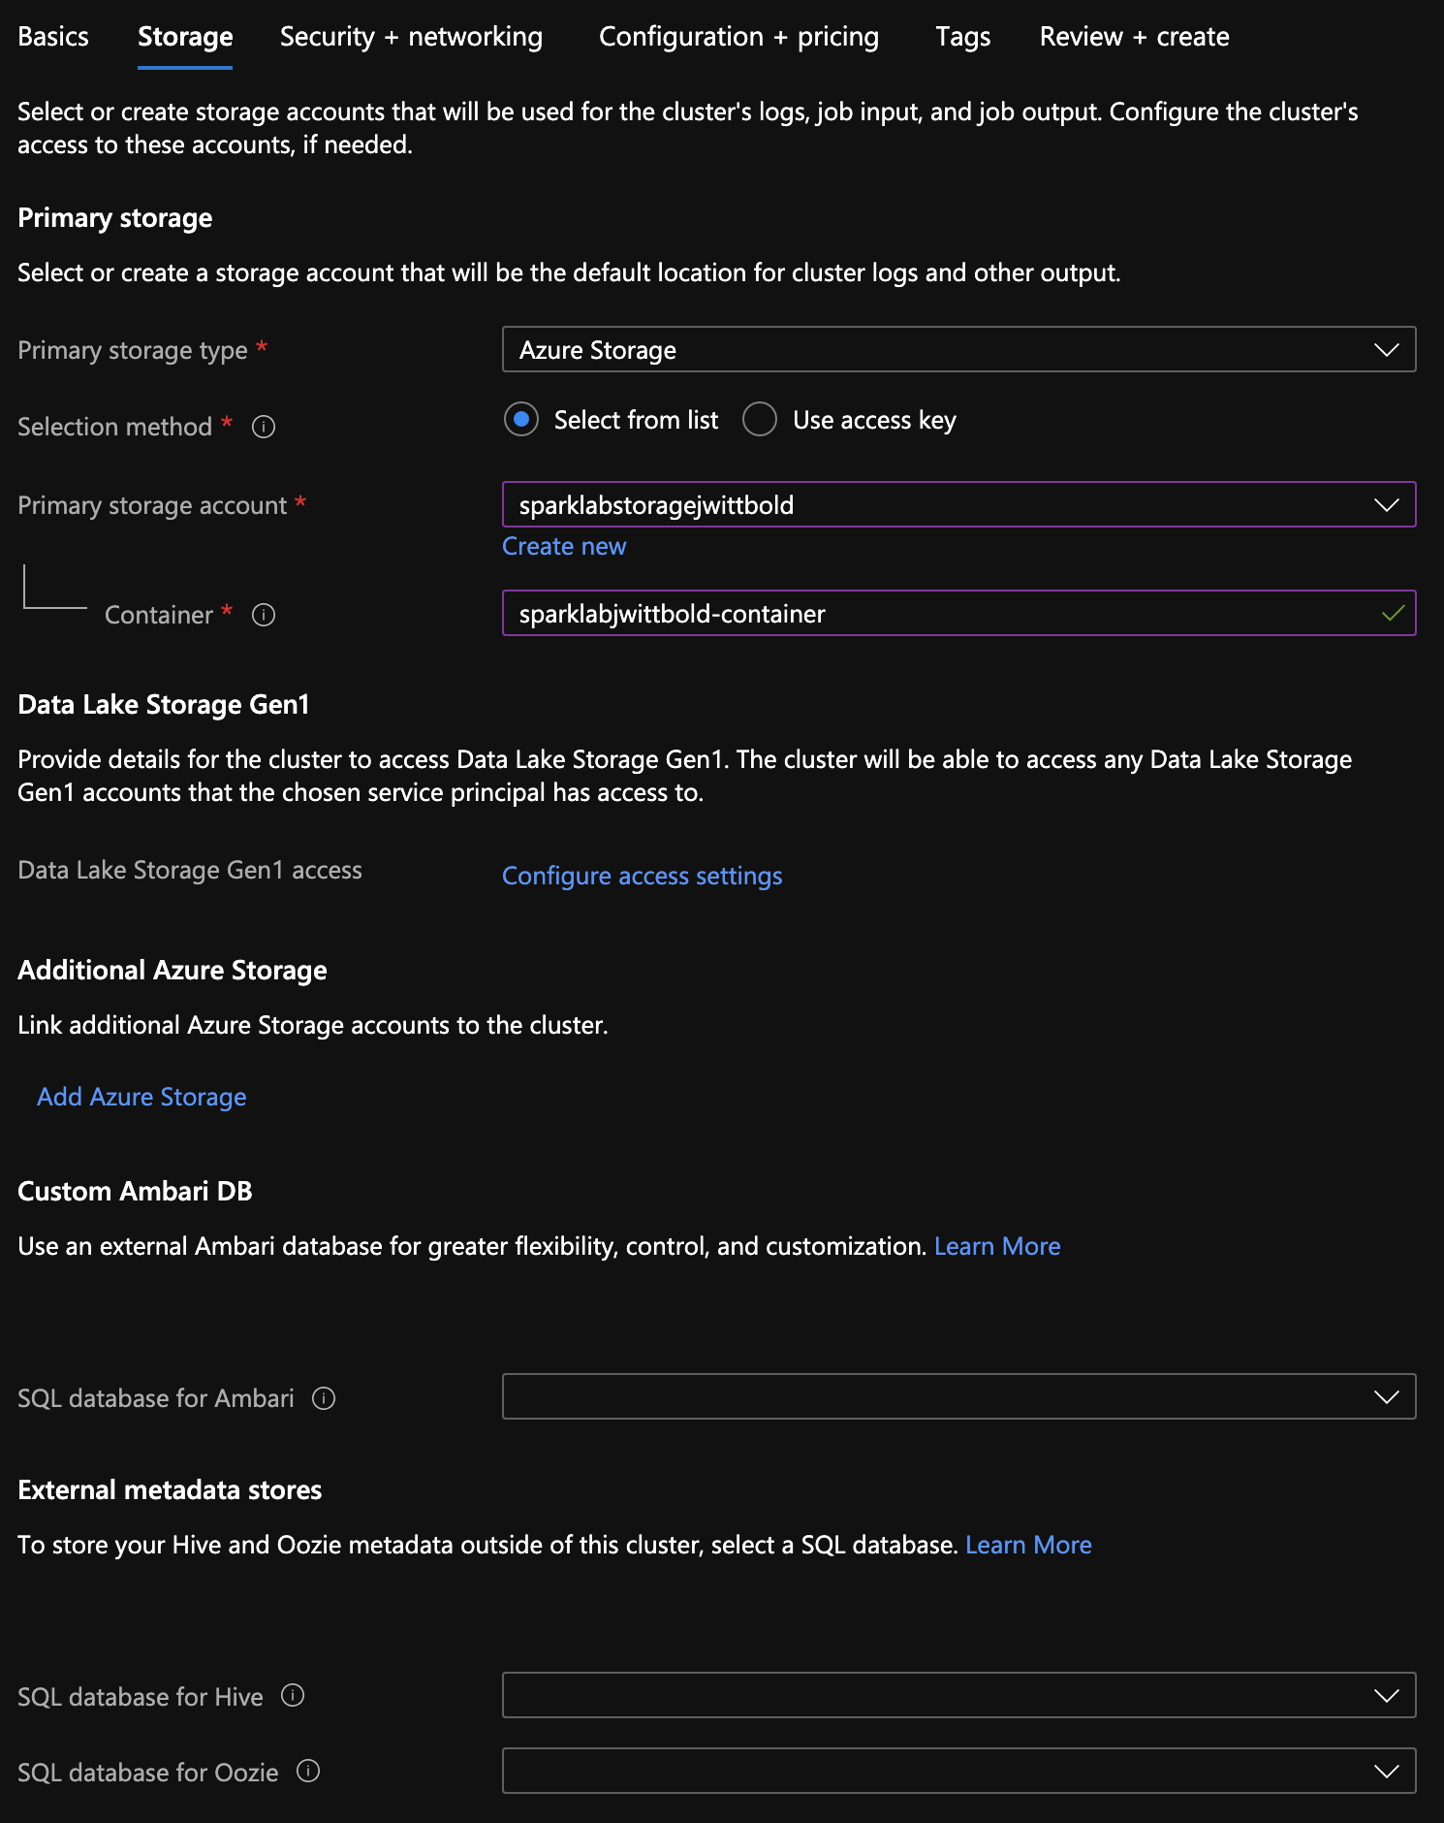
- Choose Storage Account
- Set name for Container

Slide 4
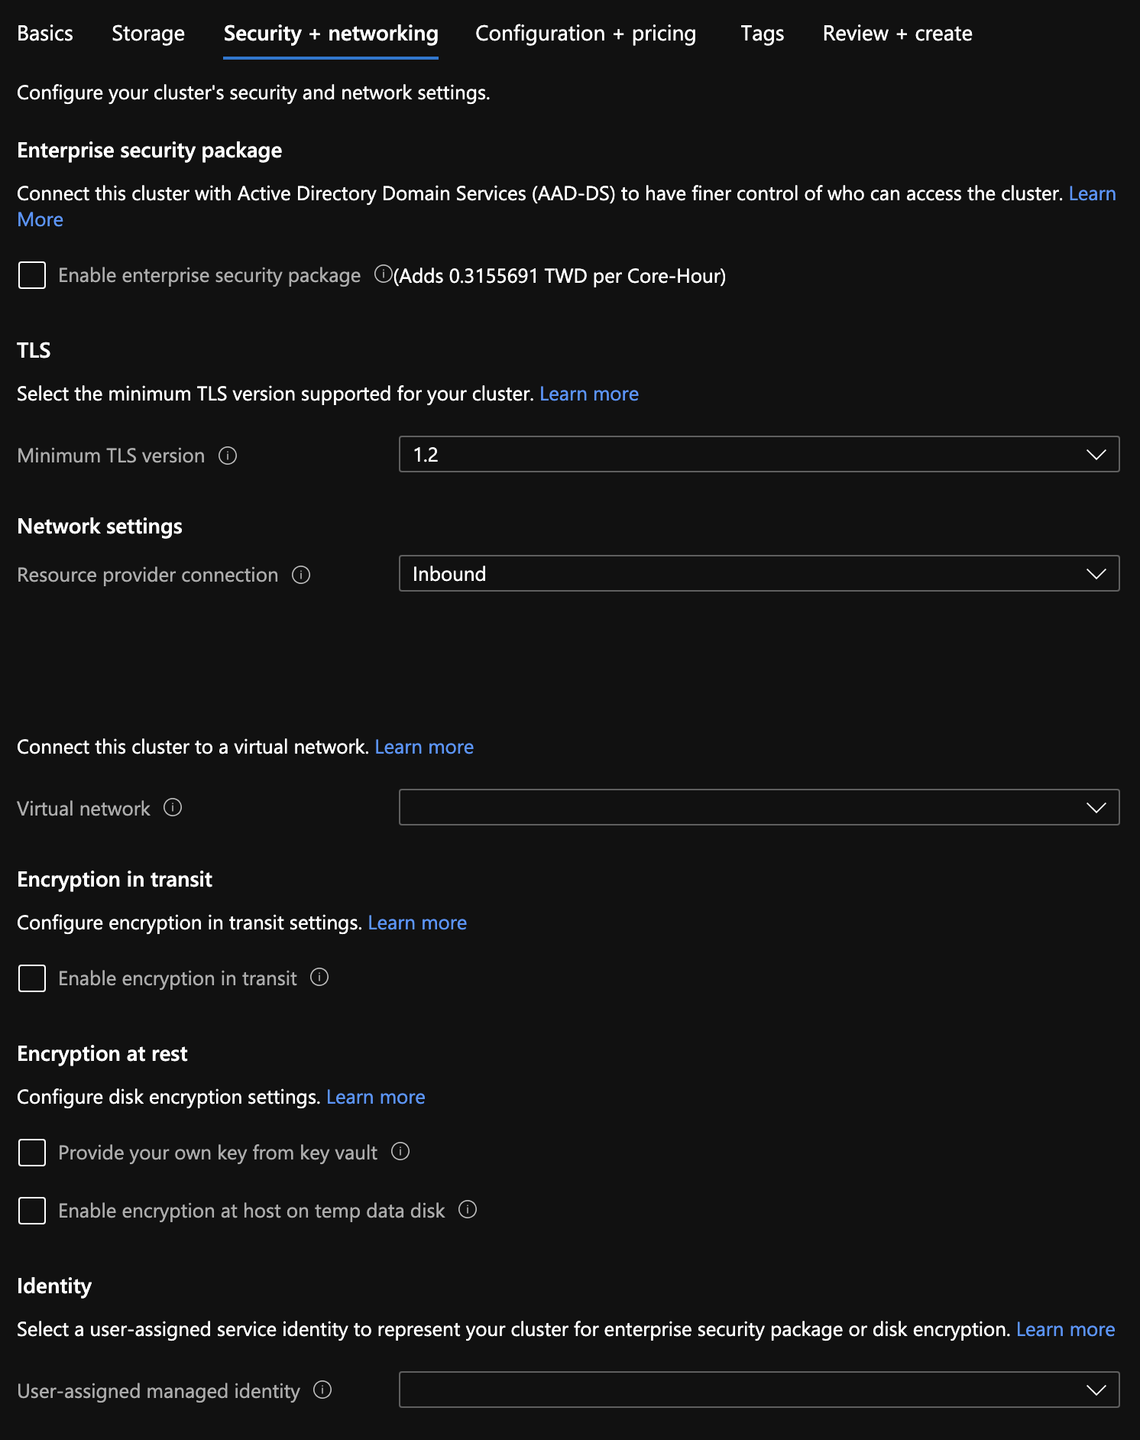
Configure Security
(not modified)

Slide 5
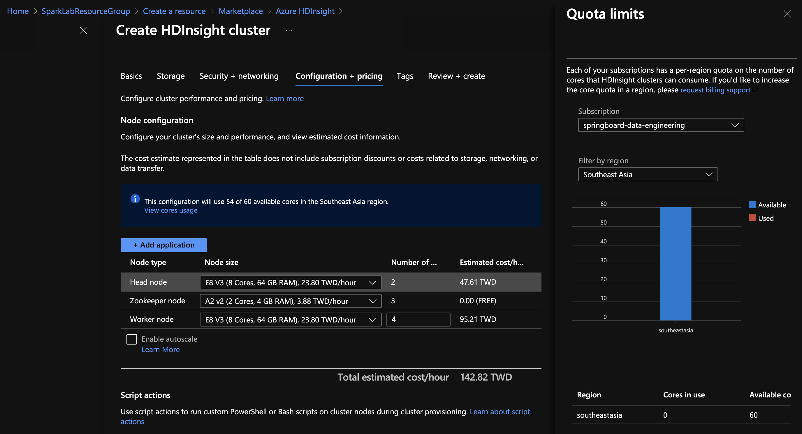
Configure Nodes
- Needed to first request Core Quota increase for subscription / region

Slide 6
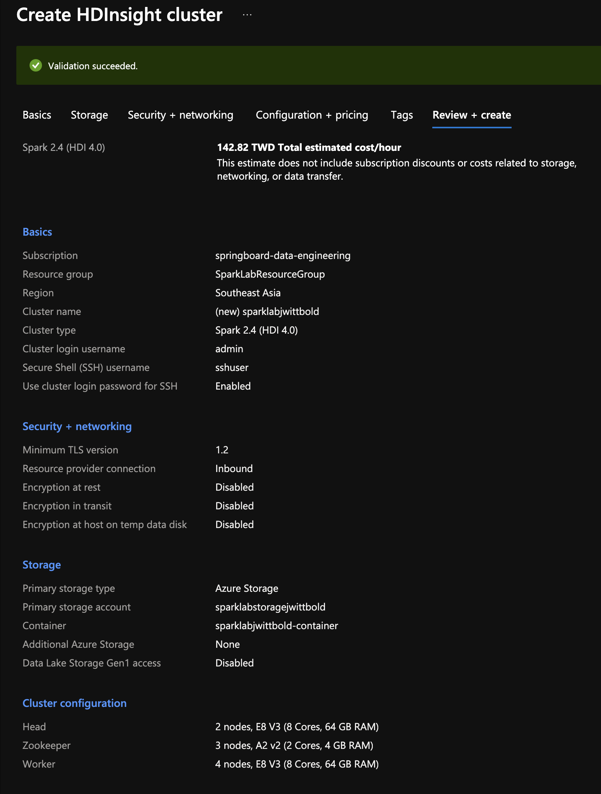
Full Details of HDInsight Cluster
- Validation Successful

Slide 7
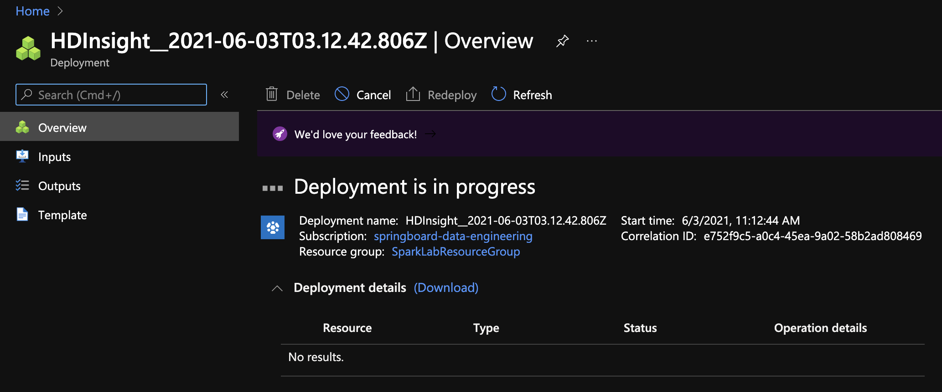
Deployment in progress...

Slide 8
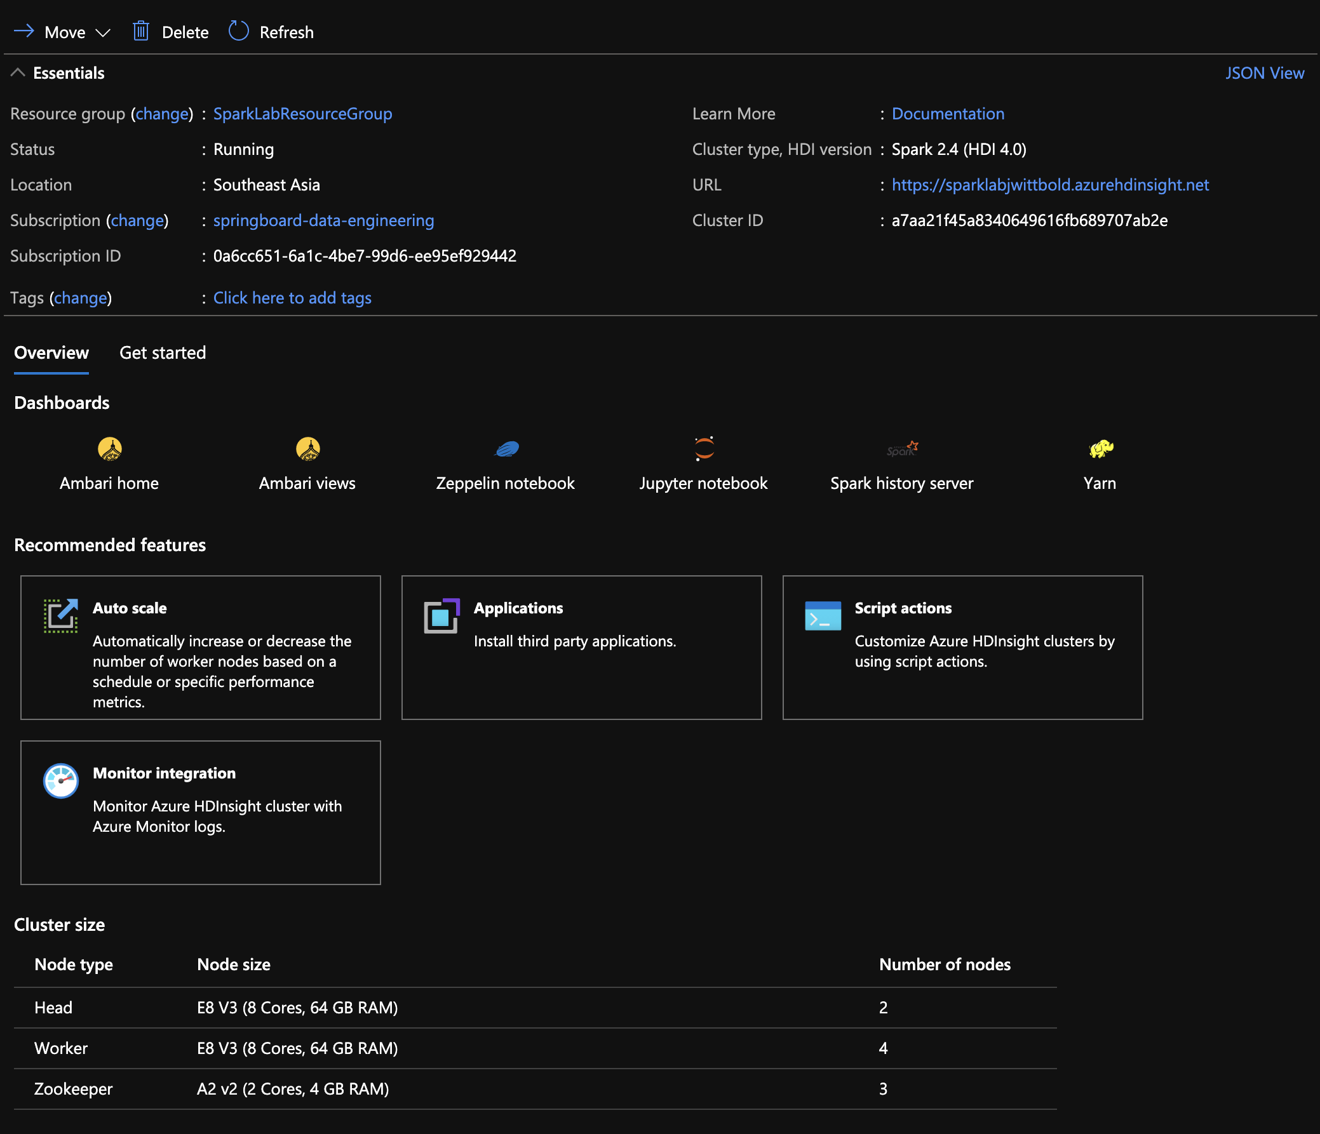
Cluster successfully created

Slide 9
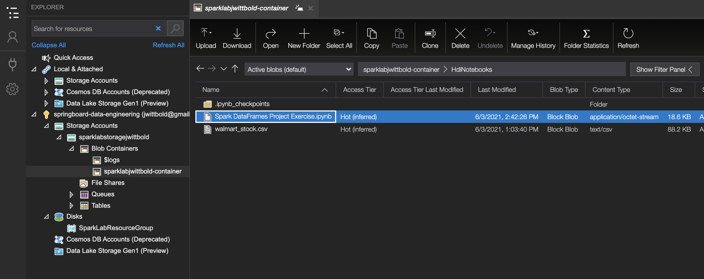
Resource files uploaded to cluster via
Azure Storage Explorer

Slide 10
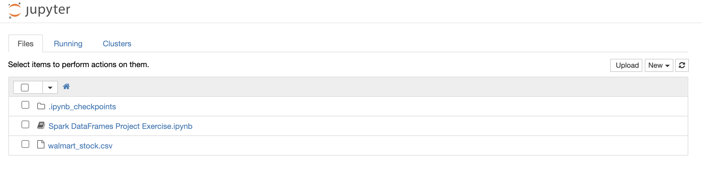
Jupyter Notebook and walmart_stock.csv data file available to work with

Slide 11
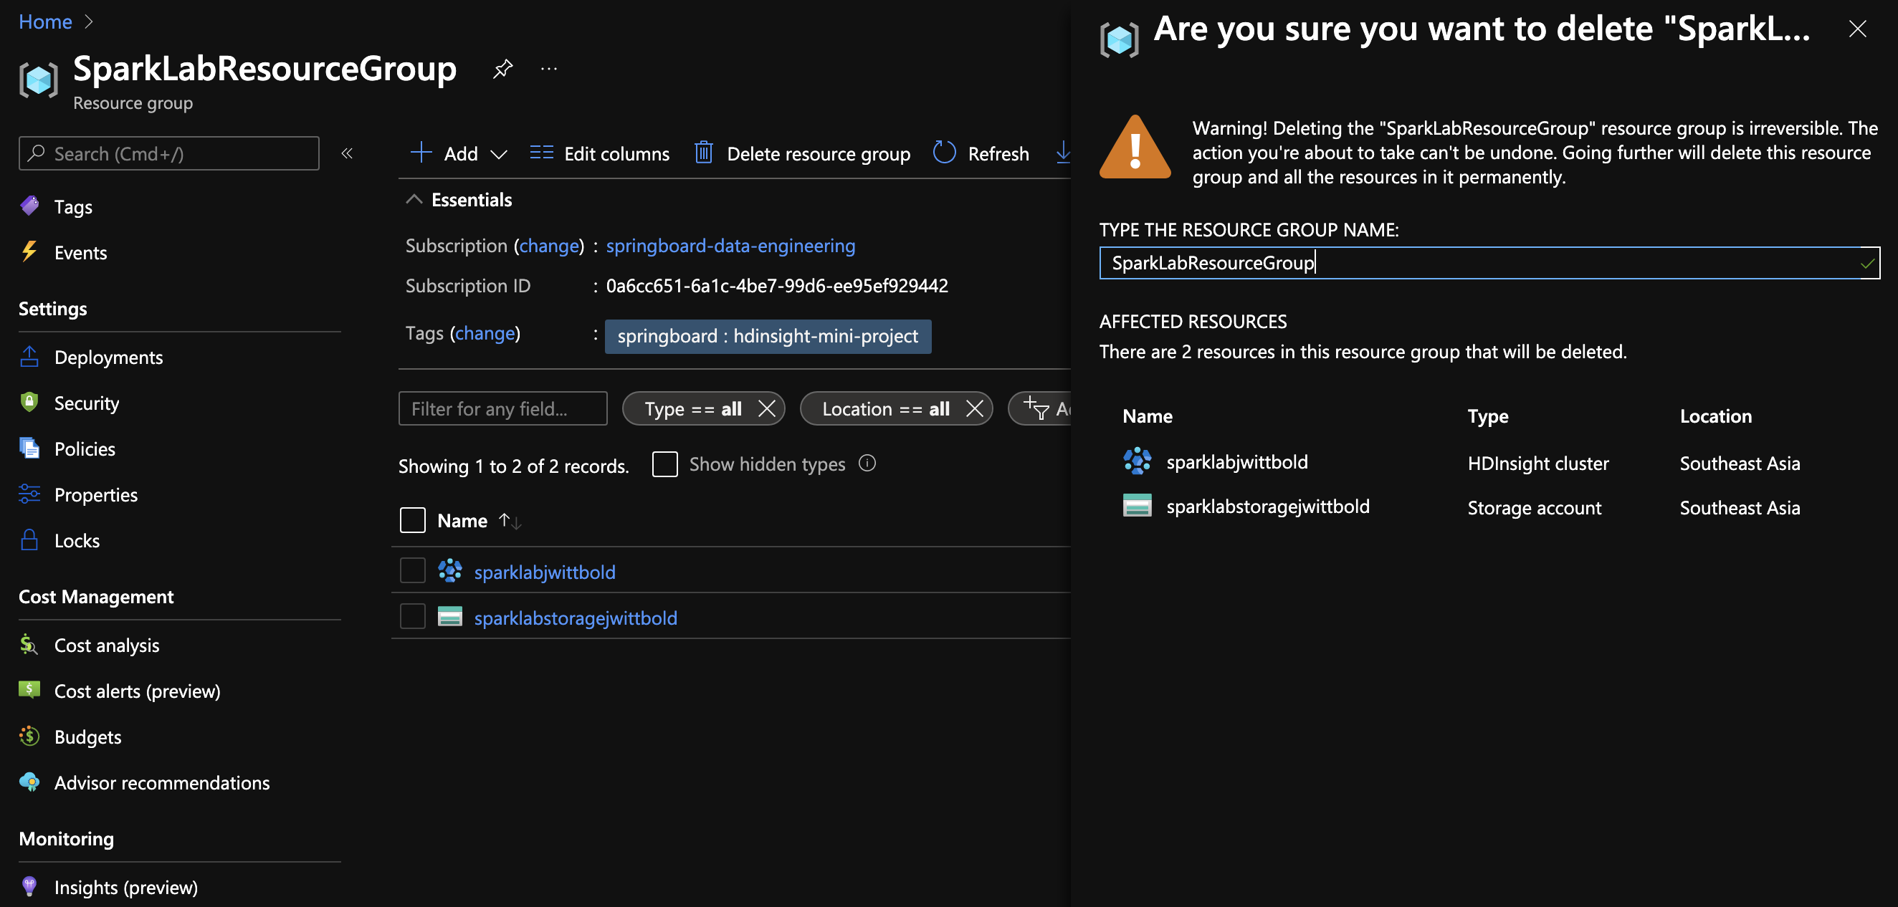
Deleting Resource Group (and all contained contents) after completing exercise

Slide 12
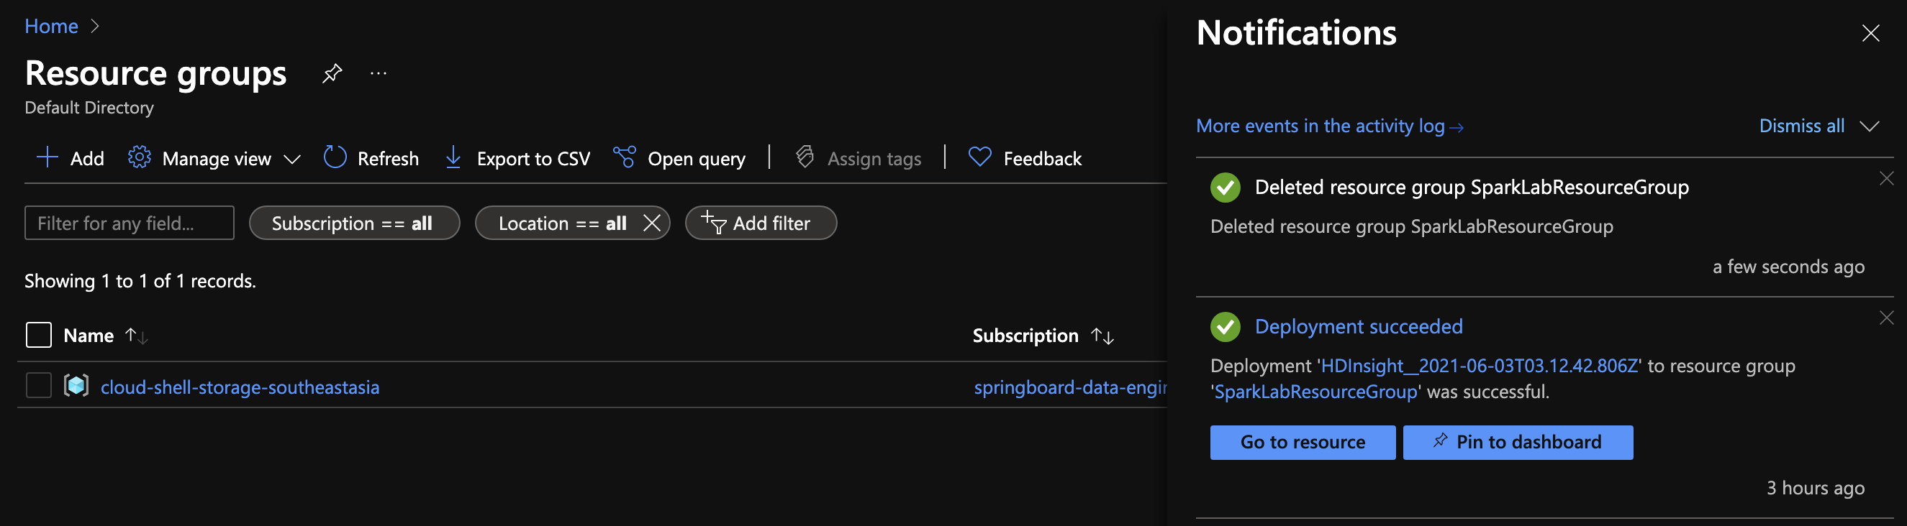
Successfully deleted

Slide 13
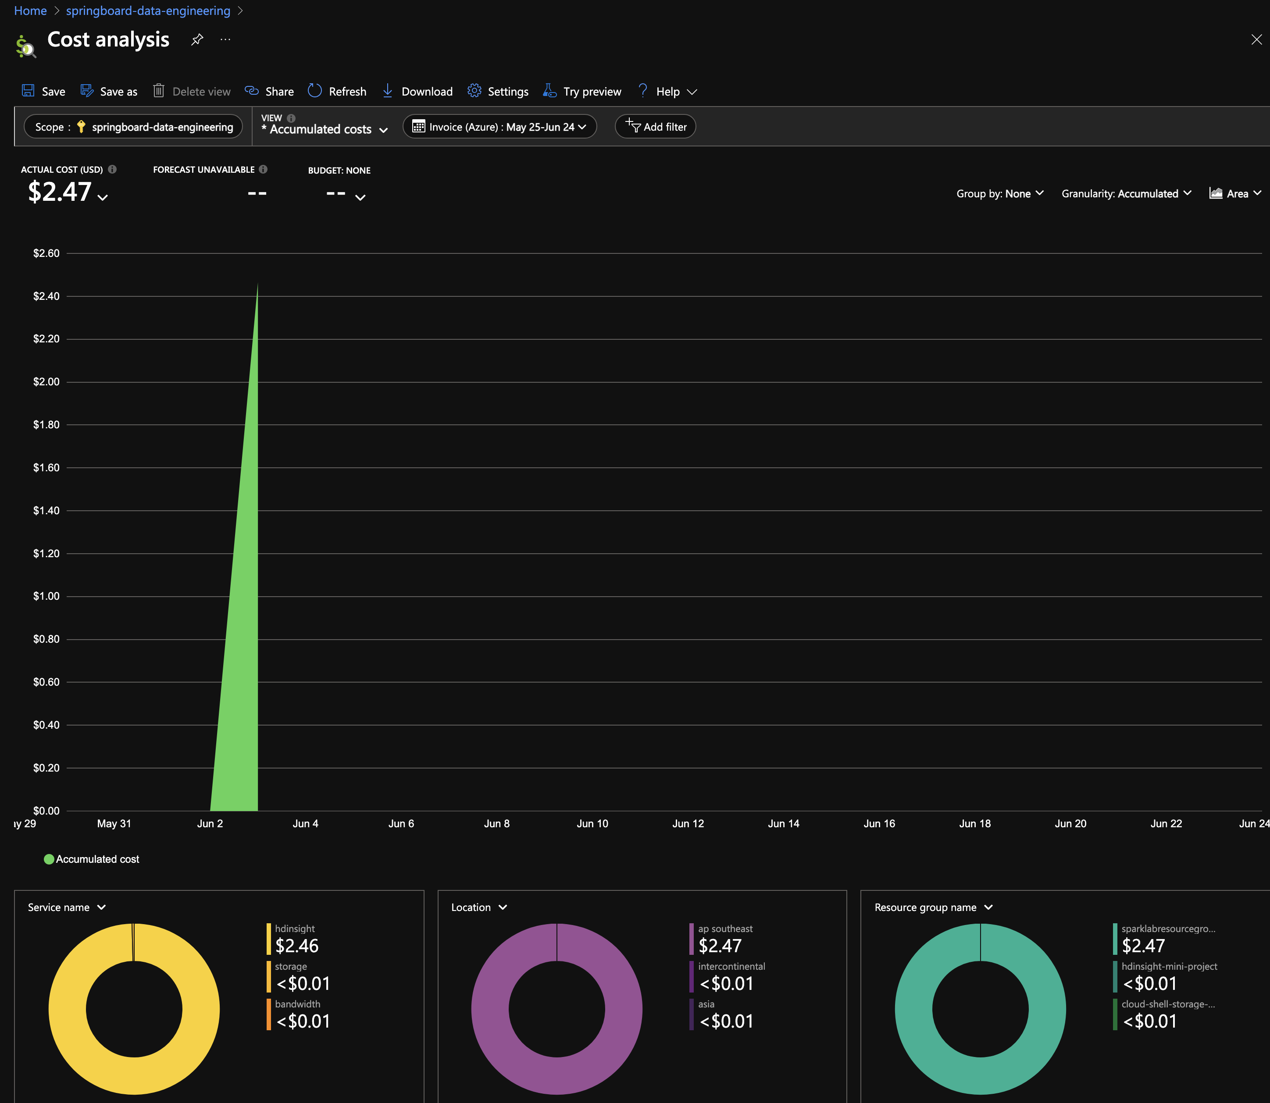
Cost Analysis for ~ 3hr HDInsight Cluster
= $2.47 USD

