Slide 1

Northeastern University - Seattle
CS6650 Building Scalable Distributed Systems
Vishal Rajpal

Slide 2
Week 4 – Distributed Systems Fundamentals
Topics we will cover today:
Communications Basics
Remote Procedure Calls
Distributed Coordination
Time in distributed systems

Slide 3
Communication Basics
Scaling a system involves adding multiple independently moving parts
Software runs on multiple machines.
Databases store data on multiple storage nodes.
Scalable software solutions are
Distributed across multiple nodes in multiple locations.
Each node processes events concurrently.
Nodes exchanging messages over a network.

Slide 4
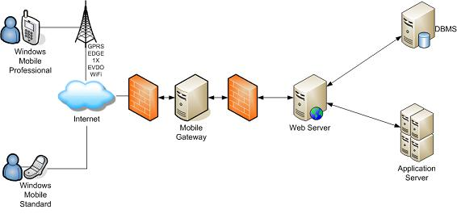
Communication Basics
Every distributed system has software components that communicate over a network. E.g:
A cell phone app sends a request over the cellular network addressed to a bank to retrieve bank balance
Request is routed across the internet to the bank’s web server.
Bank’s web server authenticates the request (checks it’s you) and sends a request to a database server for balance.
Database server reads bank balance from disk and returns it to the web server.
Web server sends balance in a reply message to the app, which is routed over the internet and the cellular network.
Balance appears on your mobile device.

Slide 5
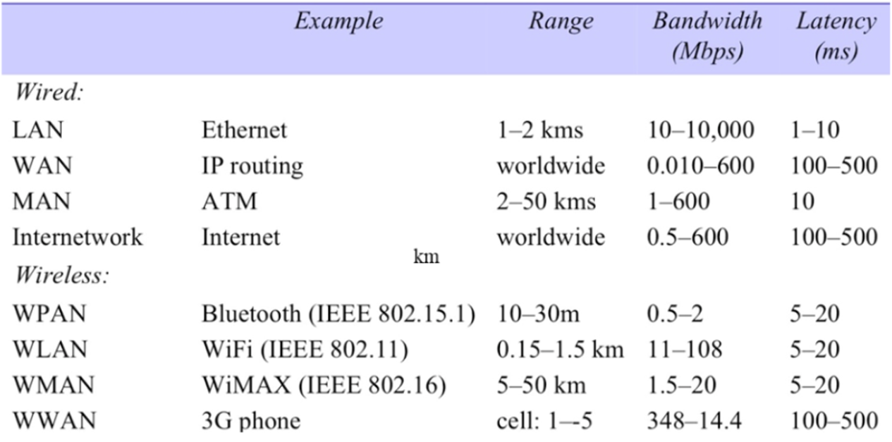
Communication Basics
Internet consists of many different types of networks

Slide 6
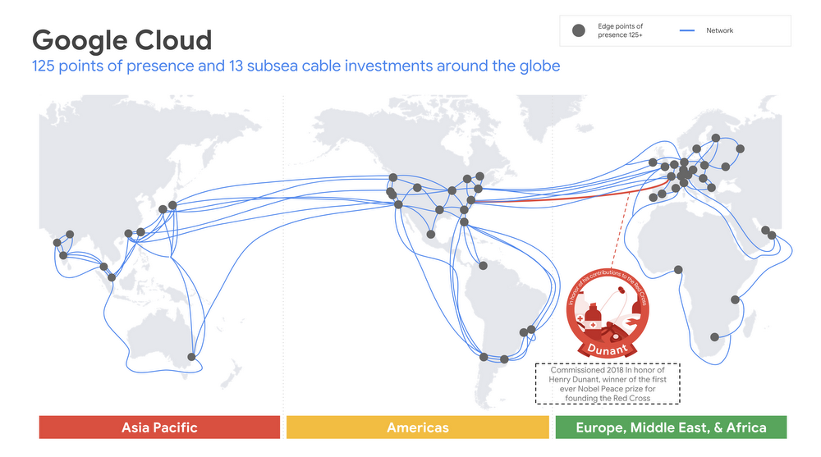
Communication Basics
Wide Area Networks (WANs)
WANs traverse the globe
High speed data ‘pipelines’ connecting continents with fiber optic cables.
Cables support a networking technology known as wavelength division multiplexing
Transmit up 171 Gbps over 400 channels, giving
~70 Terabits per second (Tbps) of bandwidth for a single fiber link.
Cables comprise four or more strands of fiber, giving bandwidth capacity of hundreds of Tbps for each cable.

Slide 7
Communication Basics
WAN Latencies

Slide 8
Communication Basics
WAN Routers
Internet routers transmit data across the physical network connections from source to destination.
Specialized, high speed devices that can handle several hundred Gbps of network traffic
pulling data off incoming connections
sending data out to different outgoing network connections based on their destination.
Core internet routers comprise racks devices
Can process 10s to hundreds of Tbps.

Slide 9
Communication Basics
Wireless Networking - Wifi
Wi-Fi protocol, 802.11ac, allows for maximum (theoretical) data rates of up to 5,400Mbps.
The most recent 802.11ax protocol, promises increased throughput speeds of up to 9.6Gbps.
Range of Wi-Fi routers is of the order of 10’s of meters, affected by physical impediments
Notes:
802.11ax also known as WiFi 6.

Slide 10
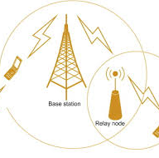
Communication Basics
Cellular Networks
Uses radio waves to send data from phones to routers mounted on cell towers, connected by wires to the core
4G LTE is 10 times faster than 3G,
download speeds around 10 Mbps (peak download speeds are nearer 50 Mbps)
upload speeds between 2 and 5 Mbps.
5G cellular networks promise 10x bandwidth improvement over 4G
1-2 millisecond latencies between devices and cell towers, compared with 20-40 20-40 millisecond for 4G.
5G base station range operates at about 500m maximum, compared with 4G range of 10-15kms

Slide 11
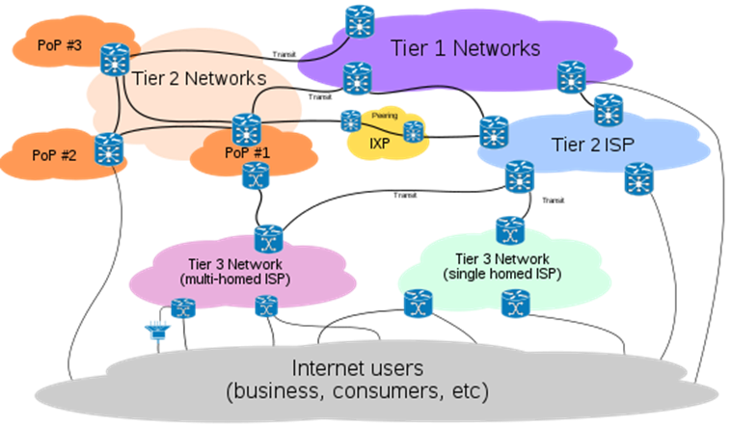
Communication Basics
The Internet
Notes:
Around 20 Tier 1 ISPs which manage the global traffic and are the backbone of the internet.
Tier 2 ISPs are regional for each country and have bandwidth slower than tier 1 ISPs
Tier2 ISPs deliver content through Tier 3 ISPs to which Customer pay their bills.

Slide 12
Communication Basics
Communications Software
Software systems on the internet communicate using the Internet Protocol suite.
The Internet Protocol suite specifies
Host addressing.
Data transmission formats.
Message routing and delivery characteristics.
Organized in 4 abstract layers

Slide 13
Communication Basics
IP Suite Layers
Data link layer: specifying communications across a single network segment. Implemented by device drivers and network cards inside nodes
Internet (IP) layer: specifies addressing and routing protocols for traffic to traverse the independently managed networks that comprise the internet.
Transport (TCP, UDP) layer: specifying protocols for reliable and best-effort host-to-host communications.
Application layer: application level protocols such as HTTP and SCP

Slide 14
Communication Basics
Internet Protocol (IP)
IP defines
how hosts are assigned addresses on the internet and
how messages transmitted between two hosts who know each other’s addresses.
Every device has its own Internet Protocol (IP) address.
The location of an IP address stored in a directory service known as Domain Naming Service (DNS).
DNS is a widely distributed, hierarchical database
the address book of the internet.
Notes:
Ipv4 – 32 bit addressing scheme which we might run out of ip addresses due to the number of devices.
Ipv6 is a 128 bit addressing scheme which basically provides infinite number of devices.

Slide 15
Communication Basics
DNS Lookup
Notes:
DNS lookup = local DNS server
Authoritative server = .com server. There is one for each top level domain
Whole dns database is geographically replicated

Slide 16
Communication Basics
IP Message Delivery
IP delivers data from the source to destination host based on the IP addresses in the packet headers.
IP packet structure
data to be delivered
header data including source and destination IP addresses.
Data is broken up into packets which are independently transmitted across the Internet.

Slide 17
Communication Basics
IP Packet Switching
IP is a best-effort delivery protocol. Doesn’t recover from transmission errors such as:
Data corruption
Packet loss
Duplication
Every packet is routed from source to destination independently
Results in out-of-order delivery to the receiver
Allows network to dynamically respond to conditions such as link failure and congestion
Hence IP is unreliable.
Notes:
Packet switching- routing of individual addressed packets.

Slide 18
Communication Basics
Transmission Control Protocol (TCP)
Application communications is achieved using Transmission Control Protocol (TCP) or User Datagram Protocol (UDP),
standard transport protocols for the IP network stack.
APIs for both TCP and UDP are widely available in mainstream programming languages
Use of these APIs not common as higher-level programming abstractions and protocols hide the details from most applications.
HTTP
WebSockets etc.

Slide 19
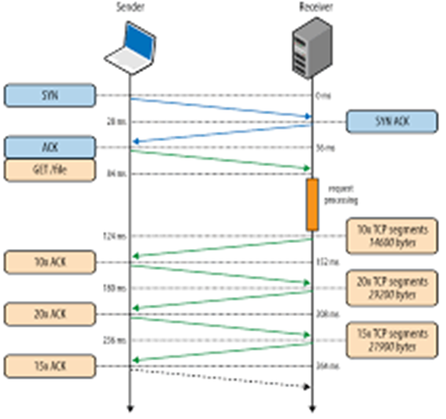
Communication Basics
Transmission Control Protocol
TCP is:
connection-oriented
stream-oriented
reliable
Uses a 3-step handshake to establish a two way connection between client and server
Data stream broken up into network packets for transmission
Each packet has source and destination address, used by the IP protocol to route the messages across the network.
Uses a sequence number so server can reassemble packets into a stream that is identical to the order they were sent.
Connection stays open until closed by client
Notes:
A stream of data is broken into individual packets with each packet size up to 64KB

Slide 20
Communication Basics
Transmission Control Protocol
TCP uses a cumulative acknowledgement mechanism for reliable delivery.
Receiver periodically sends an acknowledgement packet that contains the highest sequence number of received packets.
Implicitly acknowledges all packets sent with a lower sequence number.
If a sender doesn’t receive an acknowledgement within a timeout period, the packet is resent ➔ can lead to duplicates
TCP has many other features, e.g.
checksums to check packet integrity
dynamic flow control
TCP a relatively heavyweight protocol that trades off reliable over efficiency

Slide 21
Communication Basics
User Datagram Protocol (UDP)
Simple connectionless, unreliable protocol
No guarantee of (in order) delivery
No acknowledgements from server
Exposes the user's program to any unreliability of the underlying network.
Thin layer on top of the underlying IP protocol
trades off raw performance over reliability.
streaming audio, movies, video conferencing and gaming, are all UDP-appropriate applications

Slide 22
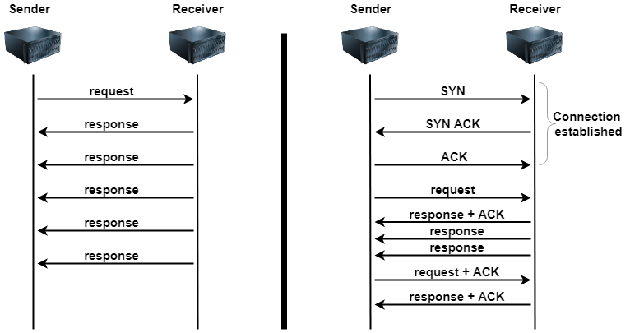
Communication Basics
Comparison

Slide 23
Remote Method Invocation
Distributed Communications
TCP sockets create a connection between a client and server which exchange data over that connection.
Client might request a balance for their checking account
{“balance”, “000169990”}
Server responds with account number and current balance
{“000169990”, “220.77”}

Slide 24
Remote Method Invocation
Application Protocol
Server will support many operations, e.g.:
“login”, “transfer”, “address”, “statement”, “transactions”, etc.
Each operation has a payload that the server processes to fulfill the client’s request.
We are defining an application specific protocol.
Application Protocol Interface (API)
// Simple mybank.com server interface
public interface MyBank {
public float balance (String accNo);
public boolean statement(String month) ;
// other operations
}

Slide 25
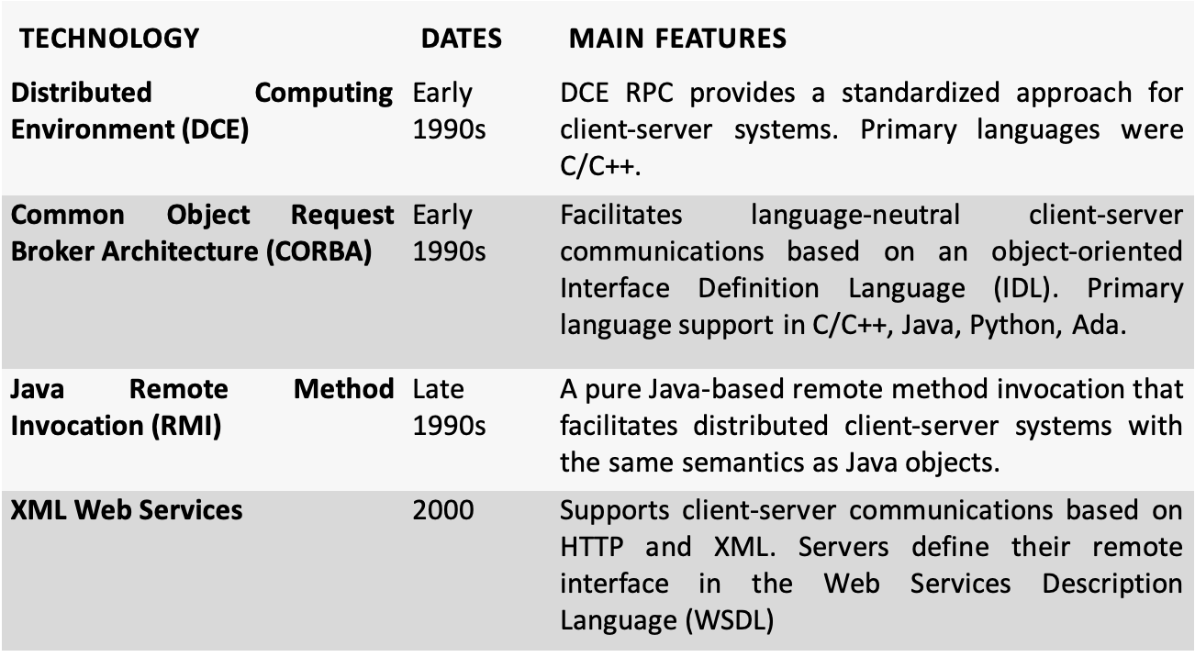
Remote Method Invocation (RMI)
Also known as Remote Procedure Call (RPC)

Slide 26
Remote Method Invocation
Java RMI Example
import java.rmi.*;
// Simple mybank.com server interface
Public interface MyBank extends Remote {
public float balance (String accNo) throws RemoteException;
public boolean statement(String month) throws RemoteException ;
// other operations
}

Slide 27
Remote Method Invocation
Java RMI Example
public class MyBankServer extends UnicastRemoteObject implements MyBank {
// constructor/method implementations omitted
public static void main(String args[]){
try {
MyBankServer server=new MyBankServer();
// create a registry in local JVM on default port
Registry registry = LocateRegistry.createRegistry(1099);
registry.bind("MyBankServer", server);
System.out.println("server ready");
} catch(Exception e){
// code omitted for brevity}
}
}

Slide 28
Remote Method Invocation
Java RMI Example – Client
// obtain a remote reference to the server
MyBank bankServer= (MyBank)Naming.lookup("rmi://localhost:1099/MyBankServer");
//now we can call the server
System.out.println(bankServer.balance("00169990"));
Notes:
Stub and Skeleton are compiler generated objects that felicitate remote communication in an RMI system.
Skeleton is a tcp network endpoint executing on a host and listening on a particular port.
When the server reference is stored in the RMI registry, the entry contains a stub that can be used to make calls to the remote server
When the client queries the registry the stub is what is returned which can be used to make calls to the server.
The stubs job is to translate the class into what can be passed across the network also known as marshalling.
Skeleton unmarshalls the request and calls the appropriate server

Slide 29
Remote Method Invocation
RMI/RPC Summary
Advantages:
Location transparency
Clear contract specification
Type-checking
Disadvantages:
Marshalling and Unmarshalling can become Inefficient
Tight coupling of client to server
Cross language marshalling and unmarshalling introduces complexity

Slide 30
Remote Method Invocation
HTTP API
Simpler
Efficient
Scalable

Slide 31
Distributed Systems Issues
Partial Failures
Distributed applications communicate using an asynchronous network:
Nodes can choose to send data to other nodes at any time
Thee network is half-duplex, such that one node sends a request and must wait for a response from the other. These are two separate communications.
Time for data to be communicated between nodes is variable - network congestion, transient failures
Receiving node may not be available due to a machine crash or other reasons.
Data can be lost. Nodes do not have identical internal clocks, hence they are not synchronized.

Slide 32
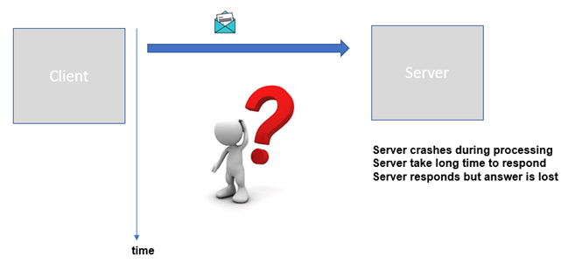
Distributed Systems Issues
Partial Failures

Slide 33

Distributed Systems Issues
Partial Failures
The request succeeds and a rapid response is received.
The destination IP address lookup may fail. In this case the sender receives an error message.
The IP address is valid but the destination node or target server process has failed. Sender will receive an error message.
The request is received by the target server, which fails while processing the request and no response is ever sent.
The request is received by the target server, which is busy. It processes the request but takes a long time to respond
The request is received by the target server and a response is sent. However, the response is not received by the client due to a network failure.
Client
Insert $100 to Adam’s balance
Server
timeOut
Insert $100 to Adam’s balance
time

Slide 34
Idempotence
Requests that make no persistent state changes are idempotent.
i.e. all read requests
Updates - clients send a unique idempotence-key in all requests that mutate state.
identifies a single operation from the specific client or event source.
Server checks if it has previously seen the idempotence key value by reading from a database for implementing idempotence.
If the key is not in the database, this is a new request.
performs the business logic
stores the idempotence key is in a database
If the idempotence key is in the database, server returns the results for the operation so that (hopefully) the client won’t retry.

Slide 35
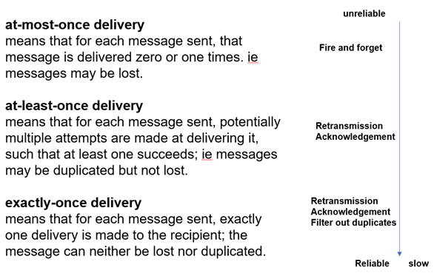
Idempotence
Idempotence key database:
A separate database table in the transactional database?
A dedicated database that provides very low latency lookups?
Idempotence key can be discarded after a TTL.
Idempotent API implementation must ensure that both the application state needs to be modified and idempotence key need to be stored.
Exactly Once Semantics
Idempotence = exactly once
Notes:
At most once delivery – UDP
At least once delivery - TCP

Slide 36

Consensus
Two Generals
https://www.youtube.com/watch?v=X7jzXlt6CgE

Slide 37
Distributed Consensus
Two Generals is analogous to nodes in a distributed system reaching agreement on some state
Partial failures are analogous to losing messages and acknowledgements.
It can be demonstrated that consensus is impossible to achieve within bounded time
On an asynchronous network
In the presence of crash faults
Messages can be delayed but not lost

Slide 38
Distributed Consensus
This is known as the FLP Impossibility Theorem .
Michael J. Fischer, Nancy A. Lynch, and Michael S. Paterson. 1985. Impossibility of distributed consensus with one faulty process. J. ACM 32, 2 (April 1985), 374–382.
FLP is a worst-case scenario
not possible to guarantee consensus will be reached with unbounded message delays on an asynchronous network.
In reality distributed systems reach consensus every millisecond!!
can establish sensible practical bounds on message delays
retry after a timeout period.

Slide 39
Byzantine Failures
Imagine extending the Two Generals problem to
N Generals, who need to agree on a time to attack.
Traitorous messengers may change the value of the time of the attack
Traitorous general may send false information to other generals.
Malicious failures are known as Byzantine faults
Algorithms that address malicious behavior exist.
Blockchain technologies and BitCoin.

Slide 40
Time in Distributed Systems
Clocks on individual nodes drift due to environmental conditions
Drift values of 10-20 seconds a day are not uncommon.
A time service represents an accurate time source, such as a GPS or atomic clock
Can be used to reset the clock on a node to correct for drift on packet-switched, variable-latency data networks.

Slide 41
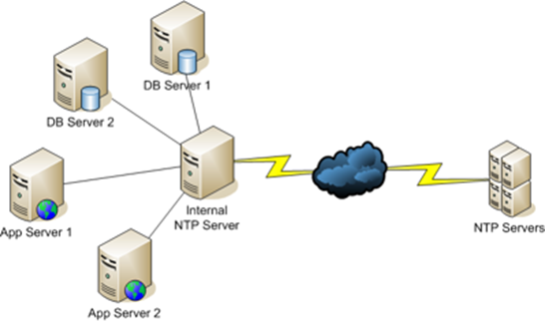
Network Time Protocol (NTP)
Node runs the NTP client to synchronize to a NTP server.
Time on a node is set by a UDP message exchange with one or more NTP servers.
Messages are timestamped time taken for transit is estimated.
On a LAN, machines can synchronize to an NTP server within a small number of milliseconds accuracy
Be careful – clocks may move backwards!!
Notes:
300 worldwide root servers
20000 servers on the second layer synchronized within a few milliseconds periodically and so on through out the hierarchy.
Maximum of 15 levels within the hierarchy
175K NTP servers available to synchronize to

Slide 42
CPU Clocks
Time of Day Clock
Number of milliseconds since midnight January 1970.
In Java, System.currentTimeMillis().
Can be reset by NTP, and hence may jump forwards or backwards
Monotonic Clock
Amount of time (in seconds and nanoseconds) since an unspecified point in the past, such as the last reboot
Only moves forward
May not be accurate as it stalls during a virtual machine suspension
In Java, System.nanoTime().

Slide 43
Clock Synchronization
NTP common – one hour to one day interval
Chrony – more accurate, scalable than NTP
E.g. used by Facebook
Amazon Time Sync Service
GPS/Atomic clocks in data centers
Clock synchronization is crucial whenever local timestamps from multiple machines need to be compared.

Slide 44
Summary
Communications in distributed systems traverse many different types of underlying physical networks
Communication latencies are highly variable
Communications can fail
TCP provides reliable connection-based communications
UDP provides unreliable datagram-based communications
RMI/RPC technologies build on TCP/IP sockets to provide abstractions for client-server communications
Achieving agreement, or consensus on state across multiple nodes is in theory impossible
In reality we can devise algorithms that achieve consensus in practice.
Clocks on individual nodes vary and cannot be used for meaningful comparisons. Need a time service for synchronization.

Slide 45
Questions?

