Slide 1

Northeastern University - Seattle
CS6650 Building Scalable Distributed Systems
Vishal Rajpal

Slide 2
Week 2 – Distributed Systems Architecture
Topics we will cover today:
User Functionality before Scalability
Multi tier Architecture
Scale up and Scale out
Load Balancing
Stateless Services
Distributed Databases
Queuing
Case Study

Slide 3
Software Systems Origins
Very few systems start with scalability as the primary driver.
Agile methods prioritize delivering user facing functionality.
YAGNI (“You Aren’t Gonna Need It”) principle
Rapid application delivery frameworks dominate
Ruby on Rails, Django etc.
Trade off ease of delivery versus performance, scalability and availability.
Notes:
Most systems start small and grow based on their success
YAGNI – You Aren’t Gonna Need It

Slide 4
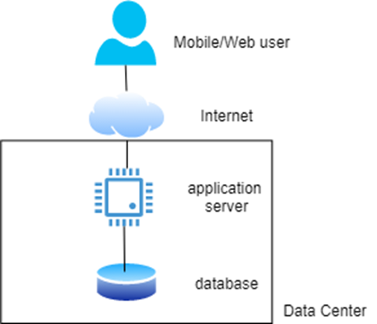
Basic Multi tier distributed systems architecture
Notes:
A typical simple software architecture for a starter system which resembles closely to when you use rapid application development frameworks.
It comprises of Client Tier, service tier and database tier.
Some frameworks have inbuilt MVC which generate a lot of boiler plate code.
Some frameworks provide you with a model view controller and a mapper which generates queries.

Slide 5
Application Server
Container (execution) environment for application services (APIs)
Accepts client requests and invokes appropriate service functionality
Based on API request endpoint/parameters
Multithreaded execution environment using a thread pool
Connections to database managed through a connection pool
Thread pool size > connection pool size
Notes:
Application Server in detail
It runs code which supports an API that clients use to send HTTP requests to.
Upon receipt the service executes the code for that API. The business logic of that API might require it to read from or write to a DB.
The application service code exploits the server’s execution environment that enables multiple requests from multiple users to be processed simultaenously.
When the API finishes its execution, it returns the result to the client.
Execution environment such as JEE/Spring for java and flask for python.
Okay with low loads, but what if the load keeps growing.
Usually results in a monolithic architecture
Which is difficult to modify.

Slide 6
Scale Up
As request loads grow, scale up the system to support high load.
Get a bigger application server and database server.
Server with
More CPUs
More memory
More disks
Additional costs
Notes:
The first strategy to support growing loads is to scale up.
For example, if your application is running on AWS, you might upgrade your server from a modest t3.xlarge instance with 4 (virtual) CPUs and 16GBs of memory to a t3.2xlarge instance which doubles the number of CPUs and memory available for the application.

Slide 7
Scale Up
Advantages
Simple to replace a low end server with high end server.
Disadvantages
Larger machines will incur more costs.
Single Point of Failure (SPoF)
There is still a limited capacity.
No matter how big the server is the capacity is still limited.
SPoF is another bigger problem
Highly reliable hardware is available but expensive.
Historical interest –Tandem/HP Non-stop servers – no longer sold.

Slide 8
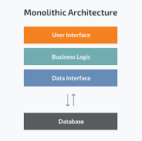
Scale Up
Larger Issue of Monolithic Architecture
Implementations for 10s-100s of APIs all bundled in same code
Hard to make changes and evolve.
Alternative is microservices which is lightweight and popular.
Notes:
- Digress to monoliths vs microservices for this slide.

Slide 9
Scale Out
Replicate a service and run multiple copies on multiple server nodes.
Cheap, commodity hardware
Requests from clients are distributed across the replicas
If we have N replicas, each server node processes {#requests/N}.
Adding processing capacity as simple as adding a new server node
Notes:
Scaling out requires replicating a service to multiple nodes.
Requests from clients are distributed across those replicas.
If there are N replicas each node processes (Number of requests/N) requests.

Slide 10
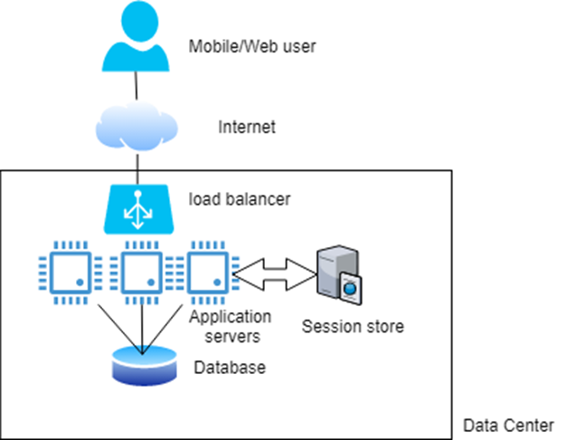
Scale Out
Proxy (Forward)
Reverse Proxy
Notes:
Proxy (Forward Proxy) - A forward proxy accepts connections from computers on a private network and forwards those requests to the public internet. It is the single point of exit for subnet users who want to access resources outside of their private network.
Protect their identity
Block access to certain content
Reverse Proxy - The reverse proxy acts as a single point of entry for external systems to access resources on a private subnet. It accepts the request forwards it to one of the servers and returns a response as if the proxy had returned it.
Load balancing
Caching
Security

Slide 11
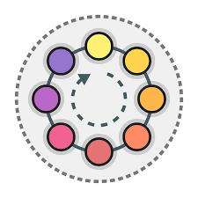
Scale Out
Load Balancer
Distributes requests across available services
Load balancing policy (e.g. round robin)
Stateless services
Each request must be self-contained so load balancer can choose any service
Any session state must be stored external to a service
Example :- last page visited, shopping cart, session state

Slide 12
Scale Out
Advantages
Add new (virtual) services to handle increased request loads
As latencies rise, just deploy another server instance.
Requires no code changes
just pay for the hardware deployed
Availability: If a service fails, the requests it is processing will be lost
Failed service manages no session state,
requests can be simply reissued by the client and sent to another service instance for processing
Notes:
You can keep adding new hardware and services to support growing loads and keep request latencies consistent and low.
Where could be the bottleneck now?

Slide 13
Scale Out
Adding new service instances gives increased capacity
Eventually increased capacity will overload the database
Slow queries will mean longer response times
If overload continues, some system component will fail due to resource exhaustion
clients will see exceptions and request timeouts
Need to remove database bottleneck
Notes:
As the server capacity grows potentially infinitely, at some stage the ability of your single database to provide low latency query responses will diminish.
Slower response from DB means increase in response time.
As the requests keep arriving, the system will become overloaded and fail due to resource exhaustion.
Scaling up is a very common database scalability strategy.

Slide 14
Scale Up Database
Simple to scale up but the problem of SPoF still persists.
GCP can provision a SQL database on 96 vCPUs, 624GB of memory, 30TBs of disk and can support 4000 connections.
Cost between $6K and $16K per year.
How can we improve?

Slide 15
Caching
Avoid using the database!!
Employ distributed caching in the service tier
Caches store commonly accessed database results in memory
Can be quickly retrieved without database access
Distributed caches such as a Redis or memcached widely used
Essentially distributed Key-Value stores with very simple APIs.
Notes:
What if you used the DB only when it is really necessary?
Example can be a recently accessed tweet or an Ad etc.

Slide 16
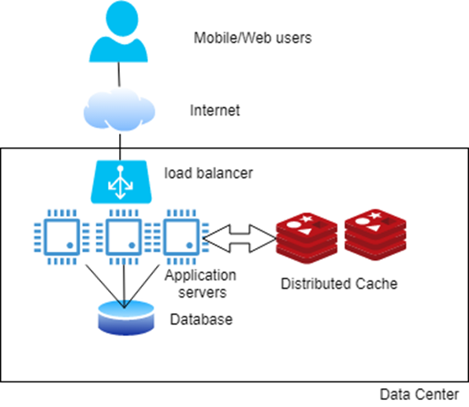
Caching
Well designed caching can reduce database usage by a lot.
Combined with scale up, is sufficient for many applications.
Notes:
The logic in the server can check the cache first and then talk to DB only when the data does not exist in the cache.
Is that enough? Or are their any other bottlenecks?
- Many systems still need to rapidly access terabytes and larger data stores that make a single database effectively prohibitive. In these systems, a distributed database is needed.

Slide 17
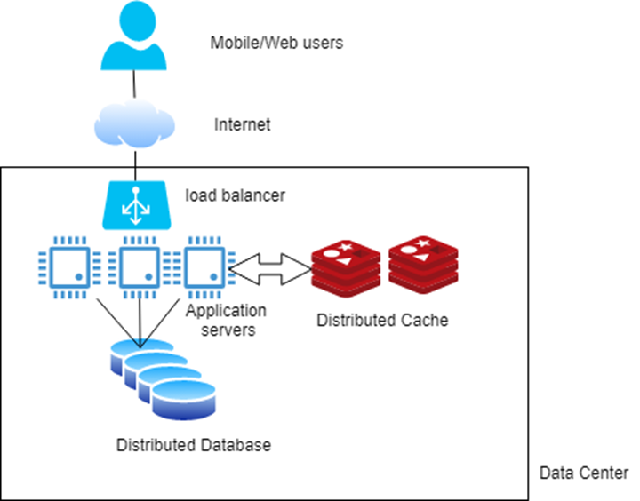
Distributed Databases
Notes:
As the data volume grows a distributed database has features to enable the number of storage nodes to be increased.
As nodes are added or removed, the data across these nodes is rebalanced to ensure that processing and storage capacity of each node is equally utilized.
Distributed databases promote availability. Since they support replicating the data if one node fails another is available to serve the request.
However there are tradeoffs. (Consistency)

Slide 18
Distributed Databases
Two main flavors:
Distributed SQL stores
Store data across multiple disks that are queried by multiple database engine replicas.
Multiple engines logically appear to the application as a single database, hence minimizing code changes
Distributed so-called NoSQL stores
Variety of data models and query languages
Distribute data across multiple nodes running the database engine, each with their own locally attached storage.
Leading products in this category are Cassandra, MongoDB, Neo4j, AWS DynamoDB etc.
Notes:
Distributed SQL Stores: Available from Oracle and IBM. Enable organizations using SQL databases to scale out by storing the data across multiple disks that are queried by multiple database engine replicas. These engines logically appear to the application as a single database.
Distributed NoSQL Databases – These have variety of data models and query languages to distribute data across multiple nodes running the database engines each with their own locally attached storage.

Slide 19
Distributed Databases
As data volume grows, the number of database nodes can be increased.
data rebalanced to ensure the processing and storage capacity of each node is equally utilized.
Distributed databases also promote availability through replication
If a node fails or cannot be accessed due to network problems, another copy of the data is available.
Can utilize cloud-hosted databases to simplify administration

Slide 20
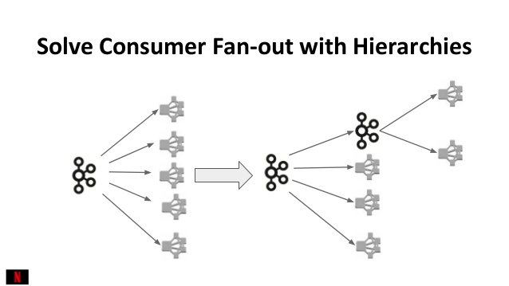
Multiple Processing Tiers
Any scalable system has many services that interact to process a request.
E.g. accessing a Web page on the Amazon.com can require in excess of 100 different services before a response is returned to the user .
With stateless, cached, load-balanced services, we can extend these core design principles and build a multi-tiered application.
In fulfilling a request, a service calls one or more downstream services
Notes:
Any realistic system that you need to scale will have many different services that interact to process a request.
The benefits of stateless, load balanced and cached architecture is that it is possible to extend these core design principles to build a multi tier system.
The downstream services can be load balanced and cached.

Slide 21
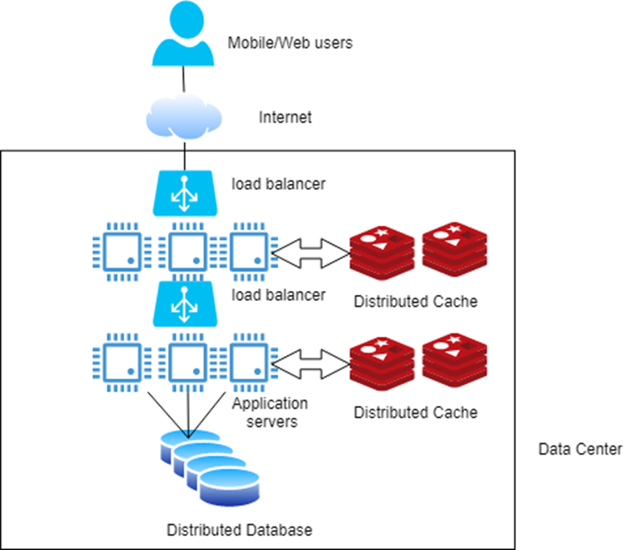
Multiple Processing Tiers
Scaling multiple processing tiers
Notes:
Every tier has a single application

Slide 22
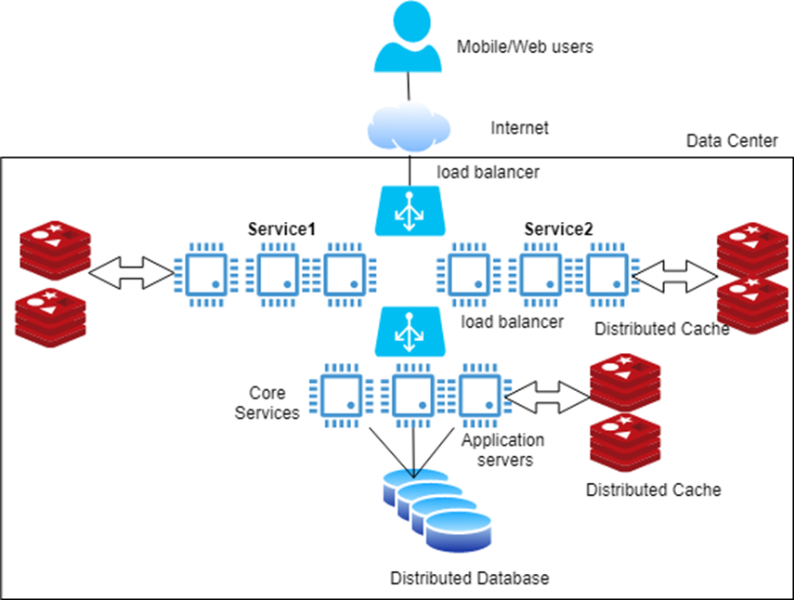
Multiple Processing Tiers
Multiple services in a single tier
Notes:
This also show cases having multiple services in a single tier.
One service for Mobile and another for Desktop, One for different region?

Slide 23
Multiple Services
Refactoring the monolith into multiple independent services has advantages:
Easier to build, test, modify
Can be scaled individually based on the service demand.
E.g. Two services:
one for Web users
one for mobile users
Can deploy more mobile services and less Web services to meet demand if only mobile usage grows
Backend for Frontend (BFF) pattern
On the road to microservices
Notes:
By breaking each application into multiple independent services, each one of them can be scaled depending on the demand.
Example: Different number of replicas for Web/Desktop and different for Mobile service.

Slide 24
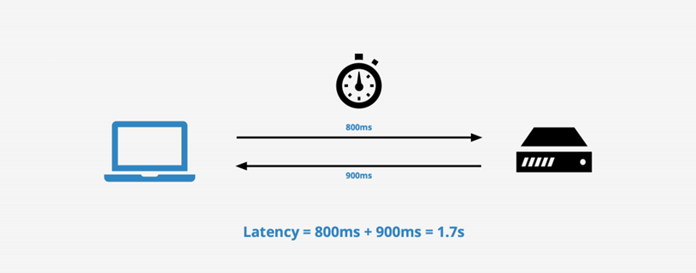
Responsiveness
Most client requests need a response.
List all auction items
View the real estate for sale in a given location.
Client sends a request and waits until a response is received.
Time interval between sending the request and receiving the result is the latency of the request.
Can decrease latencies using caching and precalculated responses,
Many requests will need a (slow) database access.

Slide 25
Responsiveness
Similar story for update requests
user updates their default delivery address
new delivery address must be persisted so that the user can confirm the address before they hit the ‘purchase’ button.
Latency includes the time for the (slow) database write
Some requests don’t need to be persisted immediately, e.g.
User favorites a product in a catalog
User adds a song to playlist
Update GPS location
We can exploit this to improve request responsiveness
Client sends request
Server responds with a ‘promise’ to perform the update (no slow database write)
Server performs the update ‘eventually’
Notes:
- Some updated need to be persisted immediately. Such as address update to be used immediately on checkout.

Slide 26
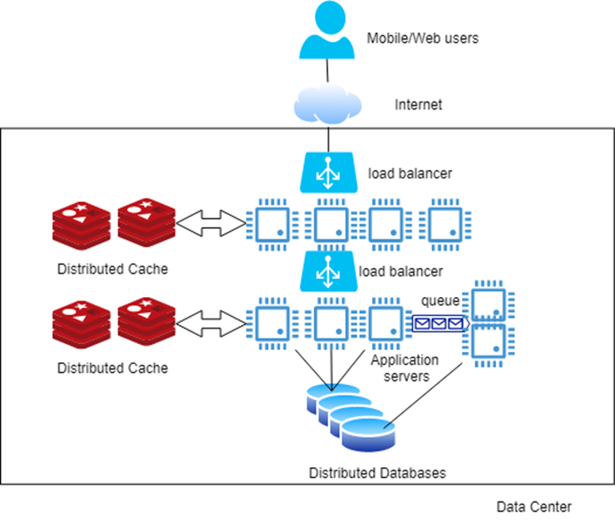
Responsiveness
Increasing Responsiveness with Queueing
Notes:
- With queueing, the server can acknowledge the receipt of the data and concurrently stores it in a queue and responds to the requsets. Distributed queueing platforms can then persist the data eventually.

Slide 27
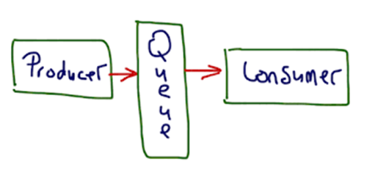
Queueing
Can be utilized when results of a write are not immediately needed
Queuing technologies provide asynchronous communications based on the producer consumer pattern
Producer writes to queue
Consumer reads from queue and updates database
Data is eventually persisted. Eventually means:
A few milliseconds
A second
Longer ….
Use cases that employ this design should be resilient to longer delays without impacting the user experience.

Slide 28
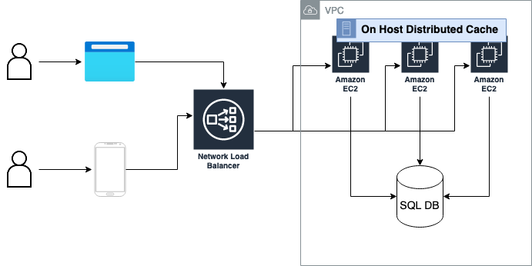
Case Study
A chat application where users can join chatrooms from their browser of mobile apps.

Slide 29
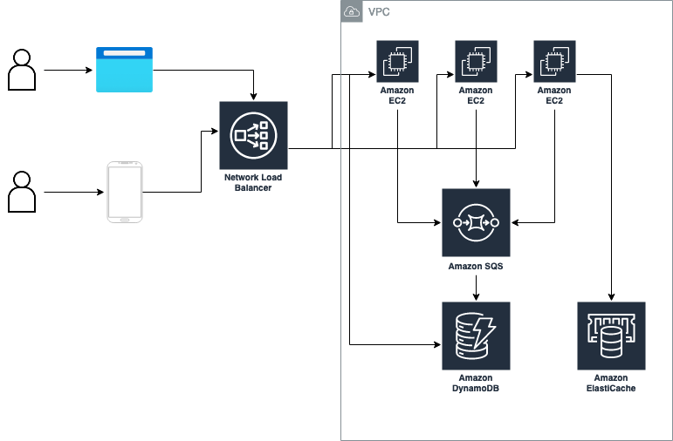
Case Study: After

Slide 30
Summary
Scalability based on a few basic approaches:
Scale up/out
Load balancing
Stateless services
Caching
Distributed databases
Queues
All topics we will revisit throughout the rest of this course

Slide 31
Questions?

