Slide 1

Northeastern University - Seattle
CS6650 Building Scalable Distributed Systems
Vishal Rajpal

Slide 2
Week 7 – Serverless Computing
Topics we will cover today:
Why Serverless Computing?
Google App Engine Overview
Experimental Results
AWS Lambda Overview

Slide 3
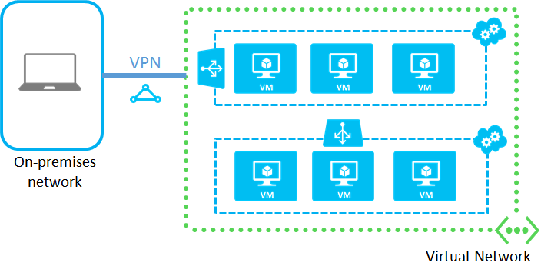
Why Serverless Computing?

Slide 4
Why Serverless Computing?
VM Based Processing
Provision and configure VMs
Choose instance type
Install software
Instance monitoring
On-going maintenance
As load grows
Load balancing
Increase database capacities
Application monitoring
Scale down during low usage periods to save costs

Slide 5
Why Serverless Computing?
VM Based Cloud Apps Costs
On going monitoring and management
System Administration
Potentially unused resources
Serverless Computing
Aka Function as a Service (FaaS)
No VMs to provision and manage
No costs if not running code
Auto scaling up and down

Slide 6
Why Serverless Computing?
FaaS Platforms
Examples
AWS Lambda
Google App Engine
Azure Functions
Upload code to deploy
Each platforms supports a variety of languages/frameworks
Auto horizontal scaling configurable for different workloads
Triggered by
HTTP Request
Events (SQS Trigger, S3 Object Update etc.)

Slide 7
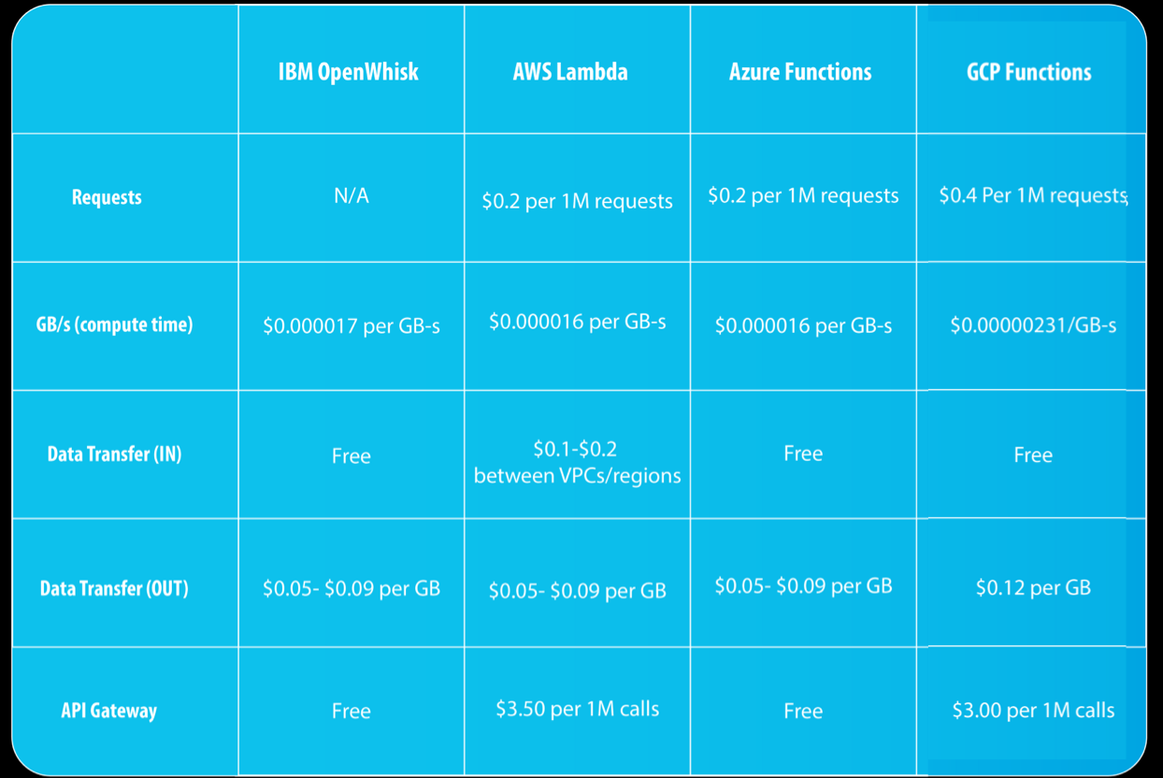
Why Serverless Computing?
Tradeoffs
Stateless - All state needs to be externalized/persistent between invocations
Execution Duration - Maximum typically 60-300 seconds by default - Configurable
Start up latency - Cold starts, Warm starts
Application/language/environment dependent
Costs - Pay per invocation of a function
Requests: around $0.2 per 1M executions across the board, across all providers
CPU & RAM: ~ $0.000067 per GB-second
Can be more expensive than VMs if utilization high
API Gateway

Slide 8
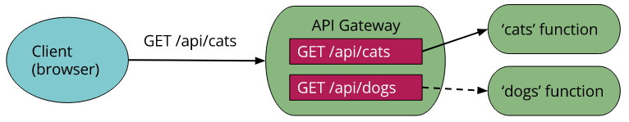
Why Serverless Computing?
API Gateway
Similar to the façade pattern
E.g. HTTP, WebSockets
Clients call Gateway and Gateway routes request to application (microservice) endpoints
Authorization
Monitoring
API version management
Other stuff input validation, traffic tetc
Results sent to API Gateway and relayed to client
Cloud-provider managed server

Slide 9
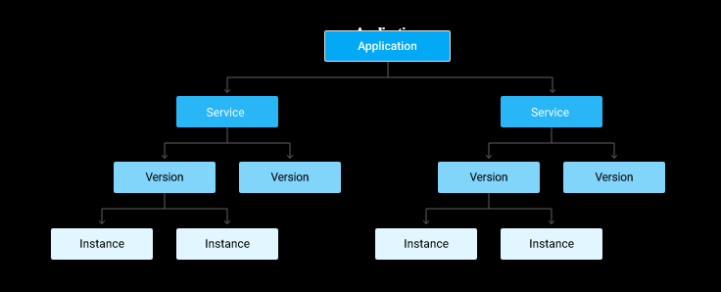
Google App Engine
GAE application comprises of one or more services
Services can be in different languages/configured differently
Service can have multiple deployed versions
Versions have multiple instances that handle requests

Slide 10
Google App Engine
App Engine Services
Equivalent to a microservice
App source code
API
Configuration
Version
Can use traffic splitting to perform A/B tests across different versions
Services/versions need unique names, eg:
http://my-version.my-service.my-project-id.appspot.com
Notes:
A/B tests are great to test two versions of a service on live traffic.

Slide 11
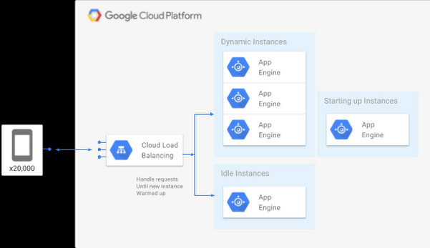
Google App Engine
Instances – Managed by GAE
Auto-scaled by default
Requires a new runtime to be deployed
JVM
Python VM
Etc
Startup costs per instance
Min/max instances
Unused instances removed (scale down)
Pay by 15 mins intervals
Instance resources (CPU/memory)
GAE Request Handling

Slide 12
Google App Engine
Auto Scaling – app.yaml
By default:
Concurrent_requests = max_concurrent_requests * target_throughput_utilization
Default max_concurrent_requests = 10
If target throughput utilizations is set to 0.6 (default) then concurrent_requests = 6.
CPU Utilization : When an instance reaches 60% CPU, the service is scaled
Can specify minimum and maximum wait times for a request before scaling a service
Default 30 msec

Slide 13
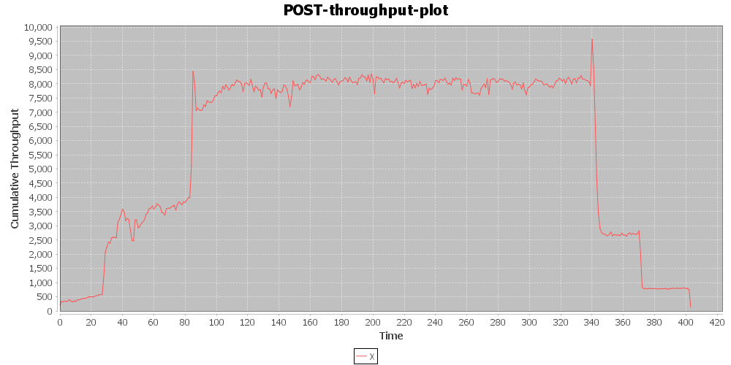
Experimental Results
Typical Load Test Profile
Notes:
64 – 1024 clients over an iteration of 400 seconds

Slide 14
Experimental Results
How much does programming language effect performance and costs?
Google app engine server
Same API
Same database model and operations (Google Datastore)
Same client and test load
Same B1 instances, default autoscaling settings
4 server implementations
Go
Java
Python
Node.js
Notes:
- 80%write (POST) and 20% (GET)
- Behind the scenes code for all languages wrote to a NoSQL DB.

Slide 15
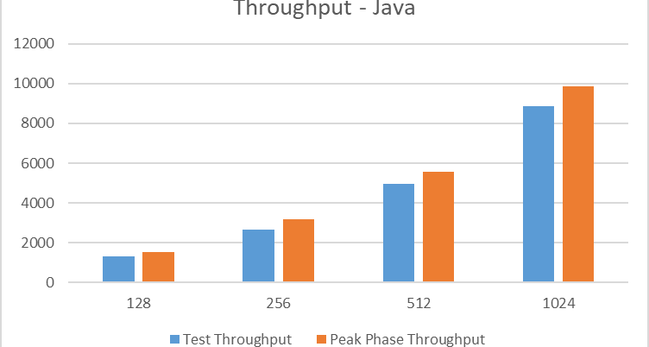
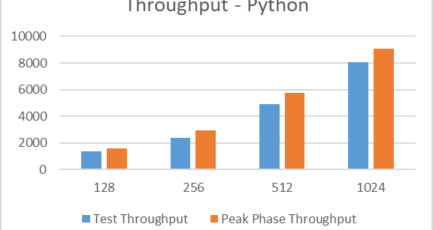
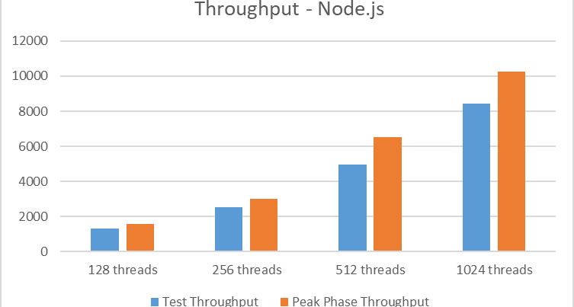
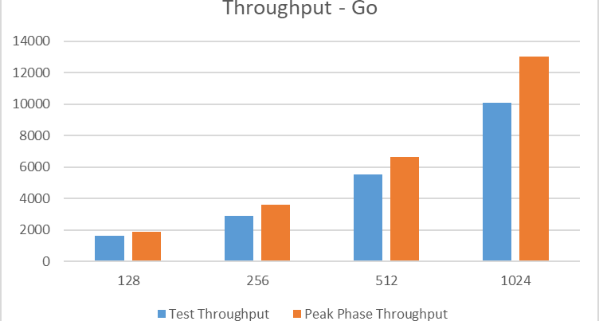
Experimental Results

Slide 16
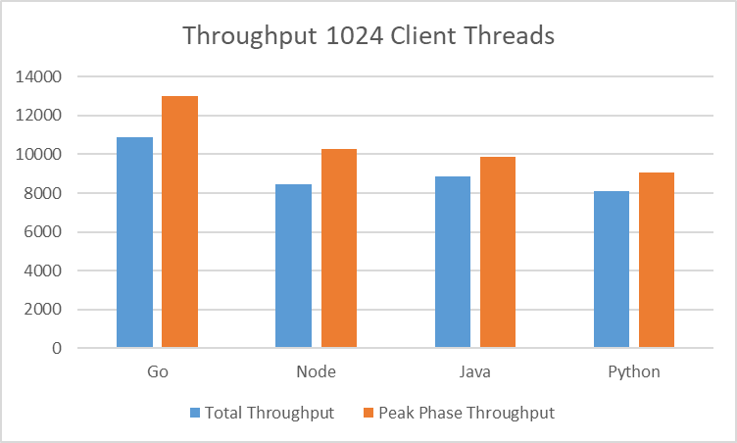
Experimental Results

Slide 17
Experimental Results
Language Cost Comparison

Slide 18
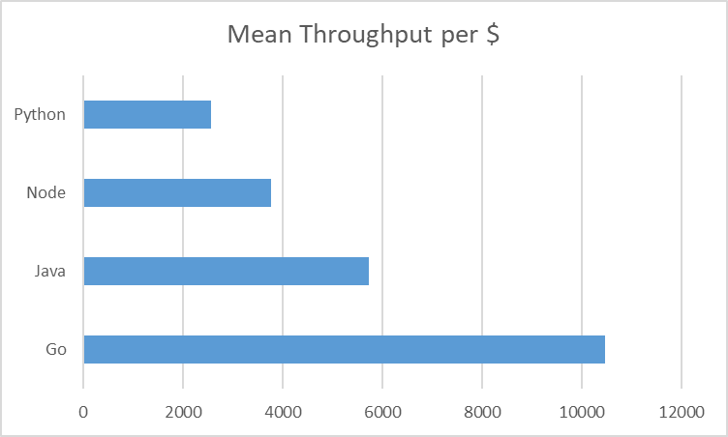
Experimental Results
Price Performance Ratio

Slide 19
Experimental Results
Autoscaling Parameters Experiment
parameter | default
target_cpu_utilization | 0.6
target_throughput_utilization | 0.6
max_concurrent_requests | 10
max_pending_latency | 30
min_pending_latency | 30

Slide 20
Experimental Results
Study Design with Go Server
Metric? | maxc10 | maxc35 | maxc65 | maxc90
CPU60
CPU70
CPU80

Slide 21
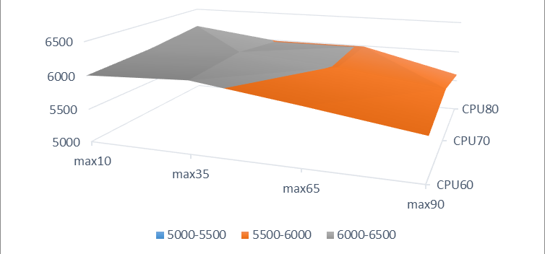
Experimental Results
Mean Throughput
Notes:
Response surface

Slide 22
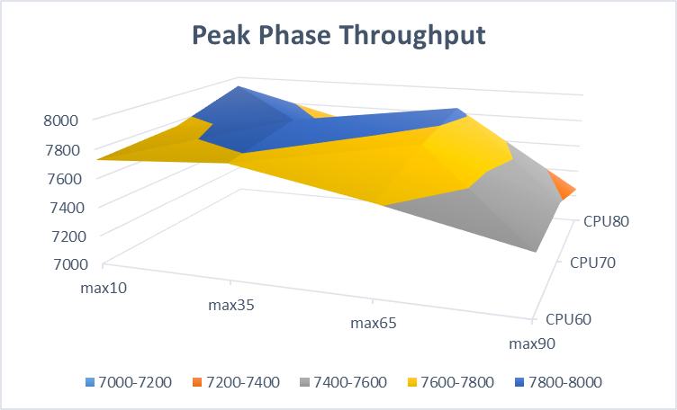
Experimental Results

Slide 23
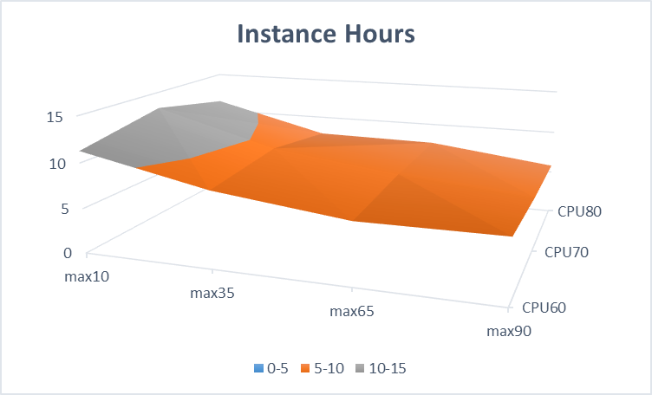
Experimental Results

Slide 24
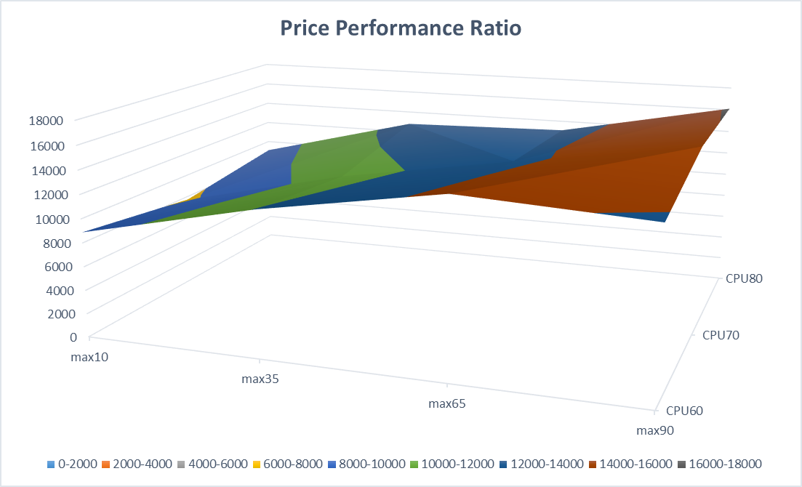
Experimental Results

Slide 25
Experimental Results
Some Takeaways
Higher performance possible at ~20% cheaper than default setting
Can achieve ~96% of default configuration performance at ~54% of default configuration costs
throuhput mean | max10 | max35 | max65 | max90
CPU60 | 6006 | 6067 | 5860 | 5636
CPU70 | 6064 | 6121 | 5993 | 5793
CPU80 | 6178 | 5988 | 5989 | 5605
instance hours | max10 | max35 | max65 | max90
CPU60 | 11 | 8 | 7 | 7
CPU70 | 13 | 9 | 7 | 6
CPU80 | 11 | 8 | 8 | 6
Notes:
Higher perf: max10-cpu60 , max35-cpu70
96% of default – max10-cpu60 (instance hours) – max90-cpu70

Slide 26
AWS Lambda
Servers are stateless Lambda functions
Triggered by HTTP or events on AWS services, e.g.: S3, DynamoDB
Charged based on 100ms metering intervals
Scales automatically
Example
package example;
import com.amazonaws.services.lambda.runtime.Context;
import com.amazonaws.services.lambda.runtime.LambdaLogger;
public class Hello {
public String myHandler(int myCount, Context context) {
LambdaLogger logger = context.getLogger();
logger.log("received : " + myCount);
return String.valueOf(myCount);
}
}

Slide 27
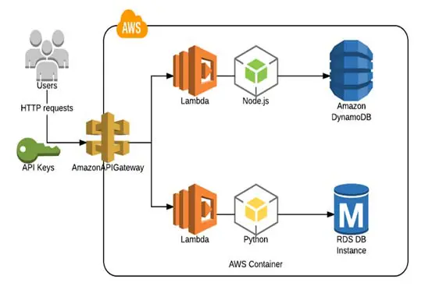
AWS Lambda
Expose Lambda Function as a HTTP endpoint
Map HTTP request to Lambda function

Slide 28
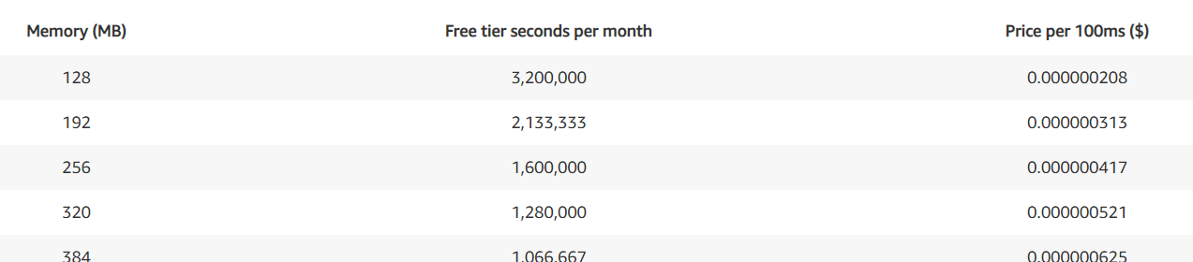
AWS Lambda
Multiple language support
No specific frameworks required
Specify memory for functions and AWS Lambda allocates proportional CPU power, network bandwidth, and disk I/O and costs

Slide 29
AWS Lambda
Scaling
First request loads function and runs handler method
Same function instance maybe reused after requests finished
As more requests arrive, Lambda routes to available instances and creates new ones
If a burst arrives, Lambda throttles instances
Functions cumulative concurrency can reach between 500 and 3000 (region dependent)
Can scale 500 instances per minute after initial burst
Can also reserve/cap concurrency on a function
Provide known maximum capacity (costs)

Slide 30
Summary
Serverless platforms available for all major cloud providers
Aim to make deployment and management ‘admin free’
Examples GAE and AWS Lambda
Different features and scaling approaches

Slide 31
Questions?

