Slide 1

Northeastern University - Seattle
CS6650 Building Scalable Distributed Systems
Vishal Rajpal

Slide 2
Week 5 – Scalable Service Design
Topics we will cover today:
HTTP API Design
Servlets
Application Services Containers
Horizontal Scaling
Load Balancing

Slide 3
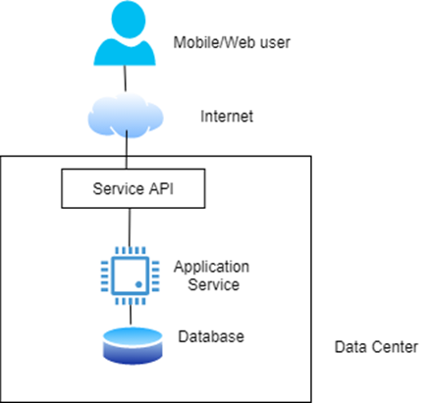
HTTP API Design

Slide 4
HTTP API Design
API defines a contract between the client and server.
Dominant contemporary style is HTTP APIs.
CRUD - Create, Read, Update, Delete.
An aside - REST is an architectural style that was defined by Roy Fielding in his PhD thesis

Slide 5
HTTP API Design
CRUD HTTP APIs
Verb | Uniform Resource Identifier Example | Purpose
POST | /skico.com/skiers/{skierID}/{date} | Create a new ski day record for a skier
GET | /skico.com/skiers/(skierID) | Get the profile information for a skier, returned in a JSON response payload
PUT | /skico.com/skiers/{skierID} | Update skier profile
DELETE | /skico.com/skiers/{skierID} | Delete a skier’s profile as they didn’t renew their pass!

Slide 6
HTTP API Design
CRUD HTTP APIs
A HTTP CRUD API applies HTTP verbs on resources identified by Uniform Resource Identifiers (URIs)
/skico.com/skiers/768934
Combination of HTTP verb and URI define the semantics of the API operation.
Payloads formatted as JSON
XML or text also possible.
Resources, represented by URIs, are conceptually like objects in Object Oriented Design (OOD) or entities in Entity-Relationship (ER) model.

Slide 7
HTTP API Design
API Specification – OpenAPI
Notes:
The OpenAPI specification defines a standard specification which is also any programming language agnostic for HTTP APIs
Swagger is a set of open-source tools built around the OpenAPI Specification that can help you design, build, document and consume REST APIs.
https://swagger.io/docs/specification/about/
Defined in YAML

Slide 8
Designing Services
Application server receives requests and routes them to the appropriate handler function.
Handler is defined by the application and implements the business logic
Each request is (typically) allocated a thread to execute the request
Example Express.js server
app.get('/skiers/:skierID', function (req, res) {
// process the GET request
ProcessRequest(req.params)
}
Notes:
There are different ways technologies choose to route requests.
In Express.js the container calls the matching method to the API signature

Slide 9
Designing Services
1. @RestController
2. public class SkierController {
3.
4. @GetMapping("/skiers/{skierID}",
5. produces = “application/json”)
6. public Profile GetSkierProfile(
7. @PathVariable String skierID,
8. ) {
9. // DB query method omitted for brevity
10. return GetProfileFromDB(skierID);
11. }
12. }
Notes:
In Java. There are annotations defined to route requests.
@RestController identifies classes that implement APIs and automatically serializes the return objects into HTTP response.
@GetMapping maps the API to a specific method and defines format of the response body.
@PathVariable a parameter that originates from the URI.

Slide 10
Java Servlets
@WebServlet annotation identifies the base pattern for the URI which causes a servlet to be invoked.
Servlet must extend the HttpServlet abstract class and override at least one method that implements a HTTP request.
doGet: HTTP GET requests
doPost: HTTP POST requests
doPut: HTTP PUT requests
doDelete: for HTTP DELETE requests
Notes:
Java Enterprise edition defines Servlets with different annotations.

Slide 11
Java Servlets
import javax.servlet.http.*;
@WebServlet(
name = “SkiersServlet“,
urlPatterns = “/skiers”
)
public class SkierServlet extends HttpServlet (
protected void doGet(HttpServletRequest request, HttpServletResponse response) {
// handles requests to /skiers/{skierID}
try {
// extract skierID from the request URI (not shown for brevity)
String skierID = getSkierIDFromRequest(request);
if(skierID == null) {
// request was poorly formatted, return error code
response.setStatus(HttpServletResponse.SC_BAD_REQUEST); }
else {
// read the skier profile from the database
Profile profile = GetSkierProfile (skierID);
// add skier profile as JSON to HTTP response and return 200
response.setContentType("application/json");
response.getWriter().write(gson.toJson(Profile);
response.setStatus(HttpServletResponse.SC_OK);
} catch(Exception ex) {
response.setStatus(HttpServletResponse.SC_INTERNAL_SERVER_ERROR);
}}}}
Notes:
Servlets therefore require code but are more efficient.

Slide 12
State Management
HTTP is known as stateless protocol. But …
The underlying socket connection between a client and server is kept open
HTTP supports cookies, which are known as the HTTP State Management Mechanism .
HTTP/2 supports streams, compression and encryption, all of which require state management
So, perhaps not anymore?

Slide 13
State Management
Conversational State
Service implementations that need to scale should avoid storing conversational state.
any information that is retained between requests such that the subsequent request can assume the service has retained state about the interactions
GET /skico.com/skiers/768934
PUT /skico.com/skiers/phoneno/4123131169
When the service receives the initial GET request:
creates a session state object that uniquely identifies the client connection.
session state object stores conversational state – in our example this would be skierID.
When PUT request arrives it uses the session state object to look up the skierID
Services that maintain conversational state are known as stateful services.
JEE servlets support the HttpSession object,
Session object in ASP.NET.

Slide 14
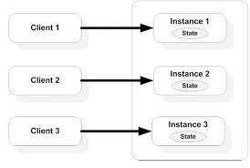
Stateful Services
Problems with state management:
session state uses available server memory
how long to keep session state available?

Slide 15
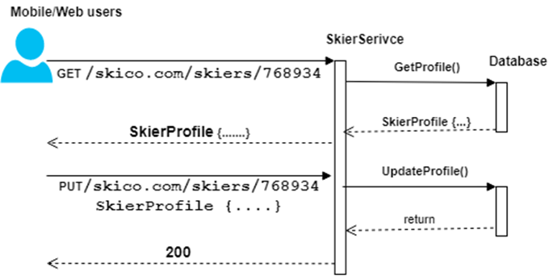
Stateless Services
Stateless services do not store conversational state
Each request is standalone and can be processed individually.
Requires client to provide all the necessary information for the server to process the request and provide a response.
PUT /skico.com/skiers/768934/phoneno/4123131169

Slide 16
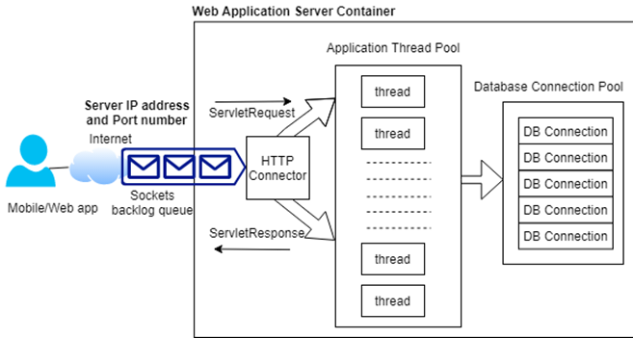
Application Servers
Heart of a scalable application
Host the business services that comprise an application.
Technological landscape of application servers is broad, e.g:
Java Enterprise Edition (JEE)
Express.js server supports Node
Flask supports Python
GoLang a server can be created by incorporating the net/http package.
Apache Tomcat server
Tomcat Example
Notes:
JEE – Heavyweight and classifies as a web server
Apache Tomcat – open source implementation of a subset of JEE platform (Servlets, JSP, Java expression language, and Java Websockets)
Tomcat implements a servlet container which acta as an execution environment for application defined servlets.
Servlets are run using this container which provides lifecycle management and multithreaded runtime environment.
8080 – HTTP, 8443 – HTTPS
One or more listener threads process incoming requests which creates a TCP/IP socket connection between client and the server.
Application Thread Pool: min 24, max 200
If no application threads are available there is a queue of Runnable tasks. (Unbounded)

Slide 17
Application Servers
Apache Tomcat
Highly configurable to different handle different workloads.
Request latency governed by:
the request processing time in the servlet
the time spent waiting in queues for threads and DB connections
In a heavily loaded server
Context switching may start to degrade performance.
Available memory may be become limited.
Queues grow as requests wait for resources.
Eventually new TCP/IP connections will be refused,
Overloaded server will run out of resources and crash.

Slide 18
Application Servers
Performance Tuning
Tuning configuration parameters is important
If CPU utilization consistently exceeds the 70-80% range = overload signal
Similar insights exist for memory usage
Once any resource gets close to full utilization, systems tend to exhibit less predictable performance

Slide 19
Application Servers
Monitoring Tools
Monitoring tools available for Web application frameworks,
Latencies
active requests
queue sizes
Java-based application frameworks support the JMX (Java Management Extensions) framework,
JMX exposes monitoring information based on the capabilities of MBeans (Managed Beans),
Eco-system of tools for monitoring JMX
JConsole
JavaMelody

Slide 20
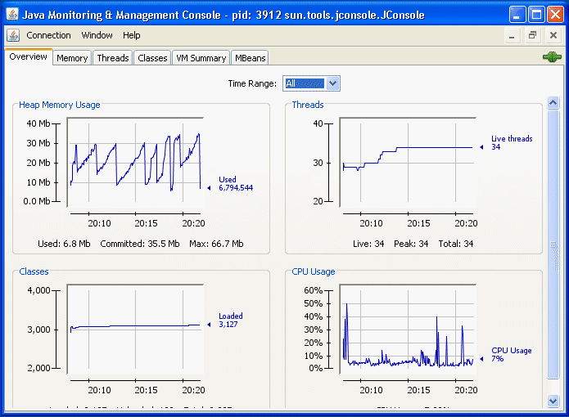
Application Servers
JConsole

Slide 21
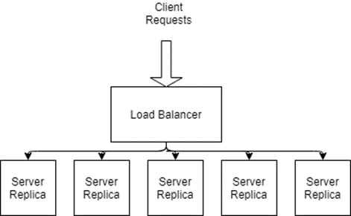
Horizontal Scaling
Service replicas are deployed on their own (virtual) hardware
The services need to be stateless
Any request sent to any service by load balancer
Horizontal scaling also increases availability.
eliminates single point of failure (SPoF)
If one replica fails, requests can be directed to any replica.

Slide 22

Load Balancing
Aims to utilize capacity of a collection of services to optimize response time for each request.
Distributes requests across the available services as evenly as possible
Clients send requests to the load balancer
redirects requests to target services
relays the results back to the client.

Slide 23
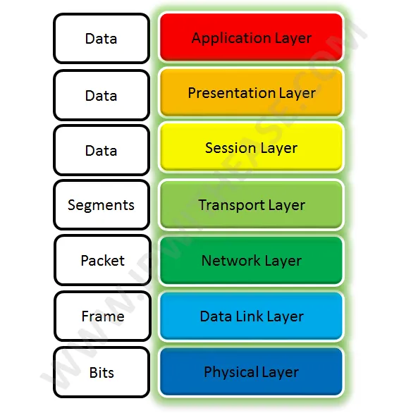
Load Balancers
Two types of load balancers
Network Level
Application Level
Called Layer 4 and Layer 7 load balancers respectively.
Notes:
Layer4 represents transport layer in Open Systems Interconnect (OSI)
OSI characterizes network communications into 7 abstract layers.
Each layer defines how the data is packaged and transported.

Slide 24
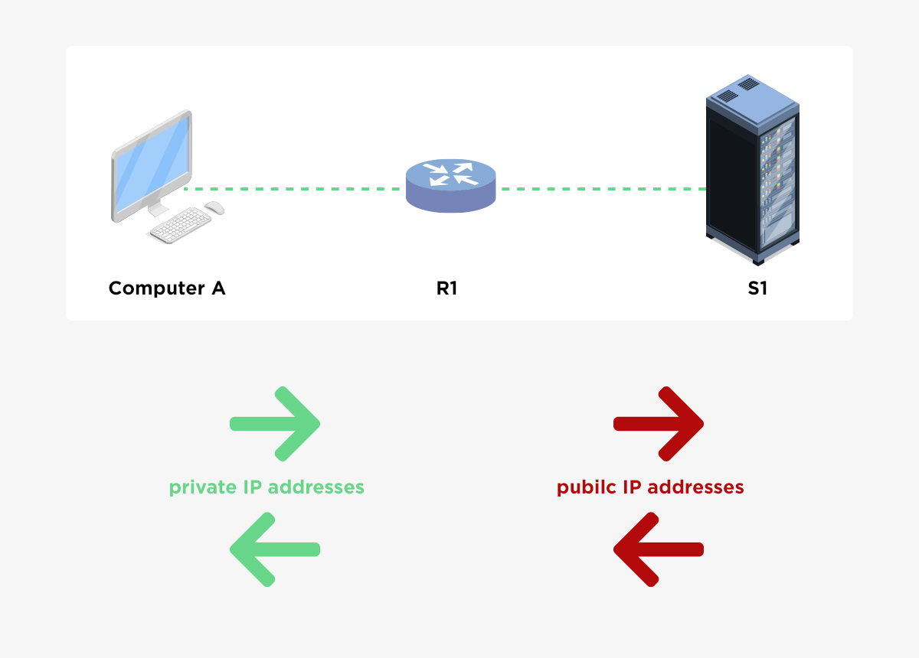
Load Balancers
Network Load Balancers
Distribute requests at the network connection level
Operates on individual TCP/UDP packets.
Routing decisions based on IP addresses.
Uses a technique called Network Address Translation (NAT).
Relatively simple and extremely fast
Notes:
Operate on an individual packet level.
Fast as they only provide few features such as NAT etc.

Slide 25
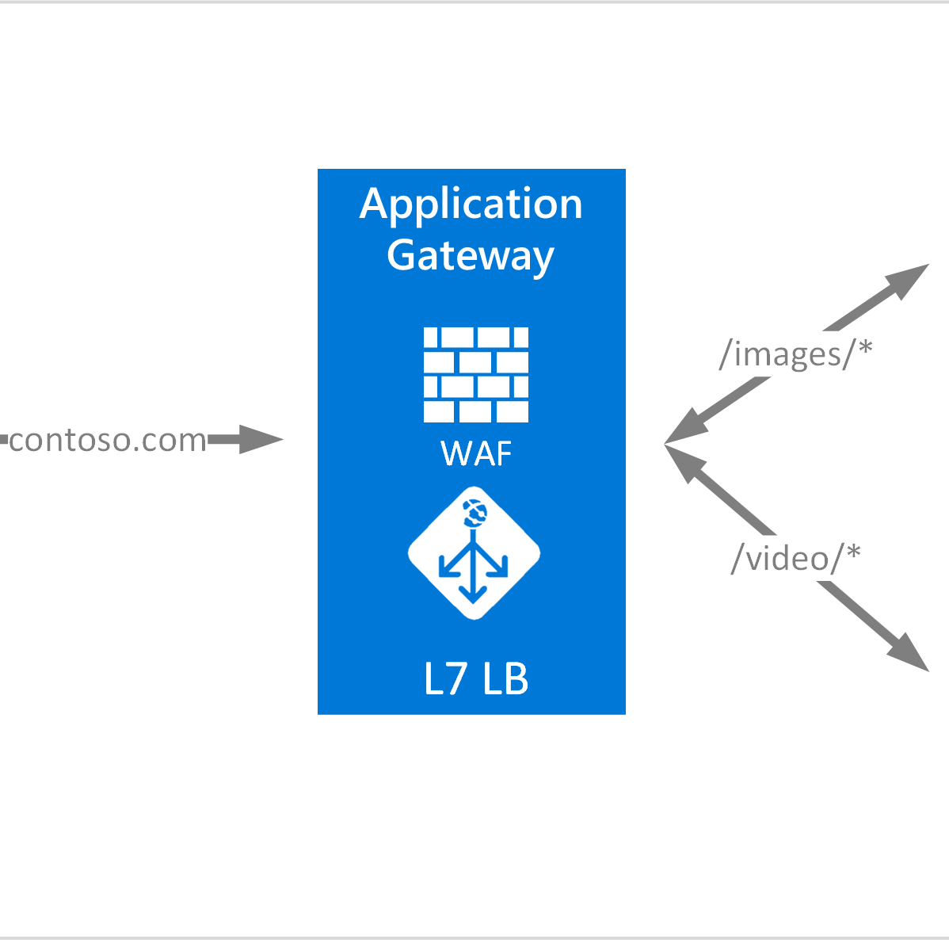
Load Balancers
Routing decisions based on HTTP headers and on the contents of the message.
For example:
send all POST requests to a subset of available services
distribute requests based on a query string in the URI
Richer capabilities means they are slightly slower than network load balancers

Slide 26
Load Balancers
Load Balancer Features
Load Distribution Policies
Many policies supported, e.g.
round-robin
least connections
HTTP header field
HTTP operation
Also support allocating server weights
Load distribution policies
Health monitoring
Elasticity
Session affinity

Slide 27
Load Balancers
Load Balancer Features
Health Monitoring
Periodically sends pings and attempts connections to test health of each service in load balancing pool.
Known as health checks.
If a server
unresponsive
fails connection attempts
It is removed from the load balancing pool

Slide 28
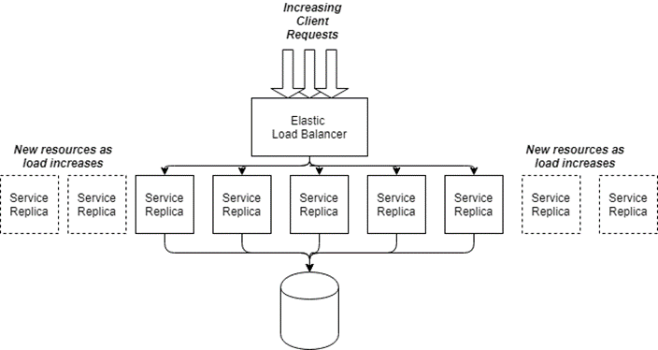
Load Balancers
Load Balancer Features
Elasticity
Two ways to control the number of services in a group.
Schedule-based
dynamic based on thresholds such as CPU usage
Instances need time to startup
not available until after warmup period
When service group average CPU utilization drops below a threshold, scale in or scale down invoked
Notes:
AWS Auto scaling group

Slide 29
Load Balancers
Load Balancer Features
Session Affinity
Aka sticky sessions
Load balancer sends all requests from the same client to the same service instance.
AWS Elastic Load Balancing generates an HTTP cookie that identifies the service a client’s session is associated with.
Cookie is returned to client, which must send it in subsequent request to ensure session affinity is maintained
Notes:
Feature that allows to balance requests for stateful services

Slide 30
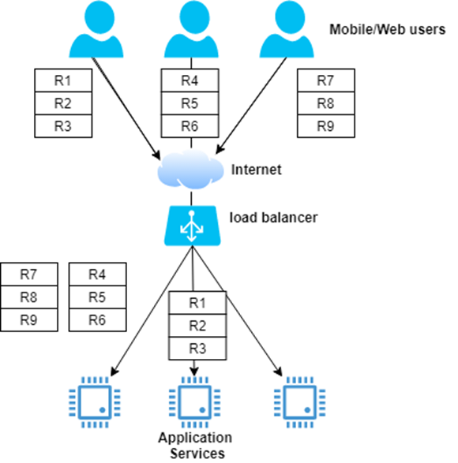
Load Balancers
Load Imbalance
Notes:
Load imbalance occurs if sessions last varying amount of time.
For smaller systems this may not be a problem but for large systems this is inevitable. Some are overwhelmed and may fail due to memory exhaustion.

Slide 31
Stateful versus Stateless
Stateful services have other downsides
How do clients connect when the service fails?
How do clients respond when the service is unresponsive?
Stateless services have none of these downsides.
If service fails, the clients retries and request routed to another live service.
If a service is slow, the load balancer takes it out of the service group until it passes health checks of fails.
Stateless services
enhance scalability
simplify failure scenarios
ease the burden of service management

Slide 32
Scalable Service Design - Summary
Service API specifies contract with client
Application service containers provide powerful multithreaded execution environments
Performance tuning and monitoring are crucial for optimization
Load balancing with stateless services is a key scalability pattern

Slide 33
Caching
Introduction
Caching is essential in a scalable system
Makes the results of expensive queries and computations available for reuse
Caches exist in many places in an application
This section covers:
Application based caching
HTTP/Web based caching
Notes:
CPUs have caches to reduce queries to main memory
Database engines have caches so that queries do not query disks for similar queries.
Web based caching – Generally a browser based cache controlled by request and response headers

Slide 34
Application Caching
Improve request responsiveness by storing the results of queries and computations in memory
Newspaper articles
Concert seating map
Hourly weather forecast
Caching relieves databases of heavy read traffic
Caching requires additional resources/cost to store cached results.
3% of infrastructure at Twitter is dedicated to application level caches

Slide 35
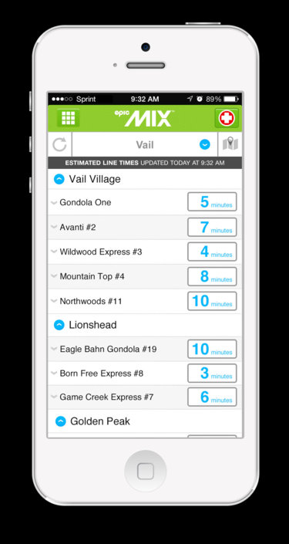
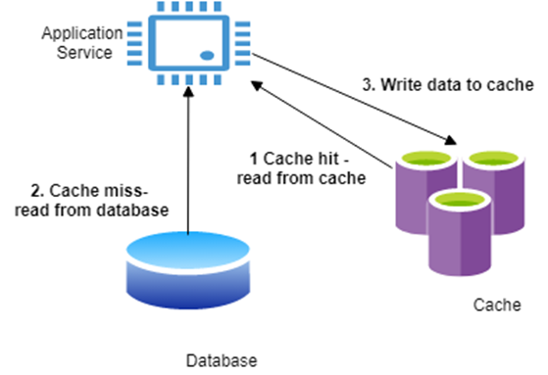
Application Caching
Utilize cache engines, e.g.:
Redis
Memcached
Distributed in-memory key-value stores
Objects allocated to individual cache servers using hashing on object key

Slide 36
Caching Example
public class LiftWaitService {
public List getLiftWaits(String resort) {
List liftWaitTimes = cache.get(“liftwaittimes:” + resort);
if (liftWaitTimes == null) {
liftWaitTimes = skiCo.getLiftWaitTimes(resort);
// add result to cache, expire in 300 seconds
cache.put("liftwaittimes:" + resort, liftWaitTimes, 300);
}
return liftWaitTimes;
}
}

Slide 37
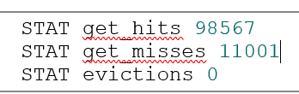
Application Caching
Satisfy as many requests as possible from the cache - hit rate.
maximize the hit rate and miss rate
If items updated regularly, cost of cache misses negate benefits of the cache.
Monitor the cache usage for the service

Slide 38
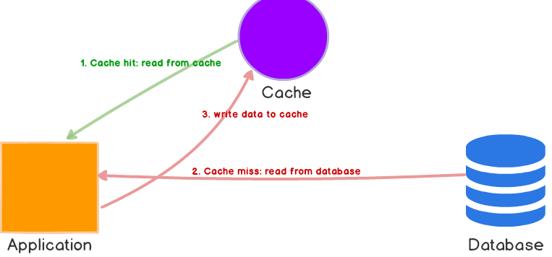
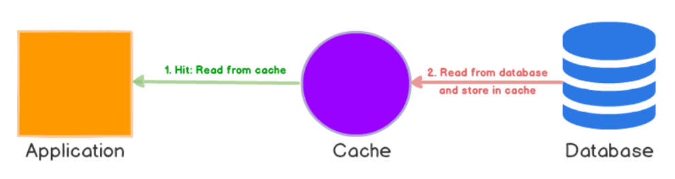
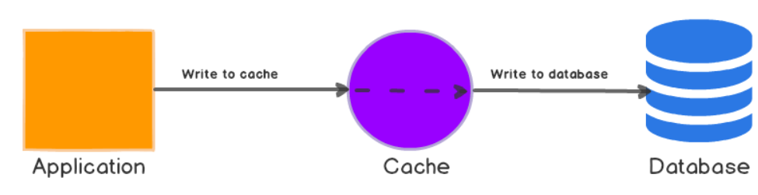
Caching Patterns
Application level caching known as cache-aside pattern – Application bypasses the database if the results are in the cache.
Alternatives exist, commonly supported by databases
Read-through
Write-through
Write-behind
Cache Aside Caching
Read Through Caching
Write Through Caching
Notes:
Write behind is similar to write through except the application does not wait for the application to write to the database.

Slide 39
Analysis of Caching Patterns
Read/write-through/behind simplify application logic as service always accesses cache contrast to Application cache as it needs to be aware of cache misses.
Require a cache augmented with an application-specific handler to performs database reads and writes, e.g:
NCache
Amazon’s DynamoDB Accelerator (DAX)
Cache aside:
More complex programming model
Resilient to cache failure
Super scalable
Notes:
Application specific handler require it be exact as the data model

Slide 40
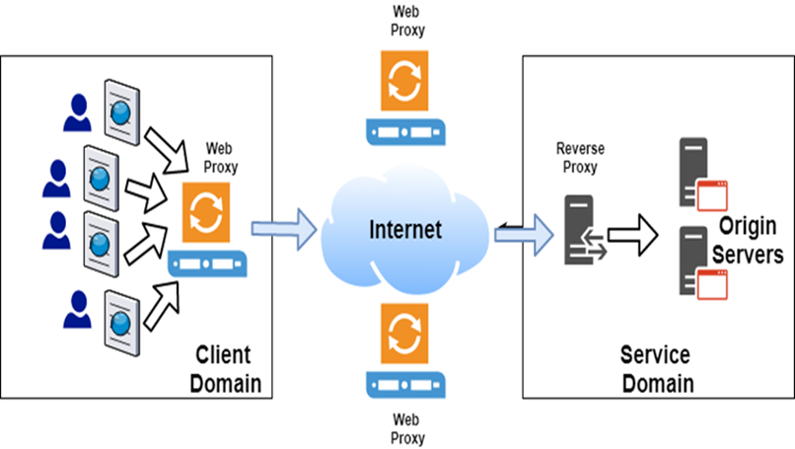
Web Caching

Slide 41
Cache Control
1. Response:
2. HTTP/1.1 200 OK Content-Length: 9842
3. Content-Type: application/json
4. Cache-Control: public
5. Date: Fri, 26 Mar 2019 09:33:49 GMT
6. Expires: Fri, 26 Mar 2019 09:38:49 GMT
Notes:
Services can control which results are caches and how long

Slide 42
Cache Directives
no-store: a resource from a request response should not be cached.
no-cache: a cached resource must be revalidated with an origin server before use.
private: a resource only be cached by a user-specific device such as a Web browser
public: a resource can be cached by any proxy server
max-age: defines the length of time in seconds a cached copy of a resource should be retained.
Notes:
- Can use headers to How caching should be utilized

Slide 43
Expires and Last-Modified
Used if max-age not specified
specify how long resources in cache should remain valid, or fresh.
Once this period expires, it becomes stale and a candidate for eviction.
Expires header is next used to calculate the freshness period.
Finally the Last-Modified header can specify the freshness lifetime based on a heuristic calculation ((date header – last modifies) * 10%)
Request: GET /skico.com/liftlines/Blackstone Response: HTTP/1.1 200 OK Content-Length: ... Content-Type: application/json Cache-Control: public Date: Fri, 26 Mar 2019 09:33:49 GMT Expires: Fri, 26 Mar 2019 09:38:49 GMT <!-- Content omitted -->
Notes:
Maxage then expires header and then last modified.

Slide 44
Etag
Opaque value that van be used by a cache to check if a cached resource is still valid, eg:
Request:
GET /skico.com/weather/Blackstone
Response:
HTTP/1.1 200 OK Content-Length: ...
Content-Type: application/json
Date: Fri, 26 Mar 2019 09:33:49 GMT
Cache-Control: public, max-age=3600
ETag: “09:33:49"
Notes:
Etag represents the version of the report that was last issued.

Slide 45
Etag – Cache Revalidation
1. Request:
GET /upic.com/weather/Blackstone
If-None-Match: "09:33:49“
4. Response:
5. HTTP/1.1 304 Not Modified

Slide 46
Implementing Etags
Generate new daily report:
stored in a database
Stored in cache {#resortname-weather, etag value}
GET requests:
return the weather report and the Etag.
Conditional GET requests:
Lookup the Etag value in cache and return 304 if value unchanged.
If the cached Etag has changed, return 200 along with the latest weather report and a new Etag value.
Update weather report: A
new version of the weather report is stored in the database
Etag value is modified to represent this new version of the response

Slide 47
Summary
Web caching can significantly reduce latencies and save network bandwidth.
Reduces the request load on origin servers, creating additional capacity
Web Proxy caches such are extensively deployed in the Internet

Slide 48
Questions?

