Slide 1
👋 Instructor Introduction

Slide 2
Technical Product Manager Academy
Who I am, what to expect, how we’ll work
Notes:
Standalone instructor intro deck. Drop this into any cohort opener — kickoff session, Week 1 Day 1, or a one-off mid-academy session for a new instructor. Sets credibility, expectations, ground rules.

Slide 3
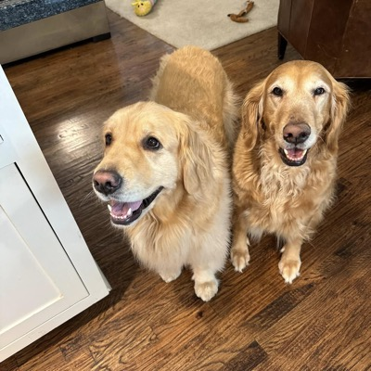
👋 About Me
John Kidd
20+ years building commercial software
20+ years teaching technology and related subjects
First tech I taught: Lotus Notes
Yes, I love Goldens!
John Kidd
Notes:
Briefly establish credibility. Keep it under 90 seconds — the goal is to set context, not deliver a CV.

Slide 4
✅ Prerequisites
This academy assumes you:
Completed the pre-work — PM Philosophies, Agile Methodologies, and Prompt Engineering
Are comfortable with browser-based tools and a markdown editor
Have working access to a generative AI assistant (ChatGPT, Claude, or equivalent)
Please note: if any of these is your first exposure, flag it now so we can pair exercises and pace appropriately.
Notes:
Quick show-of-hands or chat poll on the prerequisite items helps calibrate pace for the cohort.

Slide 5
🎯 Where This Fits
Adjacent skills you’ll touch
Prompt engineering & AI-augmented research
System design & architecture trade-offs
Stakeholder mapping & negotiation
Agile delivery and ADO mastery
Where to go next
Capstone artifact carries into your real product work
Ongoing TPM mentorship inside Expeditors
Skills/SkillIQ post-academy assessments
Notes:
Position the academy in the wider learning map so participants see how today’s work pays off downstream.

Slide 6
🤝 My Pledge to You
I will…
Make this academy interactive — small-group breakouts every block
Ask you questions — and welcome yours
Make sure every voice in the cohort gets heard
Create an inclusive learning environment
Use an on-screen timer for breaks and lab timeboxes
If you have an accessibility need, please let me know — in chat, by email, or directly — and I’ll adapt.
Notes:
Set the contract for the academy. Inviting accessibility requests up front reduces friction later.

Slide 7
🧑‍🏫 How We’ll Work Together
All materials live in the academy repo — decks under week-XX/presentations/, lab briefs under week-XX/labs/
We’ll use a generative AI assistant and a markdown editor — please install ahead per participant-setup/TECH-SETUP.md
Follow along in the day’s lab brief
Activities and labs are embedded in each day — come prepared to work in quads
Ask questions any time — chat, raised hand, or unmute
Notes:
Cover the participation contract. Demonstrate the chat/raise-hand mechanics before content begins.

Slide 8
🗣️ Cohort Introductions
In ~30 seconds each, please share:
Your name and pronouns
Current role and team
Where you’re based
A product you ship to today — internal or external
A fun fact — one sentence
Notes:
Keep introductions tight. Use this to identify quads — pair complementary backgrounds where possible.

Slide 9
🛡️ Recording & Notetaker Policy
Notetaker apps (Read AI, Otter, Fireflies, etc.) are not permitted in this session.
The instructor will decline notetaker requests — no exceptions
These tools capture more than shared text; they raise privacy and IP concerns
For follow-up questions, reach out directly to the instructor
Thanks for your cooperation.
Notes:
Repeat verbally on Day 1. Some learners auto-launch notetakers without realizing.

Slide 10
🚀 Ready to Begin
Welcome to the TPM Academy
Notes:
Energy reset. Hand off to whatever comes next — kickoff agenda, Week 1 Day 1 content, or a different session opener.

