Slide 1
Modern Cloud Applications
Speaker Name

Slide 2
Agenda
Characteristics of traditional vs. cloud applications
Developing cloud applications with Azure services
Improving application scalability

Slide 3
Traditional applications

Slide 4
“Traditional” Applications
Client
Request
Response
Front-End
Application Logic
(Relational) Database
Notes:
What is a Modern App? To answer that question, let’s look at what a “Traditional” application is first. Most applications these days use architectures that we’re designed roughly 2 decades ago. These are multi-tier applications using a request/response model. The client, a browser or some other client talks to a front-end, mostly web servers. These pass on the request to the Application Logic tier, which in turn talks to a database. This is typically a relational database. The response follows the opposite route. Of course there are variations on this basic architecture, but many applications are designed using similar principles.

Slide 5
Characteristics of traditional applications
Real-time request/response
Synchronous
Always connected
Transactional
Scale-Up
Failover
Notes:
Traditional applications typically take a real-time request/response approach, and as such synchronous communication. This ties into the way our brain works. We think in cause and effect in a synchronous way. That also usually means the client is always connected, because it needs to receive results synchronously. When we update data in traditional applications, that always happens in a transactional process. In fact, transactions are even involved when retrieving data. That’s just how a relational database works. Transactions aren’t bad in itself, but they do limit scalability, and cause an application to only scale-up rather than scaling out. This also implies the database needs to be in a failover setup. Also, these applications often assume you are connected to the network when you use the application, either with a client or the browser.
In a mobile first, cloud first world traditional architectures like this don’t work very well. The number of clients has exploded with mobile devices and more people around the world having internet access, and applications that were created under traditional architectures can’t handle that. We see that around us on a regular basis, like when tickets became available for Star Wars: The Force Awakens. The reservation systems of several cinema chains broke under the load.

Slide 6
Characteristics of modern cloud applications
Asynchronous
Queued
Eventual Consistency
Microservices
Command & Query Pattern
Polyglot Persistence
Notes:
One of the key aspects of Modern Cloud Apps is asynchronous processing of anything that can’t be handled with a very low latency response. If it can’t be processed immediately a queue is used to throttle the incoming load to back-end services. You may be familiar with the concept of microservices, which breaks up functionality into small, specialized services that can be reused across applications. Microservices are great, but the communication with a high number of microservices can incur latency. This is why asynchronous / queued communication is important for scaling.
A common way top deal with asynchronous operation is using the Command & Query pattern, which splits commands that change data from commands that retrieve data. By using this pattern, your application makes changes using a command and gets the result by querying for it separately. That may involve querying, but notifications to a client are also an option.
Instead of using transactions, Modern Cloud Apps mostly use principles around Eventual Consistency. This means your application needs to be able to deal with inconsistencies between different parts of the system, potentially half way across the world.
Another important aspect is Polyglot Persistence, which ensures you use the types of data stores best suited to the kind of data you need to store.

Slide 7
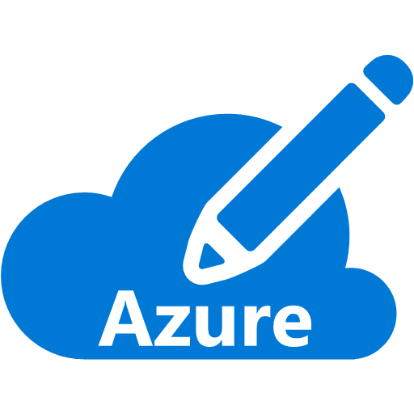






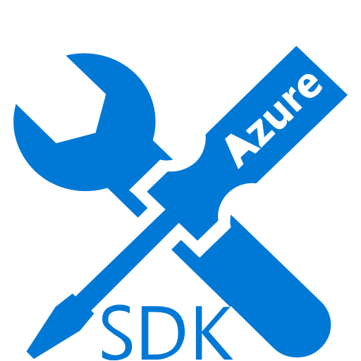

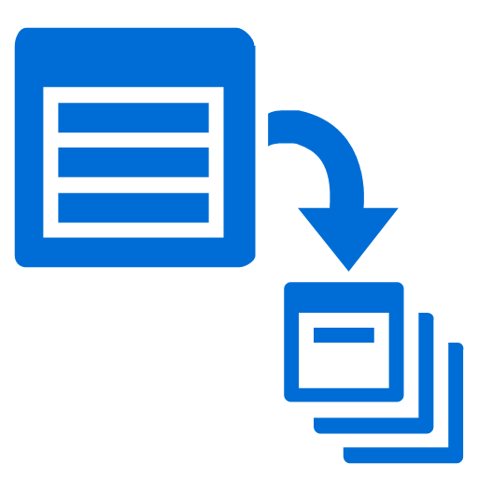

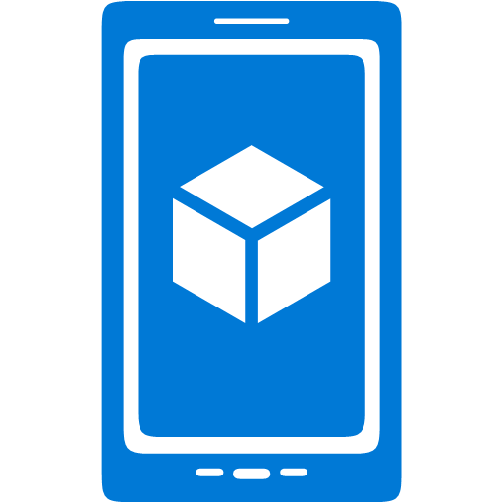



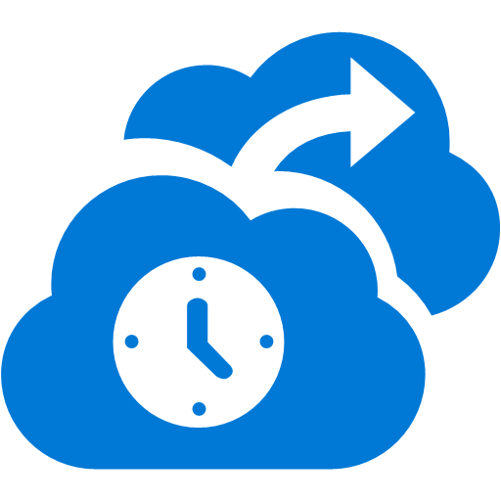







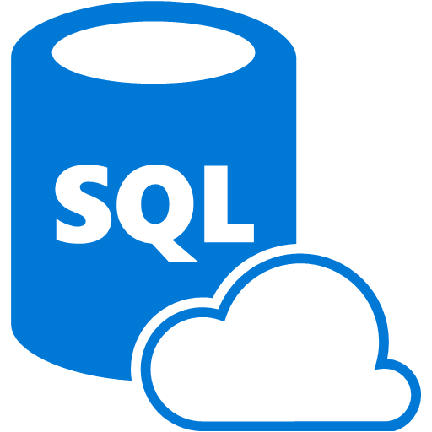



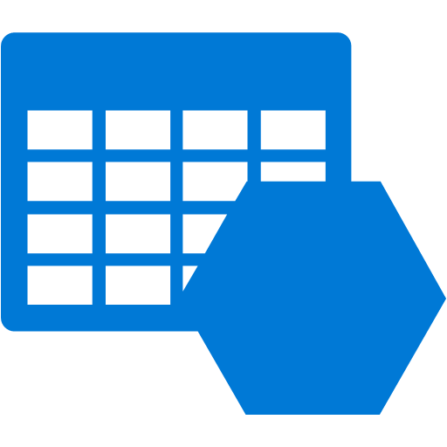









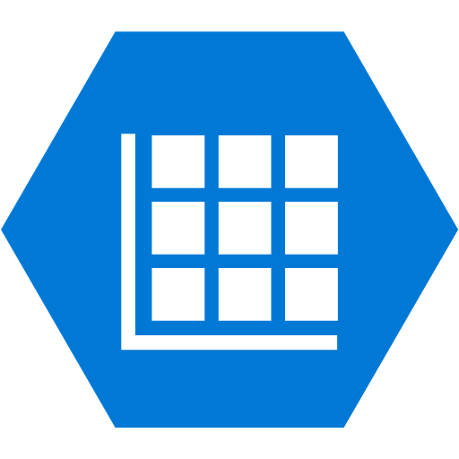




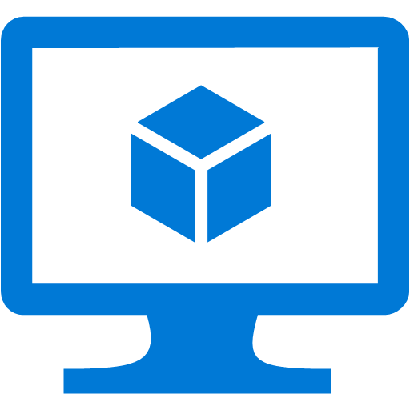
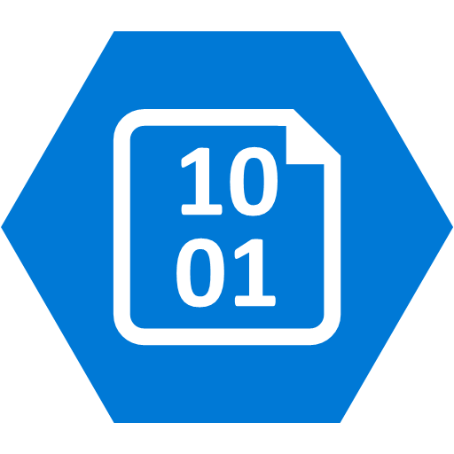



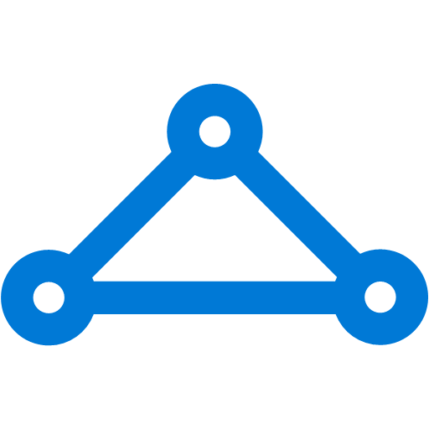


Security & Management
Platform Services
Hybrid Operations
Portal
Compute
App Platform
Developer Services
Azure AD
Connect Health
Cloud
Services
Service
Fabric
Web Apps
API
Apps
API
Management
Visual Studio
Azure SDK
Active
Directory
AD Privileged
Identity Mngt
Batch
Remote App
Mobile
Apps
Functions
Notification
Hubs
Team Project
Application
Insights
Multi-Factor
Authentication
Backup
Integration
Analytics & IoT
Data
Automation
Operational
Insights
Storage
Queues
Logic
Apps
HDInsight
Machine
Learning
SQL
Database
SQL Data
Warehouse
Key Vault
Hybrid
Connections
Service
Bus
Import/Export
Store /
Marketplace
Data
Factory
Event
Hubs
Redis
Cache
Search
Media & CDN
Site
Recovery
Stream
Analytics
Mobile
Engagement
DocumentDB
Tables
VM Image Gallery
& VM Depot
Media
Services
Content Delivery
Network (CDN)
StorSimple
Infrastructure Services
Compute
Storage
Networking
Windows
Linux
Containers
BLOB Storage
Azure Files
Premium Storage
Virtual Network
Load Balancer
DNS
Express
Route
Traffic Manager
VPN Gateway
Application Gateway

Slide 8
Application Hosting Options
Virtual
Machines
VM
Scale Sets
Container Service
Service Fabric
App Service
Infrastructure as a Service (IaaS)
Platform as a Service (PaaS)

Slide 9


Azure App Service
Web Apps
Mobile Apps
Functions
Web apps that scale with your business
Build Mobile apps for any device
Serverless event
processing
LOGIC Apps
API Apps
Automate business process across SaaS and on-premises
Easily build and consume APIs in the cloud

Slide 10
Full capability set available
.NET, Node.js, Java, PHP, and Python
WebJobs for long running tasks
Integrated VS publish, remote debug
Continuous integration
Auto-load balance, Autoscale
Site slots for staged deployments
Web Apps
Web apps run as-is
no changes required

Slide 11
Streamlining mobile experiences
Build native or cross platform applications
Connect to enterprise systems
Stay productive while offline
Rich push notification system
Mobile Apps
Mobile services plus
a whole lot more
Notes:
https://azure.microsoft.com/en-us/documentation/articles/app-service-mobile-value-prop-preview/
Mobile Apps is an entire platform for building and scaling enterprise grade mobile applications. It supports native applications for Windows Phone, iOS, and Android, and cross-platform apps build on Xamarin and Cordova. Regardless of platform, Mobile Apps helps solve common scenarios that have traditional been difficult to maintain with mobile apps – identity, offline, and push messaging. Users can be authenticated against a variety of identity providers, including AzureAD, Microsoft Accounts, Facebook, and more. What happens when users of your application are offline, or in an area of limited cell reception? Mobile Apps lights up a rich offline capability that allows users to go offline, then sync data back to the right systems when connectivity is restored. This feature works across a variety of data sources, including SQL, Table Storage, Mongo, or Document DB, and SaaS APIs including Office 365, Salesforce, and Dynamics. Finally, push messaging can be cumbersome to implement well. Each of the 3 major mobile ecosystems have their own processes and technologies for implementing messaging. Mobile Apps smooth over that process, helping you get messaging implemented quickly and smoothly.

Slide 12
New Logic Apps for easy automation
No code designer for rapid creation
Dozens of pre-built templates to get started
Out of box support for popular SaaS and on-premises apps
Use with custom API apps of your own
LOGIC Apps
Automate SaaS and
on-premises systems
Notes:
Logic Apps are an interesting new part of the Azure App Service. Such applications are “no code” solutions that are authored by dragging and dropping elements onto a design canvas. This empowers developers and IT pros alike to create useful integration workflows that solve a variety of needs. Want to replicate records from a line of business system back to a SQL database and notify the front desk via an email? Sent a SMS notification when a certain condition is met? Identify negative Tweets and post into a Slack channel? Logic apps can help each of these scenarios and more.
Workflows are initiated with a “trigger” event, such as a particular email, or a change in an Azure Storage account. Workflow steps then take place as “actions”, which operate against a series of “connectors” for data flow. To get going even more quickly, check out the numerous pre-built Logic app templates in the Azure Marketplace.
Have a need that cannot be met by an existing connector in the gallery? You can roll your own API App and integrate it into your Logic workflow.

Slide 13
Easily use cloud or custom APIs:
Create and publish custom, reusable APIs
Dozens of built-in APIs for popular SaaS
Visual Studio tooling with one click publish and remote debugging
Automatic client SDK generation for many languages
Api Apps
Create, consume and
host APIs more easily
Notes:
API Apps provide a rich platform and ecosystem for building, hosting, and consuming RESTful API’s in the cloud, and on-premises. Built in support for authentication helps handle the Oauth flow you, ensuring your user’s credentials are allowed via AzureAD. Integrating your API App with other API’s – both your own and 3rd party SaaS services – is handled with a well defined connector process. A gallery of commonly used connectors even exists to speed such integration activities. Finally, Visual Studio provides excellent tooling for creating, deploying, and managing your API’s. Since API apps are built on a common foundation as the other app service components, it is straightforward to consume API apps as steps within your Logic Apps for integration scenarios.

Slide 14
App Service Plans
Azure Subscription
Datacenter Region
Resource Group
Standard Tier
App Service Plan A
Website A
API A
Free Tier
App Service Plan B
Website B

Slide 15
App Service Environments
Premium option for dedicated resources
Capable of very high scale
Enables isolation and secure network access

Slide 16


Isolating App Service Environments
Virtual Network
Subnet A
10.0.1.0/26
Subnet B
VIP
192.23.1.2
ASE
VIP
192.56.47.63
ASE
Inbound
Traffic
NSG
NSG
Regional
Network

Slide 17
“Serverless” Compute

Slide 18
What is “serverless”
Abstraction of servers
Event-driven scale
Sub-second billing
Notes:
Abstraction of servers, infrastructure and configuration of operating system
Event-driven scale
Sub-second billing
Stateless

Slide 19



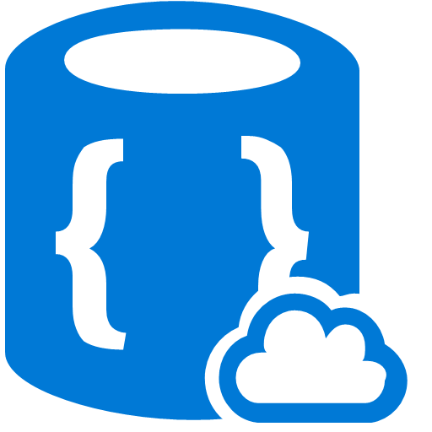





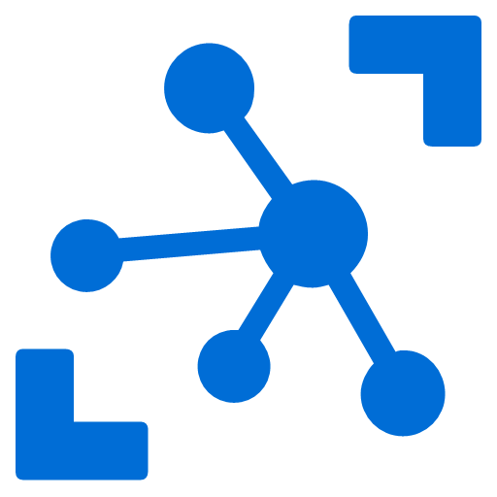



Microsoft Serverless Technologies
Functions
Logic App
Media Services
Cortana
Management Suite
App Service
Storage
OMS
Management Suit
Visual Studio
Services
Traffic
Manager
Document DB
CDN
Machine Learning
Active Directory
Key Vault
App Insights
Cognitive Services
Embedded Power BI
Search
IoT Hub
Service Bus
Notification Hub
Stream Analytics
Hockey App
Scheduler
Notes:
Microsoft already has a lot of serverless assets → But the lynchpin is Serverless compute
While serverless is still very early ‘technology’, such examples (and other Lambda examples) support the benefits of serverless architecture outlined earlier. The more serverless tooling and framework mature, the more adoption we’ll see across wide range of application. Serverless is here to stay and to fundamentally change cloud compute and application developments paradigm.
With that in mind, it is in Microsoft best interest to become a leader in the serverless space. Serverless goes beyond just serverless compute (Azure Functions). As it appears, Microsoft already has a lot of serverless assets across C&E, with Azure and other Microsoft groups. However, Microsoft doesn’t project any serverless presence other than Azure Functions – there is no Microsoft wide serverless agenda.
Microsoft needs to invest in evangelizing serverless architecture and solutions as core tenant of building modern application for the cloud, whether Bots, Cortana skills, mobile apps, or insurance actuary algorithm. Since Microsoft already has a lot of serverless solutions, we can simply spin the current story or add the serverless angle to it.
Here is list of Azure services that can be categories as serverless and are not being represented as serverless:
storage blob
network
DocDB
Functions
Storage Queues
CDN
AAD (no ARM)
Key Vault – Securement management
App Insights
Machine Learning (no ARM)
Cognitive Services
PowerBI Embedded
Search
IOT Hub
Service Bus
Notification Hub
Stream Analytics
Logic Apps
Log Analytics
VSTS
Xamarin: Hockey App/ test cloud/
scheduler

Slide 20
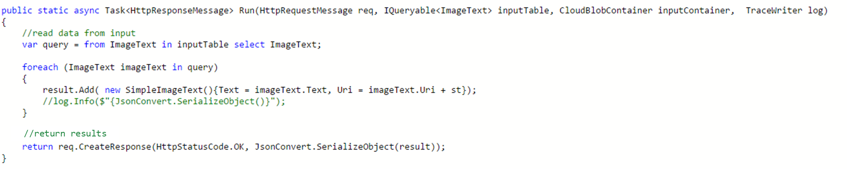
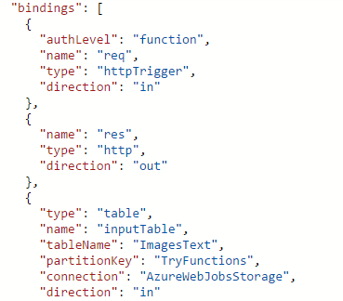
Functions Programming Model
Trigger
(data)
Input
Input
Input
Output
code
Output
Function as a single unit of work
Functions are executed per trigger
Functions have inputs and outputs
Notes:
Function as the unit of work
Functions are executed; they start and finish
Functions have inputs and outputs

Slide 21
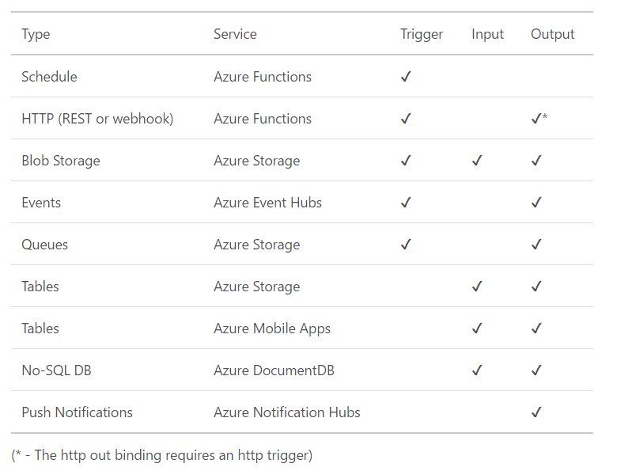
Triggers and bindings
Notes:
https://azure.microsoft.com/en-us/documentation/articles/functions-triggers-bindings/
We will show in the next demo that the portal has more binding and more granular per service

Slide 22
Building Applications With Functions
Instead of …
implementing a route inside of a Web Application server, I write a function.
pulling – triggers
‘SDK’ – bindings
writing large functional tests against a server, your functional tests look more like unit tests per function.
building and deploying servers, deploy collections of Functions

Slide 23
Functions Programming Model - Best Practices
Functions should “do one thing”
Functions should be stateless
Functions should be idempotent
Functions should finish as quickly as possible
1

Slide 24
Polyglot persistence

Slide 25
Relational Databases
Two-dimensional rows/columns
Strongly typed column data
Declarative schema
Customer Table
CustomerName
Address
Telephone
Proven stability and security
Flexible query-ability, reporting
For when model is known; query unknown
Order Table
OrderNumber
CustomerName
ProductName
Product Table
ProductName
Quantity
Color
Variable data structure
Scaling out

Slide 26
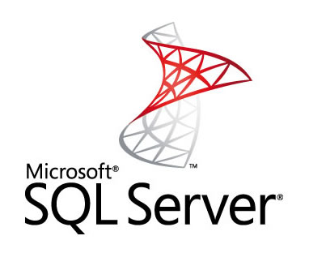
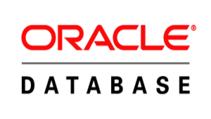
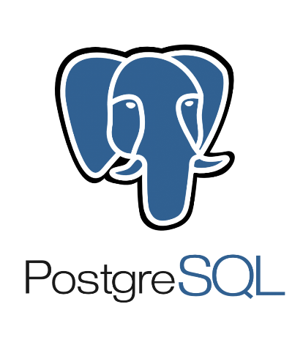
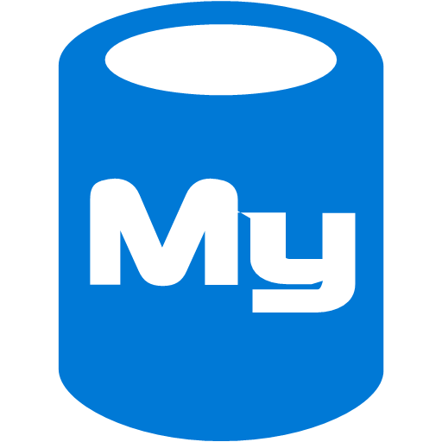

Relational Databases on Azure
PaaS
IaaS
Azure SQL Database
MySQL (via ClearDB)

Slide 27
Key-Value Databases
Simple Map
Semi-Structured
De-normalized
Partition Key | Row Key | Value
Marketing | 00001 | Name | Age
 |  | Bob | 35
Marketing | 00002 | Name | Age
 |  | Karen | 42
Marketing | Department | Name | Count
 |  | MKTG | 104
Sales | 00010 | Name | Age
 |  | Sam | 29
Extremely fast
Scalable
For when you have & will query by the key
Interacting with indexes
Searching on properties within the Value
Complex queries

Slide 28

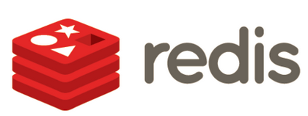


Key-Value Databases on Azure
PaaS
IaaS
Azure Table Storage
Azure Redis Cache

Slide 29
Document Databases
No schema, no relationships
Collections of documents
Documents are JSON objects
{
"title": "Polo Long Sleeve Shirt",
"color": "red",
"material": "cotton"
}
{
"title": "NoSQL Distilled,
"author": [ "Martin Fowler", “P. Sadalage" ],
"isbn": "978-0321826626",
"pages": 192
}
Flexibility
Fast to get going
For when query is known, but structure is unknown
Complex relational data
Elaborate joins

Slide 30





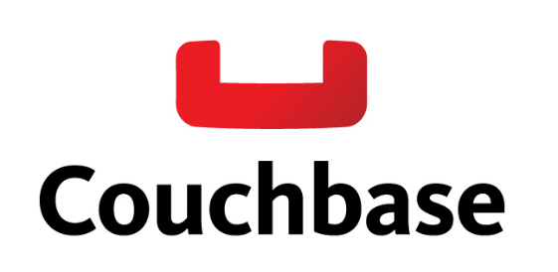

Document Databases on Azure
PaaS
IaaS
DocumentDB
RavenHQ
MongoLab

Slide 31
Graph Databases
Employee
Name: Sarah
Manages
Map-based
Relationships of Edges and Nodes
Works In
Works For
Employee
Network and relationship style applications
Social connections
Name: Walter
Department
Name: Marketing
Manages
Works For
Partitioning is problematic
Scale-up, not out
Works In
Employee
Name: Karen

Slide 32



Graph Databases on Azure
PaaS
IaaS
Azure AD
Microsoft Graph

Slide 33
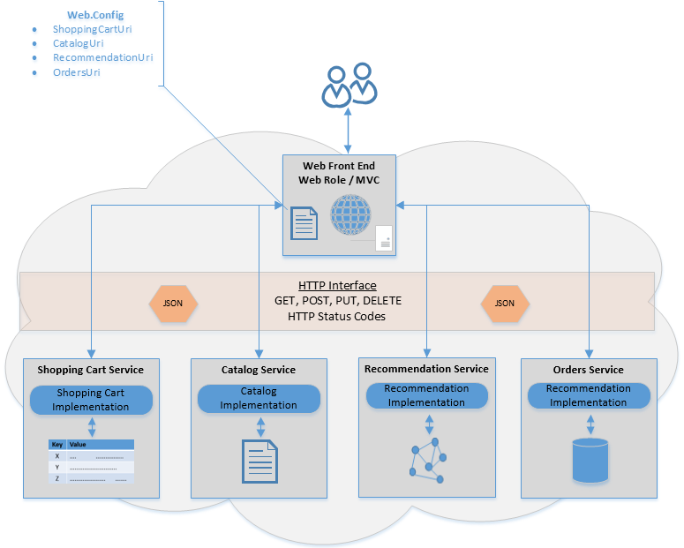
Repository Pattern

Slide 34
Benefits of Polyglot Persistence
Use each database type for its strengths
Enhanced developer productivity
Improved data access performance

Slide 35
Scaling cloud applications

Slide 36
Scalability
The ability of a system to handle a
growing amount of work
in a capable manner or its
ability to be enlarged
to accommodate that growth
Source: http://en.wikipedia.org/wiki/Scalability

Slide 37
Scaling Options
Scale Up
Vertical scale
Increase resource capacity within existing nodes
Scale Out
Horizontal scale
Increase resource capacity by adding nodes

Slide 38
Strategy
Load Balancer / Geo Distribution
Caching Tier
Web Tier
Data Tier
Geo-Distribution for scale and high availability
Caching between layers wherever possible
Reduce the call volume by an order of magnitude between each tier

Slide 39
Common Scale Limitations
Problem | Symptom Area
Stateful applications | Memory
Synchronous calls | CPU
Storage bottlenecks | Disk
Communication latency | Network

Slide 40
Optimizing Memory - Cache
Supports stateless application architectures
Best for applications with heavy read operations
Faster to call a cache than query a database
At 20,000 RPS, caching for 1 second saves 20,000 queries
Data held in-memory compared to accessing a disk
Notes:
Caching Guidance
https://msdn.microsoft.com/en-us/library/dn589802.aspx
Cache-Aside Pattern
https://msdn.microsoft.com/en-us/library/dn589799.aspx
Distributed Caching (Building Real-World Cloud Apps with Azure)
http://www.asp.net/aspnet/overview/developing-apps-with-windows-azure/building-real-world-cloud-apps-with-windows-azure/distributed-caching

Slide 41
Azure Redis Cache
Managed instance of Redis
Basic/Standard/Premium Tiers
Backed by SLAs
Can isolate into a VNET
Turn off ARR Affinity in App Service Settings

Slide 42
Optimizing CPU - Queue Pattern
Increases app responsiveness, reliability, and scalability
De-couples web servers and backend data stores
Independently scale app components
Smooths out and “rate levels” bursts of traffic
Notes:
Queue-Based Load Leveling Pattern
https://msdn.microsoft.com/en-us/library/dn589783.aspx
Competing Consumer Pattern
https://msdn.microsoft.com/en-us/library/dn568101.aspx

Slide 43
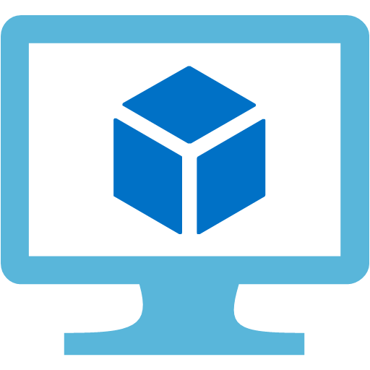


Queue Pattern
Server
Backend Data
Listeners
Server
Queue
Backend Data

Slide 44

Queues on Azure
Azure Storage Queues
Part of the Azure Storage infrastructure
Easier to get started
Larger queue size (>80GB)
Lower per-message cost
Azure Service Bus Queues
Part of the broader Service Bus architecture
Guaranteed first-in-first-out messages (“FIFO”) or ordering
Guaranteed delivery
Symmetrical API for Windows Server & Azure
Notes:
Azure Queues and Service Bus queues - compared and contrasted
https://azure.microsoft.com/en-us/documentation/articles/service-bus-azure-and-service-bus-queues-compared-contrasted/
Guaranteed Delivery?
https://azure.microsoft.com/en-us/documentation/services/service-bus/

Slide 45

Optimize Storage – Geo Replication
Several services offer replication to other datacenters
Write in one region, read from user’s closest
Simplifies data management

Slide 46

Optimize Latency - CDN
Network of servers deployed in multiple data centers across the Internet
Delivers web content: text, images, sound, and videos
Moves content from the host’s data center to servers closer to the end-user
Provides lower latency, high availability, and better performance
Notes:
The Azure Content Delivery Network (CDN) is designed to send audio, video, apps, photos, and other files to customers, faster and more reliably, using the servers closest to each user. CDN vendors have some unique elements, but basically all CDNs work the same. Key principle is, that a CDN node delivers content to millions of Internet users from its cache (very frequently); and when the cache needs to be updated (less frequently), the node queries this from a server. This reduces the traffic seen by the server, and decreases the response time as seen by the user.
In contrast to other Azure services, we outsource & resell Azure CDN from two partners – Verizon and Akamai.
The differences between CDN providers are largely minimal when compared to performance with no CDN. It is like karate. The difference in outcomes between a guy who has practiced karate and a guy who has practiced judo is negligible versus a person who has no fight experience at all. Judo or karate guy might win, no fight guy never will.

Slide 47
Azure Stack promise
Consistent
application development
Azure services
available on-premises
Integrated
delivery experience
Notes:
Consistent hybrid application development: Maximize developer productivity by empowering them to build and deploy applications the same way, whether they run on Azure or Azure Stack. Implement a common DevOps approach across hybrid cloud environments.
Azure services available on-premises: Adopt hybrid cloud computing on your terms. Meet business and technical requirements, with the flexibility to choose the right combination of cloud and on-premises deployment models for applications.
Integrated delivery experience: Focus on delivering high application service levels with integrated systems that are designed to deliver consistent Azure innovation in a predictable, non-disruptive manner.

Slide 48
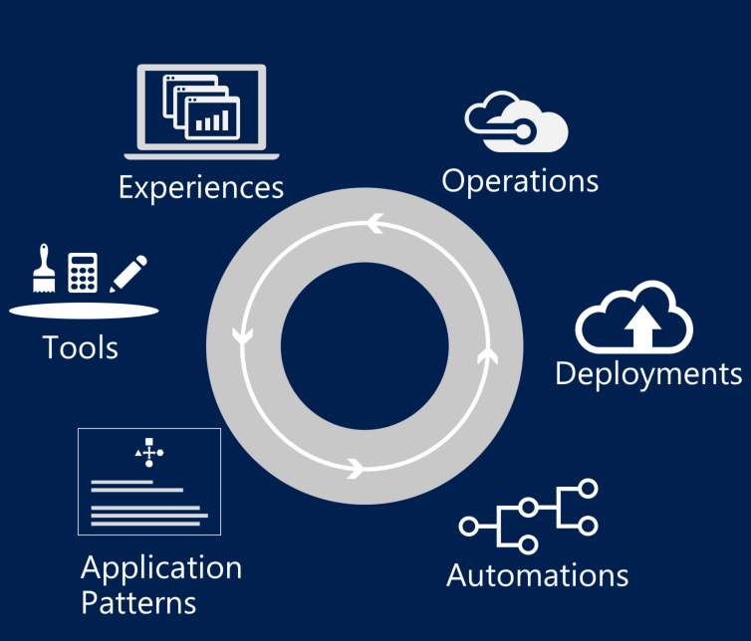
Consistent application development
Describe
Deploy
Control
Visual Studio | OSS tools
Build and deploy apps the same way whether they run on-premises or in the cloud.
Implement common DevOps practices across hybrid cloud environments.
Azure Resource Manager
Azure Resource Manager
Consistency
Azure Stack
Azure
Notes:
Talking points
Build and deploy your application the same way regardless of whether it runs on Azure or Azure Stack.
Use Azure Resource Manager to build reusable application templates for traditional and cloud-native apps.
Use role-based access control in Azure Resource Manager and Azure Active Directory to enable fine-grained access to application resources.
Write to the same Azure APIs.
Use the same Azure SDK. Continue to use Visual Studio as your development canvas, with native integration.
Just like in Azure, so you get a broad choice of open source technologies, including Linux, Java, and PHP.
Common DevOps lifecycle across Azure and Azure Stack
Unified deployment experience with Visual Studio
Integrated CI/CD pipeline with OSS (e.g., Jenkins) and Visual Studio Team System* (VSTS)
Common workflow automation tooling with support for Chef and Azure PowerShell DSC extensions

Slide 49
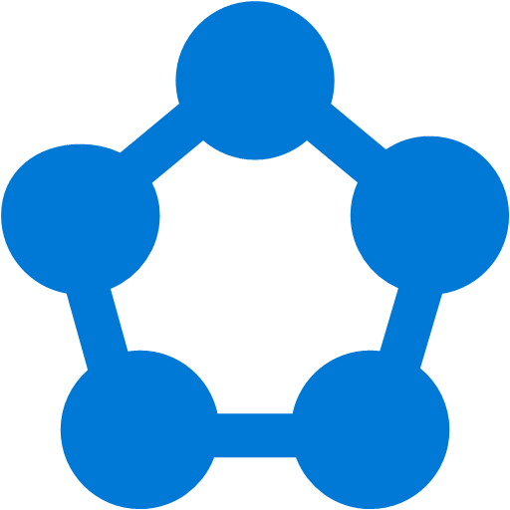
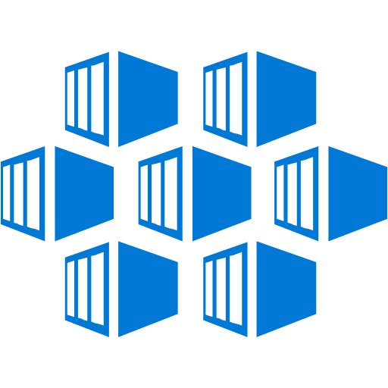
Azure PaaS available on-premises: Fully managed platforms for high productivity development
Azure App Service
Azure Functions
Azure Service Fabric
Azure Container Service
Cloud Foundry
Web, Mobile, and API apps
Serverless Computing
Always-on, scalable distributed applications
Robust container management
Open source platform
Azure Service Fabric and Azure Container Service will be available post-GA. Other services will be available at GA. We will deliver additional Azure services through frequent updates to Azure Stack.
Notes:
Great set of PaaS/ app plat services coming to Azure Stack – again, focus being on delivering app innovation in hybrid cloud environments.
This will also grow as we keep bringing that continuous innovation to Azure Stack.

Slide 50
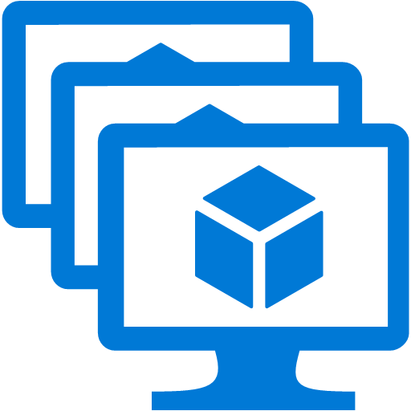
Azure IaaS available on-premises: beyond traditional virtualization
Virtual Machines (VM)
VM Scale Sets
Containers
with Docker
Networking
Storage
Rapid deployment with automated scaling
Linux and Windows Server containers
Virtual network, load balancer, VPN gateway
Blobs, tables, queues
Above services will be available at GA. We will deliver additional Azure services through frequent updates to Azure Stack.
Notes:
Yes, we have IaaS too. But think about IaaS in the context of delivering app innovation (vs. lift and shift or as a VM dispenser).
To that end, we have VM scale sets, containers in Azure VM extensions, and networking/storage resources which can be used in apps.

Slide 51
Summary
Modern Cloud apps adapt to the new ways of working
They also adapt to the new way how applications are developed and deployed
Microsoft and the Microsoft Cloud give you all tools and components to build successful and effective solutions – harnessing the power of the cloud for your purposes

Slide 52
HOL Summary
Connected to an Azure hosted WebAPI that queries a DocumentDB Collection and leveraging several Azure services at the same time.
Optimized the data call by introducing Azure Redis Cache, reducing queries and increasing performance.
Added queuing and blob storage, enabling the uploading of image files to the affordable and redundant Azure Storage.

Slide 54
Azure Dev Centers
Starting point including SDKs, sample code, and guidance around application development on Azure
.NET | https://azure.microsoft.com/en-us/develop/net/
NodeJS | https://azure.microsoft.com/en-us/develop/nodejs/
Java | https://azure.microsoft.com/en-us/develop/java/
iOS | https://azure.microsoft.com/en-us/develop/mobile/ios/
PHP | https://azure.microsoft.com/en-us/develop/php/
Python | https://azure.microsoft.com/en-us/develop/python/
Ruby | https://azure.microsoft.com/en-us/develop/ruby/

Slide 55
App Service Plan Comparison
 | Free | Shared | Basic | Standard | Premium
# of Apps | 10 | 100 | Unlimited | Unlimited | Unlimited
Shared Disk Space | 1 GB | 1 GB | 10 GB | 50 GB | 500 GB
Maximum Instances | 1 | 1 | 3 | 10 | 50
Autoscale | No | No | No | Yes | Yes
Staging Environments |  |  |  | 5 | 20
Custom Domains | No | Yes | Yes | Yes | Yes
SLA |  |  | 99.95%

