Slide 1
Objects And Classes (Part 1)
Notes:
1-<number>

Slide 2

Objectives
At the end of this module, you should be able to
Use the new operator to create objects
Describe how reference variables work
Use instance variables and methods
Discuss the use of constructors

Slide 3
Creating Objects
Every OOP language must have a mechanism for creating objects from the class definitions
Java uses the instantiation mechanism found in other OOP languages -- the new operator
There is only one way to create an object in Java - by using the new operator
The new operator is used in conjunction with a constructor to create, instantiate, an object
The virtual machine is responsible for creating the memory associated with the object and initializes the memory through a constructor

Slide 4
Creating a BankApp Object
Example 5-1: Creating a BankApp object
  public class BankApp {
  public static void main(String [] args) {
  // create the BankApp object
  BankApp thisApp = new BankApp();
  }
  }

Slide 5
Sequence of Instantiation
A lot goes on behind the scenes when you create a new object
The JVM determines what type of object to create
  Looks at the type following the new operator
  We will look at constructors in detail a bit later
The JVM loads the associated class (if it is not already loaded)
The JVM allocates enough memory in the Heap to hold the newly created object – think “garbage collector”
The new object is initialized by
  Performing default initialization of all instance variables
  Executing the specified constructor
A reference, which we can think of as a pointer to a newly created object, is then returned and assigned to the reference variable thisApp

Slide 6
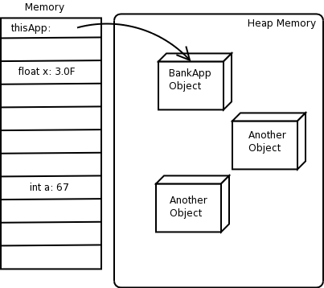
Reference Variables
Fig. 5-1: Memory allocation for reference variable thisApp

Slide 7
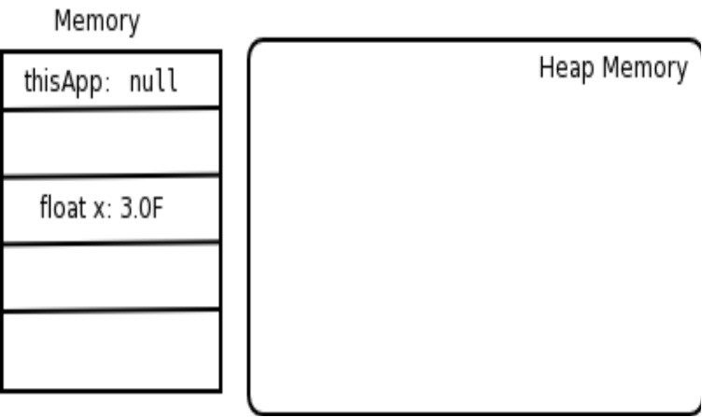
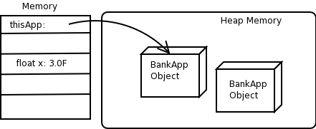
Reference Variables
Example 5-2: Creating a BankApp object and null
public class BankApp {
public static void main(String [] args){
// Declare the variable.
BankApp thisApp = null;
// Create and assign the object
thisApp = new BankApp();
// Create another BankApp object
// don’t assign IT to a variable
// now we have no way to refer to it!
new BankApp();
}
}
Fig. 5-2: Reference variable with no associated object
Fig 5-3: Final state of example 5-2

Slide 8
Object Description
Objects are normally described by two things
  Instance variables (state)
  Instance methods (behavior)
Both instance variables and methods are defined in class
Their availability for use occurs once an object has been instantiated
Referred to using the dot-notation

Slide 9
Object Description (cont.)
Instance variables are known by many names
  Attributes
  States
  Instance Variables
Though they each technically have a different meaning, the names are commonly used interchangeably Do not exist until an object of that type is instantiated
Instance methods are also known by many names
  Behaviors
  Methods
  Instance Methods
Though they each technically have a different meaning, the names are commonly used interchangeably Do not exist until an object of that type is instantiated

Slide 10
Instance Variables
Hold data for a specific object
  Each object has its own memory for the instance variables
  Instance variables exist as long as the containing object exists
  Instance variables live and die with their instance
Can be either primitive data types or reference types
Instance variables are initialized two ways:
  Through default initialization performed by the JVM
  Through constructor-defined initialization
  Constructor-defined initialization always occurs after the default initialization process

Slide 11
Instance Variables (cont.)
The instance variable values can be adjusted either by
  Accessing them directly
  objectVariable.variableName = xxx;
  Invoking a method that manipulates them
  objectVariable.setVariableName(xxx);
The manner in which you access instance variables will depend on class design

Slide 12
Instance Variable Example
  Example 5-3: Using an instance variable
  class BankAccount {
  float balance;
  String accountNumber;
  }
  class BankApp {
  public static void main(String [] args) {
  System.out.println("Starting banking application");
  // Create a couple of bank accounts.
  BankAccount account1 = new BankAccount();
  BankAccount account2 = new BankAccount();
  // Print out the objects!!
  System.out.println("Account1 =" + account1);
  System.out.println("Account2 ="+ account2);
  // Set the balances and account numbers
  account1.balance= 34.50F;
  account2.balance = 100.00F;
  account1.accountNumber= "888888";
  account2.accountNumber = "337722";
  // Print out the data
  System.out.println("Account 1:");
  System.out.println("Account Number:"+
  account1.accountNumber + " Balance=" + account1.balance);
  System.out.println("Account 2:");
  System.out.println("Account Number:"+
  account2.accountNumber + " Balance=" + account2.balance);
  }
  }

Slide 13
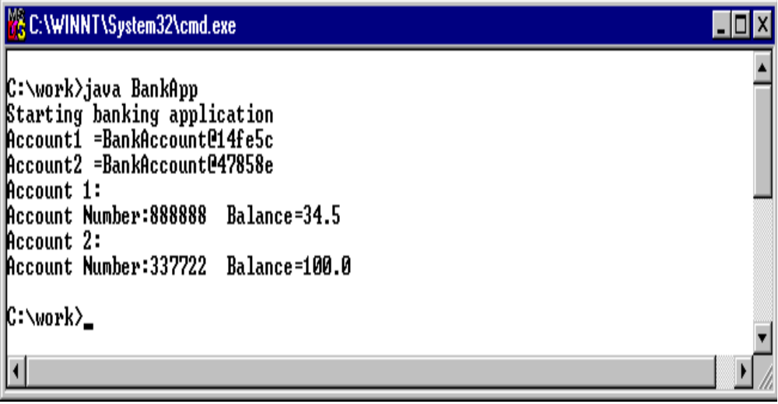
Instance Variable Example Output
Fig. 5-4: Output from example 5-3

Slide 14
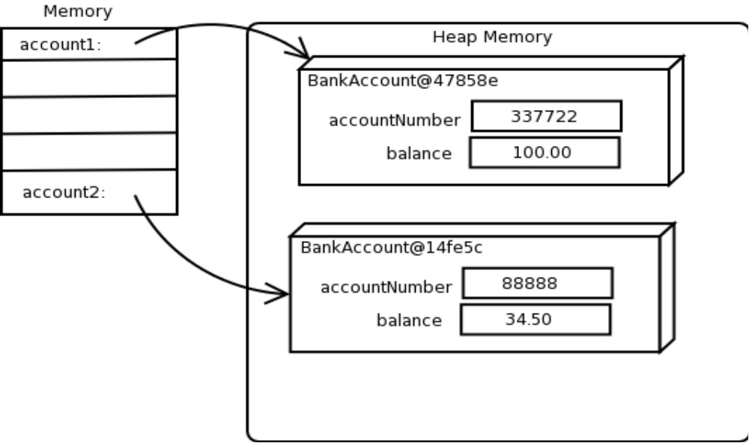
Referencing Instance Variables
  BankAccount account1 = new BankAccount();
  BankAccount account2 = new BankAccount();
  account1.balance= 34.50F;
  account2.balance = 100.00F;
  account1.accountNumber= "888888";
  account2.accountNumber = "337722";
Fig: 5-5: Objects at the end of example 5.3

Slide 15
Instance Methods
Perform some functionality on the object
Commonly associated with underlying instance variables
Typically instance methods fall into two categories when dealing with instance variables
  Accessors – retrieve values
  Mutators – change values
Instance methods are “initialized” as part of the object class loading
  Unlike instance variables, instance methods are shared by all instances of a specific class
  When an instance method is invoked, it is invoked on a specific object
  Sharing the definitions lowers the memory footprint
  You should not be too concerned about this

Slide 16
Instance Methods
The instance methods are invoked using the dot-notation
objectVariable.setVariableName(xxx);
objectVariable.methodName(arg1,arg2..);
Remember, since they are associated with an instance, the instance must exist before calling a method
Instance methods follow the method syntax we discussed earlier
<access_modifier> <return> <identifier>(<parameter list>)
float deposit(float amt)
  We will cover access modifiers later

Slide 17
Instance Method Example
  Example 5-5: Invoking instance methods
  class BankAccount {
  float balance;
  String accountNumber;
  float queryBalance()
  {
  return balance;
  }
  float deposit(float amt) {
  balance = balance + amt;
  return balance;
  }
  float withdraw (float amt) {
  balance = balance – amt;
  return balance;
  }
  }

Slide 18
Instance Method Example (cont.)
  Example 5-5: Invoking instance methods (continued)
  class BankApp {
  public static void main(String [] args) {
  System.out.println("Starting banking application");
  // create two new bank accounts.
  BankAccount account1 = new BankAccount();
  BankAccount account2 = new BankAccount();
  // Make deposits into each
  account1.deposit(40.00F);
  account2.deposit(231.98F);
  // Display their balances
  System.out.println("Account1 balance: " + account1.queryBalance());
  System.out.println("Account2 balance: " + account2.queryBalance());
  // Make a withdrawal from each account
  account1.withdraw(10.00F);
  account2.withdraw(1000.00F);
  // Display their balances
  System.out.println("Account1 balance: “ + account1.queryBalance());
  System.out.println("Account2 balance: " + account2.queryBalance());
  }
  }

Slide 19
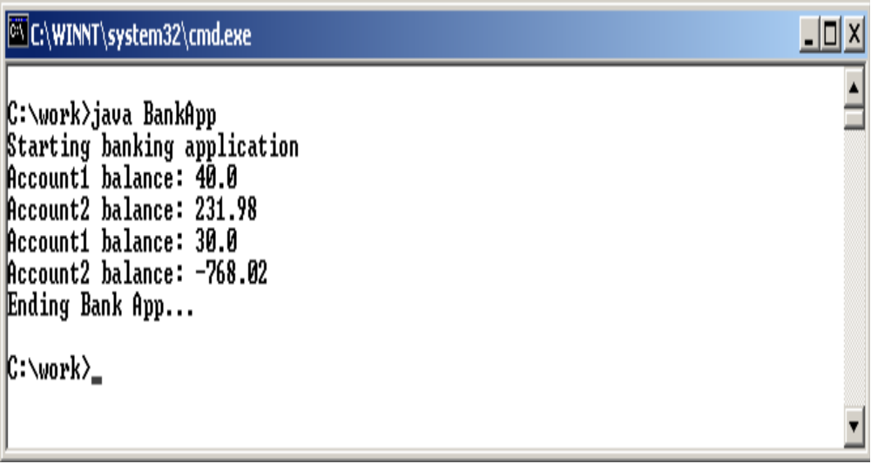
Instance Method Example Output
Fig. 5-7: Output from example 5.5

Slide 20
Application Correctness
Two standards of correctness
  Program correctness
  Application correctness
Program correctness defines
  The best way to write code
  Goes beyond just style, considers reusability, performance, robustness, etc
  Often referred to as “best practices”
Application correctness means
  Application adheres to business rules for the problem domain
  The business rules are implemented properly in the code

Slide 21
Business Rules
Policies, procedures, and workflows automated by the application are commonly referred to as business rules
  It is the programmer's responsibility to incorporate the business rules
  It is important to ensure objects in the application conform to those rules
  Business rules may take be represented as logic rules
Business rules can also place execution and environment constraints on an application
Hopefully, it is not the programmer's job to figure out the business rules
  Domain experts are responsible for defining and deriving the rules
  In our case, the domain experts are the banking staff at DI bank

Slide 22
Business Rules
Typically when methods are invoked, the method “consults” business rules when performing the operation
Sometimes these business rules are called guards
  They guard against a method executing when it should not
  There are two kinds of guards that we generally deal with in OOP
    Preconditions: boolean conditions that must be true before the method can be executed
    Postcondiitions: boolean conditions that must be true after a method executes

Slide 23
Business Rules and Methods
  Example 5-6: Adding guards to instance methods
  class BankAccount {
  float balance;
  String accountNumber;
  int accountStatus;
  float queryBalance() {
  // This is a problem for now
  if (accountStatus != 0) {
  return 0.0F;
  }
  return balance;
  }
  float deposit(float amt) {
  // This is a problem for now
  if (accountStatus != 0) {
  return 0.0F;
  }
  balance = balance + amt;
  return balance;
  }
  float withdraw (float amt) {
  // This is a problem for now
  if (accountStatus != 0) {
  return 0.0F;
  }
  // Do the withdrawal only if no overdraft results.
  if (amt <= balance) {
  balance = balance – amt;
  }
  return balance;
  }
  }

Slide 24
Initialization of Instance Variables
Variables must be initialized before they can be used
  This rule is strictly enforced with local variables
  This rule is relaxed with instance variables
    This provides flexibility –
    You can defer the initialization of an instance variable until the constructor is invoked
Three options for instance variable initialization
  Allow the instance variable to be initialized by default
    Performed automatically
    Referred to as “default initialization”
  Initialize a variable when we declare it in the class definition
    Performed as a result of assignment
    Referred to as “explicit initialization”
  Initialize a variable in the constructor
    Useful when initialization requires applying business rules
    Referred to as “constructor initialization”

Slide 25
Initialization of Instance Variables (cont.)
Initialization mechanism have different results
  Default initialization
    Reference variables, including String variables, are all initialized to null
    Numeric values are initialized to the appropriate zero value and
    boolean types are initialized to false
  Explicit initialization
    Variables initialized to some specific value
    Default initialization does not occur
  Constructor initialization
    Occurs after default / explicit
    Overrides initialization performed in (1) and (2)
    Requires explicit logic
Normally, instance variables are initialized in the constructor

Slide 26
Explicit Initialization Example
  Example 5-7: Initialization of instance variables
  class BankAccount {
  float balance = -1.0F;
  String accountNumber = "NotSet";
  int accountStatus = -1;
  char accountType = " "
  }

Slide 27
Constructors
Objects are creating through a new SomeType () call
After the memory has been created, the object is initialized in the constructor
Constructors are basically methods
  Have a special purpose
  Follow some certain rules

Slide 28
Constructor Purpose
The purpose of the constructor is to initialize the newly created
  Prevents instance variables from incorrect initialization
  Any other initialization or startup code can be executed
  Perform complex initialization logic that can not be done as an explicit initialization
Because proper object initialization is so important, the Java compiler will add a constructor automatically for you
  Referred to as the default constructor
  Think of it as performing default initialization for your object
  Compiler doesn’t know much about your class, so don’t expect anything fancy in the default constructor

Slide 29
Constructor Rules
Constructors must abide by some specific rules
The constructor always
  Has the same name as the class
  Remember Java is case sensitive
Constructors can be overloaded
    Similar to method overloading
    May be multiple constructors with different argument lists
Does not declare a return value
    This is not the same as returning void
    A constructor actually returns a reference to the newly created object

Slide 30
Constructor Example
  Example 5-8: Constructors for BankAccount class
  class BankAccount {
  float balance = -1.0F;
  String accountNumber = "NotSet";
  int accountStatus = -1;
  char accountType = " ";
  BankAccount(String num, char type) {
  accountNumber = num;
  accountType = type;
  balance = 0.0F;
  accountStatus = (type == 'p')? 100: 0;
  }
  BankAccount(String num, char type, float bal) {
  accountNumber = num;
  accountType = type;
  balance = bal;
  accountStatus = (type == 'p')? 100: 0;
  }
  BankAccount(String num) {
  accountNumber = num;
  }
  /* -- rest of class -- */
  }

Slide 31
Proper Constructor Form
Typically a class defines multiple constructors
  Each constructor varies by argument list
  Though the constructors are different, they should perform the same level of initialization
Having many constructors
  Provides flexibility
  Can be error prone if done wrong
Constructors should refer to other constructors
  To minimize redundant code
  Provide centralized initialization
  Simplify maintenance

Slide 32
Proper Constructor Form (cont.)
When referring to other constructors
  Utilize a built-in mechanism - this(…)
  Think of this(…) as constructor calling another constructor
    Like a method call
    JVM determines which constructor to call
Use this(…)
  As the first line in your constructor
  Can perform other operations once this(…) “returns”

Slide 33
Proper Constructor Form
  Example 5-9: Constructors for BankAccount class
  class BankAccount {
  float balance = -1.0F;
  String accountNumber = "NotSet";
  int accountStatus = -1;
  char accountType = " ";
  BankAccount(String num, char type, float bal) {
  accountNumber = num;
  accountType = type;
  balance = bal;
  accountStatus = (type == 'p')? 100: 0;
  }
  BankAccount(String num, char type) {
  this(num,type, 0.0F);
  }
  BankAccount(String num) {
  this (num, 'p');
  }
  /* -- rest of class -- */
  }

Slide 34
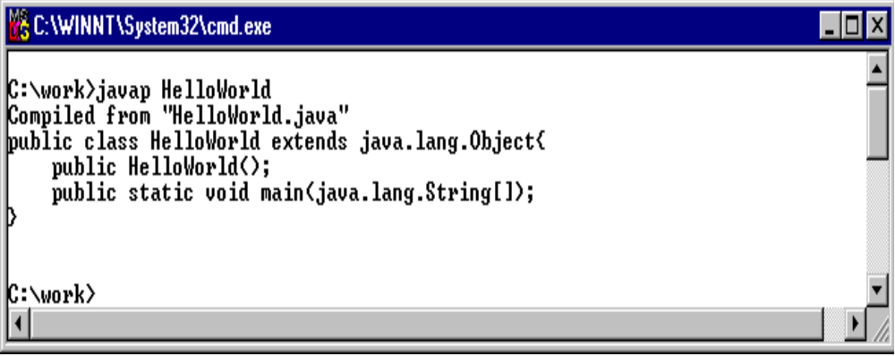
The Default Constructor
In the first module, we used the disassembler (javap) to
look into our HelloWorld class
Reproduced Figure 1-13

Slide 35
The Default Constructor
  Example 5-10: Default constructors
  //This compile and runs
  class Test1 {
  int x;
  public static void main(String [] args) {
  Test1 t = new Test1(); // this is the default constructor
  System.out.println(t);
  }
  }
  //This does not compile
  class Test2 {
  int x;
  // Adding this constructor prevents the default
  // costructor is not provided
  Test2(int xs) {
  x = xs;
  }
  public static void main(String [] args) {
  Test2 t = new Test2(); // this constructor no longer exists.
  System.out.println(t);
  }
  }

Slide 36
Summary
We covered
Using the new operator to create objects
Describing how reference variables work
Using instance variables and methods
Describing and using constructors

Slide 37
Exercises
Exercise 5-1: Instance Variables and Methods
  In this lab you return to the banking application and write the instance variables and methods needed to make things work.
Exercise 5-2: Constructors
  In this lab you work closer with constructors and investigate the behavior of the default constructor.

Slide 38
Objects And Classes (Part 2)
Notes:
1-<number>

Slide 39
Objectives
At the end of this section, you should be able to:
Describe the use of the public and private access modifiers
Use class methods and variables
Use the final keyword with variables
Use String and StringBuffer objects
Use arrays
Use wrapper classes

Slide 40
Object Reference Semantics
Objects are accessed using references
References are variables contains a “pointer” to an object
  A 32-bit integer containing the heap location of your object
  The reference value is hidden from you
Copying a reference value only copies the reference value
  You do not actually copy the underlying object
  The end result is two references with the same value, referring to the same object in the heap

Slide 41
Object Reference Semantics Example
  Example 5-11: Reference variable assignment
  class BankApp {
  public static void main(String [] args) {
  // Declare the reference variables
  BankApp thisApp = null;
  Bankapp anotherApp = null;
  // Create the object and assign the reference value
  thisApp = new BankApp();
  // Now assignment of reference variables
  anotherApp = thisApp;
  }
  }

Slide 42
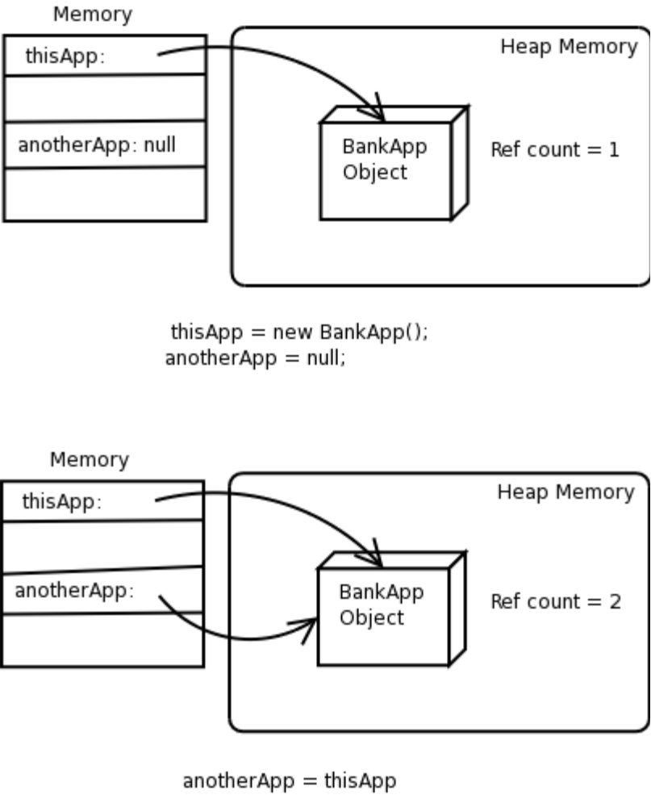
Object Reference Semantics
Figure 5-8: Reference Semantics of a variable assignment.

Slide 43
Object Life Cycle & Garbage Collection
Java provides built in memory management
  Used for allocating memory
  Used for de-allocating memory – a.k.a. garbage collector
The garbage collector (gc) is a daemon (background) thread that runs in the virtual machine
There are many different types of garbage collection algorithms; in general the gc check on a regular basis which objects have become moribund

Slide 44
Object Life Cycle & Garbage Collection (cont.)
The garbage collector frees up occupied but not referred to memory automatically
  An object is in scope as long as there is at least one reference to it
  As soon as the reference count of an object hits 0, then the object is moribund or ready to die
Objects can go out of scope when
  Their reference variables become null (through assignment)
  Their reference variables are reassigned with a new value
  Their reference variables go out of scope (local reference variables)

Slide 45
Object Life Cycle & Garbage Collection Example
  Example 5-12: Life cycle of an object
  class BankApp {
  public static void main(String [] args) {
  // thisApp is now a local variable to this block
  {
  BankApp thisApp = new BankApp();
  // BankApp object now has a reference count of
  // Step one in fig. 5-9
  {
  BankApp anotherApp = thisApp;
  // BankApp object now has a reference count of
  // Step two in fig. 5-9
  }
  // anotherApp is out of scope. Reference count is now 1
  // Step three in fig. 5-9
  }
  // thisApp is now out of scope, Reference count is 0
  // BankApp object is moribund waiting for garbage collection
  // Step four in fig. 5-9
  }
  }

Slide 46
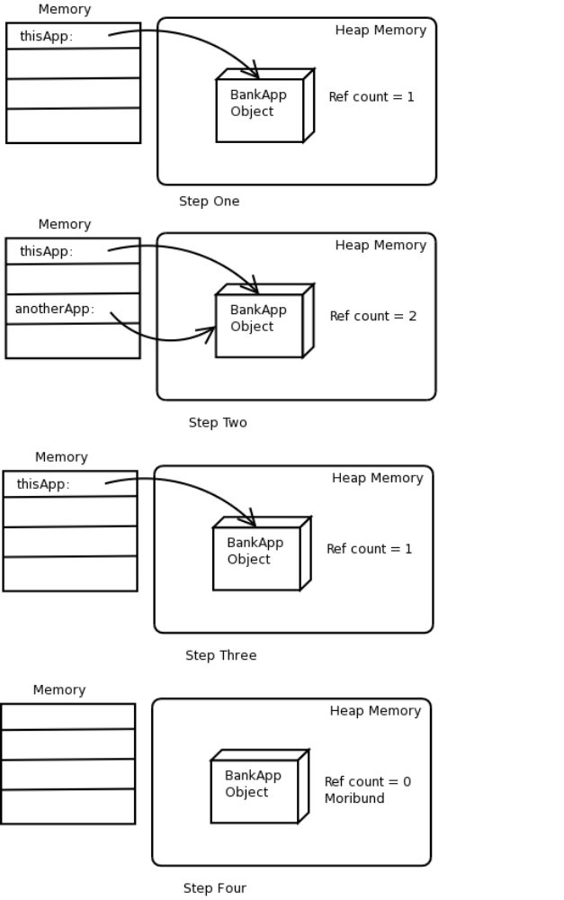
Object Life Cycle & Garbage Collection
{
BankApp thisApp = new BankApp();
{
BankApp anotherApp = thisApp;
}
}

Slide 47
The finalize() Method
Before an object is garbage collected, the JVM system calls its finalize() method
The finalize() method gives the object a chance to return allocated or in-use system resources
  Kind of the opposite of a constructor
  There is no guarantee that the finalize() method will actually be called
  The original intent of the finalize() method was to free up memory that was allocated through the JNI API, by C and C++ methods
You can include a finalize method in your class
protected void finalize()

Slide 48
finalize() Method Example
  Example 5-13: A finalize method
  class BankApp {
  BankApp() {
  System.out.println("Creating BankApp");
  }
  protected void finalize() throws Throwable {
  System.out.println("Finalizing BankApp");
  return;
  }
  public static void main(String [] args) {
  new BankApp();
  }
  }

Slide 49
Access Modifiers and Encapsulation
Object Oriented Analysis and Design encourages the use of encapsulation
Encapsulation is defined as data hiding
  Think of encapsulation as a black box
    Hide the “dirty” or sensitive details of objects
    Prevents misuse
    Thwarts “hacking”
  Encapsulation should be applied to objects
Objects are logical containers of
    Data or state
    Functionality or behavior

Slide 50
Access Modifiers and Encapsulation (cont.)
An object's variables should be not be exposed to other objects
  Instance variable exposure can allow direct variable access
  This would circumvent any business rules you have in place
  Would also allow object to obtain and corrupt sensitive data
Sensitive and critical behaviors should also be hidden from other objects

Slide 51
Access Modifiers and Encapsulation (cont.)
In Java, we use access modifiers to create encapsulation
Access modifiers define a level of accessibility for classes
  Class variables
  Class methods
Access modifiers define a level of accessibility for instances
  Instance variables
  Instance methods
  Constructors
Basic syntax is:
  Variables
  <access_modifier> Type identifier;
  Methods
  <access_modifier> <return_type> identifier(<parameter list>)

Slide 52
Access Modifiers and Encapsulation (cont.)
Java has four access modifiers
  private – only the class and object can access
  default – only class, object, and subclass in same library (package)
  protected – the class, object and subclasses in any package
  public – any class, object, subclass
We will cover access modifiers in more detail when we discuss packages
The default access modifier is automatically added if an access modifier is not explicitly specified

Slide 53
Private Variable Example
Example 5-14: Access Modifiers
class BankAccount {
// Instance Variable
private float balance;
// Constructor
BankAccount(){
balance = 0.0F;
}
// Instance Methods
float queryBalance() {
return balance;
}
float withdraw(float amt) {
if ((amt > 0.0F) && (amt <= balance)) {
balance -= amt;
}
return balance;
}
float deposit(float amt) {
if (amt > 0.0F) {
balance += amt;
}
return balance;
}
}

Slide 54
Private Variable Example (cont.)
Example 5-15: Access Modifiers
class BankApp {
public static void main(String [] args) {
System.out.println(“Starting banking application...”);
// Create a bank account
BankAccount act = new BankAccount();
act.deposit(100.00F);
System.out.println(“Balance is “ + act.queryBalance());
// This following line will not compile !!
System.out.println(“Balance is “+ act.balance);
System.out.println(“Ending banking application...”);
}
}
//producers the compiler error output
BankApp.java:9: balance has private access in BankAccount
System.out.println("Balance is "+ act.balance);
^
1 error

Slide 55
Private Variable Example
Example 5-16: Access Modifiers
class BankAccount {
// Instance Variables
String accountNumber = null;
char accountType;
float balance;
int accountStatus;
// Instance Methods
float queryBalance() {
return balance;
}
float withdraw(float amt) {
if ((amt > 0.0F) && (amt <= balance)) {
if ((accountType == 's' && accountStatus == 100) ||
(accountType == 'c' && accountStatus == 0)) {
balance -= amt;
}
}
return balance;
}
. . .

Slide 56
Private Variable Example (cont.)
Example 5-16: Access Modifiers (continued)
float deposit(float amt) {
if (amt > 0.0F) {
if ((accountType == 's' && accountStatus == 100) ||
(accountType == 'c' && accountStatus == 0)) {
balance += amt;
}
}
return balance;
}
}

Slide 57
Private Method Example
Example 5-17: Access Modifiers
class BankAccount {
// Instance Variables
String accountNumber = null;
char accountType;
float balance;
int accountStatus;
// Private Instance Methods
private boolean isAccountOK() {
return ((accountType == 's' && accountStatus == 100) ||
(accountType == 'c' && accountStatus == 0));
}
// Instance Methods
float queryBalance() {
return balance;
}
. . .

Slide 58
Private Method Example
Example 5-17: Access Modifiers (continued)
float withdraw(float amt) {
if ((amt > 0.0F) && (amt <= balance)) {
if (isAccountOK()) {
balance -= amt;
}
}
return balance;
}
float deposit(float amt) {
if (amt > 0.0F) {
if (isAccountOK()){
balance += amt;
}
}
return balance;
}
}

Slide 59
Private Variable Example
Example 5-18: Private access between object of the same type
class A {
private int var = 0;
void changeVar( A otherA) {
otherA.var++;
}
public static void main(String [] args) {
// create an two A objects
A firstA = new A();
A secondA = new A();
// use the first A object to change the private data in
// the second A object
firstA.changeVar(secondA);
}
}

Slide 60
Public Method Example
Example 5-19: Public Access
class BankAccount {
// Instance Variables
String accountNumber = null;
char accountType;
private float balance;
int accountStatus;
// Private Instance Methods
private boolean isAccountOK() {
return ((accountType == 's' && accountStatus == 100) ||
(accountType == 'c' && accountStatus == 0));
}
// Public Instance Methods
public float queryBalance() {
return balance;
}
}
. . .

Slide 61
Public Method Example (cont.)
Example 5-19: Public Access (continued)
public float withdraw(float amt) {
if ((amt > 0.0F) && (amt <= balance)) {
if (isAccountOK()) {
balance -= amt;
}
}
return balance;
}
public float deposit(float amt) {
if (amt > 0.0F) {
if (isAccountOK())balance += amt;
}
return balance;}
}
}

Slide 62
Class Variables and Methods
Java provides a mechanism to declare variables that belong to the class as a whole and not to a specific object
  Called static or class variables
  Provide much of the functionality that was provided by global variables in structured languages
  static variables belong to the class and are shared by all instances of the class
Think of class or static variables as being variables that are global within a class
Static variables can be accessed by either instance methods or static methods
Use the dot-notation to access static variables
class_name.staticVariableName
BankAccount.NumberOfAccounts

Slide 63
Class Variables
To make an instance variable static, you simply place the keyword static before the variable definition
For example, the following defines a static data member and initializes it:
Example 5-20: Static Variables
class BankAccount {
// Class Variables
static int NumberOfAccounts = 0;
// Instance Variables
String accountNumber = null;
char accountType;
private float balance;
int accountStatus;
// rest of class defintion
}

Slide 64
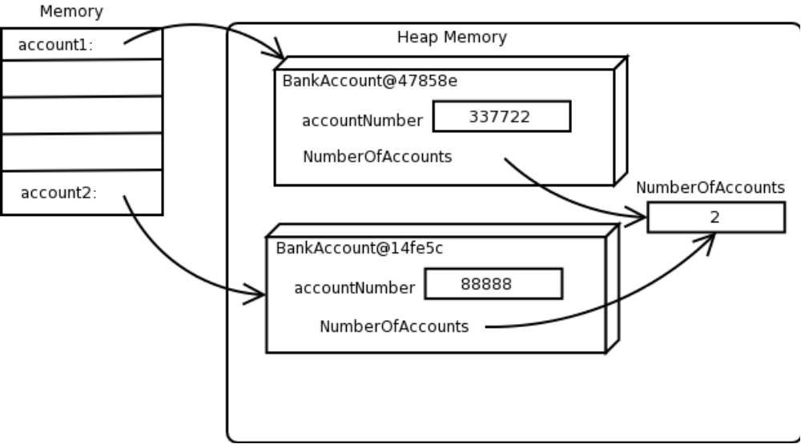
Referencing Static Variables
Fig 5-10: Shared class variable NumberOfAccounts

Slide 65
Referencing Static Variables
Example 5-21: Static Variables
class BankAccount {
// Class Variables
static int NumberOfAccounts = 0;
// Instance Variables
String accountNumber = null;
char accountType;
private float balance;
int accountStatus;
// Using static variable in a constructor
BankAccount(String num, char type, float bal) {
accountNumber = num;
accountType = type;
balance = bal;
accountStatus = (type == 's')? 100: 0;
NumberOfAccounts++;
}
}

Slide 66
Static Variable Initialization
There are three mechanisms in Java to initialize static variables
  Default initialization – exactly like default instance variable initialization
  Explicit initialization – exactly like explicit instance variable initialization
  Static Initializer – similar to a constructor
A static initializer has the same goal as a constructor
  Initialize the “object”
  The “object” in this case is the class itself
  It initializes static variables
A block of code, identified with the keyword static, is allowed in the class definition
  This block of code is executed when the static variables actually come into existence
  The static block is intended to be used to initialize the static variables, nothing more
  A static initializer is executed after both default and explicit initialization

Slide 67
Static Initialization Block
Example 5-22: Static Variables
class BankAccount {
// Class Variables
static int NumberOfAccounts;
// Instance Variables
String accountNumber = null;
char accountType;
private float balance;
int accountStatus;
static { //static initializer
NumberOfAccounts = 0;
}
// Using static variable in a constructor
BankAccount(String num, char type, float bal) {
accountNumber = num;
accountType = type;
balance = bal;
accountStatus = (type == 's')? 100: 0;
BankAccount.NumberOfAccounts++;
}
}

Slide 68
Static Methods
Java allows methods that are associated with the class
  They are not associated with any specific object
  You can access the methods without an object
  All static methods exist independently of any objects
Static methods are typically used for
  Library functionality (Math.abs(), Integer.parseInt())
  Implementing certain design patterns (Factory, Singleton, etc)

Slide 69
Static Methods
There are some rules when dealing with static methods
  You cannot reference instance variables from a static method
  You cannot reference instance methods from a static method
  However, instance methods can access static variables and static methods
Static methods are accessed using the dot-notation
  The reference variable becomes the class name
  Math.abs(-1234);
  BankAccount.incrementCount();
  It is also possible to use an instance as the reference variable, though it is consider poor programming style

Slide 70
Static Method Example
Example 5-23: Static Methods
class BankAccount {
// Class Variables
private static int NumberOfAccounts;
// Instance Variables
String accountNumber = null;
char accountType;
private float balance;
int accountStatus;
static {
NumberOfAccounts = 0;
}
// Class Methods
private static void incrementCount() {
BankAccount.NumberOfAccounts++;
}
public static int numActs() {
return BankAccount.NumberOfAccounts;
}
. . .

Slide 71
Static Method Example (cont.)
Example 5-23: Static Methods (continued)
// Using static variable in a method
BankAccount(String num, char type, float bal) {
accountNumber = num;
accountType = type;
balance = bal;
accountStatus = (type == 's')? 100: 0;
incrementCount();
}
}

Slide 72
Static Method Example (cont.)
Example 5-24: Invoking Static Methods
class Test{
public static void main(String [] args) {
BankAccount b = new BankAccount();
System.out.println("Number of Accounts: "+ b.numActs());
System.out.println("Number of Accounts: "+
BankAccount.numActs());
}
}

Slide 73
Final Variables
Variables can be marked with the final keyword
This indicates that once they are initialized, they cannot be changed
Typically, there are two types of data that should be final
  Data representing a true constant (like the value of PI)
  Data that is initialized once and never should be changed again during execution of the application
Variables can also be final and static
  This means they are class wide constants
  These variables are also typically public
So-called blank finals allow a final variable to be initialized in a constructor but then never changed again
  Note that a blank final must be initialized only in a constructor

Slide 74
Blank Finals Example
Example 5-25: Using Blank Finals
class BankAccount {
private static int NumberOfAccounts;
final String accountNumber; // blank final
final char accountType; // blank final
private float balance;
int accountStatus;
static {
NumberOfAccounts = 0;
}
BankAccount(String num, char type, float bal) {
accountNumber = num;
accountType = type;
balance = bal;
accountStatus = (type == 's')? 100: 0;
incrementCount();
}
/*--- more class code ---*/
}

Slide 75
Comparing Reference Variables
Reference variables contain a value which describes the location of an object in the heap
This value is hidden from you
If you want to compare the value of two references, you can use the equality operator
  Use the standard == operator for this comparison
  if(refVar1 == refVar2)
  if(refVar1 != refVar2)

Slide 76
Comparing Reference Variables Example
Example 5-26: Reference Variables
class Test {
public static void main(String [] args) {
String s1 = new String("Hello");
String s2 = new String("Hello");
System.out.println
("Before assignment: s1 == s2 ->"+ (s1 == s2));
String s3 = s1;
System.out.println
("After assignment: s1 == s3 ->"+ (s1 == s3));
}
}

Slide 77
Strings and StringBuffers
Java has two class for dealing with a string of characters
  java.lang.String
  java.lang.StringBuffer
Strings can
  Literals
  String literal = “String Literal”;
  Objects
  String object = new String(“String Object”);
The String class provides many methods
  length
  substring
  toLowerCase / toUpperCase
  startsWith
  Etc.

Slide 78
Strings and StringBuffers
Strings, though easy to work with can add overhead on your system
  Literals are kept around
  Not garbage collected
  Concatenation can be costly
StringBuffers can only be objects
  StringBuffer object = new StringBuffer(“StringBuffer ”);
StringBuffer does not have operator overloading like String
object.append(“Object”);
The StringBuffer class provides many methods
  length
  substring
  toLowerCase / toUpperCase
  startsWith
  Etc.
StringBuffers do not have the overhead of Strings

Slide 79
String Object Example
Example 5-27: String class methods
class Test {
public static void main(String [] args) {
String s1 = new String("Hello");
String s2 = s1.toUpperCase();
String s3 = s1.toLowerCase();
System.out.println("s1 -> "+ s1);
System.out.println("s2 -> "+ s2);
System.out.println("s3 -> "+ s3);
}

Slide 80
StringBuffer Example
Example 5-28: StringBuffer used to reverse a String
class ReverseString {
public static String reverseString(String s) {
// Use a String method to get length of String
// We need to allocate a StringBuffer of a specific size.
int size = s.length();
StringBuffer sb = new StringBuffer(size);
// Use the charAt() String method to get the character
// from the String, and then use a StringBuffer method
// to append it to the StringBuffer.
for (int index = (size - 1); index >= 0; index--) {
char c = s.charAt(index);
sb.append(c);
}
// Convert the StringBuffer to a String
return sb.toString();
}
}

Slide 81
Arrays as Objects
Early we discussed arrays as
  Basic “data structure”
  With an inherent attributed called length
Arrays in Java are technically objects
Objects are always created with the new keyword; arrays are no different
Objects typically contain attributes (instance variables); arrays contain attributes as well, typically called elements
There is no “constructor” when dealing with an array

Slide 82
Arrays as Objects Example
Example 5-29: Creating arrays
class Test {
public static void main(String [] args) {
// create the array references
BankAccount [] a1;
BankAccount a2 [];
// create an array
a1 = new BankAccount[6];
for (int k = 0; k < 3; k++) {
a1[k] = new BankAccount();
}
// make a1 and a2 point to the same array
a2 = a1;
}

Slide 83
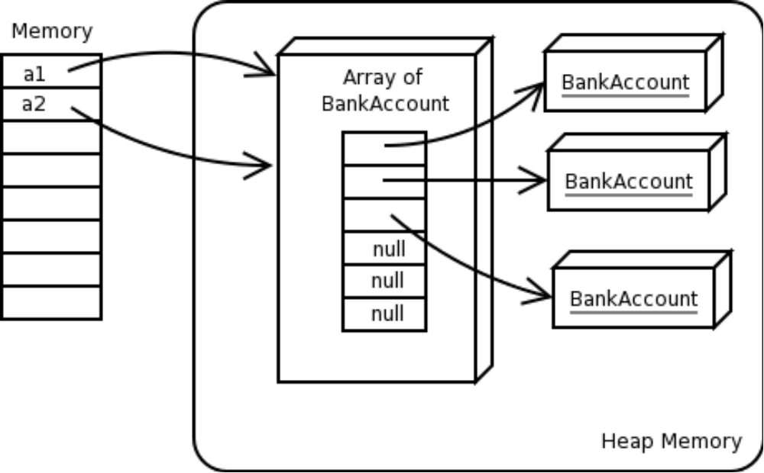
Arrays as Objects
Fig 5-11: Result of example 5-29

Slide 84
Copying an Array
Example 5-30: Copying arrays
class Test {
public static void main(String [] args) {
// create the array references
BankAccount [] a1;
BankAccount a2[];
BankAccount [] a3;
// create an array
a1 = new BankAccount[6];
for (int k = 0; k < 3; k++) {
a1[k] = new BankAccount();
}
// make a2 into a copy of a1 - hard way
a2 = new BankAccount[a1.length];
for (int k = 0; k < a1.length; k++) {
a2[k] = a1[k];
}
a3 = new BankAccount[a1.length];
// make a3 into a copy of a1 -- easy way
System.arraycopy(a1,0,a3,0,a1.length);
}
}

Slide 85
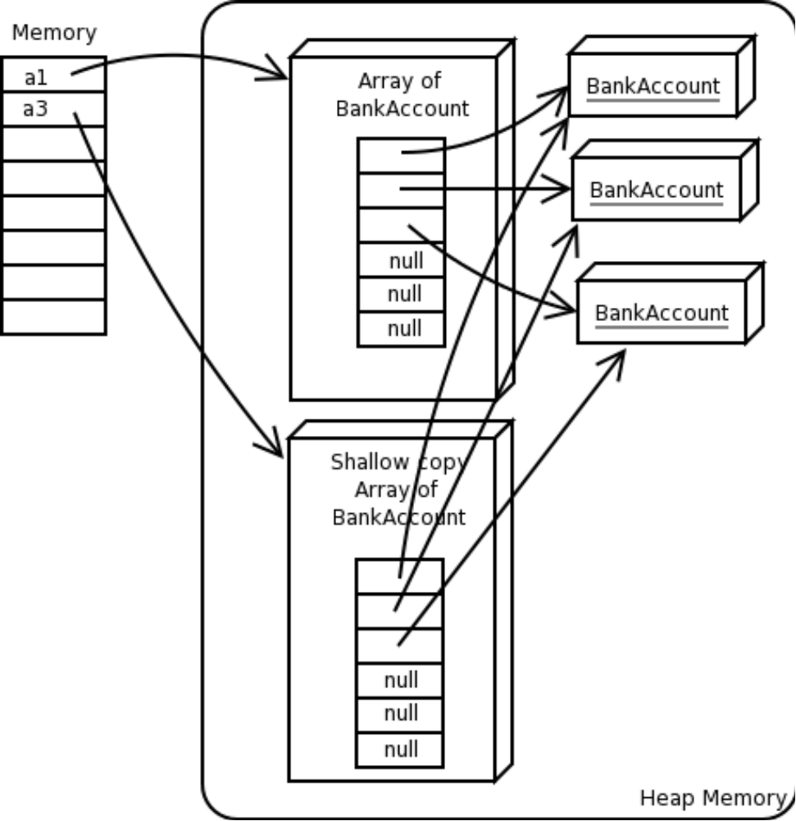
Copying an Array
Fig. 5-12: Result of shallow copy

Slide 86
Deep Copying Example
Example 5-31: Deep copying arrays
BankAccount a1 = new BankAccount[6];
for (int k = 0; k < 3; k++) {
a1[k] = new BankAccount();
// make a2 into a deep copy of a1 --
a2 = new BankAccount[a1.length];
for (int k = 0; k < a1.length; k++)
{
a2[k] = a1[k].clone();
}
}

Slide 87
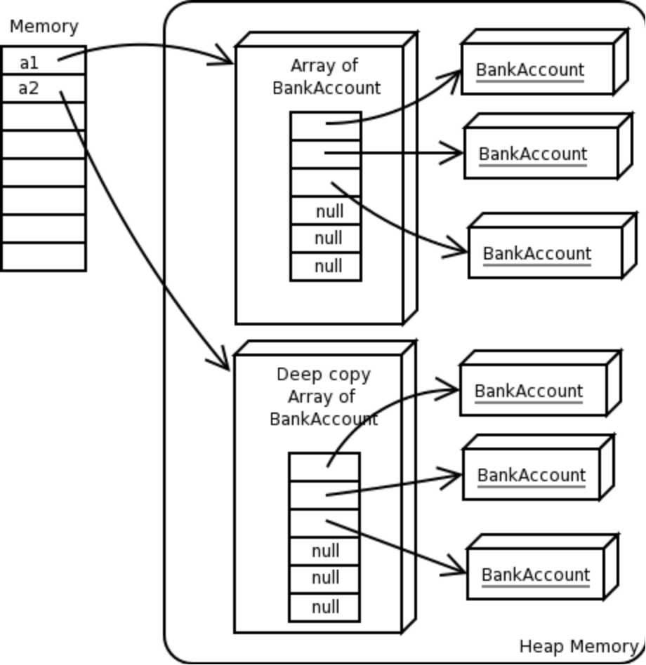
Deep Copying an Array
Fig. 5-13: Result of deep copy

Slide 88
Wrapper Classes
Sometimes it is useful to treat primitives as objects
There is no way to cast a primitive into an object
Java provides wrapper classes for all primitive types
  java.lang.Long
  java.lang.Integer
  java.lang.Short
  java.lang.Boolean
  Etc.
The wrapper classes provide some useful functionality like
  Converting primitives to and from String
  Retrieving System properties as the primitive value
Even though the wrappers represent primitives, you can not use standard arithmetic operations

Slide 89
Wrapper Classes Example
Example 5-32 Wrapper classes
class Test {
public static void main(String [] args) {
String s = "7839276";
long var = Long.parseLong(s);
System.out.println("Value of var is "+var);
// Create a Long object to wrap this value
Long obj = new Long(var);
// This is an object but we can still get the data
System.out.println("obj wraps "+ obj.longValue());
}
}

Slide 90
Summary
We covered
Using public and private access modifiers
Class methods and variables
The final keyword with variables
Using String and StringBuffer objects
Using arrays
Using wrapper classes

Slide 91
Exercises
Exercise 5-3: Working with static and final
  In this lab you will work with both static and final variables and investigate the usage and behavior of static methods.
Exercise 5-4: Array and Wrappers
  In this lab you will work closer with arrays and incorporate them into the bank account application.

