Slide 1
Chapter 30 – part II
UNIVERSITY Physics II

Slide 2
OUTLINE
R-L circuits.
L-C circuits.
R-L-C circuits.

Slide 3
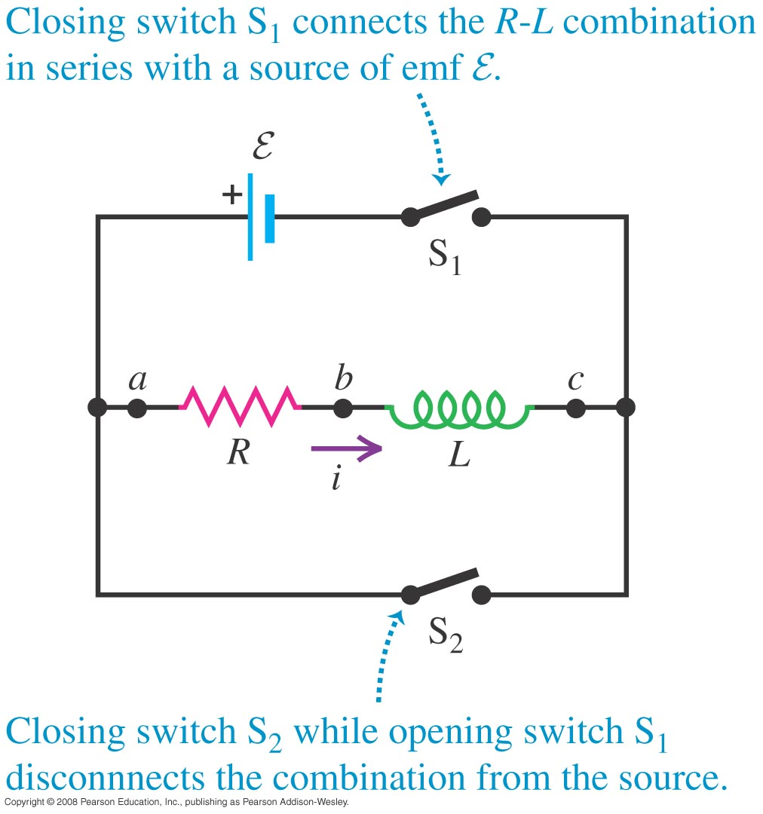
R-L circuits
An R-L circuit contains a resistor and inductor and possibly an emf source.

Slide 4
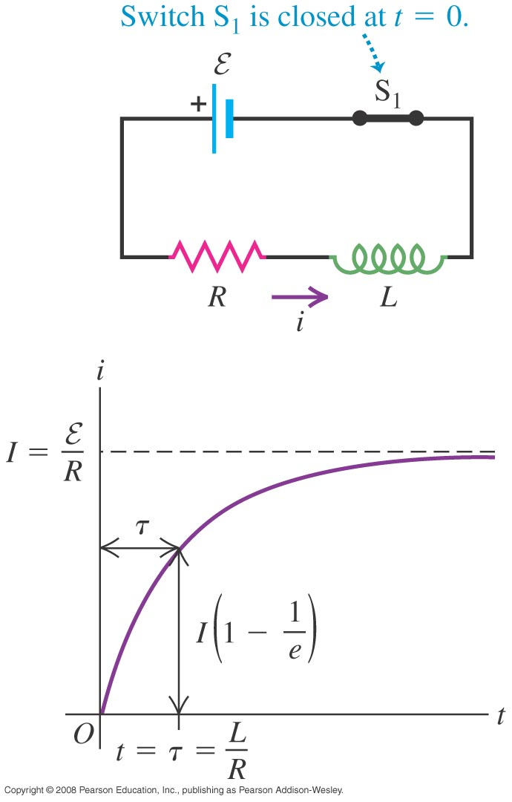
Current growth in R-L circuits
The time constant for an R-L circuit is τ = L/R.
Figure shows a graph of the current as a function of time in an R-L circuit containing an emf source.

Slide 5
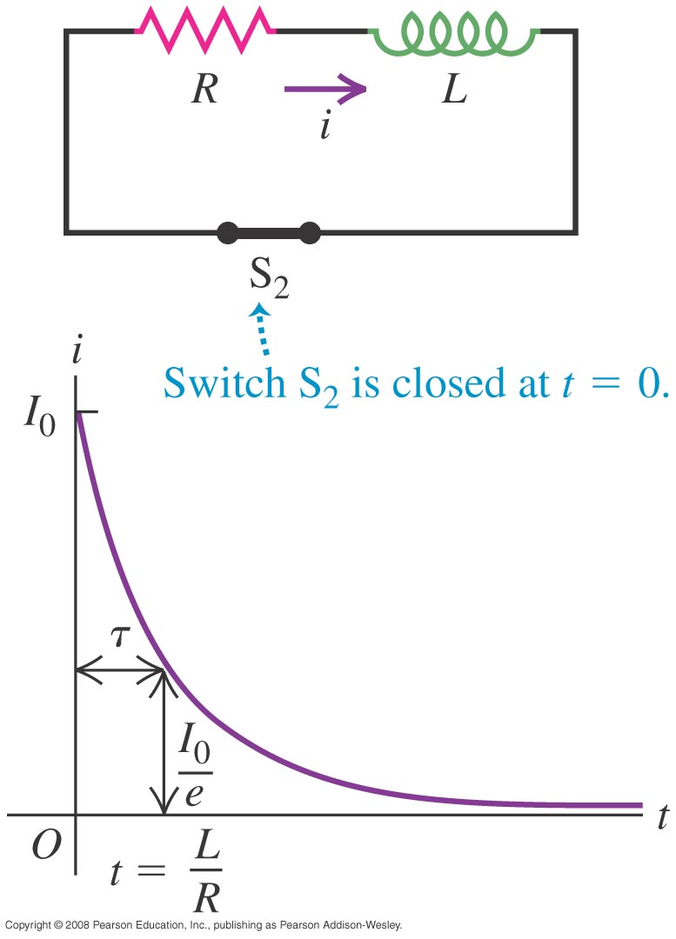
Current decay in an R-L circuit

Slide 6
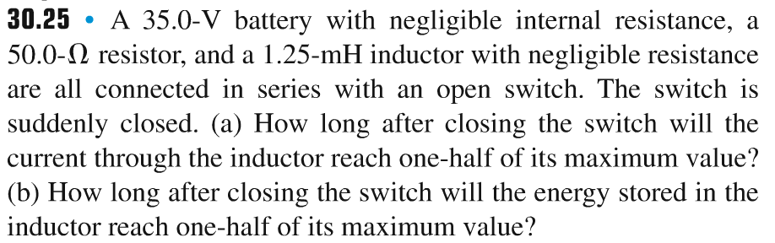
Problem #1

Slide 7
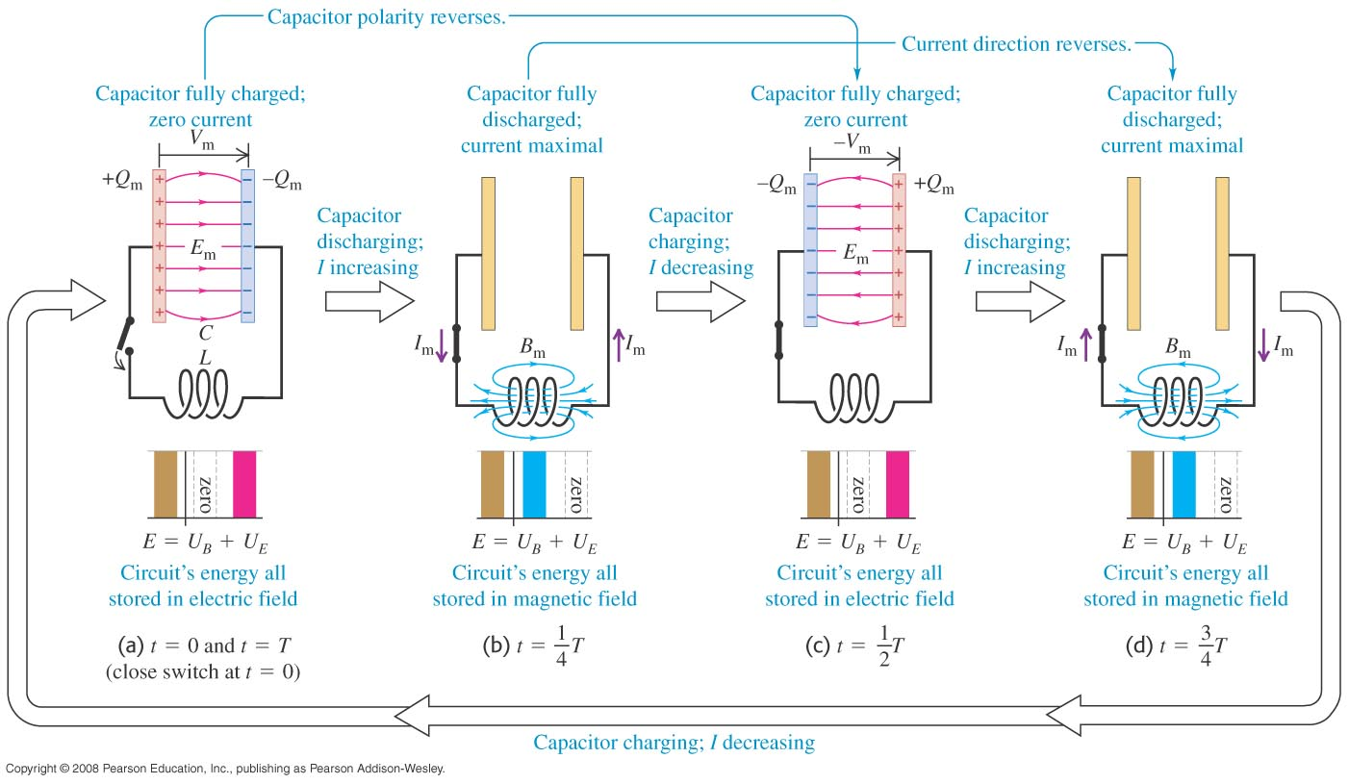
L-C circuits
An L-C circuit contains an inductor and a capacitor and is an oscillating circuit.

Slide 8
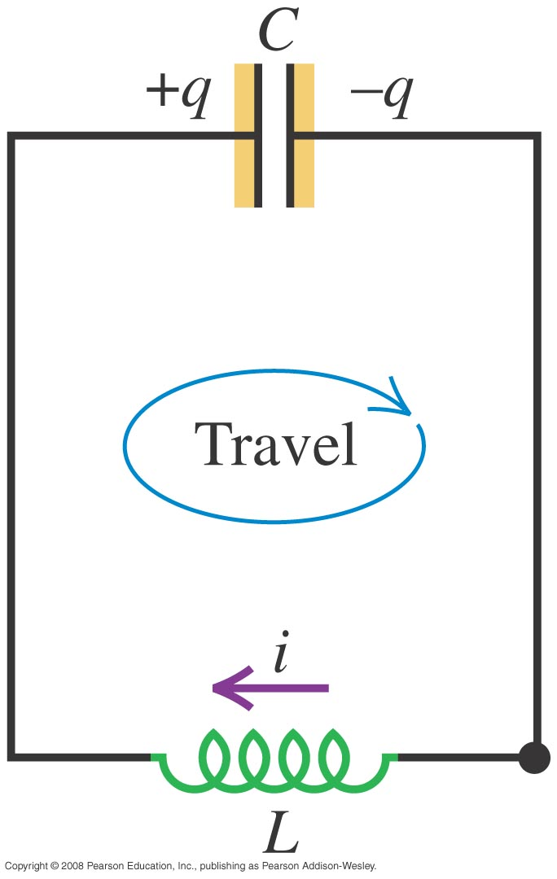
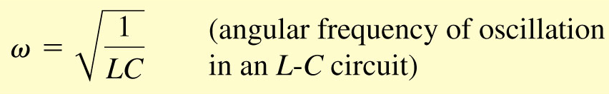
Electrical oscillations in an L-C circuit

Slide 9
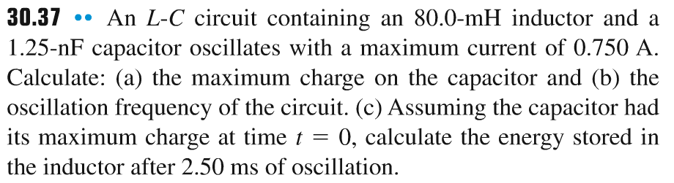
Problem #2

Slide 10
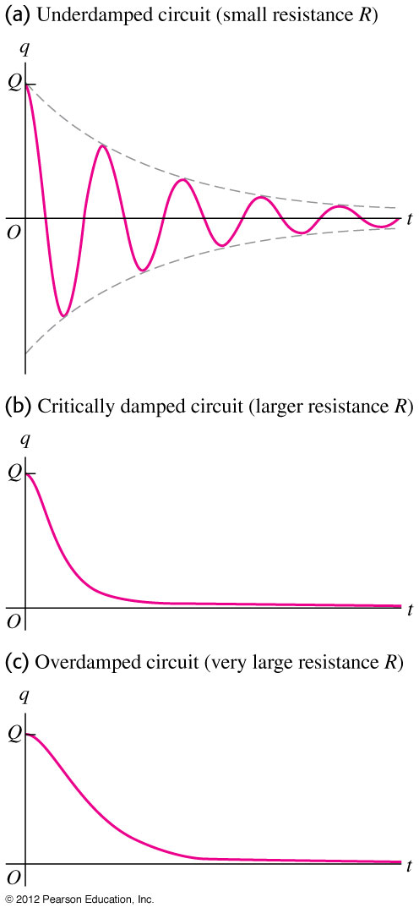
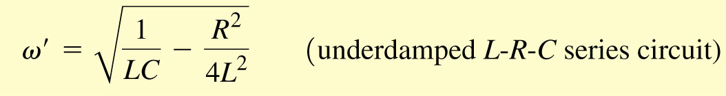
L-R-C series circuits
An L-R-C circuit exhibits damped harmonic motion if the resistance is not too large.

Slide 11
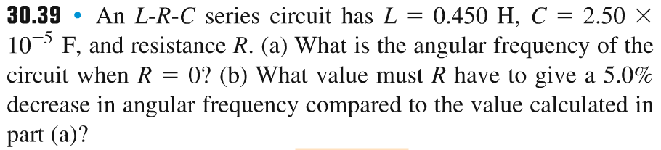
Problem #3

Slide 12
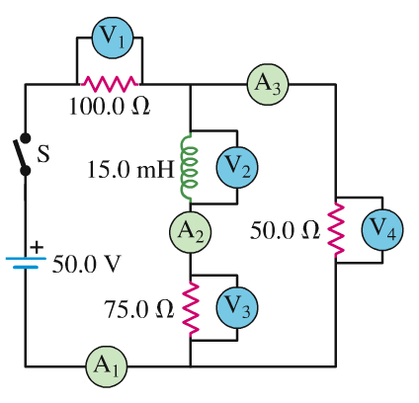
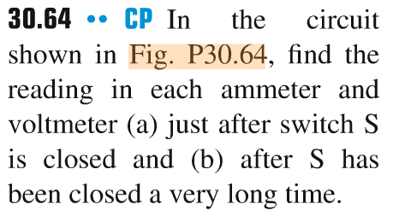
Problem #4

Slide 13
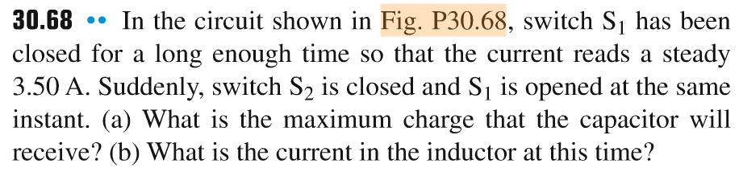
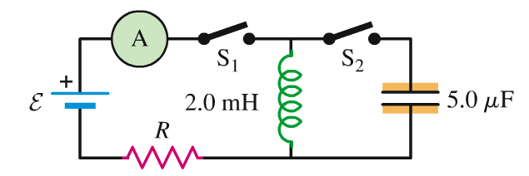
Problem #5

