Slide 1

Chapter 21 – part I

Slide 2
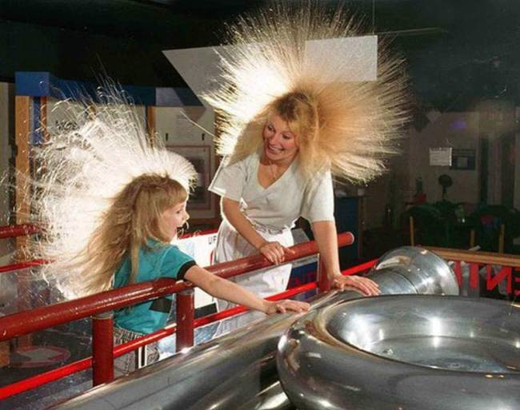
OUTLINE
Electric charge
Conductors, insulators, and induced charges
Coulomb’s law

Slide 3
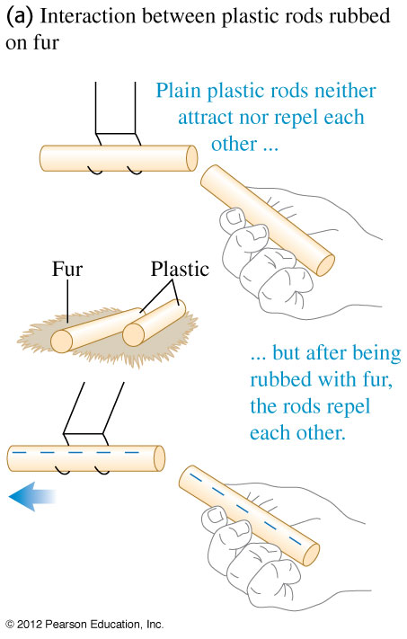
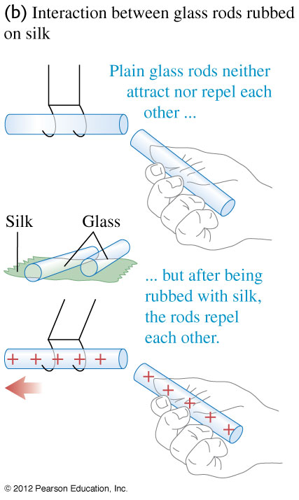
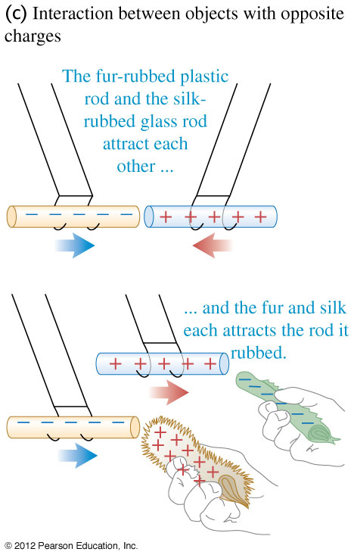
Electric charge
Two positive or two negative charges repel each other. A positive charge and a negative charge attract each other.

Slide 4
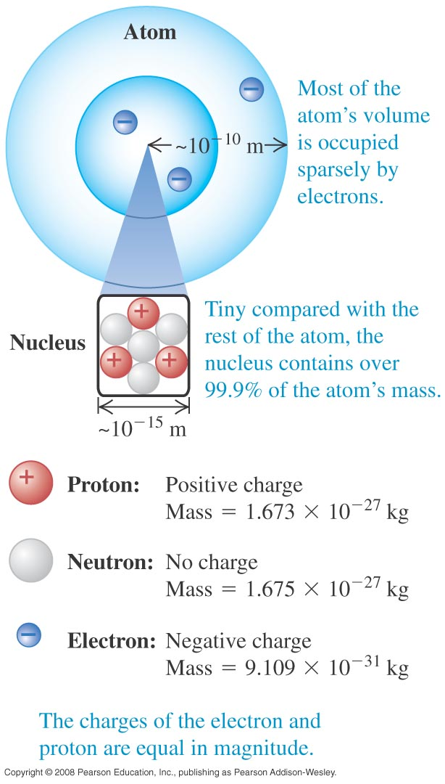
Electric charge
  The particles of the atom are the negative electron, the positive proton, and the uncharged neutron.
  Protons and neutrons make up the tiny dense nucleus which is surrounded by electrons (see Figure).
  The electric attraction between protons and electrons holds the atom together.

Slide 5
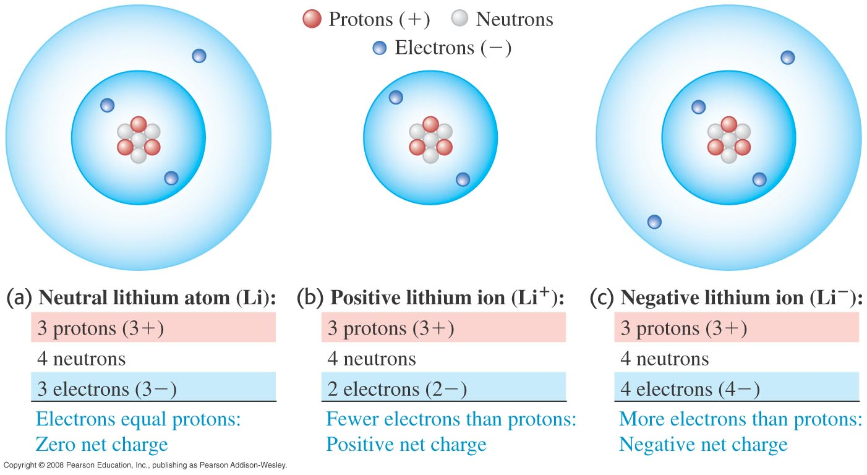
Electric charge
  A neutral atom has the same number of protons as electrons.
  A positive ion is an atom with one or more electrons removed. A negative ion has gained one or more electrons.

Slide 6
Electric charge
  The proton and electron have the same magnitude charge.
  The magnitude of charge of the electron or proton is a natural unit of charge. All observable charge is quantized in this unit.
  The universal principle of charge conservation states that the algebraic sum of all the electric charges in any closed system is constant.
Rubbing one material against the other scrapes the electrons from the surface of material 1
and places them to the surface of material 2

Slide 7
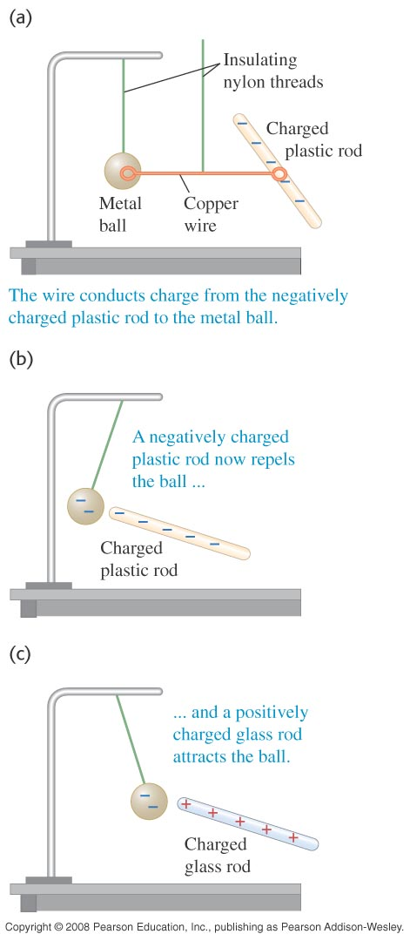
Conductors and insulators
  A conductor permits the easy movement of charge through it. An insulator does not.
  Most metals are good conductors, while most nonmetals are insulators. (See Figure at the right.)
  Semiconductors are intermediate in their properties between good conductors and good insulators.

Slide 8
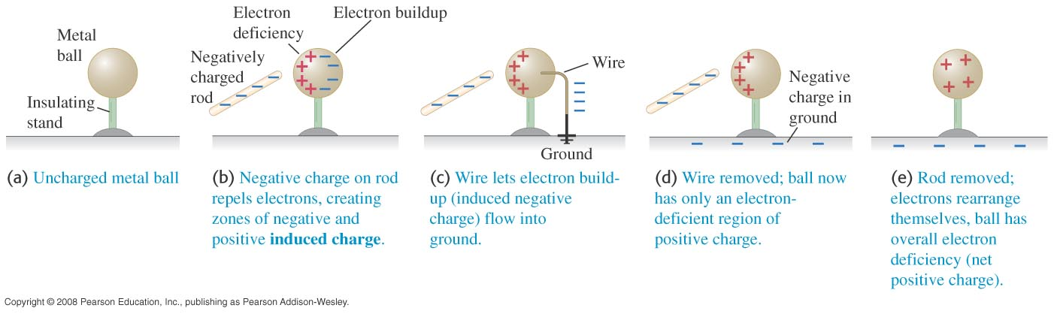
Charging by induction
  In Figure below, the negative rod is able to charge the metal ball without losing any of its own charge. This process is called charging by induction.

Slide 9
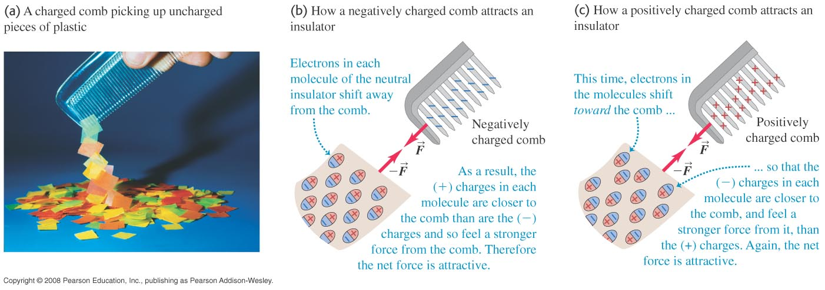
Electric forces on uncharged objects
  The charge within an insulator can shift slightly. As a result, two neutral objects can exert electric forces on each other, as shown in Figure below.

Slide 10
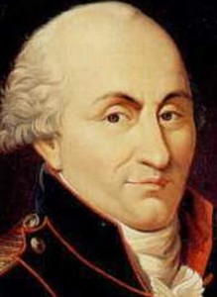
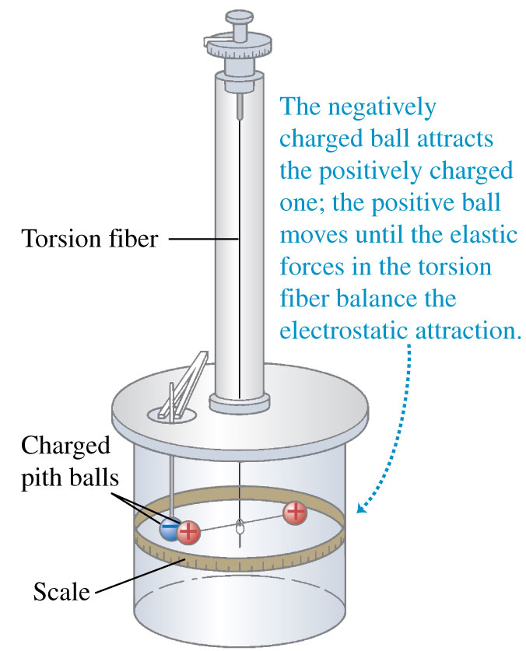
Coulomb’s law
Charles Augustin de Coulomb
(1736-1806)
  The figure at the right illustrates how Coulomb used a torsion balance to measure the electric force between point charges.

Slide 11
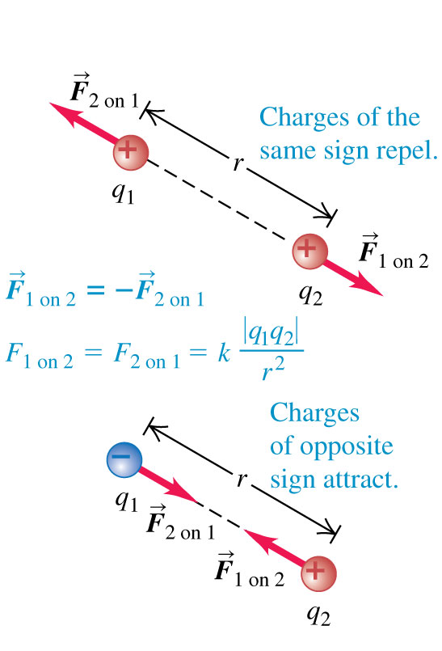
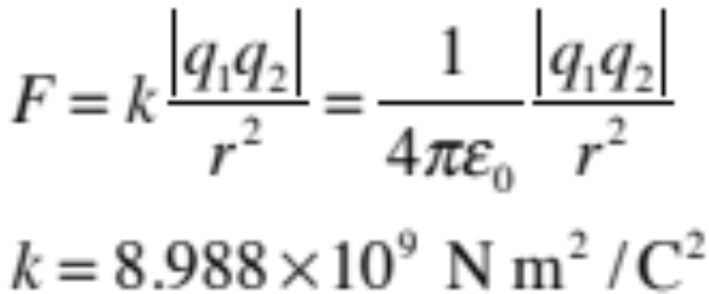
Coulomb’s law

Slide 12
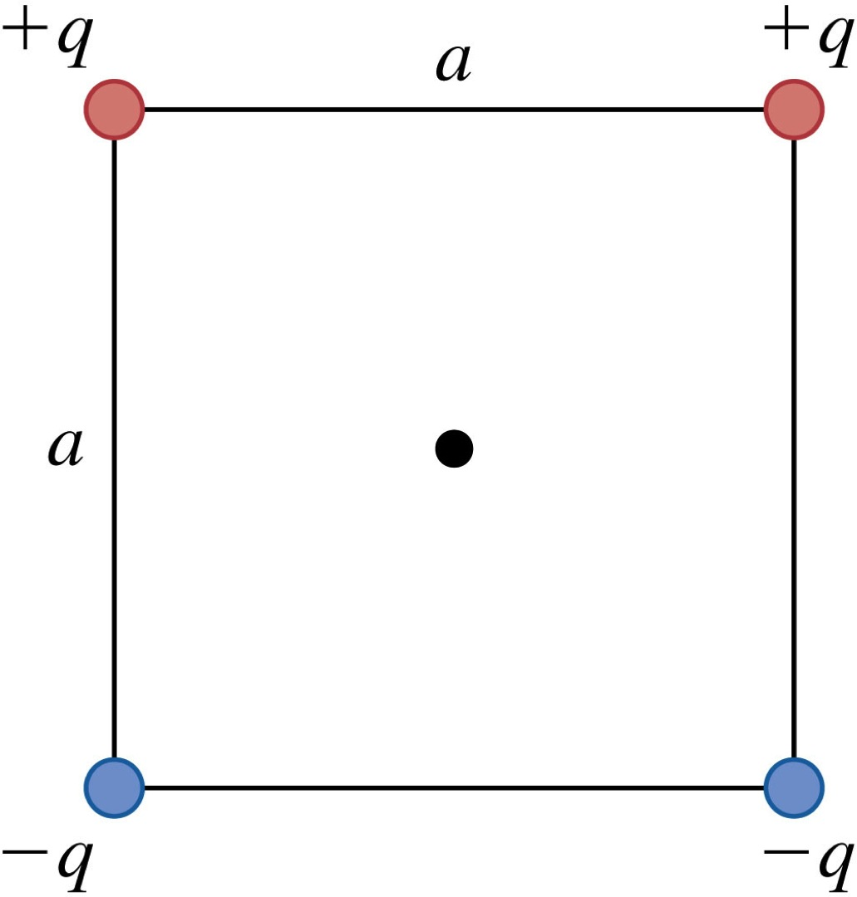
Problem #1
A point charge is placed at each corner of a square with side length a = 30 cm. The charges all have the same magnitude q = 3 nC as shown in the figure. Find the direction and the magnitude of the electric force that all four charges exert on a positive point charge Q = 2 nC placed in the center of the square.

Slide 13
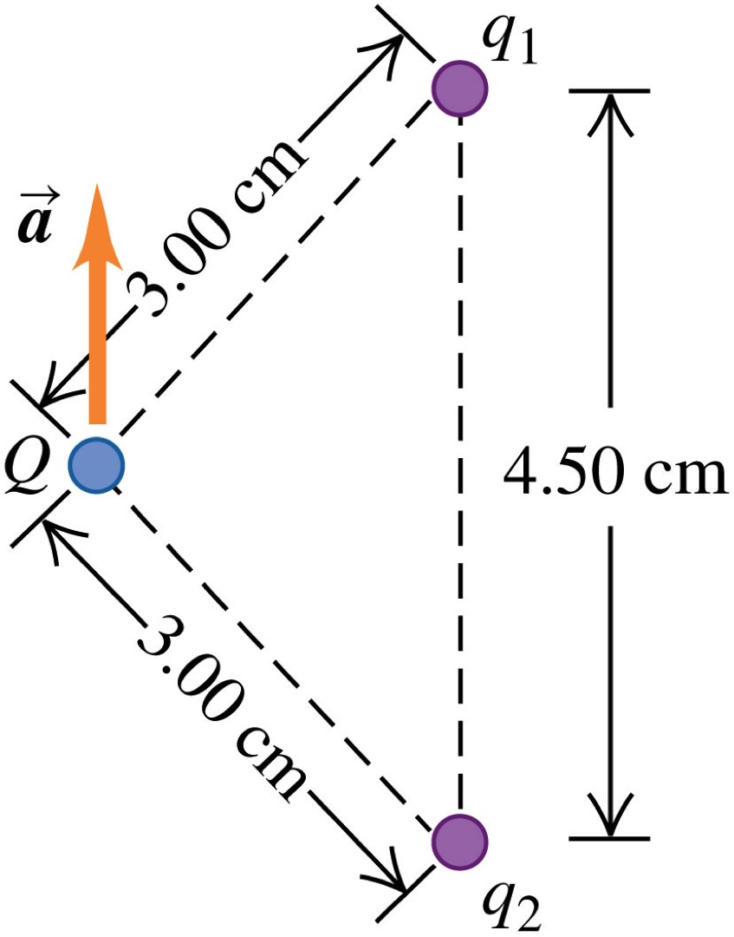
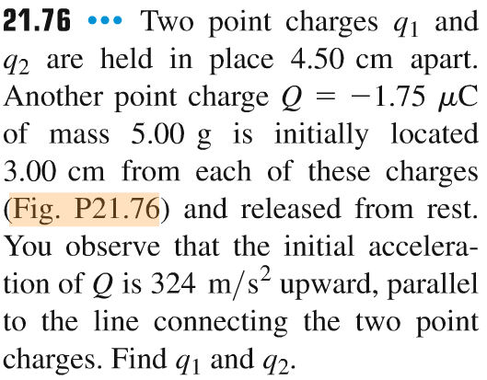
Problem #2

Slide 14
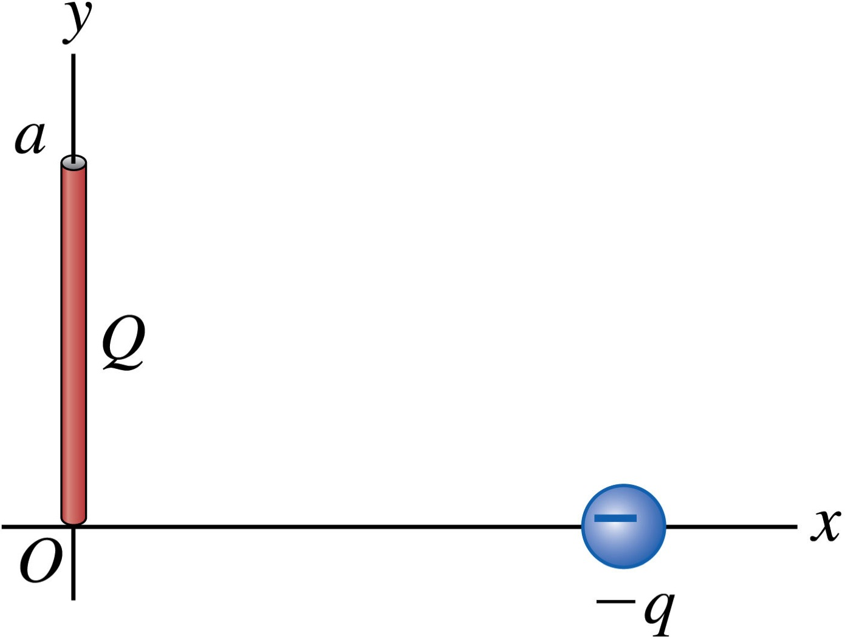
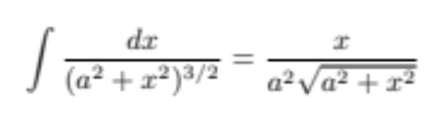
Problem #3
Positive charge Q is distributed uniformly
along the positive y-axis between 0 and a.
A negative point charge –q lies on the positive
x-axis, a distance x from the origin.
Find x and y components of the force that the
charge Q exerts on q.

Slide 15
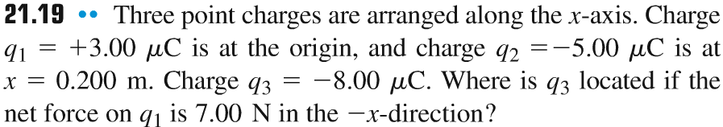
Problem #4

