Slide 1

Chapter 28 – part I

Slide 2
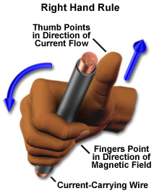
OUTLINE
  Magnetic field of moving charges.
  Magnetic field of currents.
  Magnetic forces between currents.

Slide 3
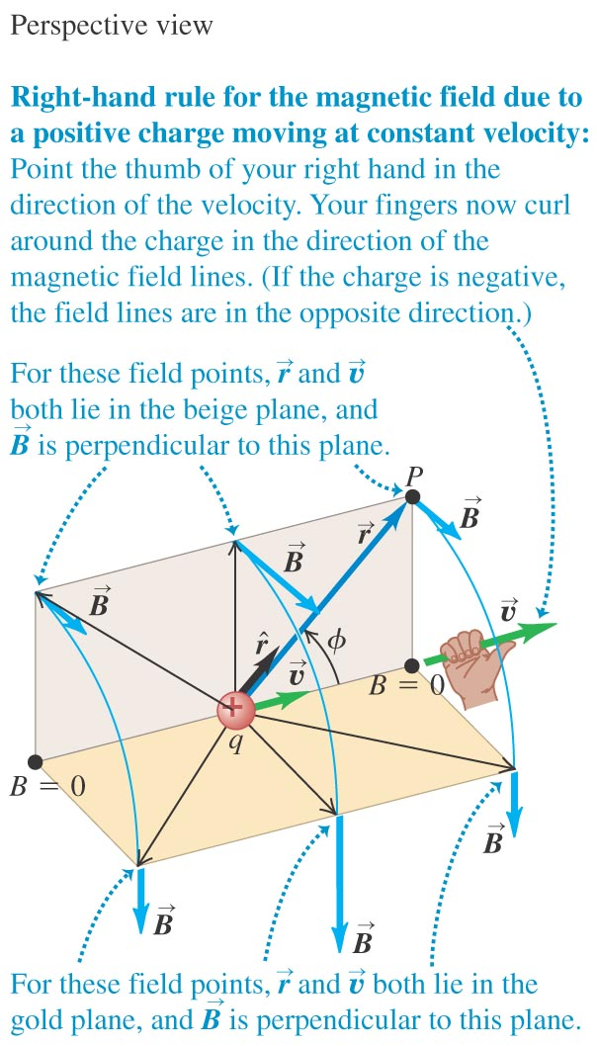
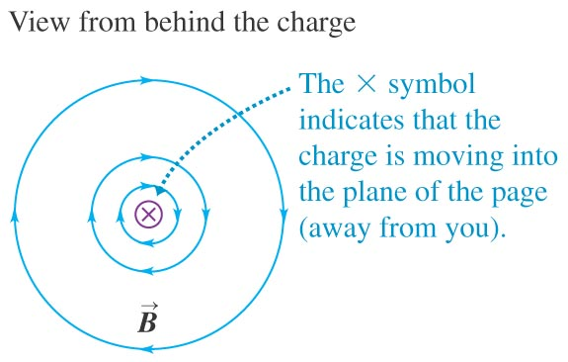
The magnetic field of a moving charge
A moving charge generates a magnetic field that depends on the velocity of the charge.
Figure below shows the direction of the field.

Slide 4
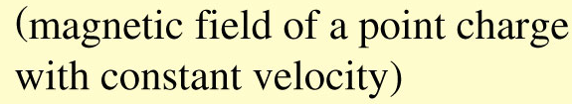
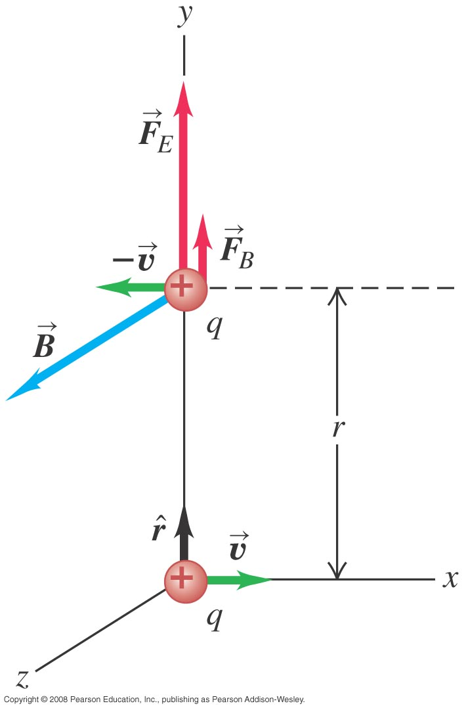
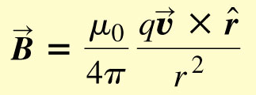
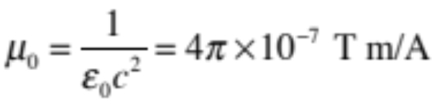
The magnetic field of a moving charge
magnetic field between 2 moving protons
magnetic permeability of free space

Slide 5
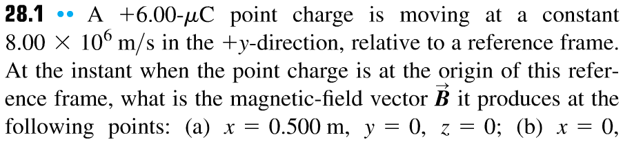
Problem #1
x = 0.500 m, y = z = 0;
x = 0, y = -0.500 m, z = +0.500 m.

Slide 6
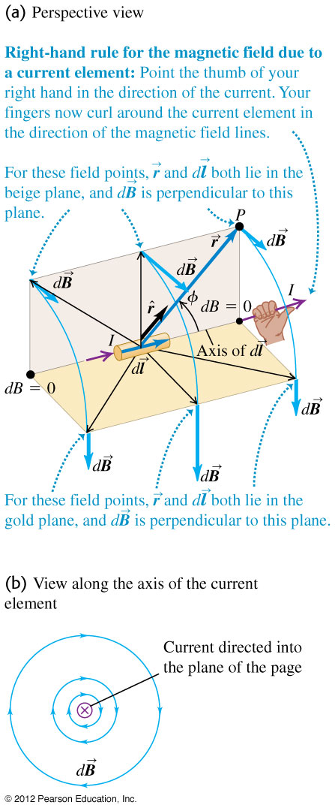
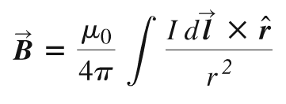
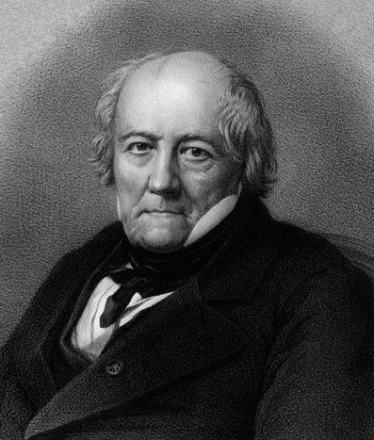
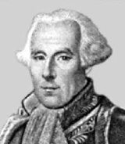
Magnetic field of a current element
The total magnetic field of several moving charges is the vector sum of each field.
The law of Biot and Savart
Jean-Baptiste Biot
Felix Savart

Slide 7
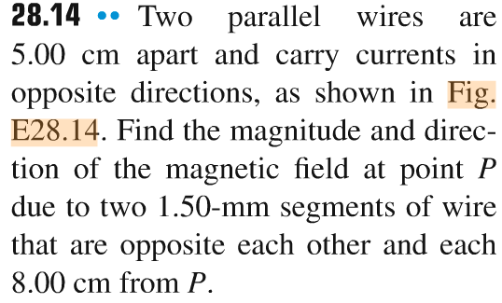
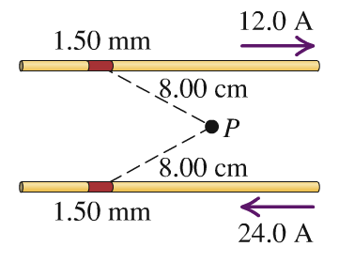
Problem #2

Slide 8
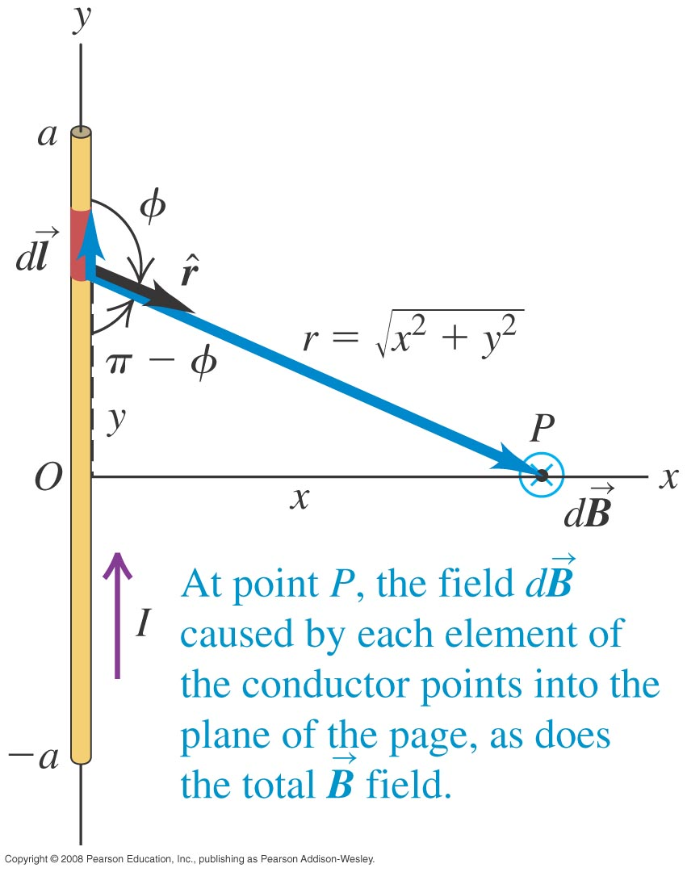
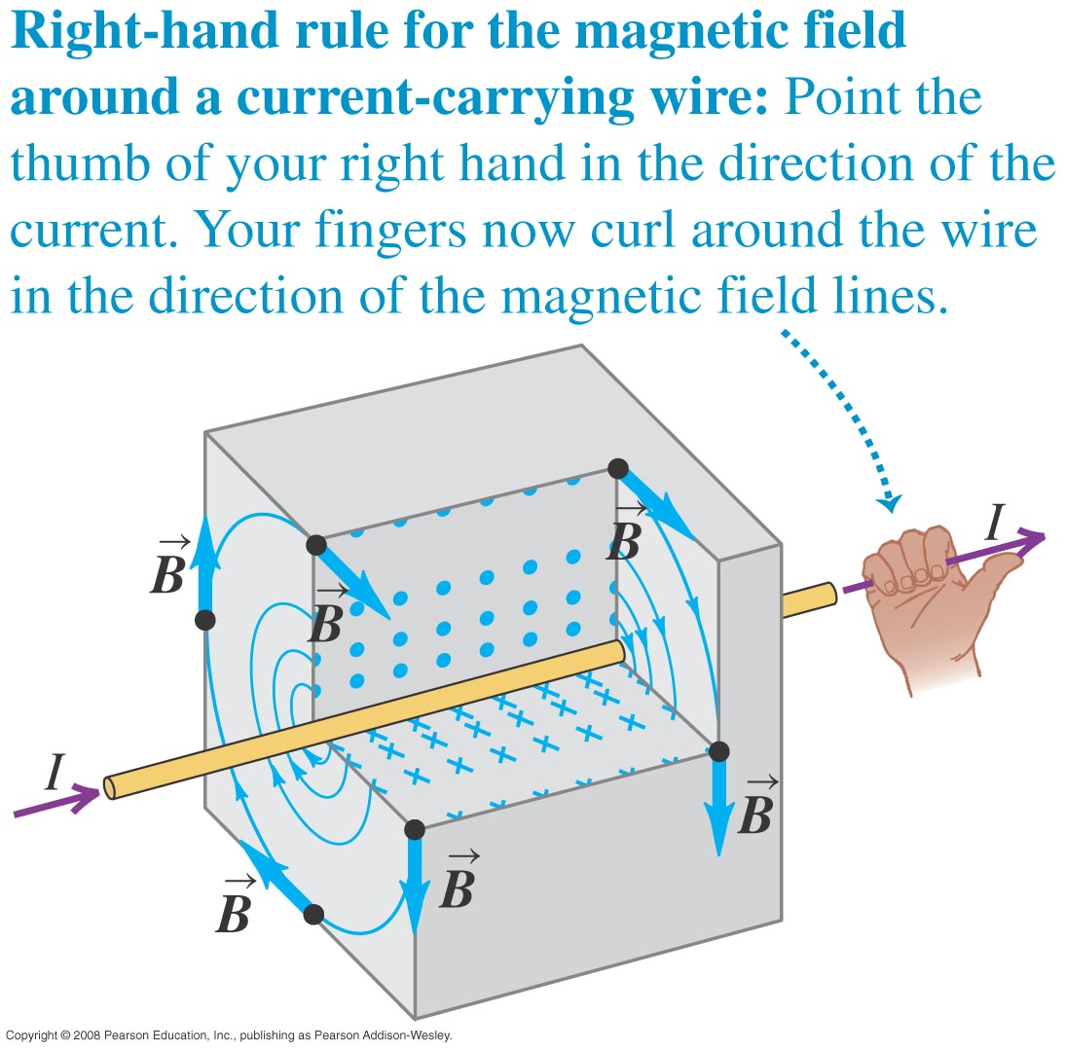
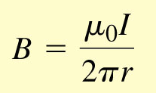
Magnetic field of a straight current-carrying conductor

Slide 9
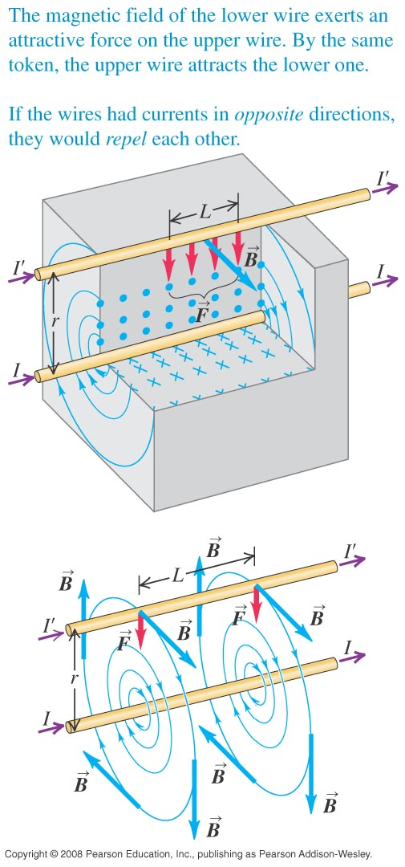
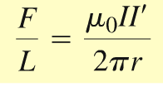
Force between parallel conductors
The force per unit length on each conductor is
The conductors attract each other if the currents are in the same direction and repel if they are in opposite directions.

Slide 10
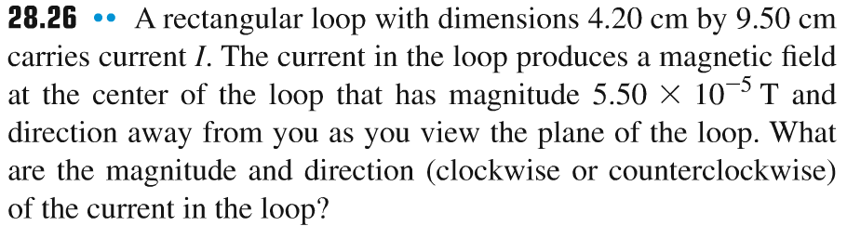
Problem #3

Slide 11
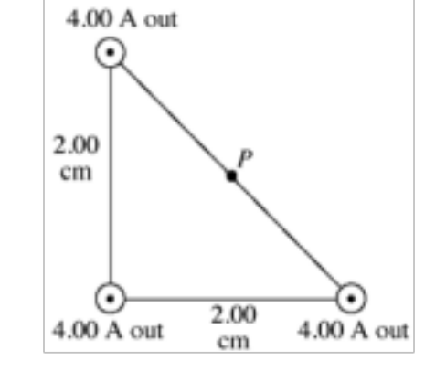
Problem #4

