Slide 1

Chapter 32 – part I

Slide 2
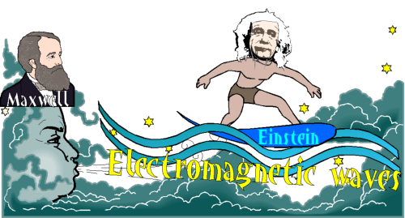
OUTLINE
  Maxwell’s equations and light.
  EM plane waves.
  Properties of EM waves.
  Sinusoidal EM waves

Slide 3
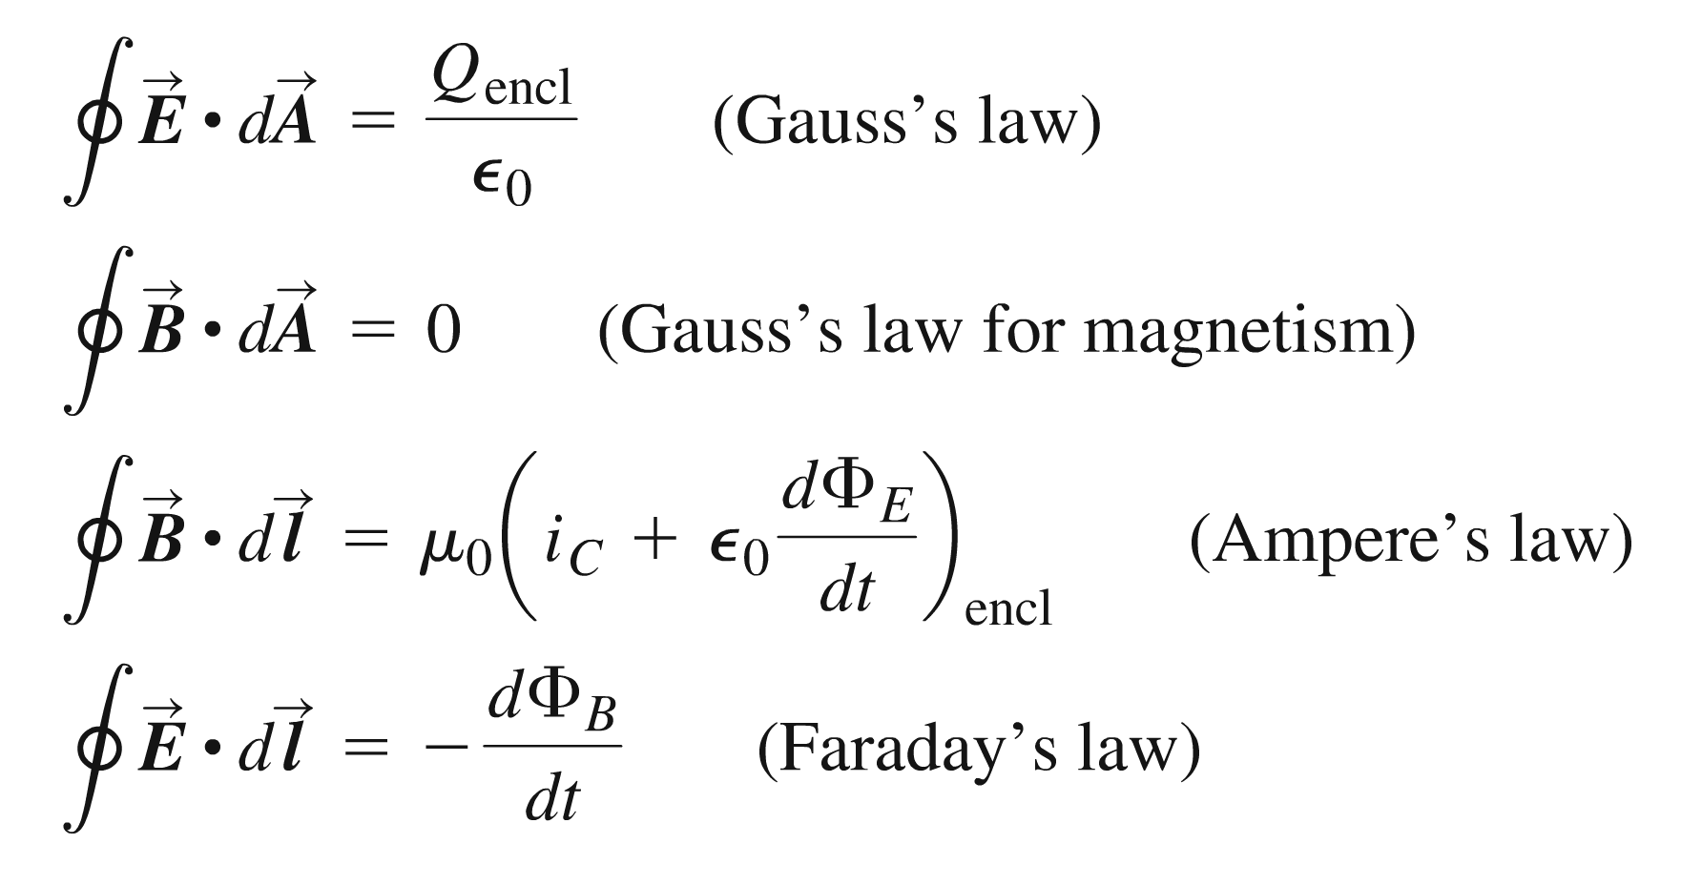
Maxwell’s equations

Slide 4
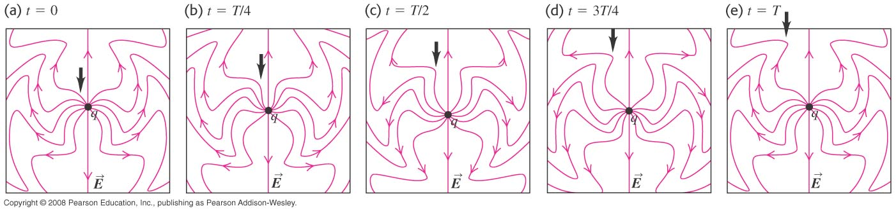
Maxwell’s equations and electromagnetic waves
  Maxwell’s equations predicted that an oscillating charge emits electromagnetic radiation in the form of electromagnetic waves.
  Figure below shows the electric field lines of a point charge undergoing simple harmonic motion.

Slide 5
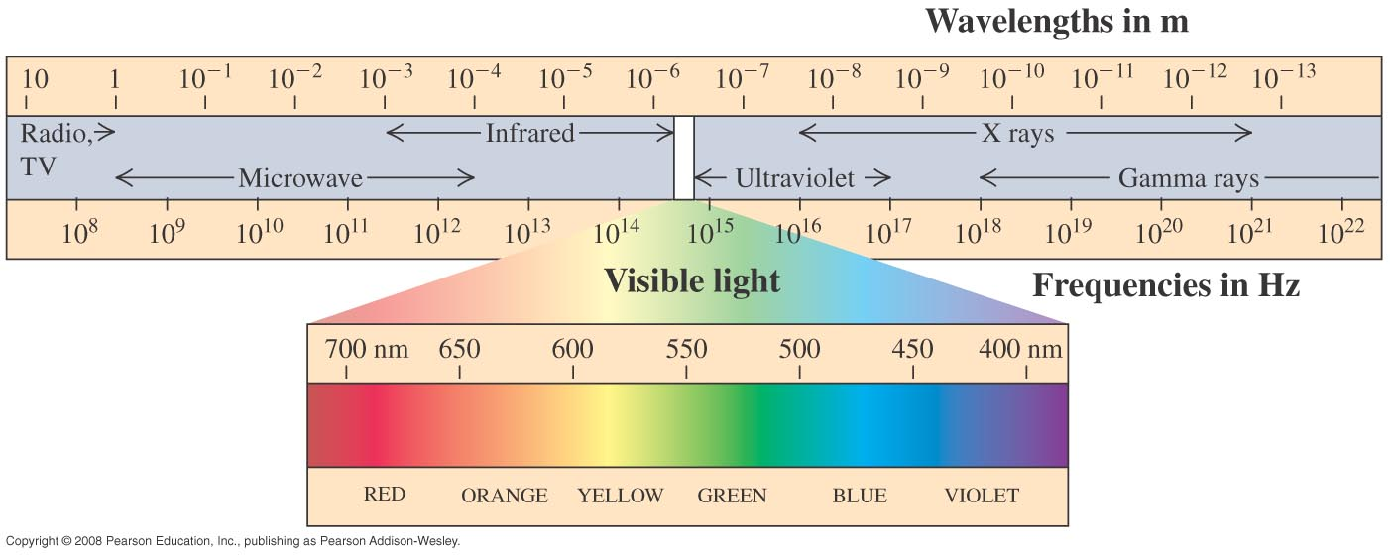
The electromagnetic spectrum
  The electromagnetic spectrum includes electromagnetic waves of all frequencies and wavelengths.

Slide 6
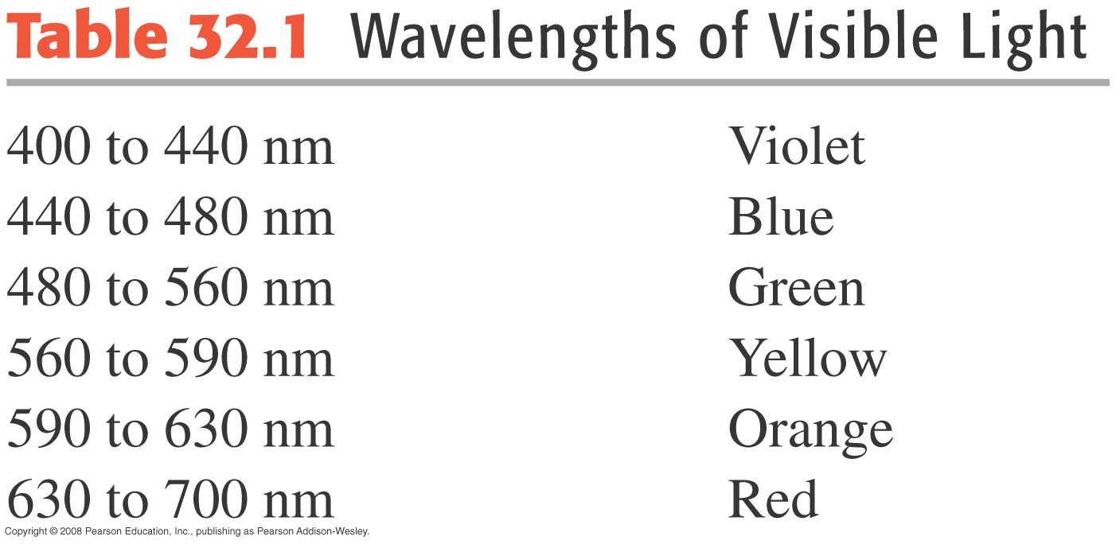
Visible light
  Visible light is the segment of the electromagnetic spectrum that we can see.
  Visible light extends from the violet end (400 nm) to the red end (700 nm).

Slide 7
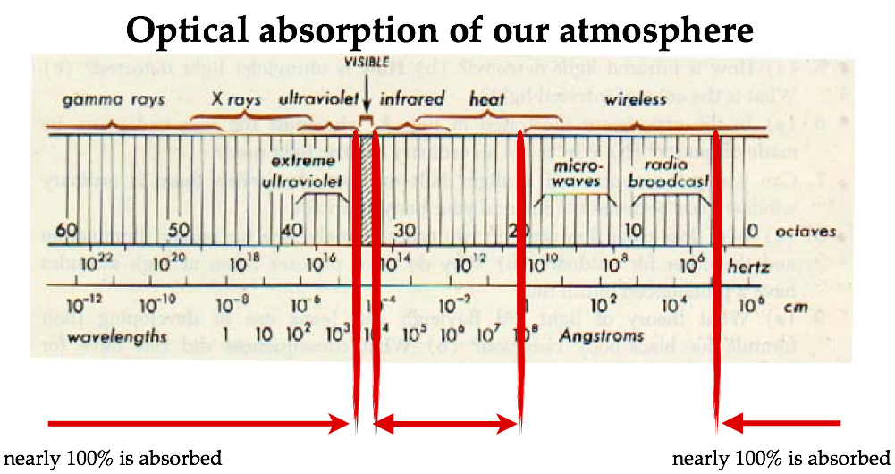
Our atmosphere

Slide 8
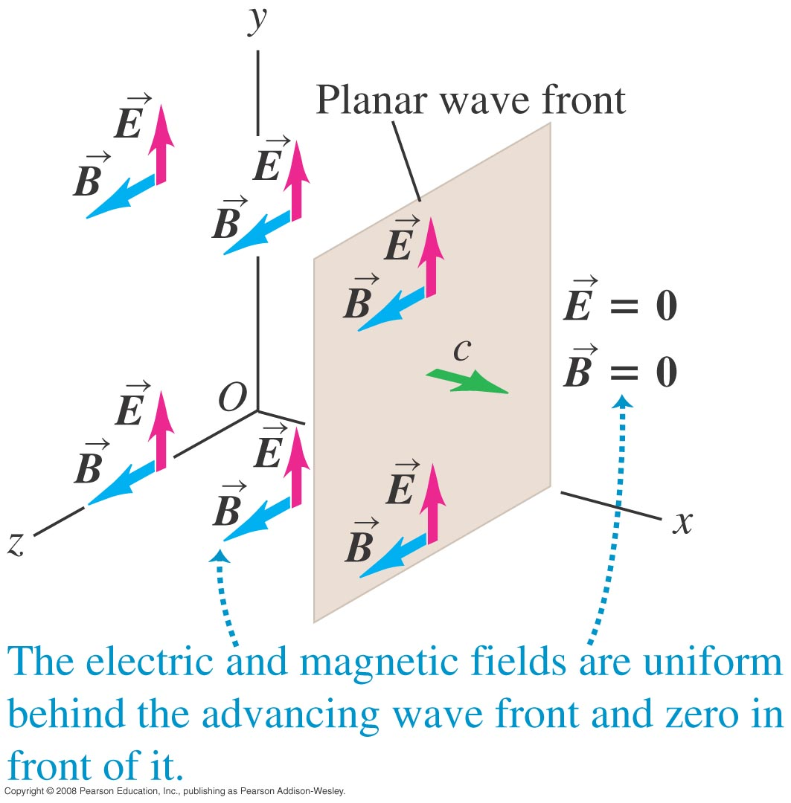
Plane electromagnetic waves
  A plane wave has a planar wave front.

Slide 9
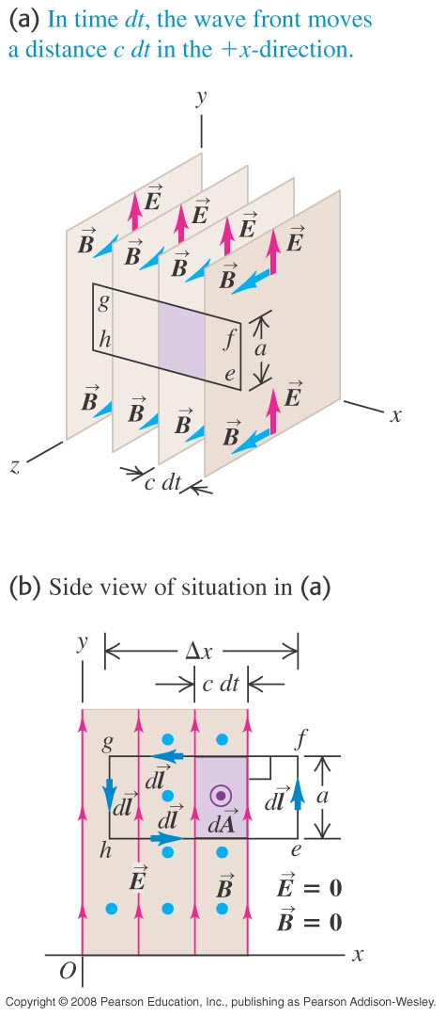
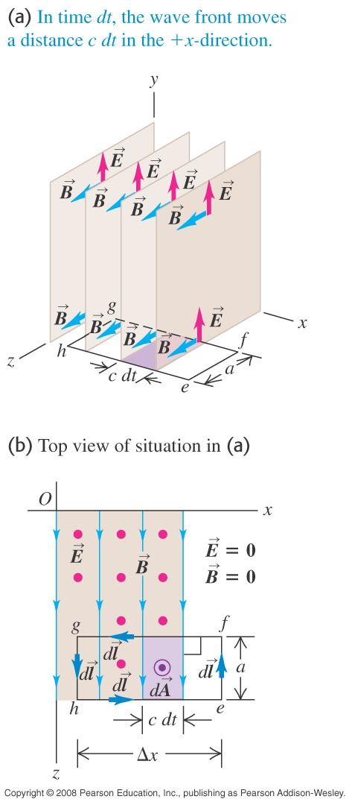
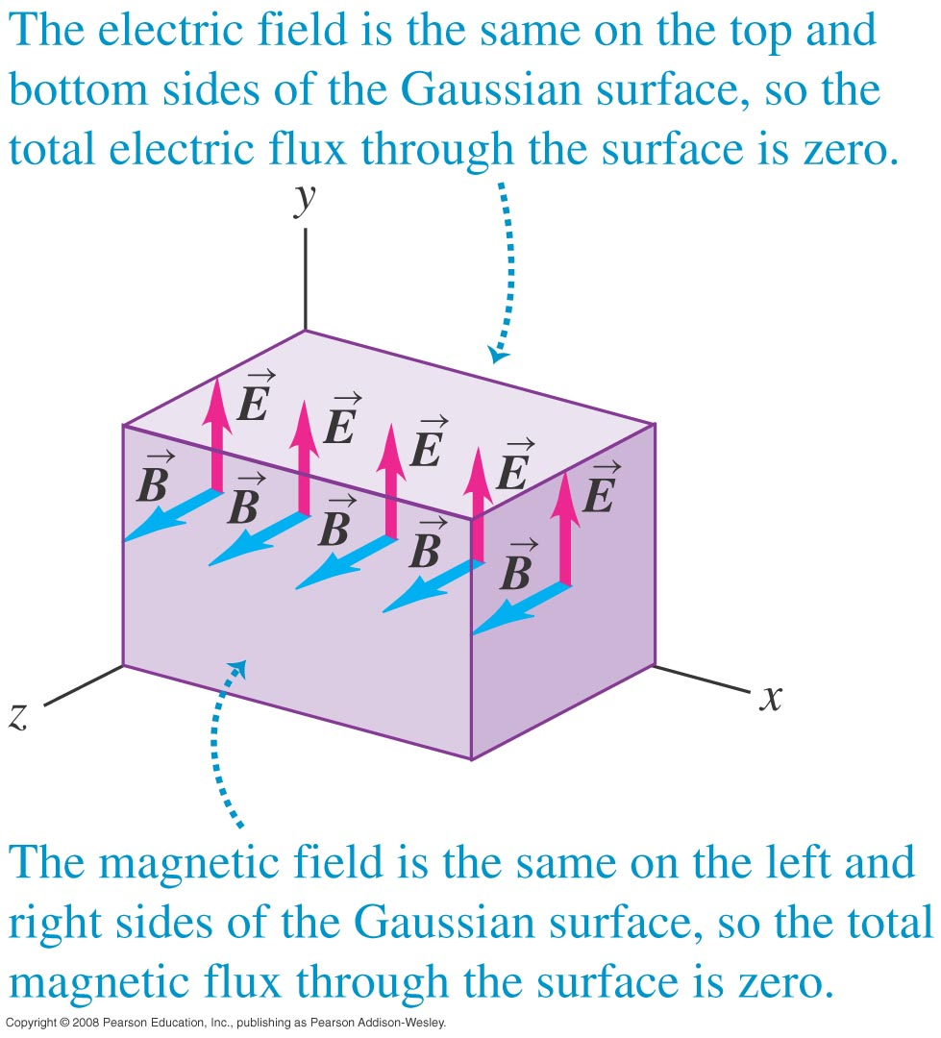
A simple plane electromagnetic wave

Slide 10
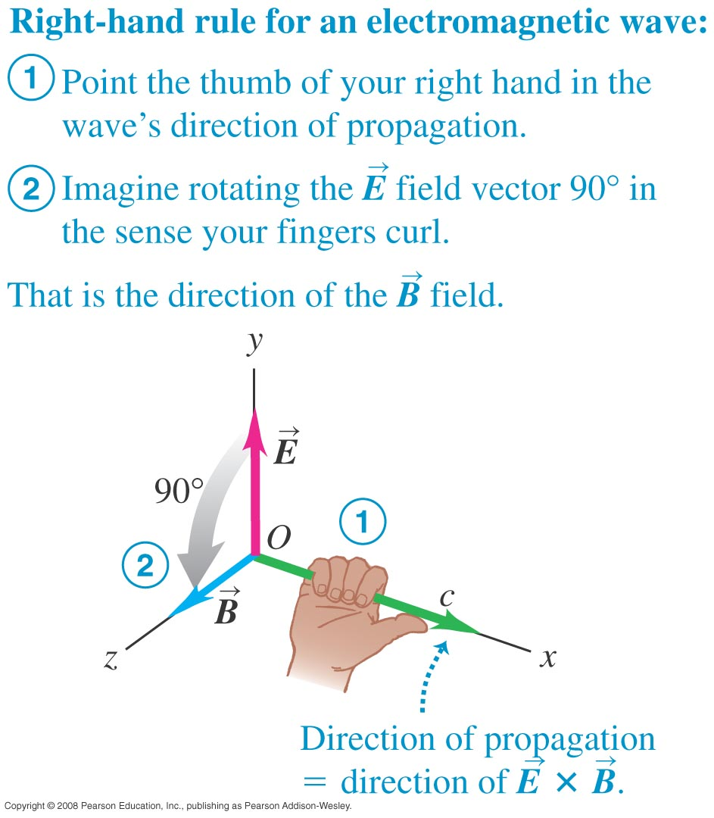
Key properties of electromagnetic waves
  The magnitudes of the fields in vacuum are related by E = cB.
  The speed of the waves is c = 3.00 × 10⁸ m/s in vacuum.
  The waves are transverse. Both fields are perpendicular to the direction of propagation and to each other.

Slide 11
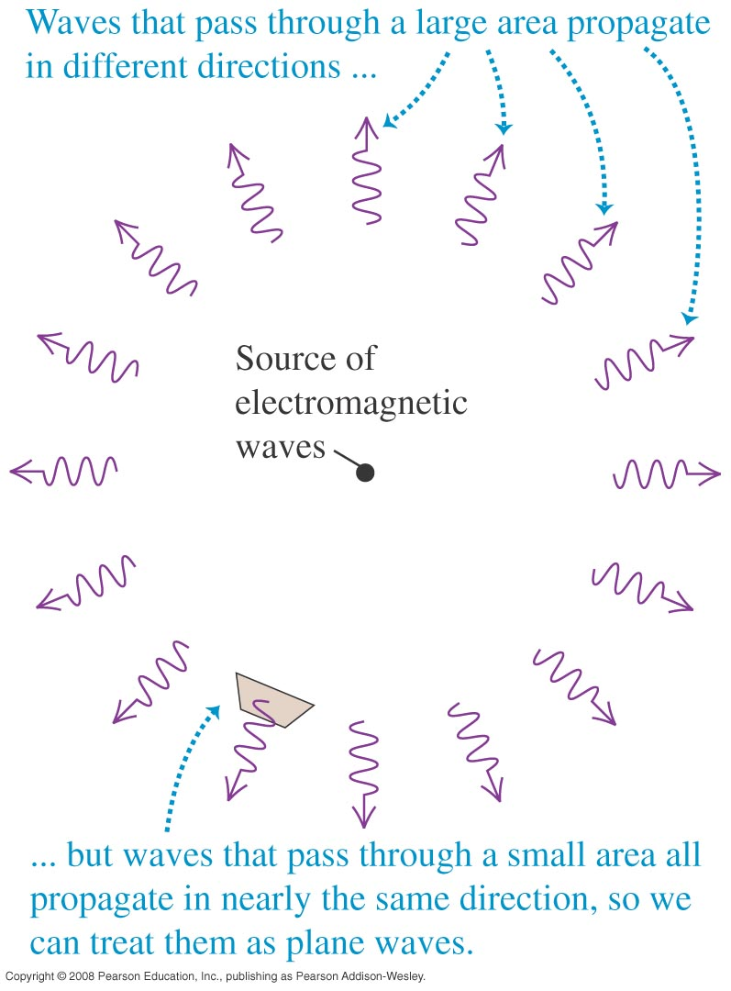
Sinusoidal electromagnetic waves
  Waves passing through a small area far from a source can be treated as plane waves.

Slide 12
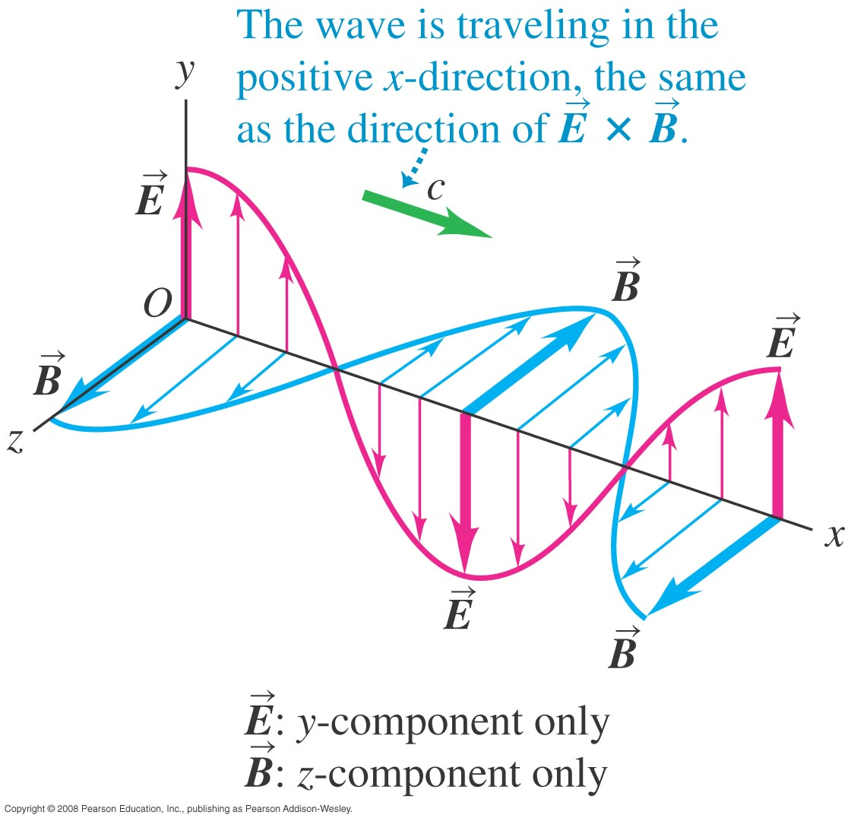
Fields of a sinusoidal wave
  Figure represents the electric and magnetic fields for a sinusoidal wave.

Slide 13
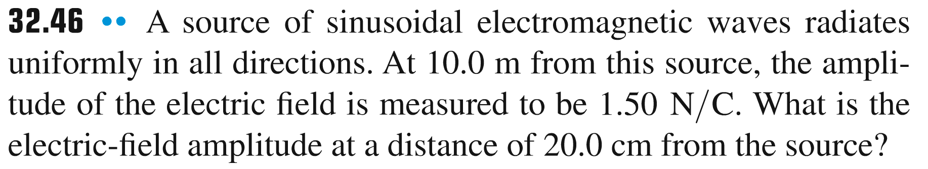
Problem #1

Slide 14
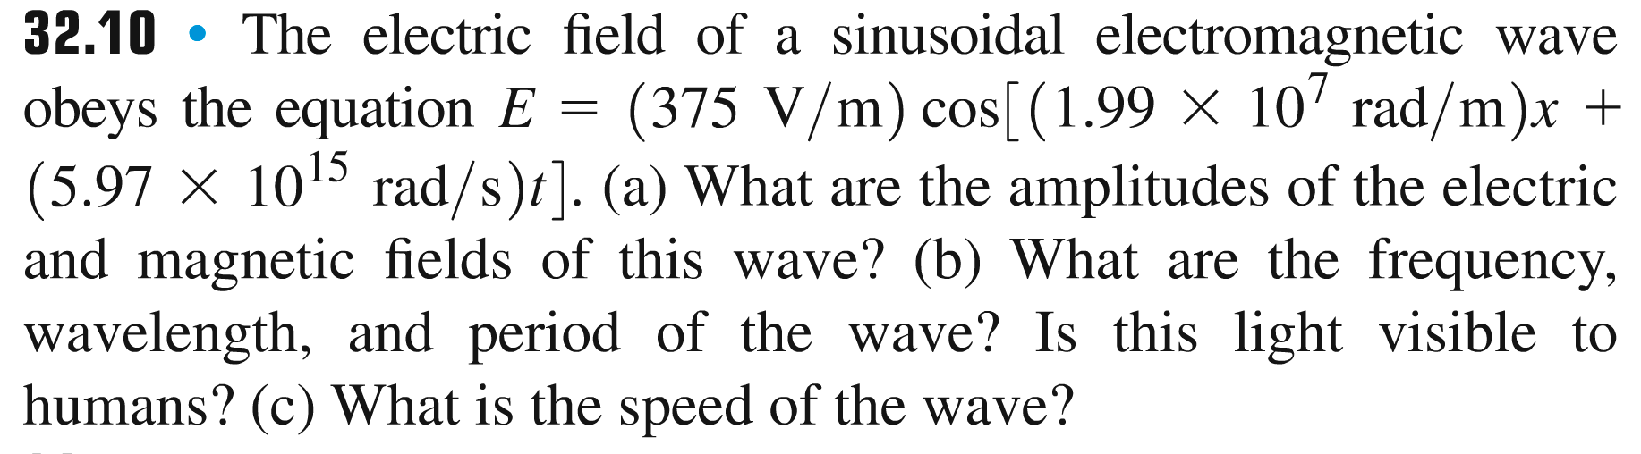
Problem #2

Slide 15
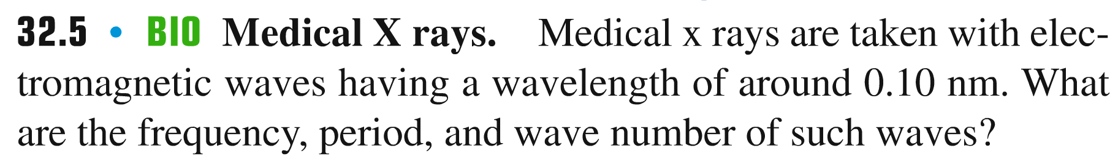
Problem #3

Slide 16
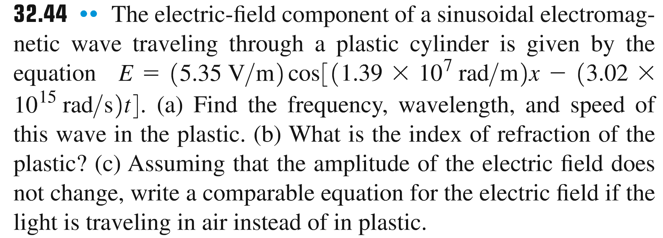
Problem #4

Slide 17
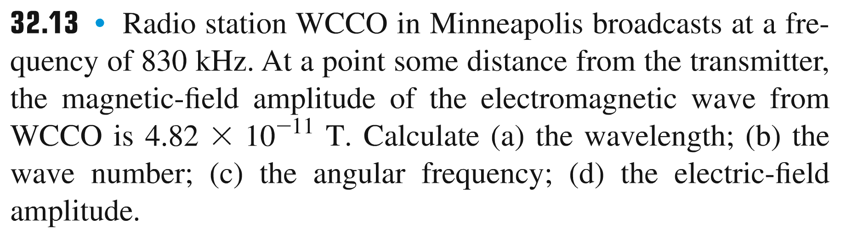
Problem #5

