Slide 1
Revisiting Deep Artificial Neural Networks for the Diagnostic of Caries Using Socioeconomic and Nutritional Features as Determinants: Data from NHANES 2013–2014
Presenter: Peter Lee, Juntian Wang

Slide 2
Research Objectives
-Oral health is often used as an indicator of one’s physical well-being.
-Zanella-Calzada et al. (2018) attempted to create predictive model of oral health, using socio-economic status and nutrition information.
-Binary Classification Task (6495 Healthy vs 3318 Unhealthy)
-Dataset with potentially high dimensional features
-Current project attempts to reproduce and improve Zanella-Calzada’s work.
-Programming Language used: Python 3.10 (Google Colab), R, SQLite

Slide 3
Data Cleaning process
-NHANE dataset (Demo, Diet, and Exam) from 2013-2014 (9813 subjects, 213 features)
-Dataset is uploaded to GitHub for reproducible research/easy access.
-3 different dataset was queried with SQLite, using SEQN variable (Primary Key)
-Data was cleaned via Python, following Zanella-Calzada et al. (2018)’s procedure.
Features (Demographic and Diet datasets) with more than 30% missing were removed. (9813 subjects, 123 features)
Missing dataset was imputed using averages, with Simple Imputer in Python.
Dataset was normalized with scikit-learn preprocessing package to eliminate the feature’s scale difference.
Oral health was coded using Diagnostic dataset: each tooth condition was examined.
Randomized train-test dataset separation (70:30)

Slide 4
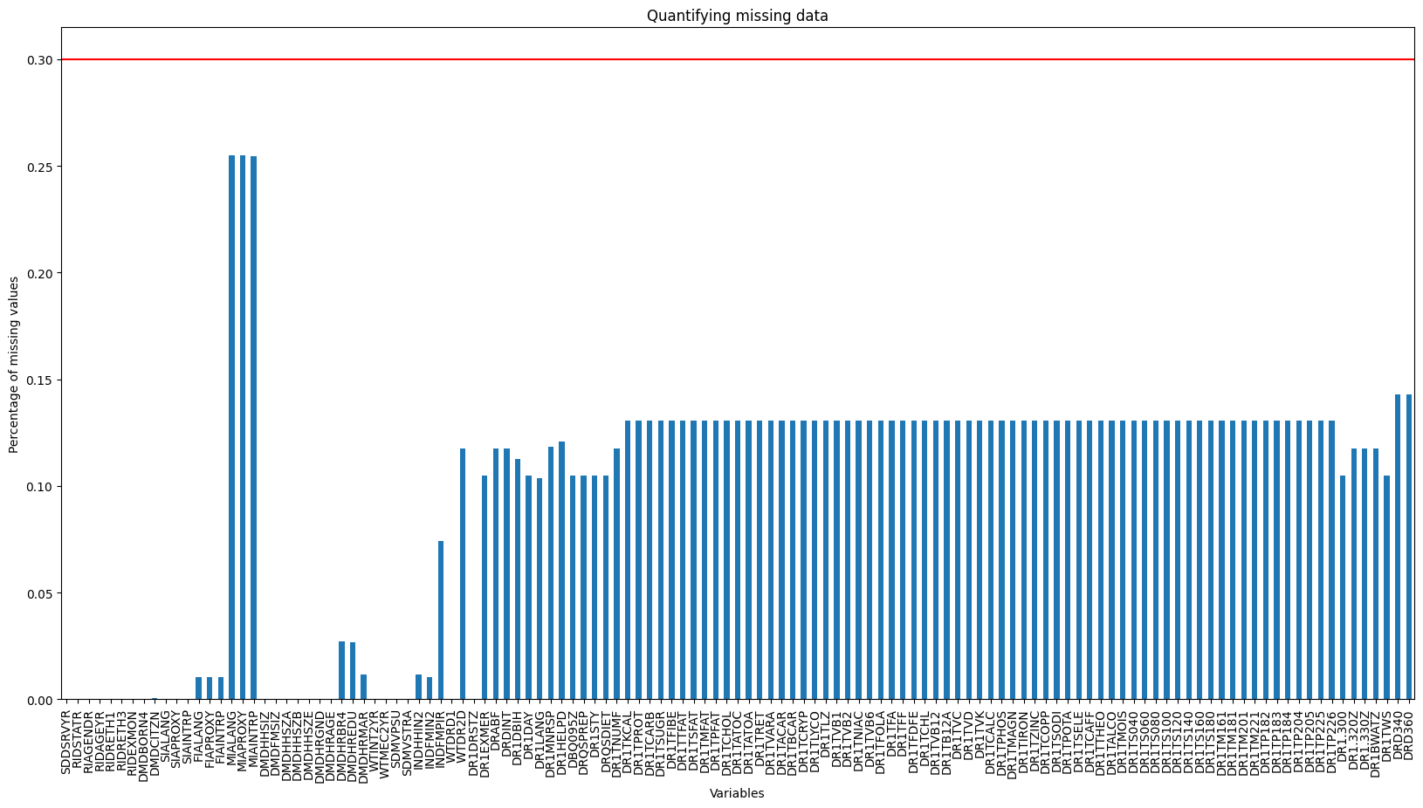

Slide 6
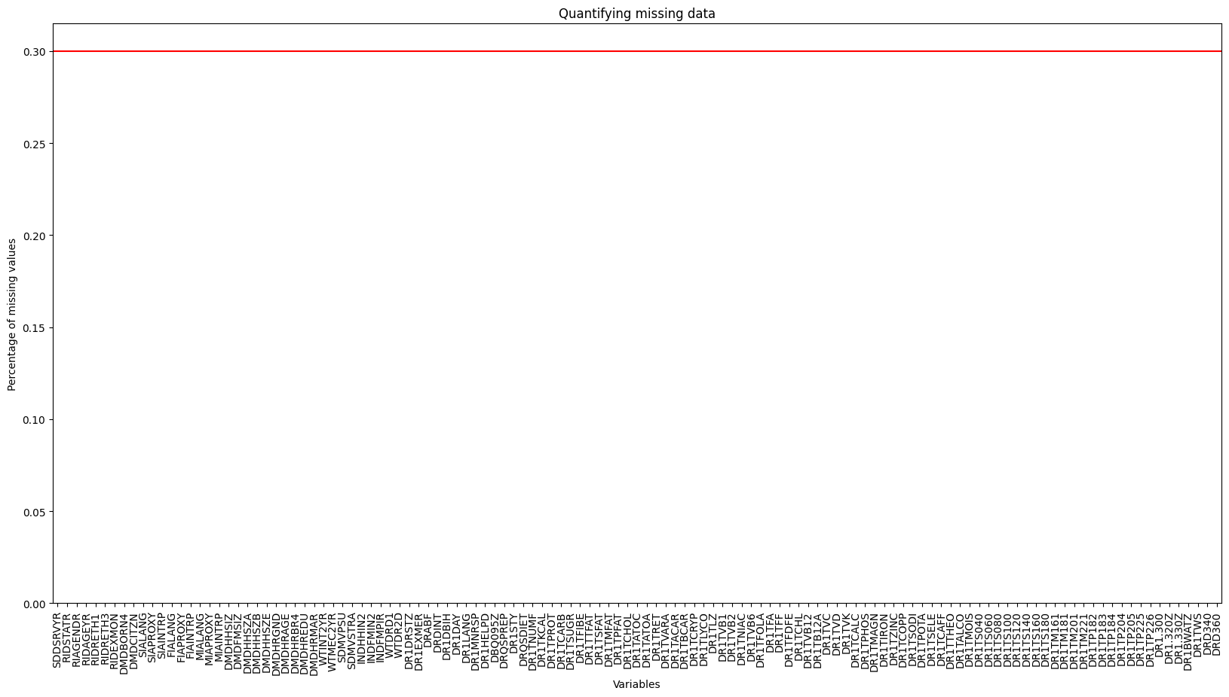

Slide 7
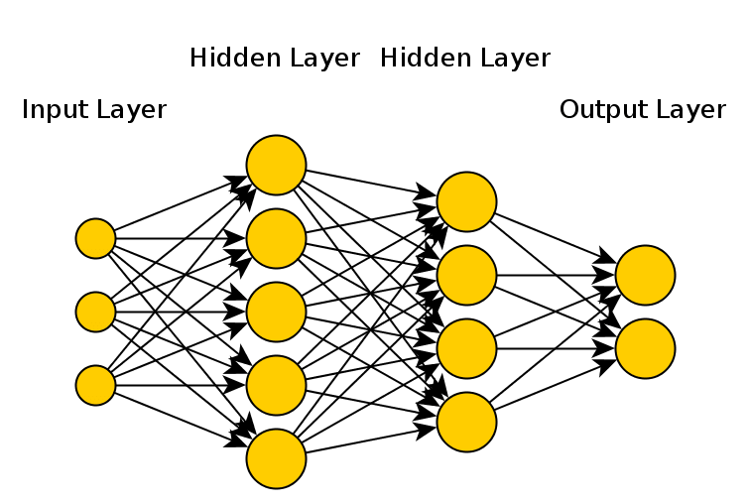
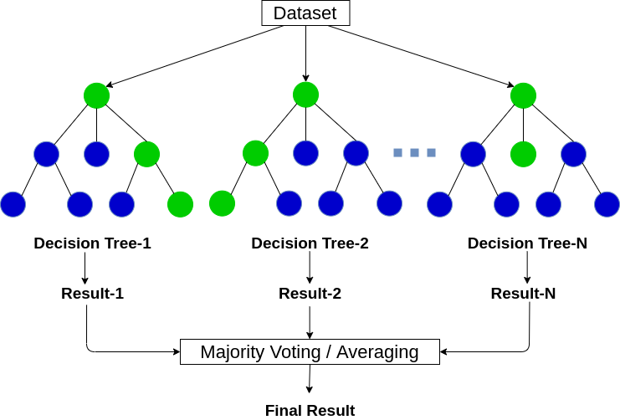
Machine Learning Model
Multi-Level Perceptron (MLP)/Artificial Neural Network (ANN) -neural network model connecting multiple layers -appropriate for high dimensional tabular data
Random Forest -Tree based ensemble model -implement hierarchical structure to the high dimensional dataset.
Model Comparison: -ROC curve AUC value -Best possible Accuracy

Slide 8
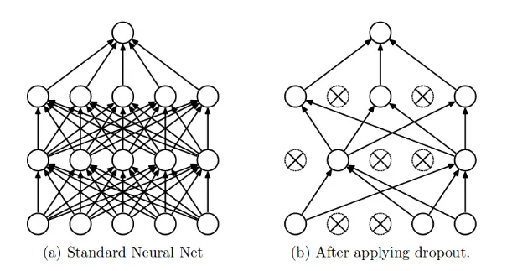
Multi Level Perceptron (MLP)
-Artificial Neural Network that has more than one hidden layers
-Consist of Dense Layer and Dropout Layer
-Dense Layer: receives output from every neuron of its preceding layer
-Dropout Layer: reduce overfitting by preventing co-adaptation through randomly dropping certain number of neurons
Notes:
When a fully-connected layer has a large number of neurons, co-adaptation is more likely to happen. Co-adaptation refers to when multiple neurons in a layer extract the same, or very similar, hidden features from the input data. This can happen when the connection weights for two different neurons are nearly identical.

Slide 9
Multi Level Perceptron (MLP)
Suggested Structures:
-4 layers of Dense and Dropout Layer
-Dense Layer: rectified linear unit (reLu); f(x) = max(0,x) -Dropout Layer Learning Rate: 0.5 -Output neuron used “softmax” -Used Adam Optimizer with 100 Epoch, with undefined batch size
Input Layer | Dense 1 | Dense 2 | Dense 3 | Dense 4 | Output Layer
123 features 123 neurons | 123 features 100 neurons | 100 features 1000 neurons | 1000 features 100 neurons | 100 features 100 neurons | 100 features 1 neuron

Slide 10
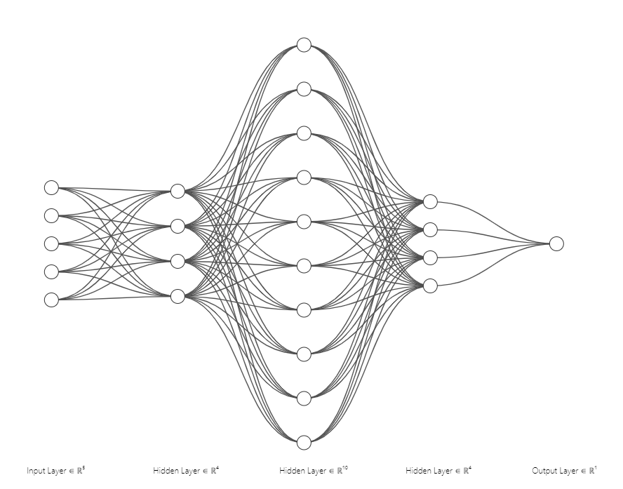
Structure of the MLP
Notes:
https://alexlenail.me/NN-SVG/index.html
Feature expansion in the layer 2 and 3; allows us to study potentially high dimensional features more carefully via using 1000 neurons,

Slide 11
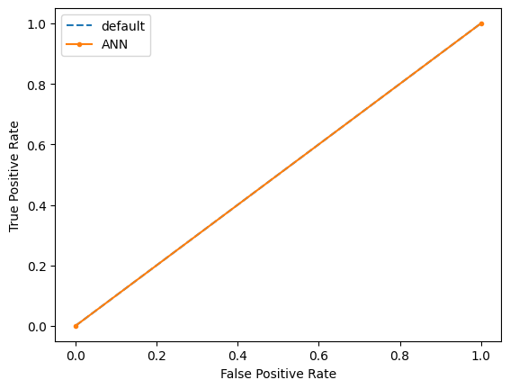
Suggested Model (Softmax)
-Accuracy: 0.66 -ROC curve AUC: 0.5 -Model did not function properly. (All prediction was 0)
 | Predicted Positive | Predicted Negative
True Positive | 0 | 994
True Negative | 0 | 1950

Slide 12
Issues with the Original paper
-For the Output layer activation function, Softmax is used for multiclass classification.
-For the Binary Classification, Sigmoid is the appropriate choice.
-Batch size was not provided and only Epoch size was provided.
-To reduce the memory load, we set Batch size to be 64, while using same Epoch size as the paper (100 iteration).
-For measuring the accuracy of the model, they simply used the cutoff of 0.5. -AUC-ROC curve should help us find an optimal cutoff point -This will give us “best possible” accuracy of the model.
-Epoch size and number of hidden layers were tuned, but the learning rate in Dropout layer was not tuned.

Slide 13
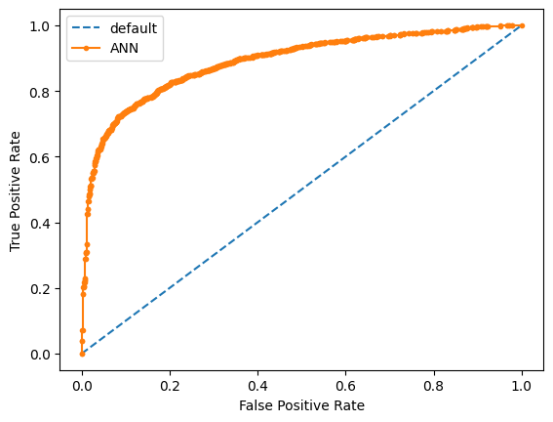
Changing Output Layer Activation function
-Retained Dense and Dropout Layers structure.
-Changed Output Layer activation function to Sigmoid, as this is binary classification.
-AUC: 0.89
-Accuracy: 0.81 with 0.64 threshold
 | Predicted Positive | Predicted Negative
True Positive | 807 | 187
True Negative | 368 | 1582

Slide 14
Hyperparameter Tuning: Learning Rates
For learning rate, we want to have: -Lowest possible cross-entropy loss -Highest possible accuracy
-Under same Epoch, Batch Size, and Hidden Layer structure, we fit various learning rates.
-Typically with large dataset, dropout learning rate of 0.5 is recommended.
Learning Rates | Test Loss Percentage | Test Accuracy
0.1 | 0.79 | 0.78
0.2 | 0.43 | 0.82
0.3 | 0.41 | 0.81
0.4 | 0.40 | 0.82
0.5 | 0.47 | 0.80
0.6 | 0.37 | 0.83
0.7 | 0.38 | 0.83
0.8 | 0.39 | 0.81
0.9 | 0.54 | 0.62
Notes:
This type of cross-entropy loss measures the dissimilarity between the predicted probabilities and the true binary labels. It encourages the model to output higher probabilities for the positive class and lower probabilities for the negative class.

Slide 15
Final Model - MLP
-Tuning learning rate from 0.5 to 0.6 did not cause any difference in the performance.
-Accuracy and AUC was identical (0.81) using same cutoff
-Confusion matrix result was identical.
-Running time: 1 minutes 28 sec
 | Predicted Positive | Predicted Negative
True Positive | 807 | 187
True Negative | 368 | 1582

Slide 16
Random Forest Model
Tuning parameter mtry: number of variables randomly sampled as candidates at each split
Default setting mtry = √p, where p is the number of parameters in the training dataset
Performances of two random forest models with different mtry settings are compared (AUC, best cutoff, and accuracy)
Running time is calculated
ROC curve is generated

Slide 17
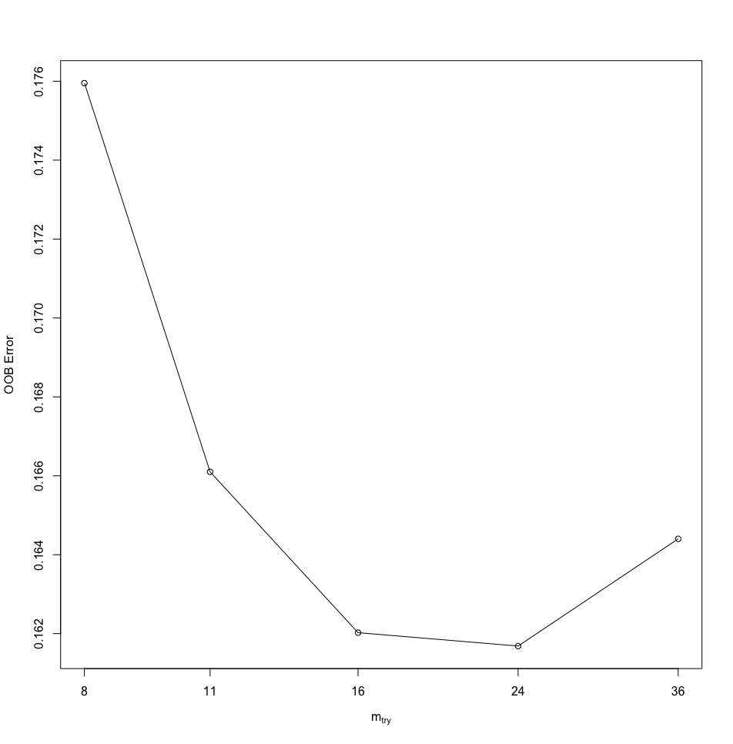
Random Forest Model
Tuning parameter mtry = 24

Slide 18
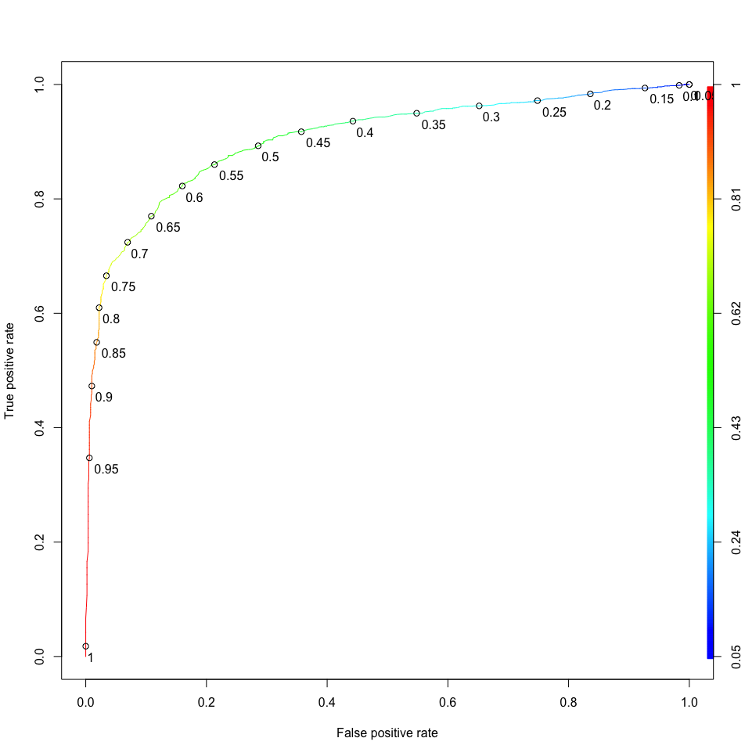
Initial Model Performance (mtry = 11)
AUC = 0.91
Best probability cutoff = 0.53
Model accuracy = 0.84

Slide 19
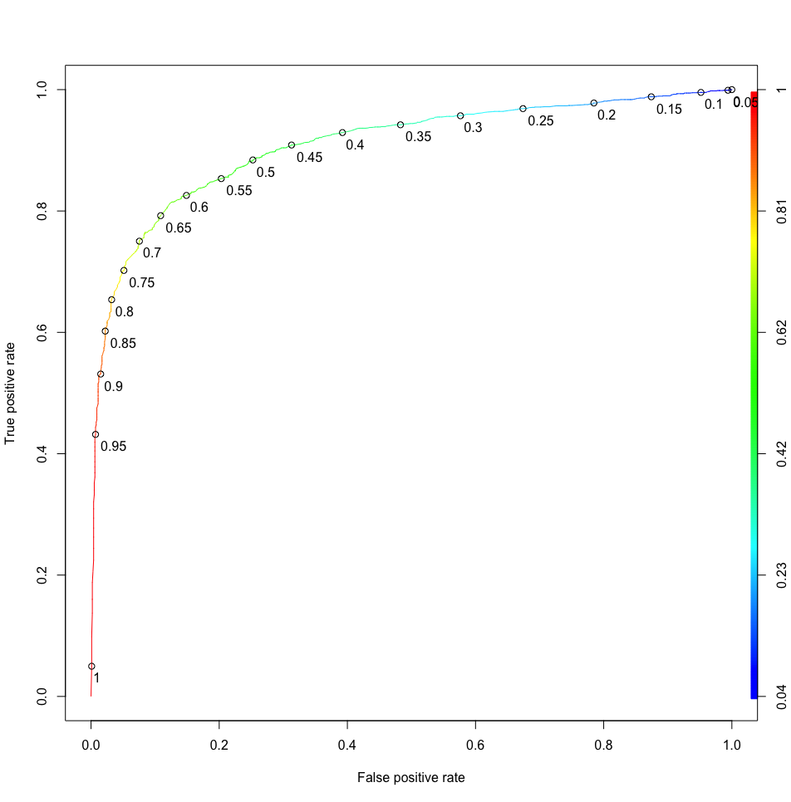
Best Model Performance (mtry = 24)
AUC = 0.91
Best probability cutoff = 0.51
Model accuracy = 0.84
Running time = 16min

Slide 20
Comparison
mtry = 11 vs mtry = 24
Same AUC = 0.91
Different probability cutoff (0.53 vs 0.51)
Same model accuracy = 0.84
Similar ROC curves
Performance almost identical

Slide 21
Conclusion
-AUC of the ROC curve in Random Forest (0.91) was slightly better than MLP model (0.89).
-Accuracy with optimal cutoff was also slightly better in Random Forest (0.84) than MLP model (0.81).
-Random Forest model required far more processing time (16 minutes) than MLP model (1 min 28 sec).
-While Random Forest model yields slightly better prediction accuracy, it required far more computational resources than Neural Network Model.

