Slide 1
EDES 301 Talking Fish Proposal
Oct 7, 2025
Jackson Lieb

Slide 2

Background Information
For my project, I am interested in hacking a voice assistant into a Big Mouth Billy Bass. I wish I could say this was an original idea. There are, however, a few integrations and upgrades I am interested in adding on that I haven’t seen before.
On the hardware side: Current impls use an H-bridge to control the existing motors. I instead intend on swapping out those motors for steppers, such that I can have more position control. This should give it better “talking” that doesn’t look like somebody lip syncing a song they don’t know the words to.
As for software: Right now the smoothest implementations I’ve seen make use of OpenAI APIs, either directly with RealTime or using TTS and STT libraries interfacing with traditional (ha, “traditional”) text-based language models. Frankly, I think on-device would be far too slow, so I agree in that regard. Less-charted territory, though, is opportunities for integration. Initial top prospects are Spotify, Calendar, and Weather, but I want to add some custom skills if I’ve got time… rapping keeps crossing my mind. I also want to introduce concurrency or at least some sort of response batching such that the fish can respond quicker, move more fluidly, and effectively stall as it waits to receive network responses.
Secondly, I want to take the funniest shell for a voice assistant ever as an opportunity to delve further into exploring models. As an extension, I may try to play around with small open-source models or the like on my computer and hook it up that way. Talking to a fish is more fun when you don’t have rising API costs in the back of your mind.
Existing projects:
https://github.com/GoBig87/chat-gpt-rasperry-pi-assistant
https://github.com/hgrf/el-poisson-billy
https://www.reddit.com/r/homeassistant/comments/1nk9o26/big_mouth_billy_bass_is_now_my_ai_voice_assistant/

Slide 3
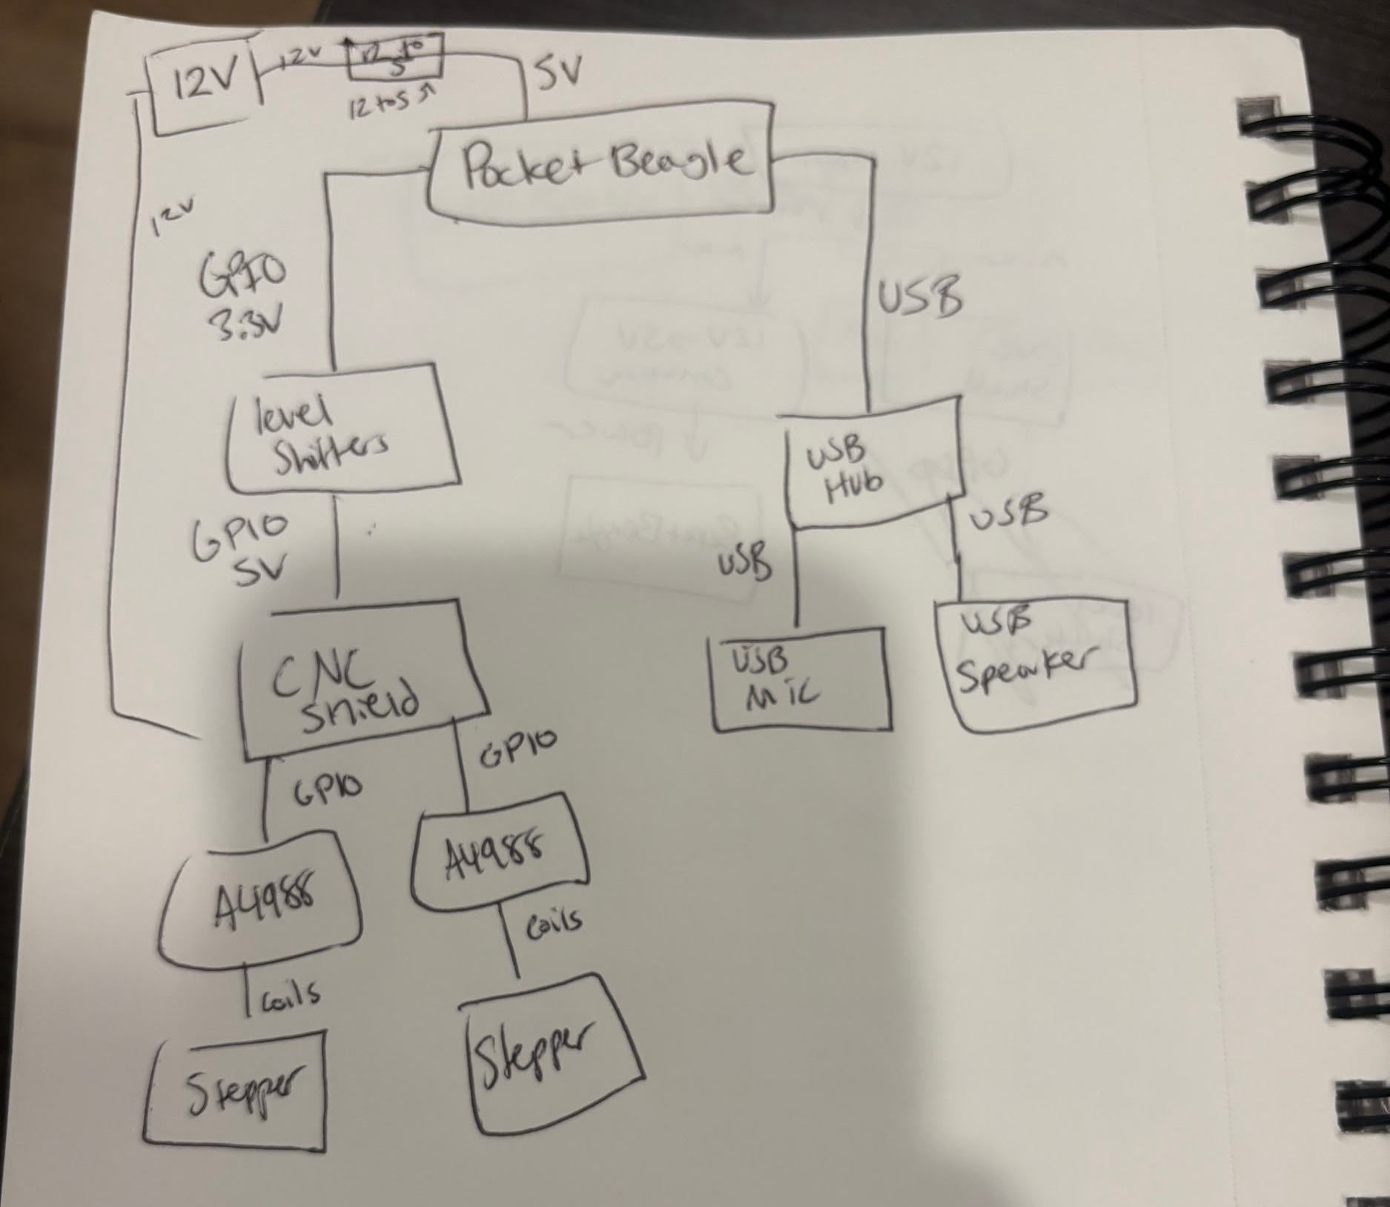
System Block Diagram

Slide 4
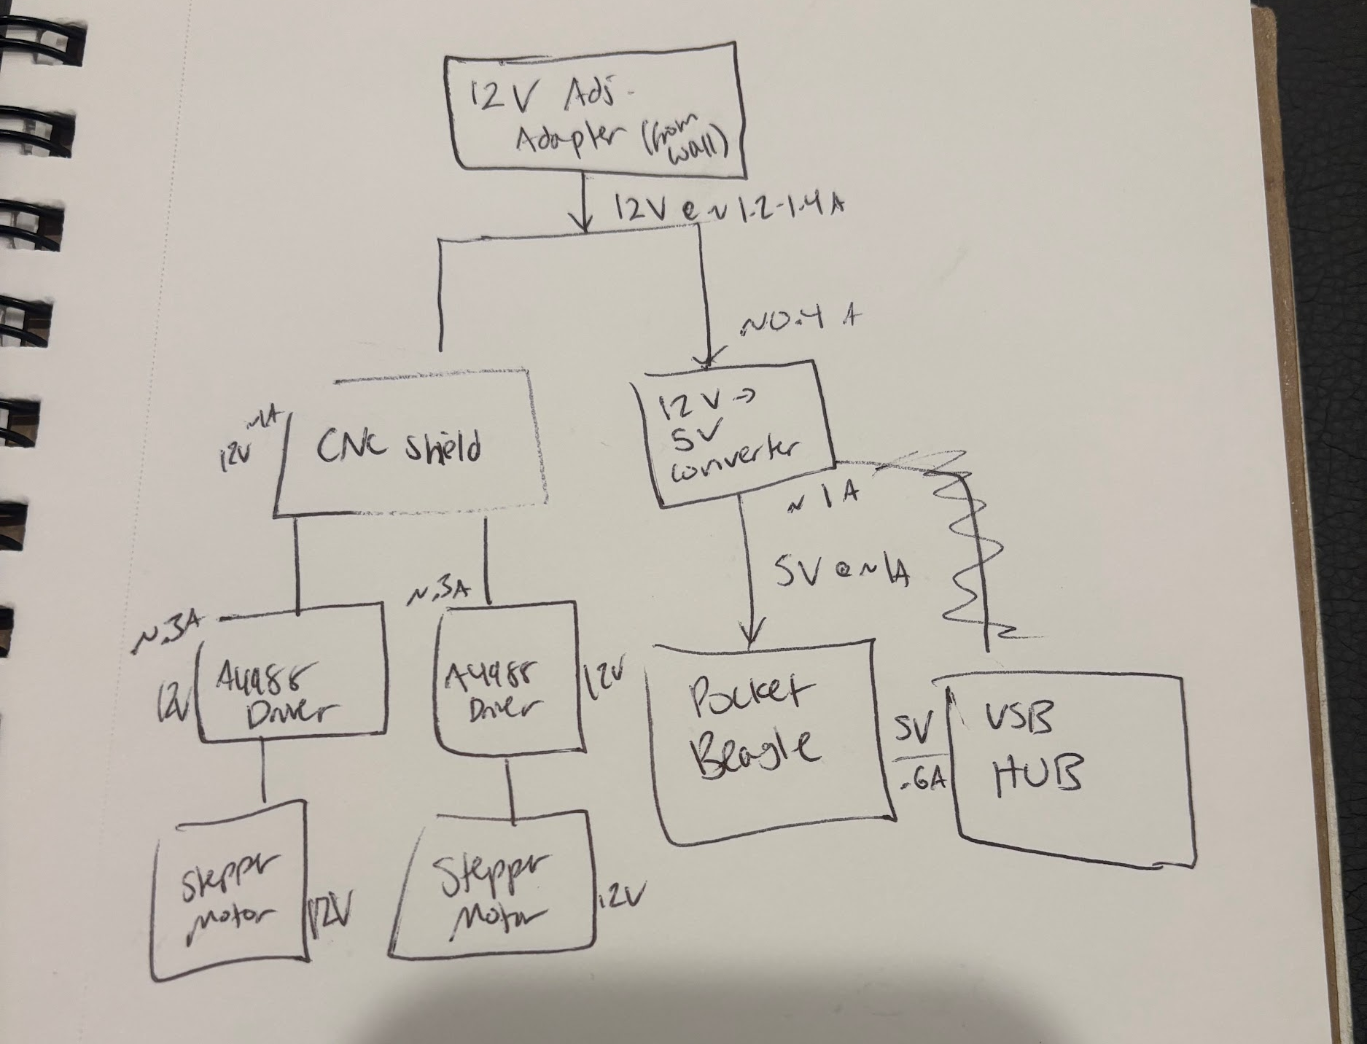
Power Block Diagram

Slide 5
Components / Budget
Component | EDES301 to Buy? | Cost
Big Mouth Billy Bass (will reuse shell & skeleton) | N | ~$45
USB WiFi provided link | Y | $9.99
Microphone provided link | Y | $7.99
USB Speaker amazon link | N | $13.99
USB Hub provided link | N | $19.99
Level Shifters x2 provided link | Y | $3.20 ($1.60ea)
Stepper Motor x2 provided link | Y | $15.98 ($7.99ea)
3D Printer CNC Shield V3 Engraver Expansion Board with 4X A4988 Driver Module and 4 x Radiator link | N | $9.99
Adjustable Voltage Adapter (2A) provided link | N | $15.98
12V -> 5V Converter provided link | N | $8.89

