Slide 1
EDES 301
PCB Project
Jackson Lieb
Due 12/16/2025 @ 11:59pm

Slide 2
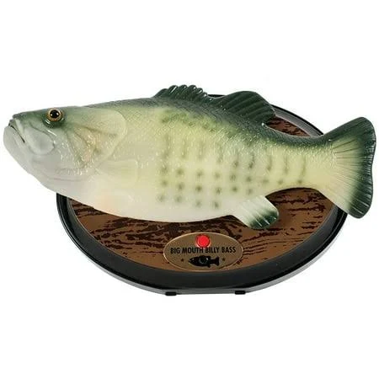
Background Information
Create a PCB for a Talking Fish Assistant
Hardware:
  PocketBeagle
  TB6612FNG Motor Driver
  USB Port (Type A)
  DC Barrel Jack
  Screw Terminal (4 ports)
  5V Regulator
  Capacitor 10uF(x2), 100uF(x1)

Slide 3
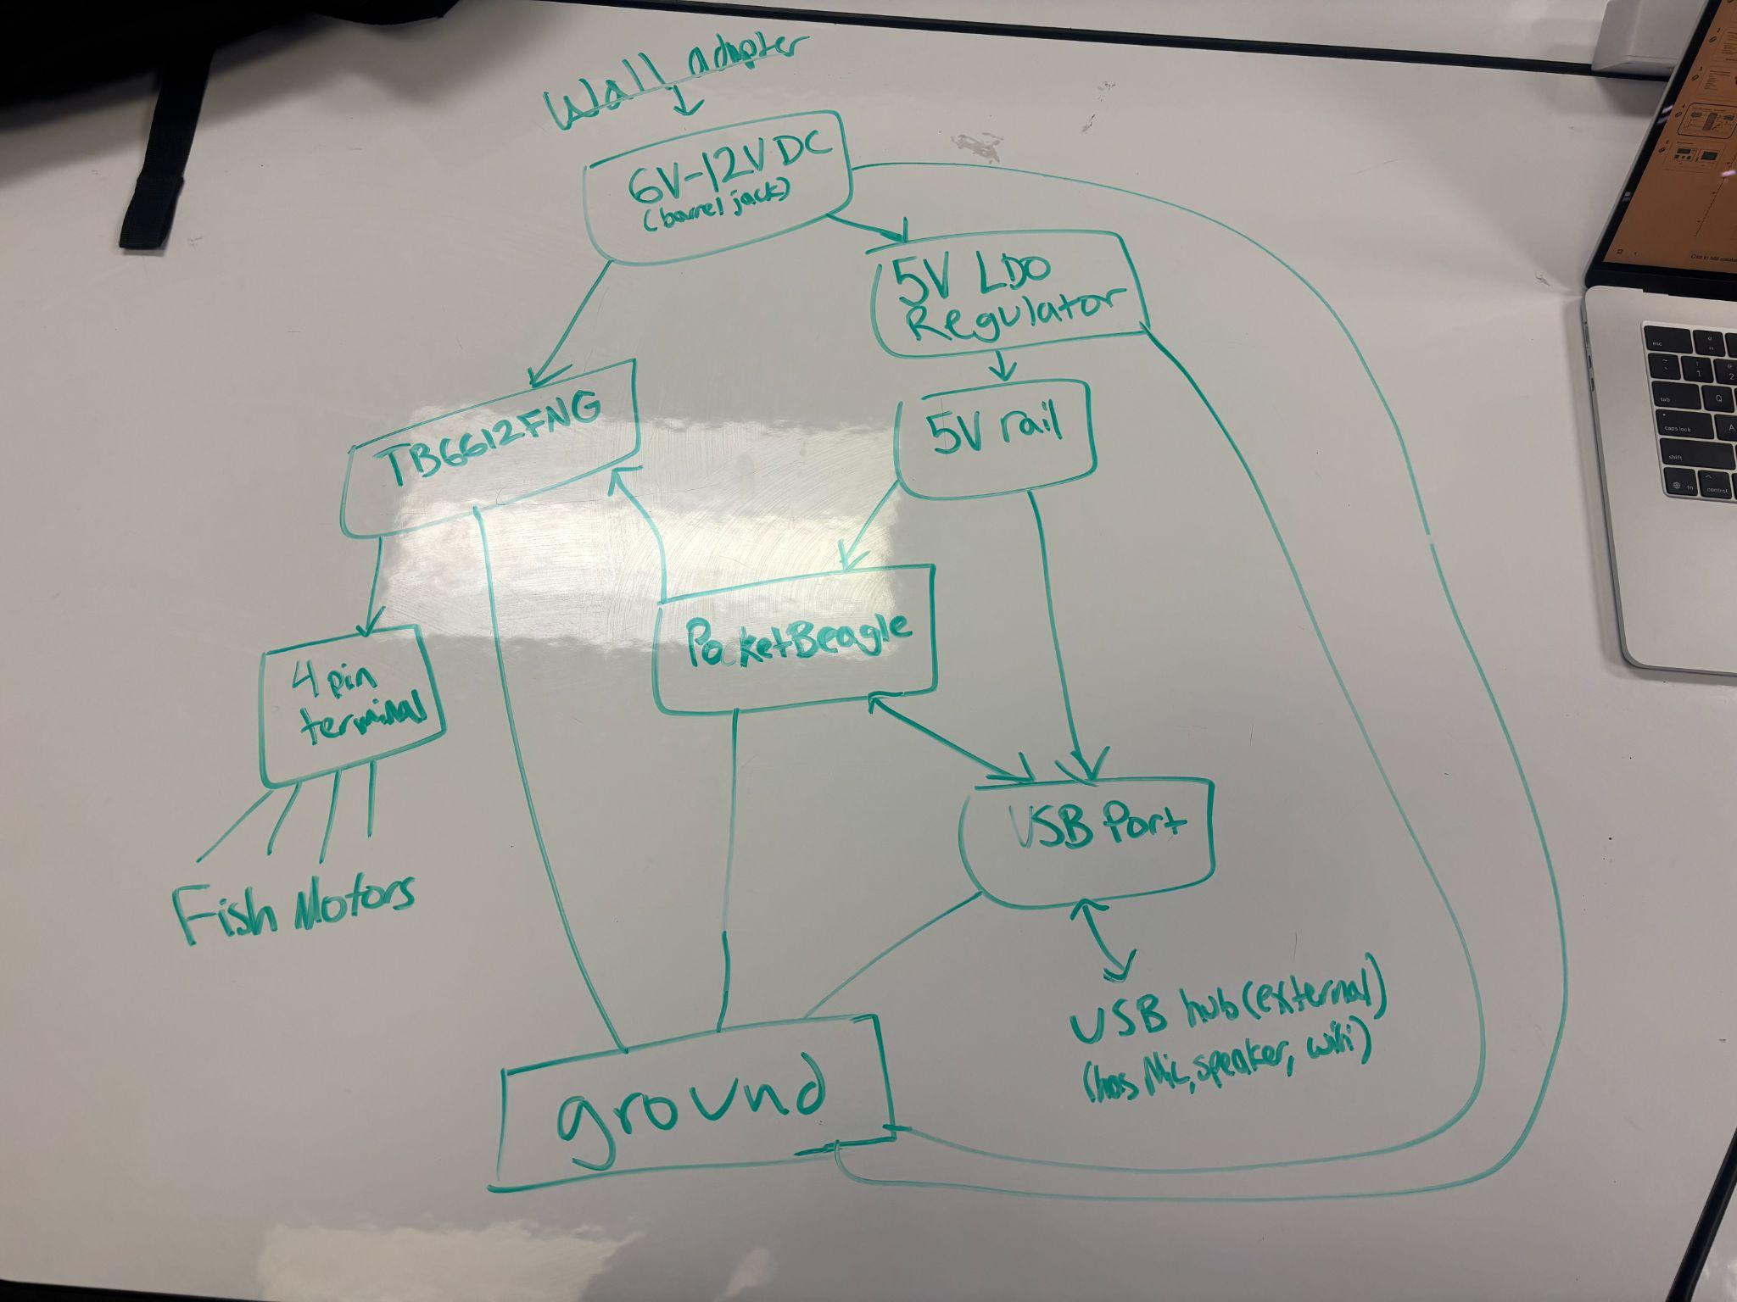
System Block Diagram – Talking Fish Assistant

Slide 4
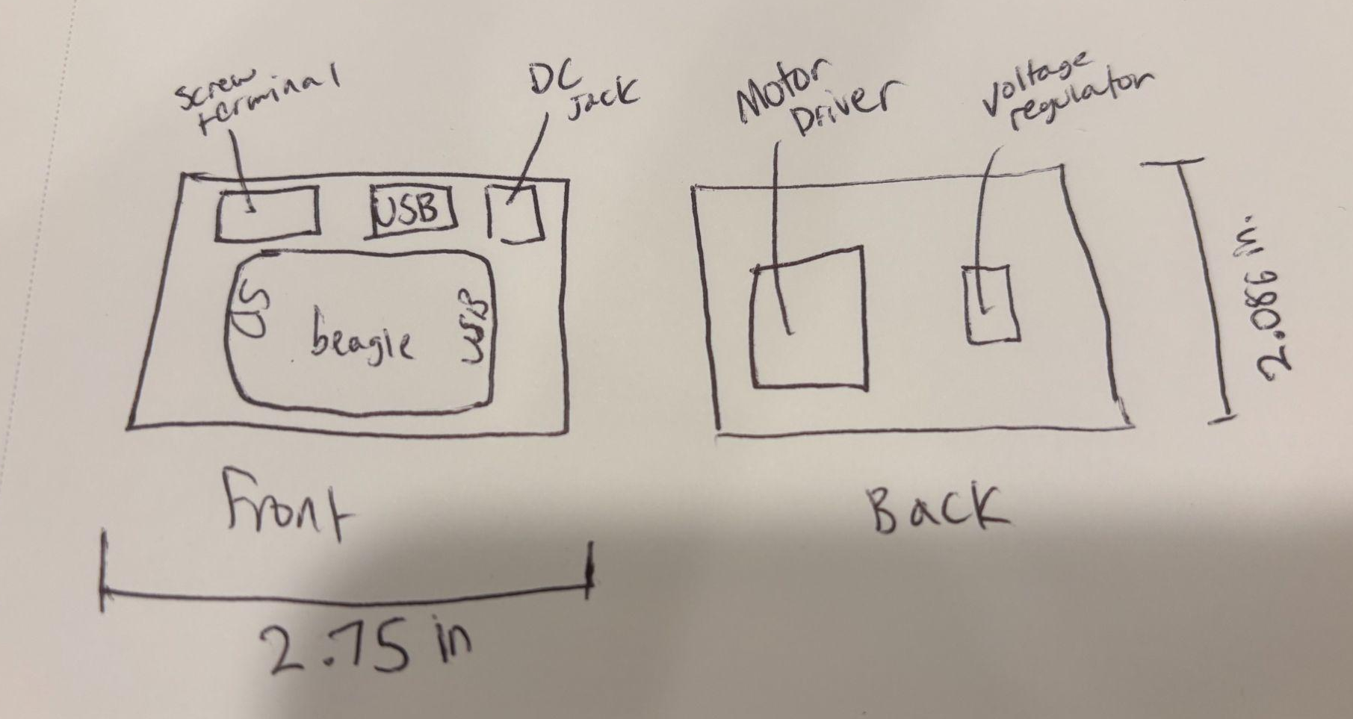
Mechanical Drawing

