Slide 1

Recomposing Conformance Checking
Wai Lam Jonathan LEE
Supervisor: Professor Jorge Munoz-Gama
Notes:
TODO:
- Add navigation bar at the bottom of slides

Slide 2
Outline
Alignment-based conformance checking (High level)
Alignment-based conformance checking (Trace level)
Performance issues with monolithic approach
Divide-and-Conquer (High level)
Merging subalignments
Total Border Agreement Theorem
Overview of the Recomposing Conformance Checking framework
Experimental results
Use cases that focus on getting tight fitness intervals, can showcase this by MaxConflicts experiments
Issue 1: Number of recomposition steps + initial decomposition as bottlenecks
Intuition of what causes border agreement issues
Where we go from here?

Slide 3

Theoretical framework: Conformance
mismatches
Log trace
model
Notes:
We can visualize conformance checking by a model and a sequence of recorded events for a particular case also known as a log trace.
In particular, we are comparing the two by aligning the log trace with the closest matching path permitted by the model. (animation).
This is in essence checking whether if “what we think is happening” matches up with “what really is happening”. (animation).
Often the reality deviates from the model and in this case, the alignment would pinpoint exactly where the mismatch is occurring and this would prompt further analysis for its cause. In a real life application such as conformance checking for a new credit card application process, a deviation might be indicating misconducts such as employees not following bank protocols fully. It could also be something to do with the bank protocol not considering exceptional scenarios that occur in reality.
Either way, whether it is with the intention of identifying deviating cases or evaluating the quality of process models on describing the reality. Being able to compute a globally optimal alignment with detailed diagnosis on deviations is important and useful for improving processes. Next we look at how deviation can be visualized in an alignment.

Slide 4
Outline
What is Process Mining?
Theoretical framework
Problem
Research questions
Proposed solution
Limitations
Contributions
Current state of investigation
Notes:
This is the outline for the presentation.
I will first give a brief introduction to the research of Process Mining. Then I will present the involved concepts of the theoretical framework. Following this, I will present the research questions, the proposed solution, its limitations and contributions. Finally, I will end the presentation with a report on the current state of research.

Slide 5
Process Mining
Driven by process models
1. van der Aalst, W. M. (2016). Process mining: data science in action. Springer.
Notes:
Processes are everywhere. A process can be defined as a set of actions or activities that occur over time and are related to each other by a common goal.
In particular, we can find processes in companies, universities and governmental institutes. For example, when you go to a bank to apply for a new credit card, the bank employee would probably walk you through filling in different forms, then after receiving your information, some other bank employee would check your information and credits before approving or rejecting your application. This sequence of activities carried out in a credit card application can be described using a process model.
Process models are used to describe and reason about processes. In many organizations, process models are used to manage their business processes.

Slide 6
Process Mining
Driven by process models
Managed by information systems
1. van der Aalst, W. M. (2016). Process mining: data science in action. Springer.
Notes:
To keep track of all the information from the execution of processes, information systems are used. Whereas previously, information might be managed through paper documents, in today’s organizations, most are supported and controlled by enterprise software.

Slide 7
Process Mining
Driven by process models
Managed by information systems
Past process executions as “footprints”
1. van der Aalst, W. M. (2016). Process mining: data science in action. Springer.
Notes:
Since information systems record all the events executed during a process, we can find an immense amount of event data on both historical or ongoing process instances. As such, these event logs extracted from information systems can be seen as “footprints” left behind by the execution of the process.
Taking a data-driven attitude, the goal of process mining is to use these event data to improve processes.

Slide 8
Process Mining
Find real process models
Compare model and log
Enrich process models
1. van der Aalst, W. M. (2016). Process mining: data science in action. Springer.
Notes:
In particular, there are three main applications:
1. From the event log, a process model can be discovered automatically by observing the recorded events
2. If both a process model and event logs are available, one can compare the reality from the observed events with the model. One main goal of this comparison is to identify points where reality deviates from the model.
3. Lastly, the information extracted from the event data can be used to enhance a process model. For example, predicting remaining time for ongoing cases based on historical event data.
My research focuses on the second application: conformance checking.

Slide 9

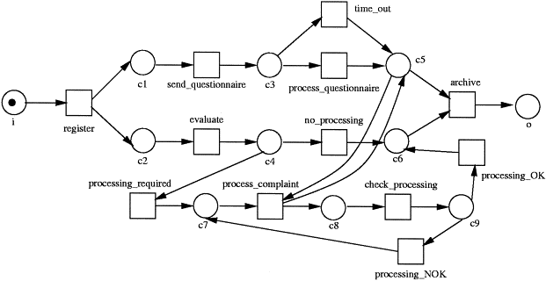
Theoretical framework: Alignment
Log
Model
Mismatch at the Log
Alignment ⁶
A B B C
E
A B
C D E
Fitness ⁴
Precision ⁵
Mismatch on the Model
How much behavior of the log
is captured by the model?
How accurate is the model
describing the log?
4. Adriansyah, A. et al.. Conformance checking using cost-based fitness analysis. In Enterprise Distributed Object Computing Conference (EDOC), 2011
5. Adriansyah, A. et al. (2015). Measuring precision of modeled behavior. Information systems and e-Business Management, 13(1), 37-67.
6. Van der Aalst, W. et al. (2012). Replaying history on process models for conformance checking and performance analysis.
Notes:
Say we have the sequence of activities for a particular case as ABBCE and we have identified that the closest matching path permitted by the model as ABCDE.
We would align the two like this (animation).
We see that the letter of the top row matches the letter of the bottom row and when this is not possible, an arrow symbol is used to indicate a mismatch. A mismatch can be at the log where there is a step required by the model but was not executed. A mismatch can also be at the model where there is a step observed in the log but is not included in the model.
We can also ask further questions related to different dimensions. For example we can ask how much behavior of the log is captured by the model or how precisely does the model describe the log.

Slide 10
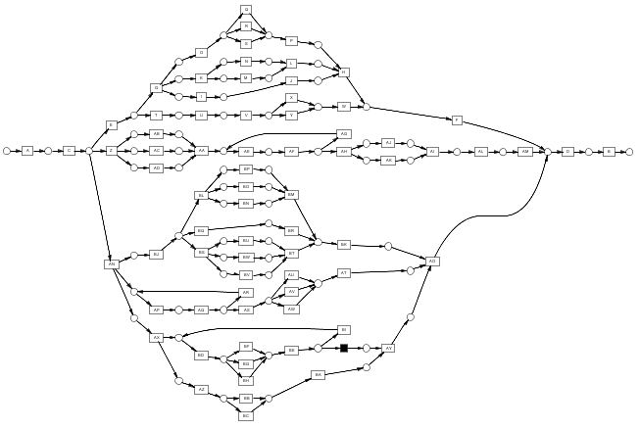
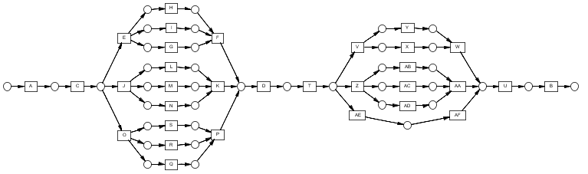
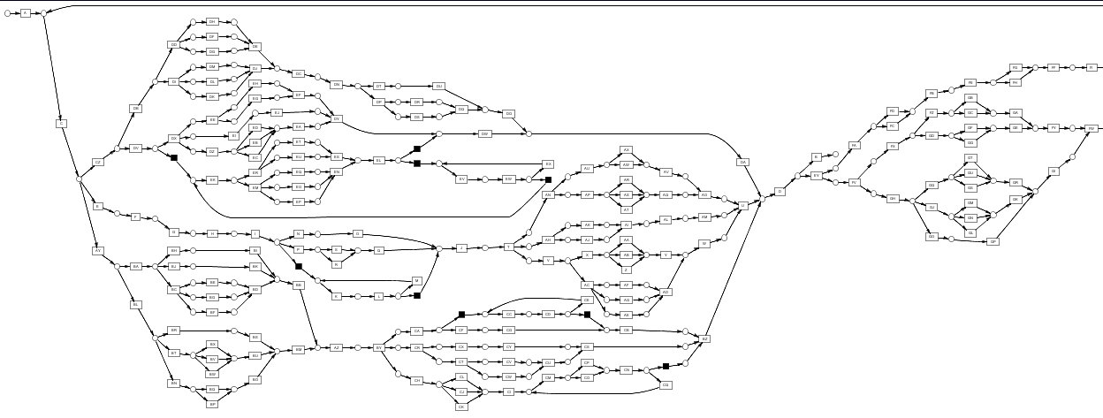
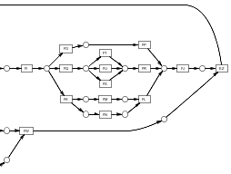
Problem: Conformance in the large
How much time does it take?
Notes:
But, an important question is how much time does alignment take.
While for a small model such as this one, it might take very little time. However, as alignment time scales worse than linear with regards to the number of activities and process complexity, for large and complex models such as this one, alignment is very time consuming. Therefore, there is a need to make alignment techniques more scalable in order to apply it to real processes that are large and complex.

Slide 11
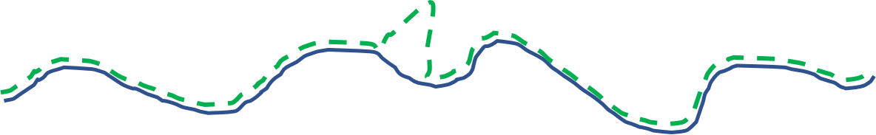
Proposed solution: Divide and conquer
Notes:
One way to make alignment-based conformance checking more scalable is to apply divide and conquer strategies.
Say we would like to arrive at the following alignment where the green trace is the log trace as observed in the event log and the blue trace is the closest matching path permitted by the model.
Instead of trying to compute this alignment by considering the whole process, we first decompose both the net and log trace into subcomponents. Aligning sub log trace with sub models would give these subalignments.
Afterwards, we would join these subalignments together to arrive at the desired alignment.
As such we are able to decompose the problem and merge solutions to subproblems as an overall solution.

Slide 12
Research questions
Under what conditions can we merge subalignments from subcomponents to get an exact overall alignment?
Is conformance checking faster?
How to decompose processes to maximize performance gains?
Extending decomposed alignments to other process modelling notations and data-aware process models.
Notes:
Concretely, our research questions are as follows:
Under what conditions can we merge subalignments from subcomponents to get an exact overall alignment?
How to decompose processes to maximize performance gains?
Extending decomposed alignments to data-aware process models.

Slide 13
Four main challenges
Complete
Time
Decomposition strategies
Multi notations + perspectives
Notes:
We can evaluate this idea with regards to three challenges:
What sort of guarantees does the decomposition technique offers? And more importantly can we guarantee that the merged alignment corresponds exactly to the alignment that we would have gotten under the monolithic or overall approach?
Is the decomposition approach faster than the monolithic or the overall approach?
How to decompose the overall model and log?
A wide range of process modelling notations are used, in order to make decomposition techniques widely applicable, there is a need to extend the techniques to other process modelling notations as well. Furthermore, in the current examples, we have only considered the order of executions of activities, there are other data related to the process such as organizational data such as resources or numerical values associated with activities such as price or cost.
We first look at the guarantees offered by the decomposition approach.

Slide 14
A note on decomposition techniques…
Decomposition is not a new idea^{2, 3, 7, 8, 9, 10}
Focuses on decision problem
Current techniques is not a complete solution
2. Munoz-Gama, J., Carmona, J., & Van Der Aalst, W. M. (2014). Single-entry single-exit decomposed conformance checking. Information Systems, 46, 102-122.
3. Van der Aalst, W. M. (2013). Decomposing Petri nets for process mining: A generic approach. Distributed and Parallel Databases, 31(4), 471-507.
7. De Leoni, M., et al. Decomposing alignment-based conformance checking of data-aware process models.
8. Van Der Aalst, W. M. Decomposing process mining problems using passages.
9. Van Der Aalst, W. M. A general divide and conquer approach for process mining.
10. Wang, L., Du, Y., & Liu, W. (2016). Aligning observed and modelled behaviour based on workflow decomposition. Enterprise Information Systems, 1-21.
Notes:
Before presenting details of our proposed solution that addresses the challenges, there is a need to give a note about the application of decomposition techniques for alignment-based conformance checking. The application of decomposition techniques is not a new idea in itself, there are a few existing work on the application of decomposition techniques. However, one common point about existing decomposition techniques is that they are not focused on giving a complete solution where the merged subalignment corresponds exactly to the alignment that we would have gotten under the monolithic approach. Instead, existing techniques are focused on the decision problem of whether if there is a deviation and the identification of problematic areas at a subcomponent level.
Our proposed solution addresses directly the original problem of aligning reality as observed from recorded events with the closest matching path permitted by the model. There are many scenarios where this global exact evaluation is required. For example, existing decomposition techniques cannot provide any guaranteed diagnosis to questions such as at which point does a case deviates with respect to the overall process or compare the quality of two models in describing the reality as observed by the recorded events.

Slide 15
Four main challenges
?
Complete
Time
Decomposition strategies
Multi notations + perspectives
Notes:
We can evaluate this idea with regards to three challenges:
What sort of guarantees does the decomposition technique offers?
Is the decomposition approach faster than the monolithic or the overall approach?
And does the decomposition approach give a complete solution such the recomposed alignment is the same as the alignment given by the monolithic approach?
We first look at the guarantees offered by the decomposition approach.

Slide 16
Proposed solution: Border agreement
Log
Model
Alignment
A B B C
E
A B
C D E
C
C
Notes:
The idea is that we can merge subalignments together to get an exact overall alignment if the borders of subalignments are in agreement.
Say we have the log trace ABBCE and the closest path permitted by the model as ABCDE and we would like to align the two traces in a decomposed manner.
First rather than trying to align the two traces as a whole, we split the two traces on a selected border activity, such as activity C.
Then we align the two sets of subtraces separately as such.
And the idea is that we notice that the moves associated to activity C of the two subalignments are the same and therefore in agreement. This means that we can merge the subalignments together without conflict to get an overall alignment.

Slide 17
Proposed solution: Border agreement
Log
Model
Alignment
A B B C
E
A B
C D E
Border agreement allows merged subalignments to correspond to the exact overall solution
Notes:
Coincidentally, this corresponds to the desired overall alignment that we would have gotten if we were to align the two traces without decomposition.

Slide 18
Proposed solution: Border agreement
Log
Model
Alignment
A C B
A
B
C
C
D E
C D E
Notes:
However, moves corresponding to border activities might not be always in agreement. Consider the log trace ACBDE and its closest path permitted by the model as ABCDE. Same as before we decompose the traces before aligning the subtraces as two subalignments. We notice that the moves corresponding to the border activity C are not in agreement because activity B and C are swapped in the first log trace which results in mismatches and since activity B is not in the second set of traces, this mismatch is not detected. This means that the two subalignments cannot be merged as one.

Slide 19
Proposed solution: Border agreement
Log
Model
Alignment
A C B
A B
C D E
D E
Solve border agreement issue by merging on problematic activity
Notes:
Our current solution to such border agreement issue is to simply merge the log trace and model trace on the problematic border activity and redo the alignment with the merged traces. In this case, it would be the same as aligning the traces without decomposition.

Slide 20
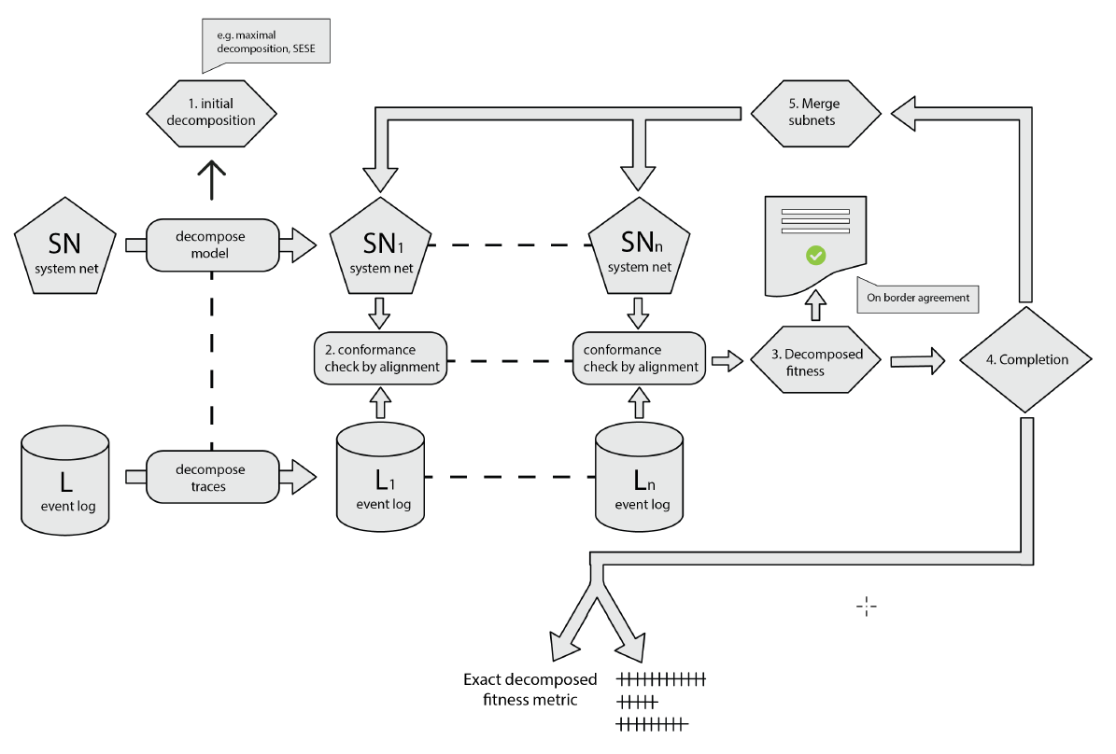
Proposed solution: Recomposition framework
Notes:
Having defined border agreement as the condition under which subalignments can be merged as an optimal overall alignment and the solution to resolve border agreement issues, we designed an iterative framework where given a pair of process model and event log, we first decompose the two into a set of n subcomponent pairs, then we would align each of the subcomponent pair separately and then try to merge the resulting subalignments if they fulfill the border agreement condition.
Those that do fulfill the condition are saved and for those that do not fulfill the condition, we try to resolve the border agreement issues by merging the subtraces and submodels upon problematic border activities before iterating through the alignment process again.
Once all the traces have been aligned, we output the results.

Slide 21

Four main challenges
Complete
Time
Decomposition strategies
Multi notations + perspectives
?
Notes:
We can evaluate this idea with regards to three challenges:
What sort of guarantees does the decomposition technique offers?
Is the decomposition approach faster than the monolithic or the overall approach?
And does the decomposition approach give a complete solution such the recomposed alignment is the same as the alignment given by the monolithic approach?
We first look at the guarantees offered by the decomposition approach.

Slide 22
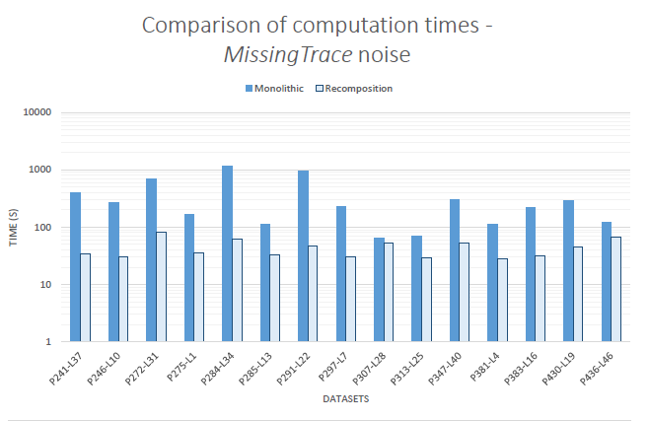
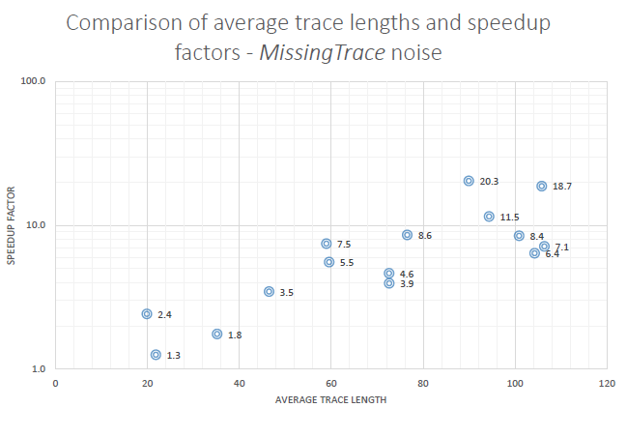
Proposed solution: Time
Better performance with large and complex processes while retaining result quality
Notes:
We have implemented the proposed framework in ProM which is an open source framework for research in Process Mining and have conducted experiments using the framework.
The following two charts compares the performance in alignment and the computation of conformance metrics under the proposed recomposition approach and the monolithic approach on a set of 15 synthetic datasets injected with noise. Each dataset is a pair of process model and an event log with 1000 cases.
The bar chart on the right shows the computation time under both approaches with time in seconds and at a logarithmic scale. We can observe:
The recomposition approach is significantly faster than the monolithic approach for all datasets
If we then computed the speedup of the recomposition approach over the monolithic approach, we would get the chart on the left. The x axis is the average trace lengths of the datasets which serves as an indicator of size and process complexity. The y axis is the speedup factor shown in a logarithmic scale. For example, a speedup of 2.4 means that the recomposition approach is 2.4 times faster than the monolithic approach. We can see that the performance gains from adopting the recomposition approach increases as the datasets get more complex.

Slide 23
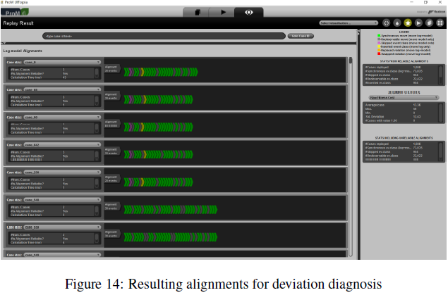
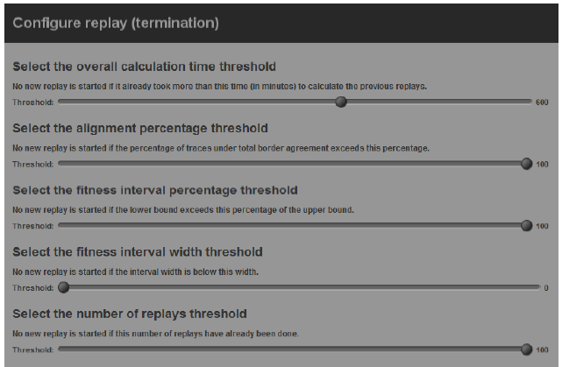
Implementation
Implemented in ProM (open source process mining software)
Notes:
These are two screenshots of our implementation at the ProM framework.
The right is a screenshot of a dialog where the user can configure different parameters such as the threshold for the overall calculation time. The left is a screenshot of the resulting alignments for each case in the event log.

Slide 24
Four main challenges
Complete
Time
Decomposition strategies
Multi notations + perspectives
?
?
Notes:
Therefore, our current results have provided insights to the first two challenges of the application of decomposition techniques to alignment-based conformance checking. Next we will be looking into how to resolve the following two challenges and others that might emerge during the process.

Slide 25
Proposed solution: Limitations
No control over “border agreement”
Decomposition strategy has a significant impact on performance
Conformance metric is now a bottleneck to performance
Notes:
There are three major limitations to the recomposition framework.
Subcomponents might never reach border agreement so that the solutions on the subcomponent level can be merged to correspond to the exact overall solution. We are now trying to give more control over this through techniques that encourage border agreements.
The choice of decomposition strategy has a significant impact on performance where an inappropriate decomposition strategy might actually result in slower time. We have yet to conduct a study to investigate this aspect.
Having significantly improved the performance of the alignment process, we find that the computation of conformance metrics is now a bottleneck so that computing metric values takes a long time. This motivates our current work on introducing new conformance metrics.

Slide 26
Proposed solution: Contributions
Alignment-based conformance checking identifies deviations
A complete solution to the application of decomposition techniques
Increases applicability to industrial-sized processes
Addressing an area of interest in both academic field and industry
Notes:
In summary, our proposed framework contributes to alignment-based conformance checking which is used to identify deviations between process models and how the process is actually executed.
Our proposed framework gives a complete solution so that decomposition techniques can be applied to compute an exact overall solution.
Since the decomposition of the problem results in faster times, this increases the applicability of alignment-based conformance checking to industrial-sized process
Last but not least, conformance checking is an area of interest in both the academic field and the industry.

Slide 27
Current state of investigation
Tasks | 2016-1 | 2016-2 | 2017-1 | 2017-2 | 2018-1 | 2018-2 | 2019-1 | 2019-2 | 2020-1
Literature review
Start doctorate program
Recomposition approach + journal paper
Conformance metric issues + conference paper
Extension to other process modeling notations
New decomposition strategies
Notes:
To wrap up I present the current state of investigation.
I officially started the doctorate program in the second semester of 2016 but we have been doing research for a little over a year and we are now on the verge of sending a paper on our results. Also as mentioned, one limitation that we found is in the computation of conformance metrics, we have been working on this and we are writing up the related solution to be sent.
The next stage will be on extending to other process modeling notations and investigating new decomposition strategies.

Slide 28
Current state of investigation
Tasks | 2016-1 | 2016-2 | 2017-1 | 2017-2 | 2018-1 | 2018-2 | 2019-1 | 2019-2 | 2020-1
Candidate exam
Oversea internship
Decomposed alignment for data-aware process models
Defense
Notes:
I will also be doing the candidate exam in 2018-1
Then I will do an oversea internship in 2018-2 and work on extending decomposed alignment to data-aware process models and the defense will be at 2020-1.

Slide 29
End

Slide 30
References
van der Aalst, W. M. (2016). Process mining: data science in action. Springer.
Munoz-Gama, J., Carmona, J., & Van Der Aalst, W. M. (2014). Single-entry single-exit decomposed conformance checking. Information Systems, 46, 102-122.
Van der Aalst, W. M. (2013). Decomposing Petri nets for process mining: A generic approach. Distributed and Parallel Databases, 31(4), 471-507.
Adriansyah, A., van Dongen, B. F., & van der Aalst, W. M. (2011, August). Conformance checking using cost-based fitness analysis. In Enterprise Distributed Object Computing Conference (EDOC), 2011 15th IEEE International (pp. 55-64). IEEE.
Adriansyah, A., Munoz-Gama, J., Carmona, J., van Dongen, B. F., & van der Aalst, W. M. (2015). Measuring precision of modeled behavior. Information systems and e-Business Management, 13(1), 37-67.
Van der Aalst, W., Adriansyah, A., & van Dongen, B. (2012). Replaying history on process models for conformance checking and performance analysis. Wiley Interdisciplinary Reviews: Data Mining and Knowledge Discovery, 2(2), 182-192.

Slide 31
References
De Leoni, M., Munoz-Gama, J., Carmona, J., & van der Aalst, W. M. (2014, October). Decomposing alignment-based conformance checking of data-aware process models. In OTM Confederated International Conferences" On the Move to Meaningful Internet Systems" (pp. 3-20). Springer Berlin Heidelberg.
Van Der Aalst, W. M. (2012, June). Decomposing process mining problems using passages. In International Conference on Application and Theory of Petri Nets and Concurrency (pp. 72-91). Springer Berlin Heidelberg.
Van Der Aalst, W. M. (2013, September). A general divide and conquer approach for process mining. In Computer Science and Information Systems (FedCSIS), 2013 Federated Conference on (pp. 1-10). IEEE.
Wang, L., Du, Y., & Liu, W. (2016). Aligning observed and modelled behaviour based on workflow decomposition. Enterprise Information Systems, 1-21.

