Slide 1
If you recall, biscuit conditionals are weird.
JWLLP 31 16th December 2022
Jakob Prange Hong Kong Polytechnic University
Many thanks to Elena Herburger, Georgetown University

Slide 2
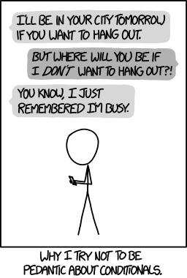
WRONG RESPONSE!
But there is a response system involved here!
There are biscuits on the sideboard
if you want them.
– J L Austin, 1961
https://xkcd.com/1652

Slide 3
Outline
The two types of conditionals and their functions
Two attempts at a unifying mechanism
How many types are there, really?
A hearer-focused account

Slide 4
Two types of conditionals and their functions

Slide 5
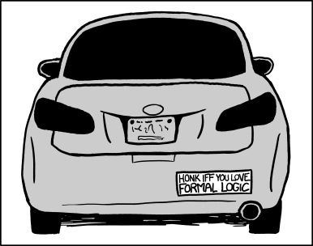
https://xkcd.com/1033

Slide 6
Two types of conditionals
Genuine conditional (GCs)
Non-conditional conditionals (NCCs)
Logical, standard, “normal”
“If … then …”
Truth-functional
Well, they’re weird.
“If” doesn’t mean “if”?
Not really about truth?
But what, then, are they about?
p | q | p → q
T | T | T
T | F | F
F | T | T
F | F | T

Slide 7
Geis & Lycan (1993): Functional & Descriptive Properties
Properties of Genuine Conditionals
A: can add "then" to consequent without change in meaning
B: can add "only" to antecedent
C: consequent inferable from antecedent + contextual assumptions
D: Contraposition and Modus Tollens hold
E: Equivalence to disjunction holds
F: can be put in subjunctive / counterfactual with similar meaning
G: intuitively conditional
H: antecedent and consequent are not asserted, but entire sentence is asserted (as opposed to conditional assertion of consequent)
NCCs do not have these properties!
Genuine conditionals and NCCs are on a spectrum
NCCs *usually* do not have *most of* these properties, while GCs *usually* do have *most* of them

Slide 8
Geis & Lycan (1993): Functional & Descriptive Properties
Function of GCs: Convey conditional dependency between p and q
Function of NCCs: Convey q, with p as felicity/relevance condition or face-threat mitigation

Slide 9
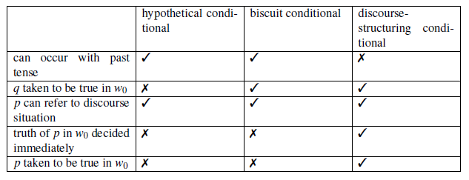
Csipak (2014): Discourse-structuring Conditionals
NCC
GC
If you promise not to tell anyone, Kirsten is asleep.

Slide 10
Conditionals around the World
Chinese
如果
那
If
Then
If- result
In-accordance-with- result

Slide 11
Conditionals around the World
German
Wenn
Dann
If
Then
Also: “when”

Slide 12
Conditionals around the World
If you fail an exam, you have to repeat a year. 如果你考試不及格, 就得重讀一年。 Wenn du eine Prüfung nicht bestehst, musst du ein Jahr wiederholen.
If you think of going anywhere tomorrow, let me know. 如果你明天想上哪兒去，就跟我說一聲。 Wenn du vorhast morgen auszugehen, sag bescheid.
If you think of going anywhere tomorrow, I’m available. 如果你明天想上哪兒去，我有时间。 Wenn du vorhast morgen auszugehen, ich habe Zeit.
Explicit speech act consequent
Biscuit

Slide 13
Conditionals around the World
If you fail an exam, (then) you have to repeat a year. 如果你考試不及格,(那)就得重讀一年。 Wenn du eine Prüfung nicht bestehst, (dann) musst du ein Jahr wiederholen.
If you think of going anywhere tomorrow, (?then) let me know. 如果你明天想上哪兒去，(?那)就跟我說一聲。 Wenn du vorhast morgen auszugehen, (?dann) sag bescheid.
If you think of going anywhere tomorrow, (#then) I’m available. 如果你明天想上哪兒去，(#那)我有时间。 Wenn du vorhast morgen auszugehen, (#dann) habe ich Zeit.

Slide 14
German (and Dutch) Word Order
Standard main clause order: V2
Wenn du eine Prüfung nicht bestehst, musst du ein Jahr wiederholen. If you fail an exam, must you a year repeat
Biscuit word order
# Wenn du vorhast morgen auszugehen, habe ich Zeit. If you think of going anywhere tomorrow, have I time
Wenn du vorhast morgen auszugehen, ich habe Zeit. I have time

Slide 15
German (and Dutch) Word Order
Davison (1983): Word order triggers biscuitness.
Kroeger (2022): Biscuit antecedent is not a constituent of the main clause at all; it attaches to some higher node in the sentence.
Csipak (2015, 2017): Speaker preference, not grammaticalized.

Slide 16
Two attempts at a unifying mechanism
We not only need to explain each type of conditional separately, but also describe a mechanism by which they can be distinguished during on-line processing.

Slide 17
DeRose & Grandy (1999): Unification as Conditional Assertion
Indicative non-biscuit conditionals do not assert “if p then q” since this does not have a truth value and hence is not assertible.
Rather, ALL indicative conditionals, biscuit or not, are conditional assertions.

Slide 18
DeRose & Grandy (1999): Unification as Conditional Assertion
Assertion of Conditional
Conditional Assertion
if p: assert q
assert (q if p else True)
assert (not p or q)
else: pass

Slide 19
DeRose & Grandy (1999): Unification as Conditional Assertion
Unified through as single semantico-pragmatic mechanism
Thus, no need to distinguish separate types
Problematic for non-biscuit conditionals, because antecedent’s truth value is unknown at time of utterance
So it would have to be counterfactual/future conditional assertions
If p was known and p were T, Speaker would assert q Once p turns out to be T, Speaker will assert q
If p was known and p were F, Speaker would not assert q If p turns out to be F, Speaker will not assert q
Biased towards NCCs

Slide 20
Csipak (2017): Unification as Truth-Semantic
Truth-functional conditional
Antecedent and consequent are conditionally dependent
yes
no
Truth-functional conditional is asserted
Hearer wonders why speaker used conditional construction nonetheless
Hearer concludes that speaker is uncertain about antecedent
Pragmatic inference
Hearer further concludes that, since antecedent and consequent are conditionally independent, speaker must have independent evidence for consequent.
NCC
Consequent is asserted

Slide 21
Csipak (2017): Unification as Truth-Semantic
Truth-functional conditional
Antecedent and consequent are conditionally dependent
yes
no
Truth-functional conditional is asserted
Hearer wonders why speaker used conditional construction nonetheless
Hearer concludes that speaker is uncertain about antecedent
Hearer concludes that speaker is uncertain about consequent
Pragmatic inference
Hearer further concludes that, since antecedent and consequent are conditionally independent, speaker must have independent evidence for consequent.
Hearer further concludes that, since antecedent and consequent are conditionally independent, speaker must have independent evidence for falsity of antecedent.
p | q | p → q
T | T | T
T | F | F
F | T | T
F | F | T
NCC
Consequent is asserted
Antecedent is denied

Slide 22
Csipak (2017): Unification as Truth-Semantic
Unified at semantic level
Distinction between different types is multi-step pragmatic inference
Predicts function of NCCs to be assertion of consequent + assertion of uncertainty about antecedent?
Mechanism for deducing the latter demands too much from the hearer
Biased towards GCs

Slide 23
How many types are there, really?

Slide 24
How many types are there, really?
Genuine conditional
If you fail an exam, you have to repeat a year.
Explicit speech act consequent
If you think of going anywhere tomorrow, let me know.
Biscuit
If you think of going anywhere tomorrow, I’m available.
Discourse-structuring (Implicit speech act antecedent)
If you promise not to tell anyone, Kirsten is asleep.
Half Biscuit, Half Speech act?
If you don’t mind, I’m trying to read.
Reverse biscuit-speech-act?
If you recall, biscuit conditionals are weird
…
What about consequent-first clause order?

Slide 25
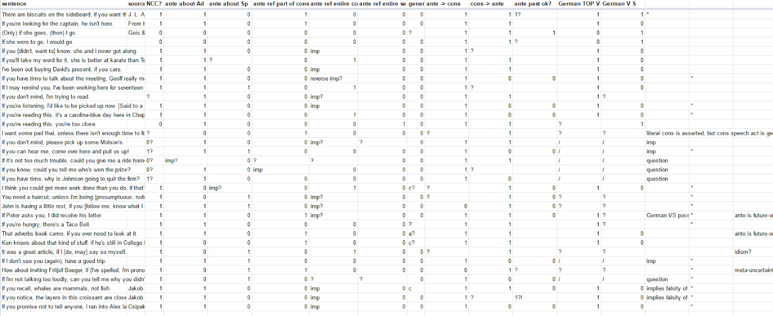

Slide 26
A hearer-focused account

Slide 27
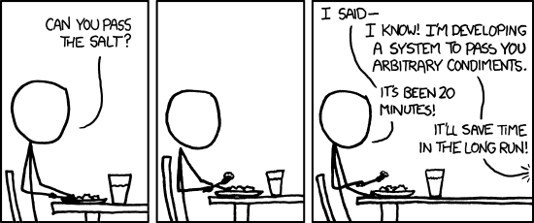
Yes.
Adapted from https://xkcd.com/974

Slide 28
Involving the hearer
Geis & Lycan, DeRose & Grandy, and Csipak all focus on truth (either objective or from the speaker’s perspective)
Csipak involves the hearer, but in a complicated and unnecessarily strenuous way (running through multiple steps of pragmatic inference to determine what is asserted)
Cannot account for consequents that are (explicit or implicit) non-assertion speech acts

Slide 29
Biscuit Antecedents as Questions
Felicity condition for question asking:
Hearer has immediate access to antecedent (knows or can change)
I claim: Biscuit and discourse-structuring antecedents have the exact same felicity conditions
If you’re thinking of going anywhere
→ Are you thinking of going anywhere?

Slide 30
Biscuit Consequents as Responses to Projected Responses
Response in the broad sense:
can be about knowing the truth (yes/no)
OR about acting upon the obvious truth
Rhetorical questions
OR about making things true
Implicit speech acts

Slide 31
Biscuit Consequents as Responses to Projected Responses
Antecedent: Are you thinking of going anywhere?
Response: Yes.
Consequent (response-to-projected-response): I’m available.
Note that this is really an implicit speech act!

Slide 32
Non-Biscuit Antecedents as Questions
Felicity condition of hearer accessibility not met
If you fail an exam
→ Do you fail an exam?

Slide 33
Unification as Projected Discourse
Hearer has immediate access to antecedent (knows or can change)
no
yes
Truth-functional conditional is asserted
NCC
knows (genuine question)
can affect (rhetorical question)
Antecedent is relevance
Antecedent is speech act
Consequent is speech-acted (speech act may or may not be assertion)

Slide 34
Unification as Projected Discourse
Unified at discourse level: Locutionary felicity conditions identical with asking antecedent as a question
Distinction mechanism uses familiar pragmatic shortcuts
Namely, the same ones used in distinguishing rhetorical from genuine questions
Does not predict consequent to be asserted in either case
In fact predicts it to usually not be asserted

Slide 35
Unification as Projected Discourse
Hearer has immediate access to antecedent (knows or can change)
no (requires reanalysis)
yes
Truth-functional conditional is asserted
NCC
knows (genuine question)
can affect (rhetorical question)
Antecedent is relevance
Antecedent is speech act
Consequent is speech-acted (speech act may or may not be assertion)

Slide 36
Summary & Directions
We inspected different types of conditionals, finding consistent patterns in English, Chinese, and German.
We reviewed two previous accounts trying to account for these differences and pointed out their shortcomings.
We proposed a new account focusing on the analogy between felicity conditions of biscuit conditionals and question-response patterns.
Next, this proposal needs to be tested empirically.

