Slide 1
Tornado onset from radar
Two experiments with a pretrained detector:
current-scan detection and short-horizon onset
Jake Van Slyke, Jeffrey Gregory
2026-10-15

Slide 2
The problem
• TorNet is a pretrained tornado detector: it reads radar features from the most recent observed scan.
• A good detection score is not, by itself, proof of an advance forecast.
• We asked two questions: can the detector be improved at its own task, and can its features predict the next +5 and +10 minutes?

Slide 3
Two studies, two questions
• Study A: Does a small adaptation improve tornado detection in the latest scan?
• Study B: Given the two oldest scans, can a new head predict tornado labels in the next two scans?
• These are parallel studies, not five successive steps in one controlled experiment.

Slide 4
The radar and the test sets
• TorNet v1.1 contains 203,133 storm-centered samples from 2013 to 2022.
• Each sample contains four scans, about five minutes apart, and a tornado label at every scan.
• Both studies use 2014–2015, but different splits, targets and metrics. Their scores cannot be directly ranked.

Slide 5
Study A: frozen features
• Jeffrey froze the published CNN and pooled each scan into 384 features.
• A 385-parameter linear head predicted tornado presence in the current scan.
• Three changes were compared independently with that baseline: history, hard negatives, and larger head capacity.

Slide 6
Study A: four configurations
configuration | one change from baseline | validation AP
one scan, linear head | trained baseline | 0.658 ± .005
two-scan average | add previous scan; same head | 0.675 ± .001
warned negatives ×2 | weight hard-negative training cases | 0.656 ± .005
current scan, MLP | use larger nonlinear classifier | 0.670 ± .007
Mean validation AP across seeds 42, 43, and 44. The selection rule chose two-scan averaging.

Slide 7
Study A: the held-out result
model | test AP | positives found | false alarms
released TorNet detector | 0.517 | 68 of 89 | 276
one-scan linear head | 0.508 | 70 of 89 | 571
two-scan mean, linear | 0.548 | 69 of 89 | 564
The history model ranked clips better, but the operating threshold produced many more false alarms.

Slide 8
Study A: what it says
• Test AP moved +0.031 over the released CNN, but the paired group-bootstrap interval was [−0.061, +0.155].
• It found one more positive clip and produced 288 more false alarms at similar test recall.
• History may help ranking; these results do not establish a reliable operational improvement.

Slide 9
Study B: the onset task
• Jake used the two oldest scans of each four-scan TorNet sample as the input.
• The pretrained encoder runs on each scan. Its spatial maps are concatenated and a new head predicts +5 and +10 minute labels.
• Run 1 froze the encoder. Run 2 fine-tuned it with a smaller learning rate.

Slide 10
Keeping the onset test honest
• A tornado visible in an input scan is not a meaningful advance-onset success.
• The evaluation retains pre-onset cases: both inputs labeled non-tornadic, final (+10 min) target tornadic.
• There are 495 selected cases; 208 were already positive at +5 minutes. Warned storms supply difficult negatives.

Slide 11
Study B: onset results
pre-onset WC AUC | +5 min | +10 min
detector, latest observed scan | 0.731 | 0.726
frozen encoder, new head | 0.699 | 0.710
fine-tuned encoder, new head | 0.724 | 0.728
detector, actual future scan | 0.769 | 0.797
The last row is a future-scan oracle reference, not a performance limit for all forecasting systems.

Slide 12
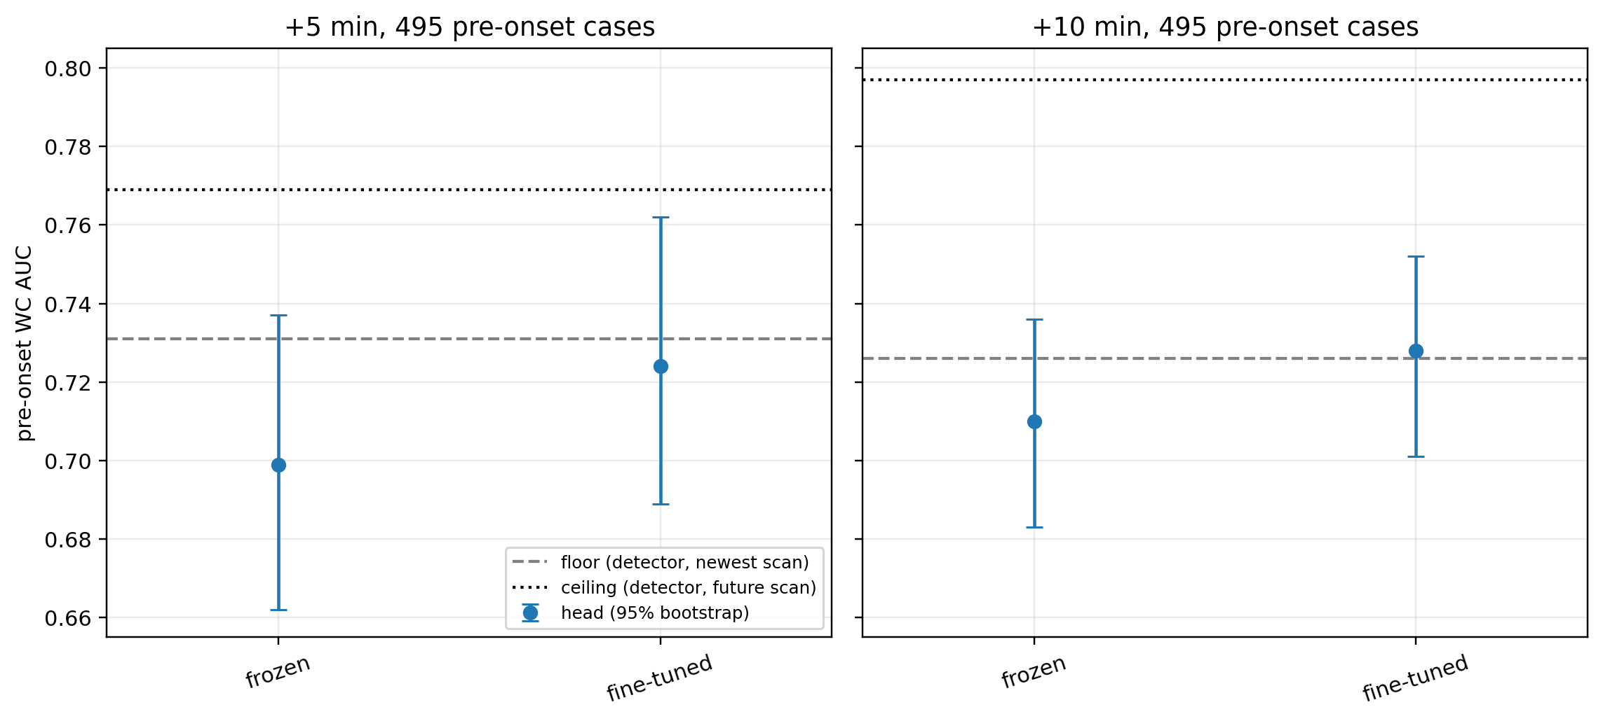
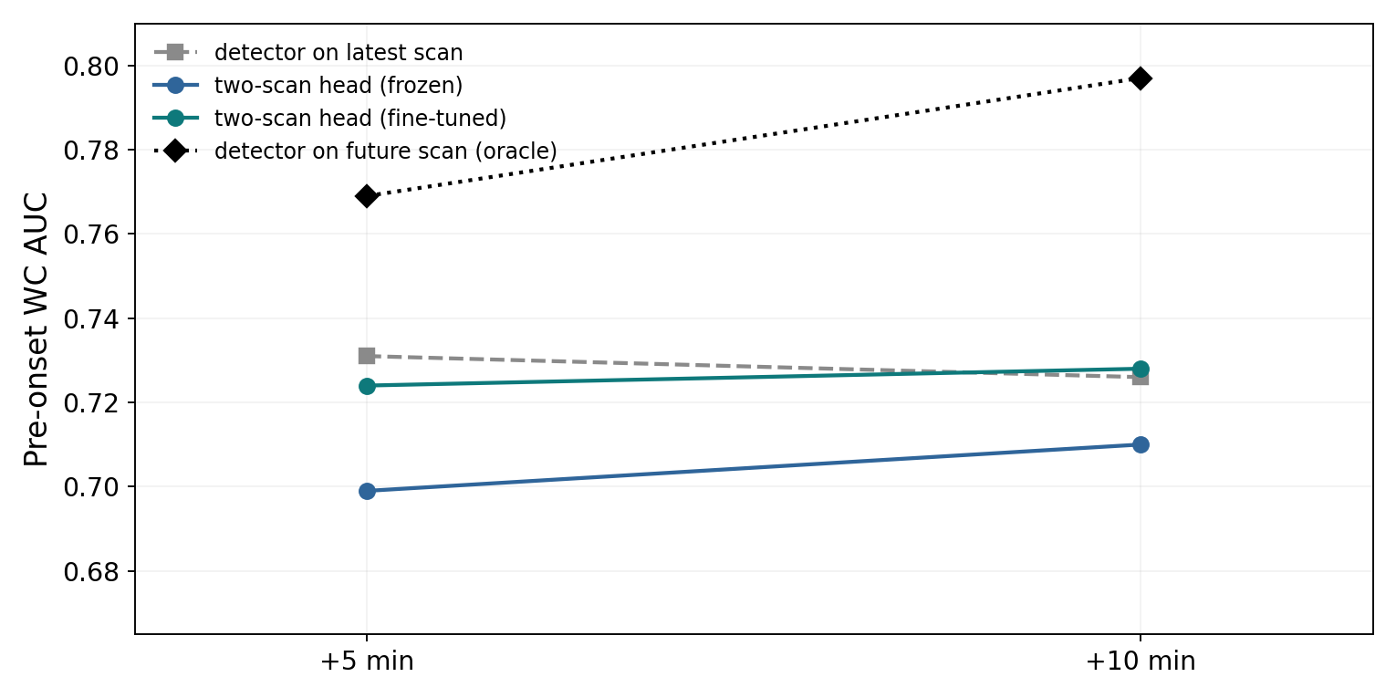
Study B: the picture

Slide 13
Study B: what it says
• With the encoder frozen, the onset head underperformed the latest-scan detector at both horizons.
• Fine-tuning recovered roughly the baseline: 0.724 versus 0.731 at +5; 0.728 versus 0.726 at +10.
• The apparent tie does not demonstrate additional lead-time information from this two-scan model.

Slide 14
What the references mean
• The persistence reference applies the released detector to the newest observed scan and compares it with a future label.
• The future-scan oracle feeds the detector radar measurements not yet observed. It is not a theoretical ceiling.
• The onset subset was selected using a future outcome; retrospective AUC is not measured deployment performance.

Slide 15
The limitations
• Study A tested only 10 storm groups; adjacent radar clips are correlated and pretraining-weather overlap cannot be excluded.
• Study B’s reported intervals resample individual clips, not independent storms; event-level uncertainty may be wider.
• Only 2014–2015 was examined, and the onset fine-tune had a five-epoch cap.

Slide 16
What we would test next
• Use longer storm histories and a temporal model that can learn how the radar changes.
• Hold out entire weather systems, and measure false alarms, recall and lead time on incoming storms.
• Re-run with more years and longer fine-tuning, keeping model selection separate from the final test.

Slide 17
The takeaway
• The released detector already discriminates some retrospectively selected storms before the final onset label.
• Our adapted detectors did not establish a better or more reliable way to use that information.
• The next experiment must test temporal information and independent storms, not just a different readout.

Slide 18
Sources and reproducibility
• Veillette et al., TorNet, Artificial Intelligence for the Earth Systems. DOI: 10.1175/AIES-D-24-0006.1
• MIT Lincoln Laboratory: github.com/mit-ll/tornet
• Team study: github.com/jwm-dev/deep-learning-tornet-team-project
• Jeffrey’s executed study: github.com/jwm-dev/tornet-transfer-learning

