Slide 1
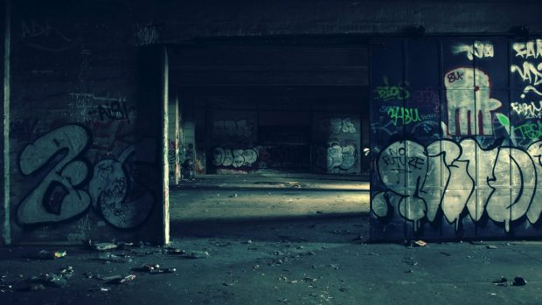
Web
Programming
201735839 서장원

Slide 2

Contents
1. Menu
2. Slide Show
3. MouseOver
4. Background Music

Slide 3


1
Menu
Before
After
The Frame previously was divided into 3 portions but it changed to be divided into 2 portions. Also Nav tag was added to the frame.

Slide 4
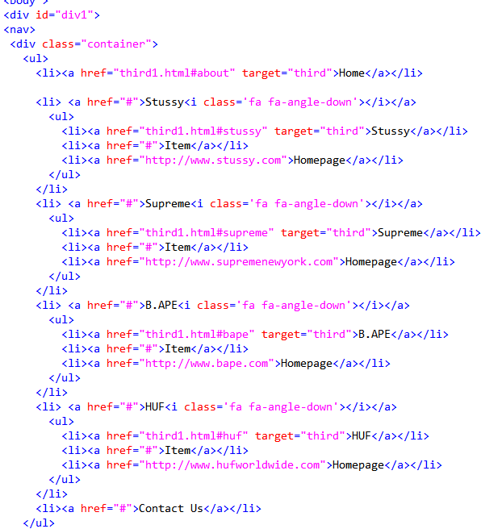
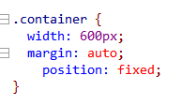
Main Nav Code
‘position:fixed’ above is an important tag to fix the nav tag even after scrolling down the page.
Also there are a lot of CSS tags for the Menu

Slide 5
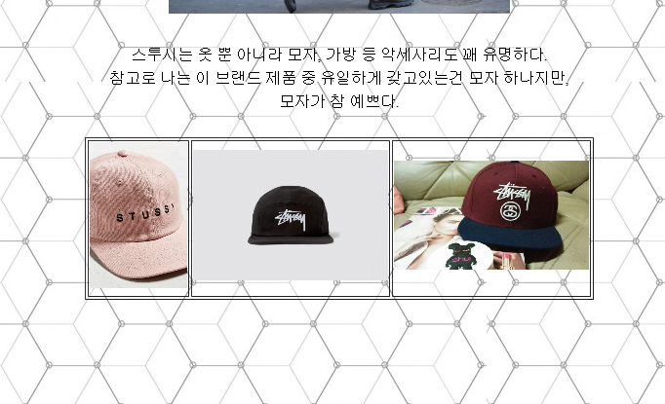

2
Slide Show
Before
Several pictures were shown simply in a table form but it was changed to show new pictures as time passes with the slide show effect.
After

Slide 6
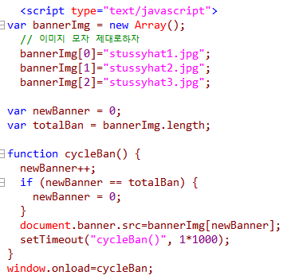

Each picture was put into an Array and each of them were created as 1 second passes.
Names are only brought into Body from the banner titles and previously selected pictures are put inside.

Slide 7
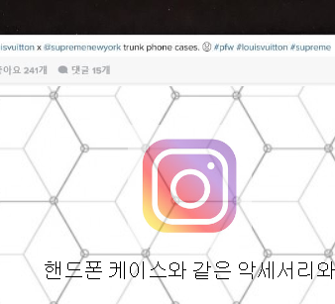
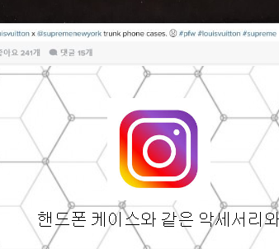
3
Mouse Over
There was just a Picture but instragram image and a link to the picture were added.
When the mouse is on the picture, picture becomes clear

Slide 8
Onmouseover and onmouseout were used with an opacity to make it unclear when its mouseout-ed and make it clear when its mouseover-ed.
Opacity = 1 → Clear
Opacity = 0.5 → Unclear

Slide 9
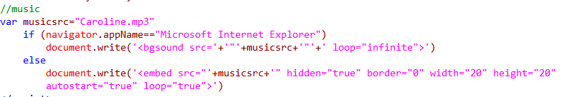
4
Background Music
Background music fit to topic of the homepage was selected and was used as background music.
By making loop=infinite
The music never ends until the homepage is closed.

Slide 10
Thank You

